Slide 1


BIG DATA ANALYSIS
TA class I
TA : Lee Chi-Hsuan

Slide 2
Outline
Anaconda & Jupyter notebook
Python Quick Review
Matplotlib

Slide 3
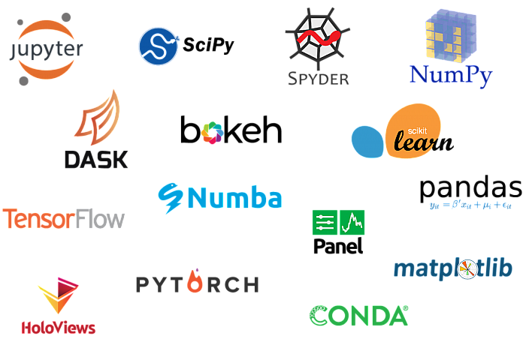

Anaconda
．Data science toolkit
．Tons of packages

Slide 4
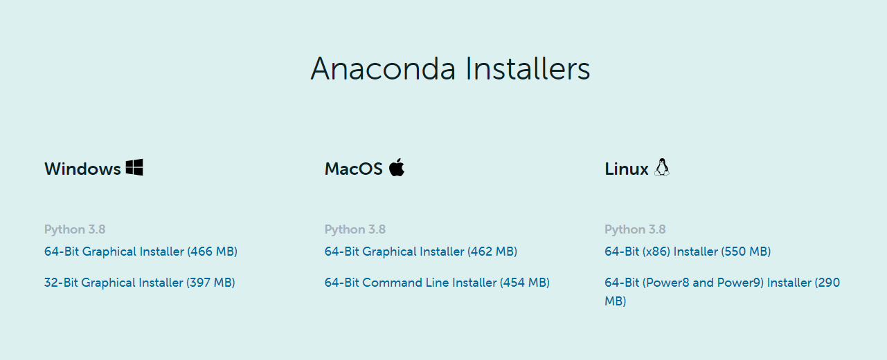

．Download and Install…

Slide 5
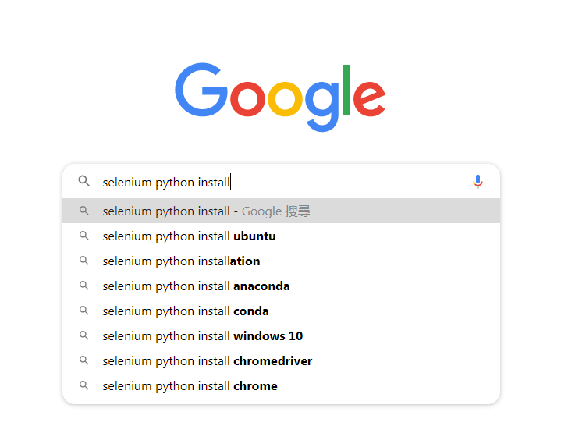
．Packages…

Slide 6
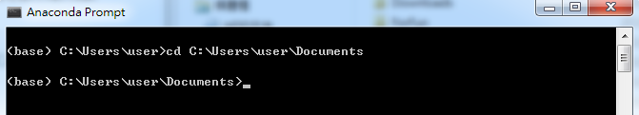
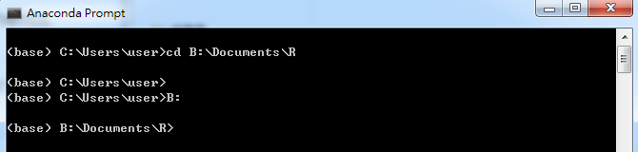
．Changing directory
Same parent
Different parent

Slide 7
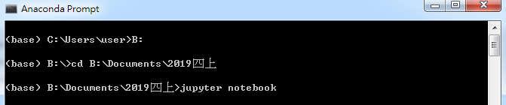
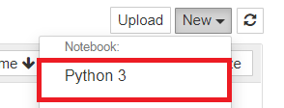
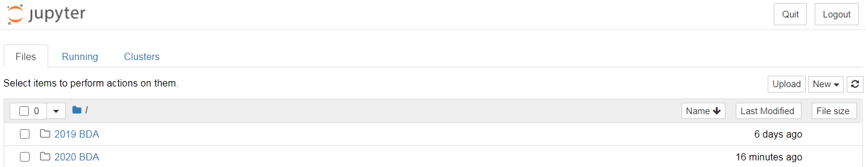
Jupyter Notebook
．Starting the Notebook

Slide 8
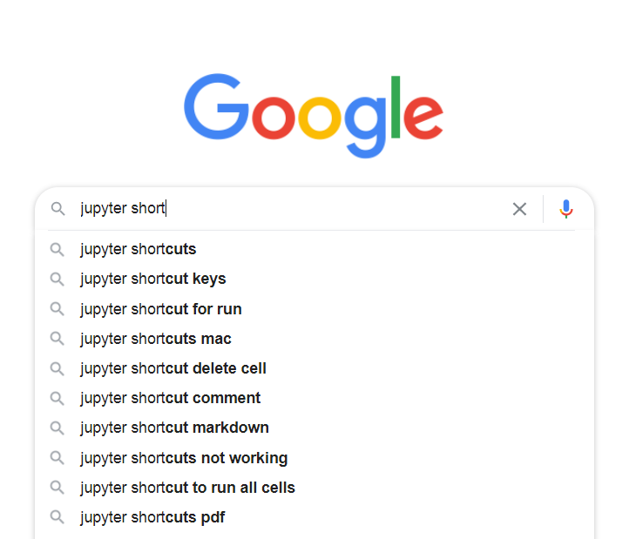
（shift + Enter or Ctrl + Enter）
．Run your code block-wise
．Tab for auto-fill
．Ctrl + / for comment out multiple lines
．Shift + Tab for tooltips
And more…

Slide 9

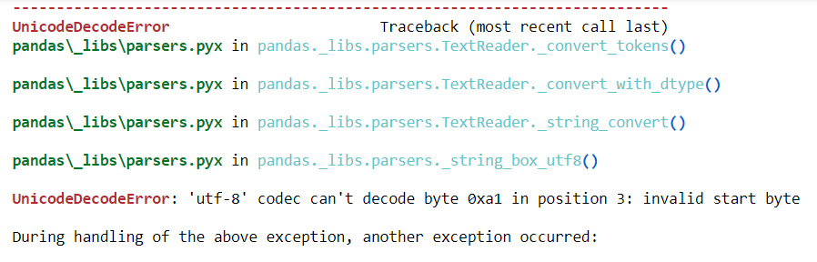
Python Quick Review
Wut… Error again ?!!

Slide 10
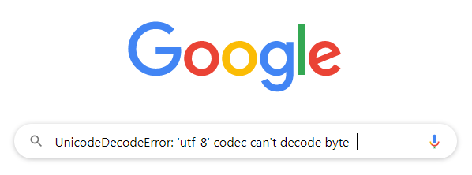
You definitely are not the first person to encounter this kind of problem.

Slide 11
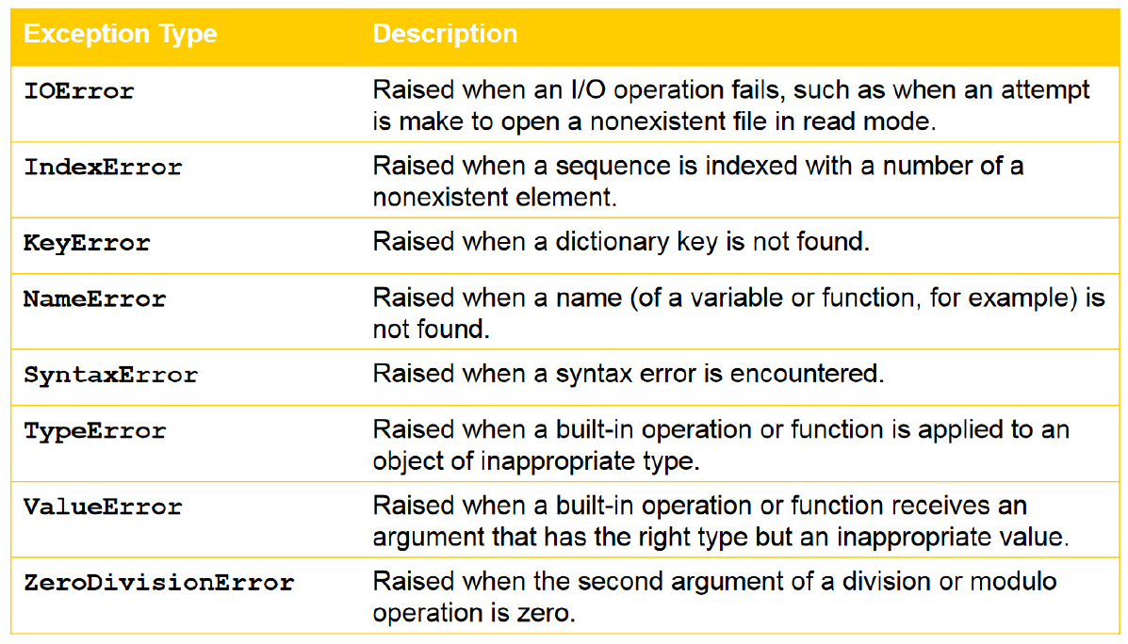

Slide 12
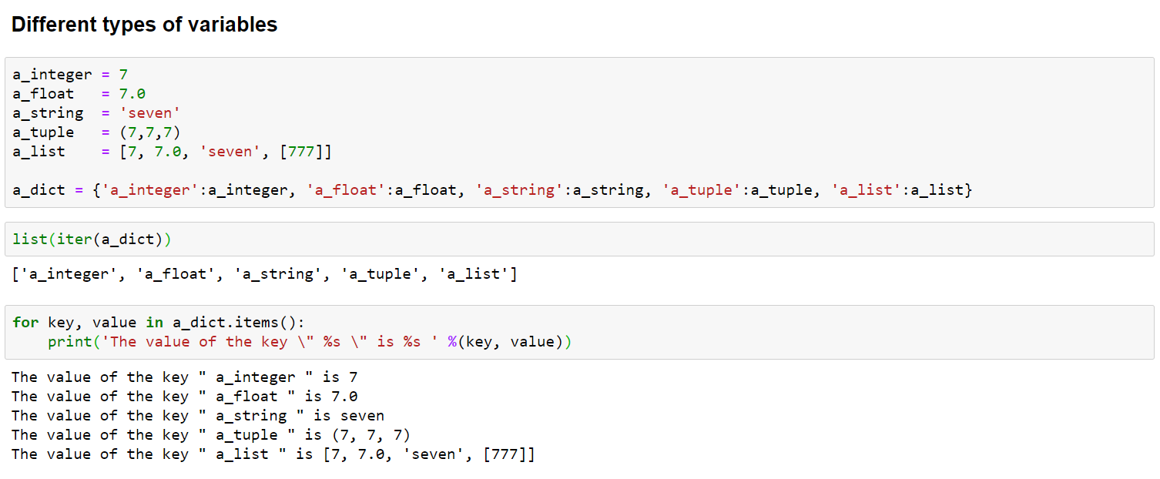
Different types of variables

Slide 13
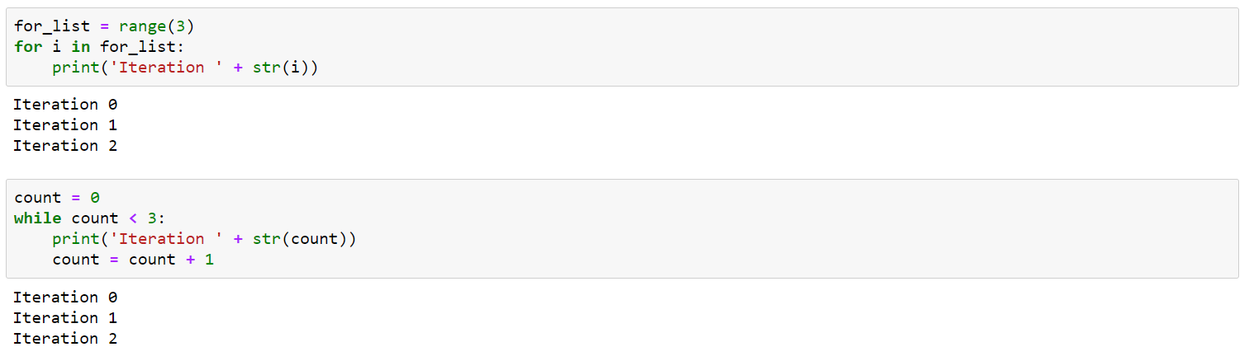
for / while / if else / def()

Slide 14
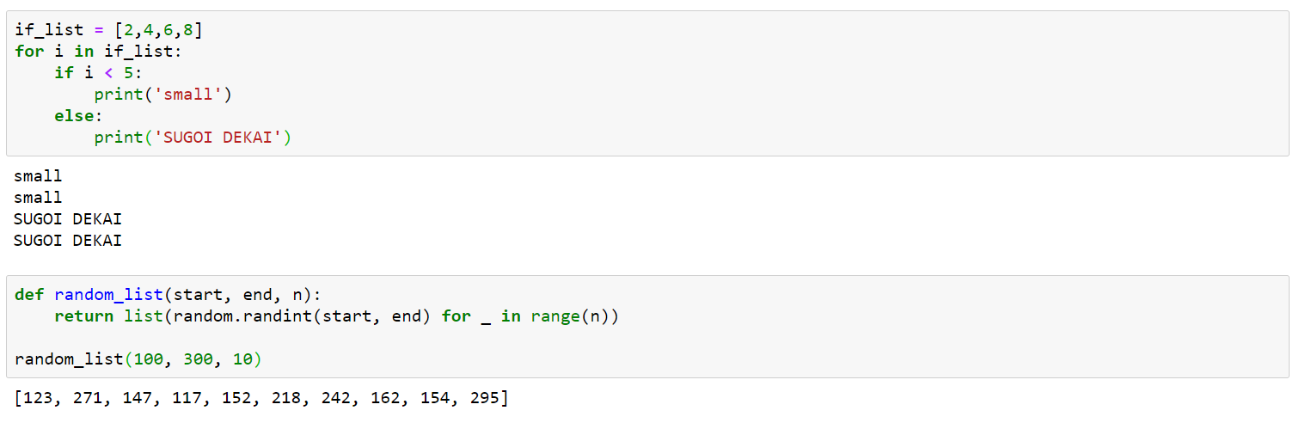

Slide 15
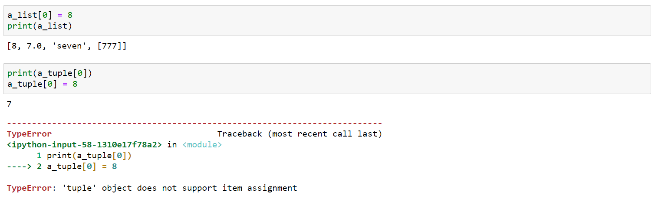
mutable vs. immutable

Slide 16
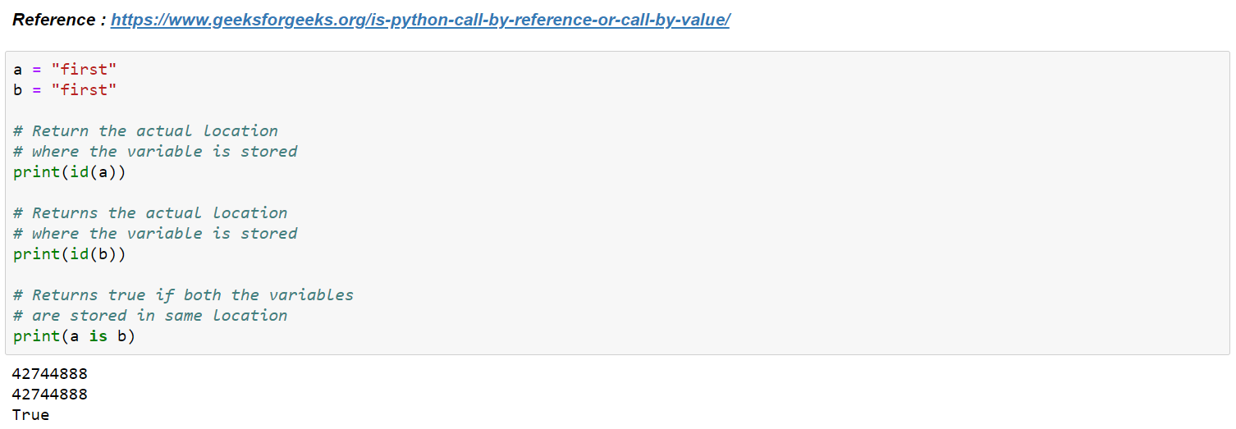
Address - Binding Names to Objects

Slide 17
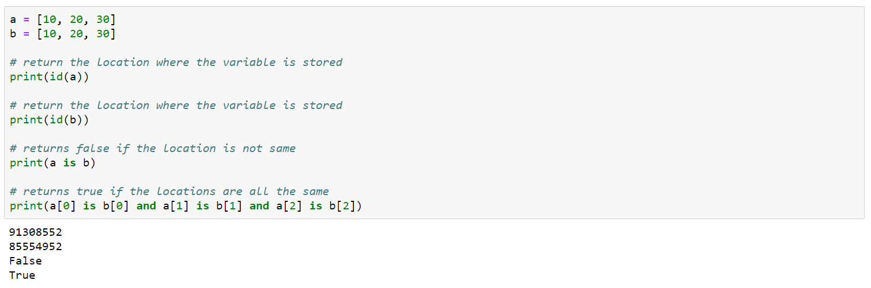

Slide 18
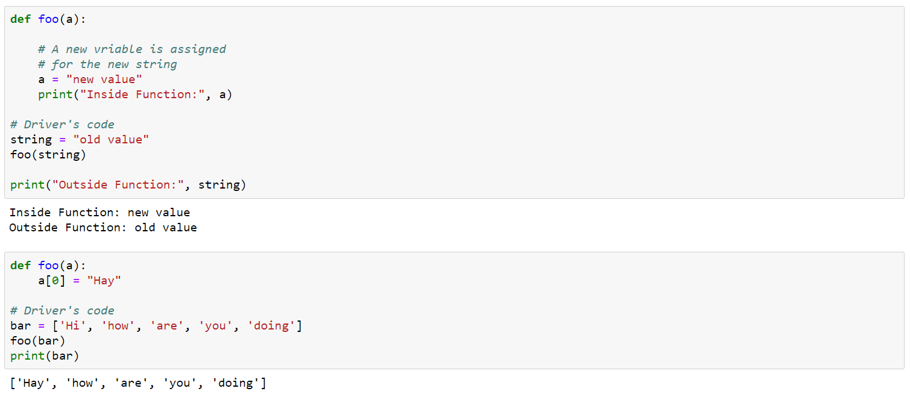
Call by assignment

Slide 19
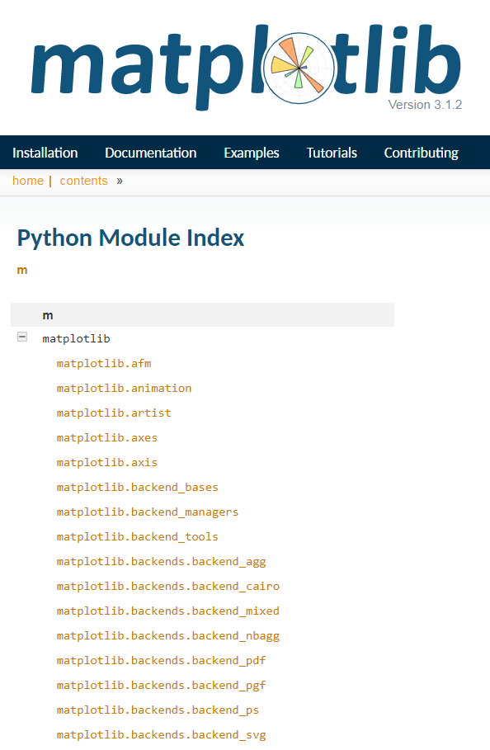
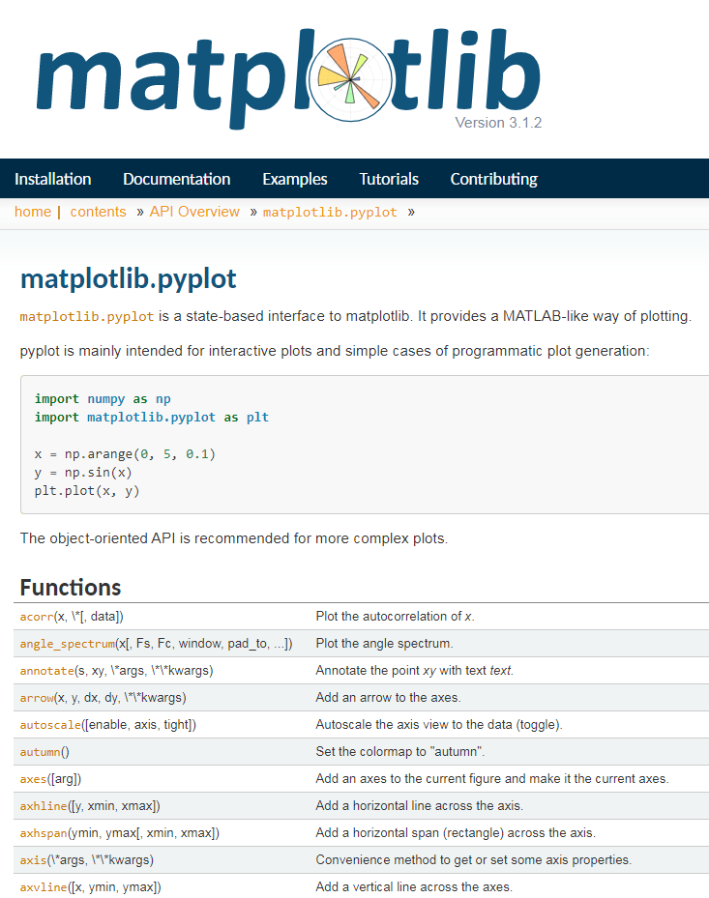
matplotlib
Check out what parameters should be put in each functions

Slide 20
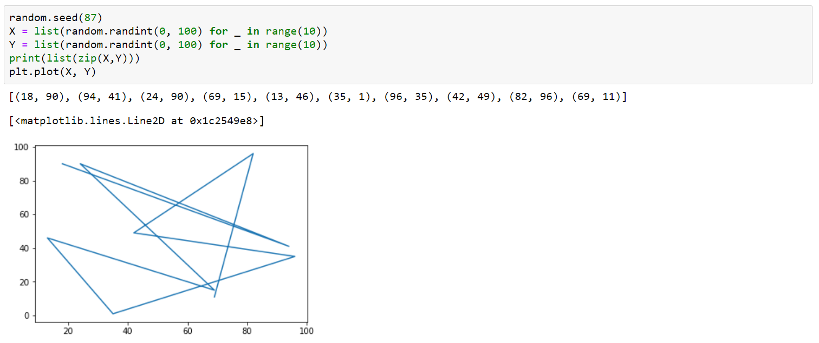
Some examples
You can either plot a list directly or assign some specific X's and Y's.

Slide 21
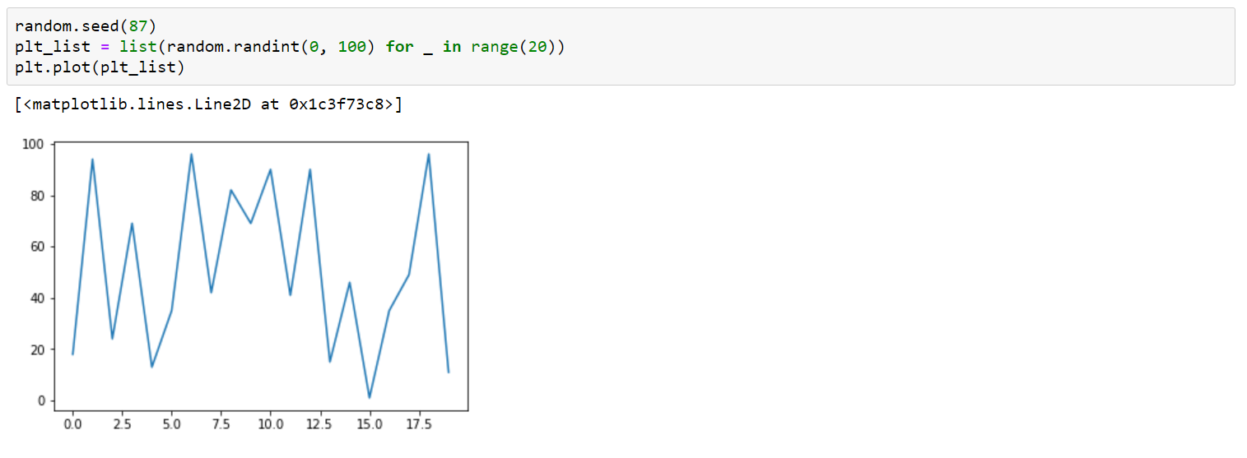
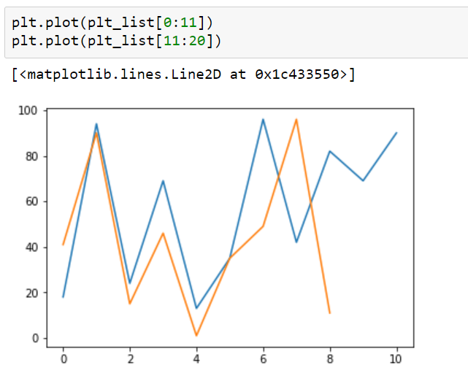
You can slice the list and plot it.

Slide 22
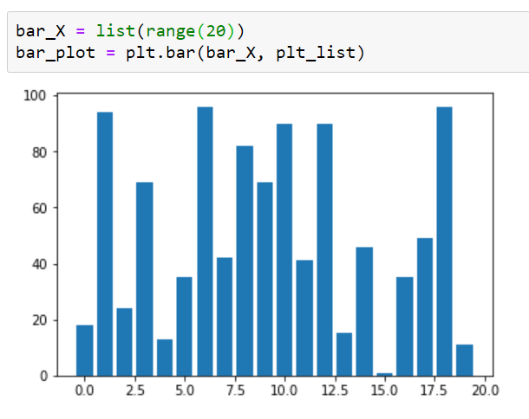
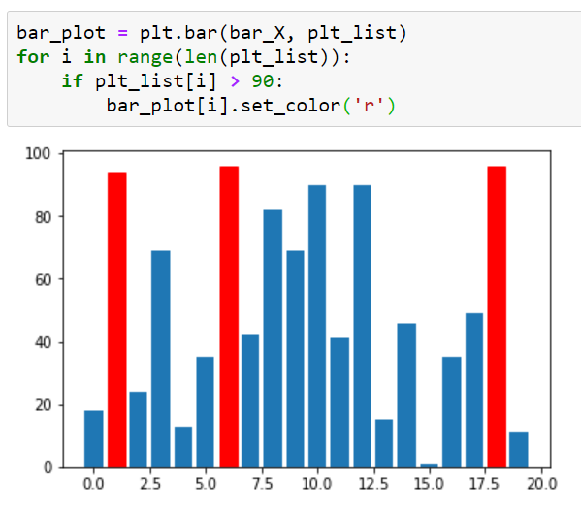
Bar plot
Customize

Slide 23
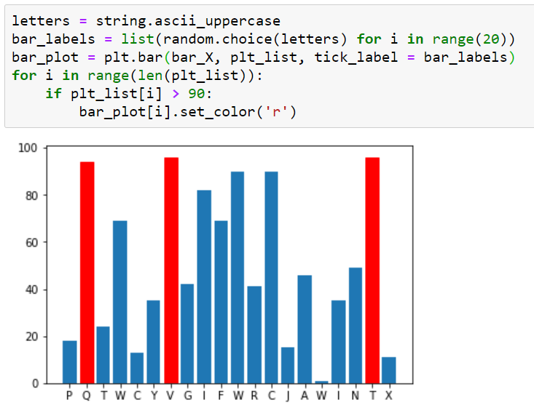
Setting X tick labels

Slide 24
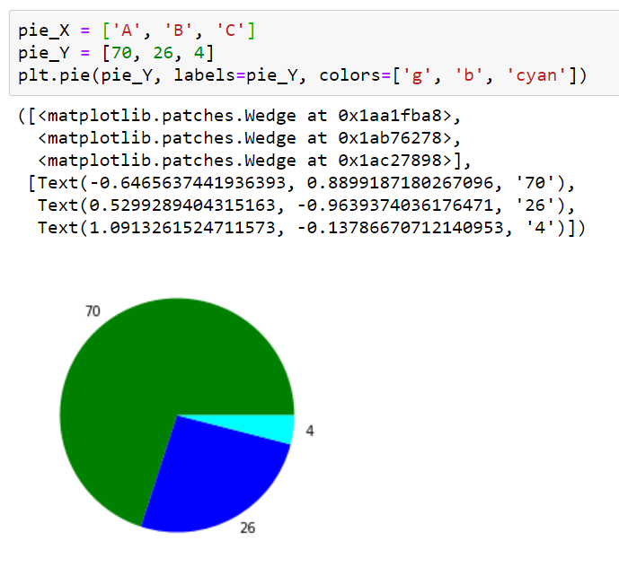
Pie chart

Slide 25
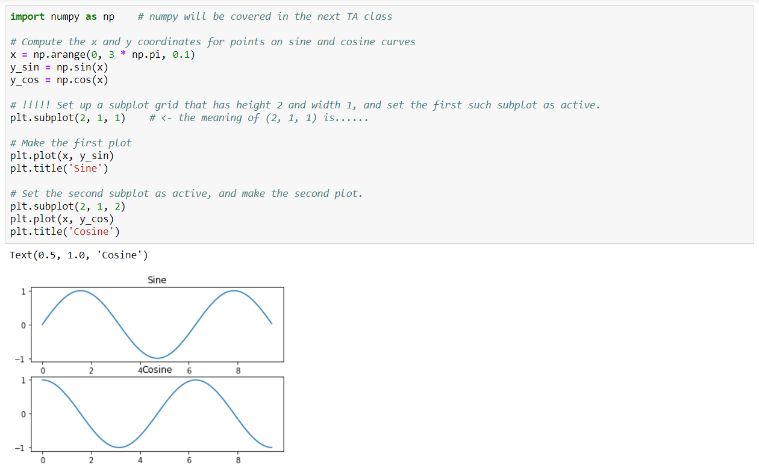
Subplots

Slide 26
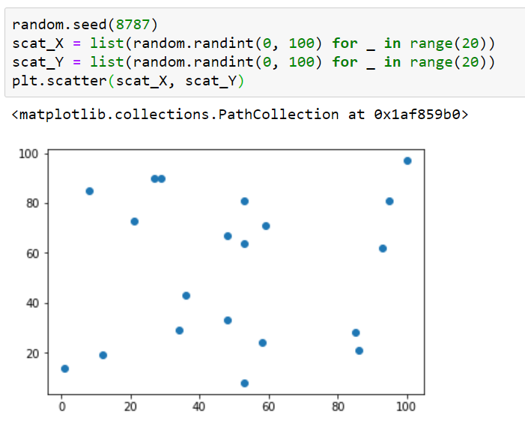
Scatter plot

Slide 27
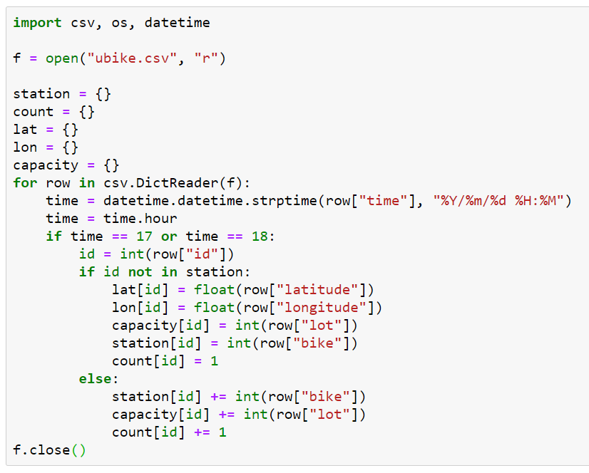
Real world data……

Slide 28
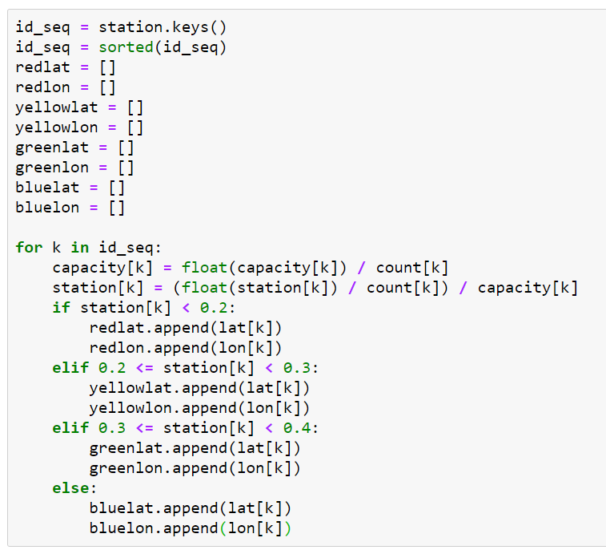

Slide 29
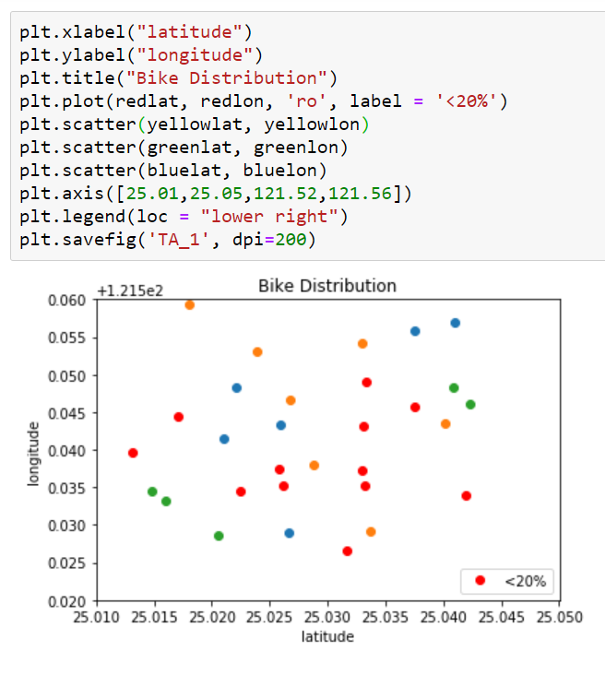

Slide 30
For most functions,
you don’t have to build it.
You only need to find it
and learn how to use it.

