Slide 1
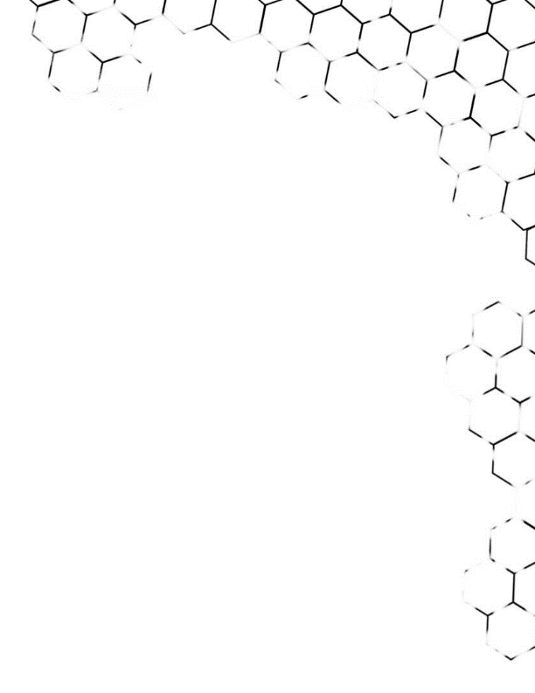
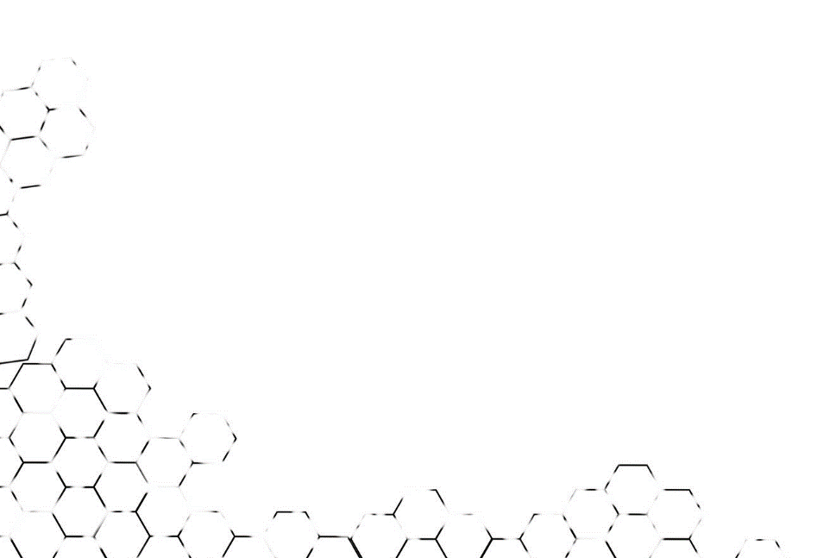
BIG DATA ANALYSIS
TA class IV
TA : Lee Chi-Hsuan

Slide 2
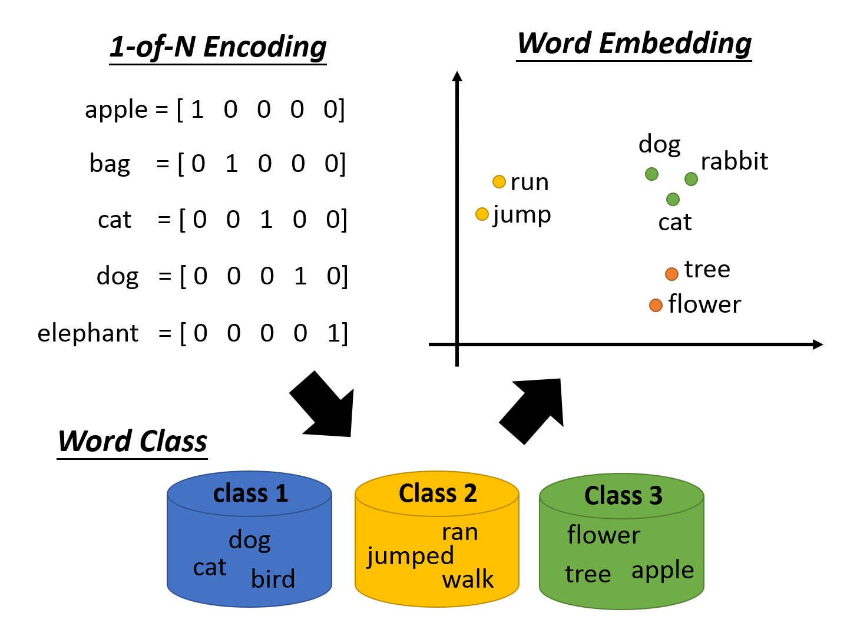
Word2Vec

Slide 3
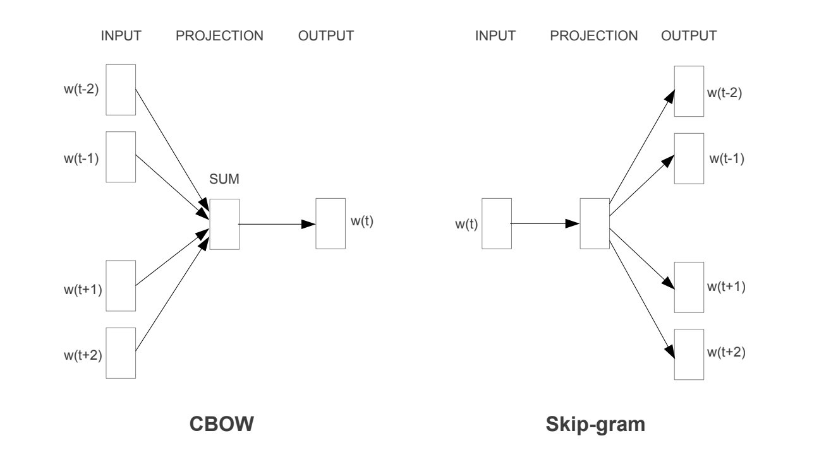

Slide 4
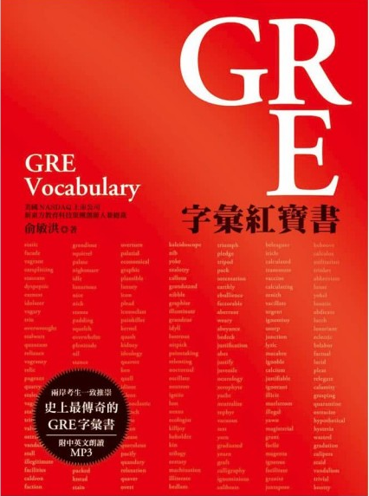
Break down words into pieces
．prefix / root / suffix
?

Slide 5
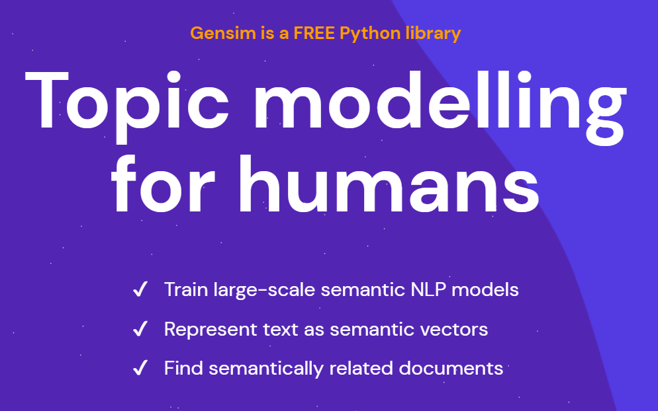
Gensim

Slide 6
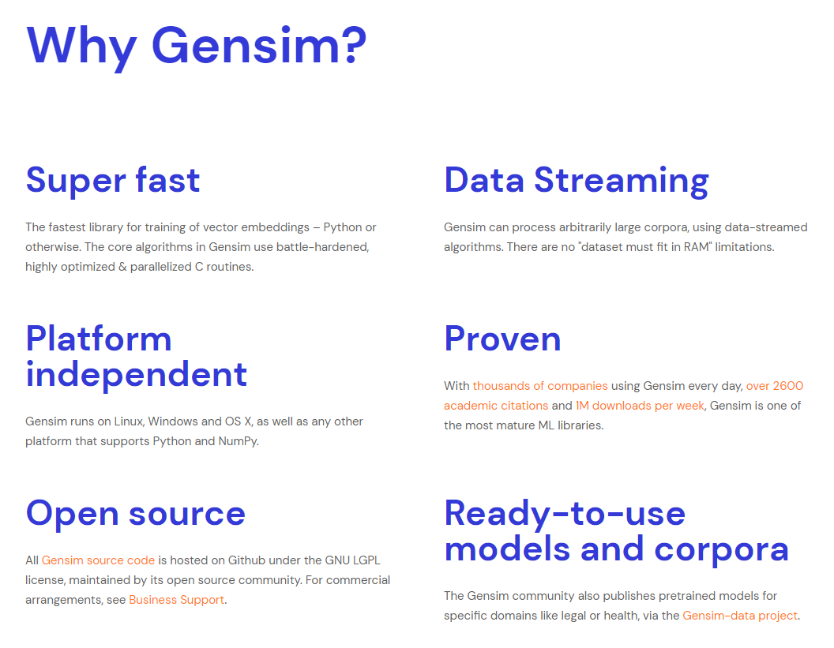

Slide 7
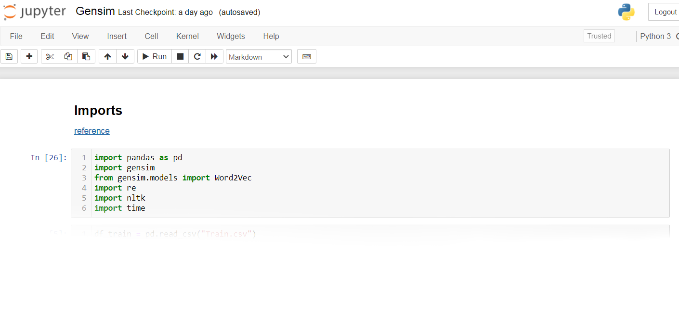
Hands-on examples

Slide 8
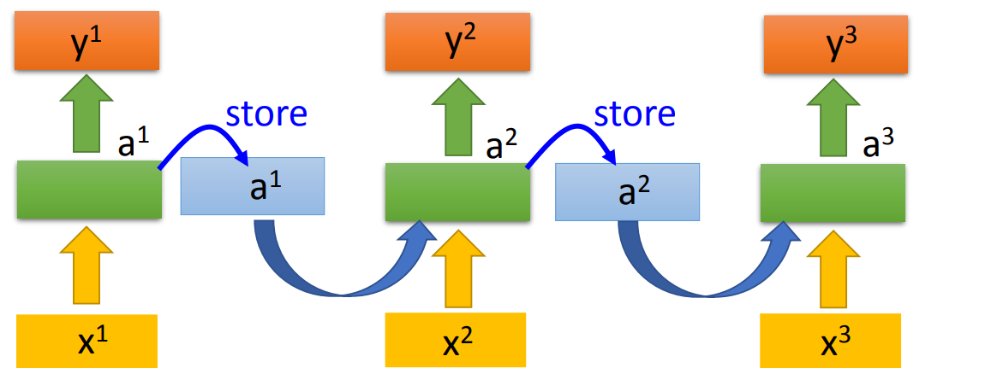
More Applications
．use word embeddings to train
RNN / LSTM / GRU models
word embedding
word embedding
word embedding

Slide 9
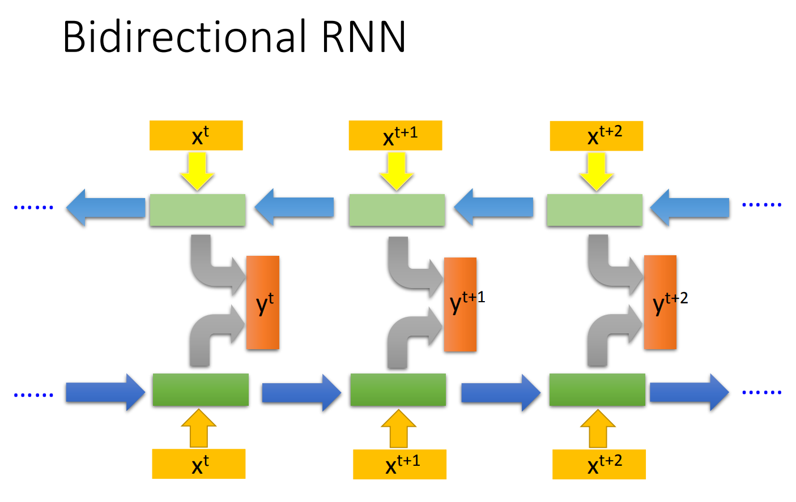

Slide 10
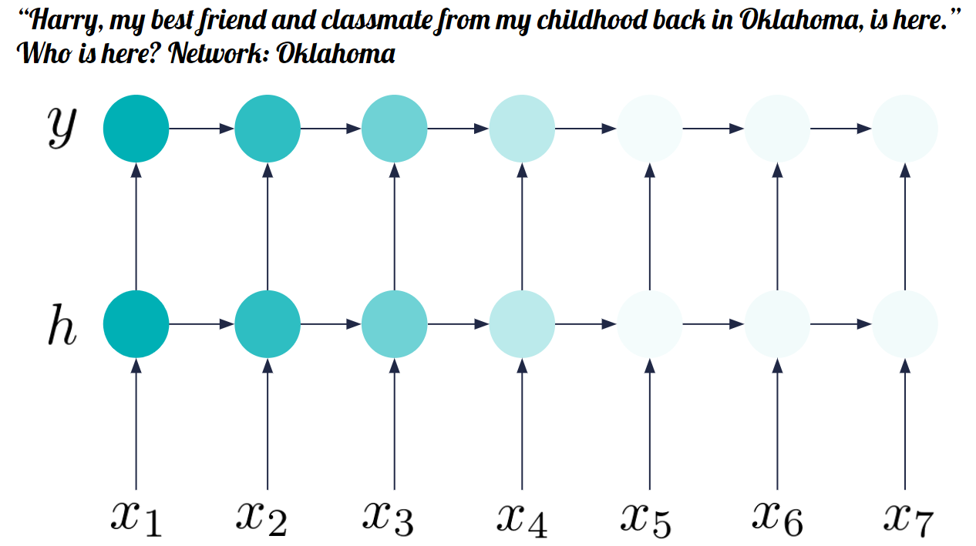
．problems of RNN ?
- it forgets information

Slide 11
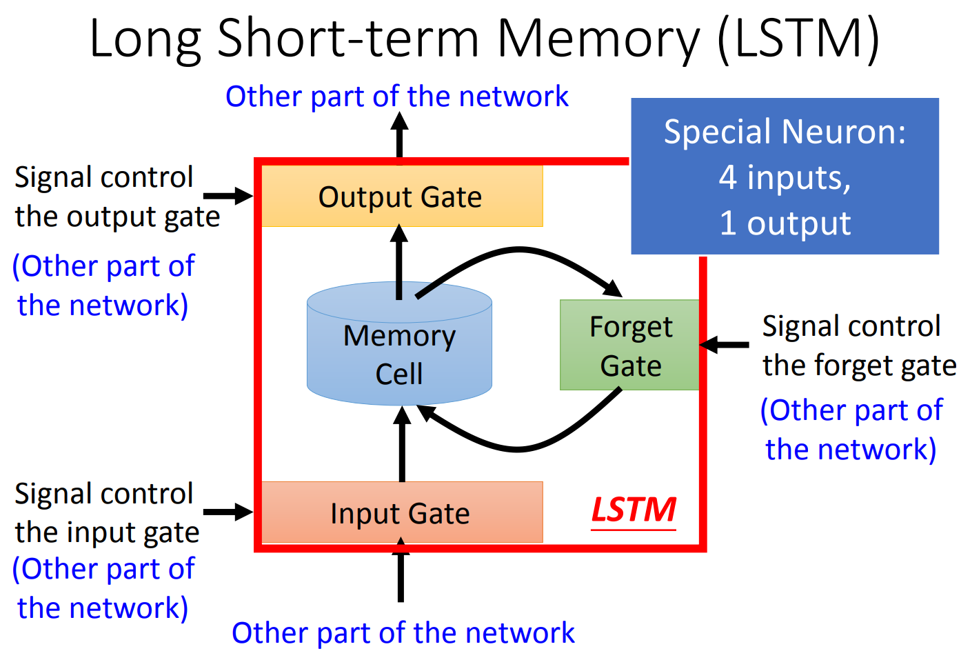
．LSTM and GRU

Slide 12
．Gated Recurrent Unit (GRU) :
- simpler than LSTM
- only contains Update Gate
and Reset Gate

Slide 13
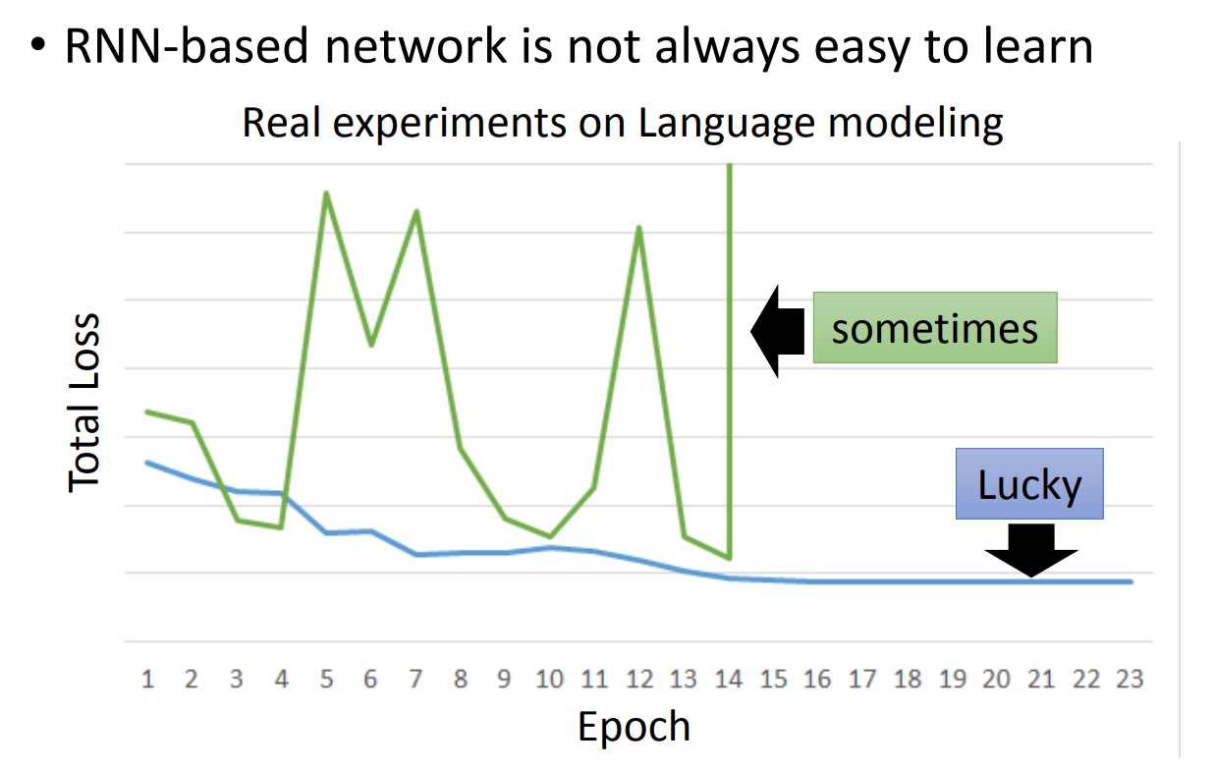

Slide 14
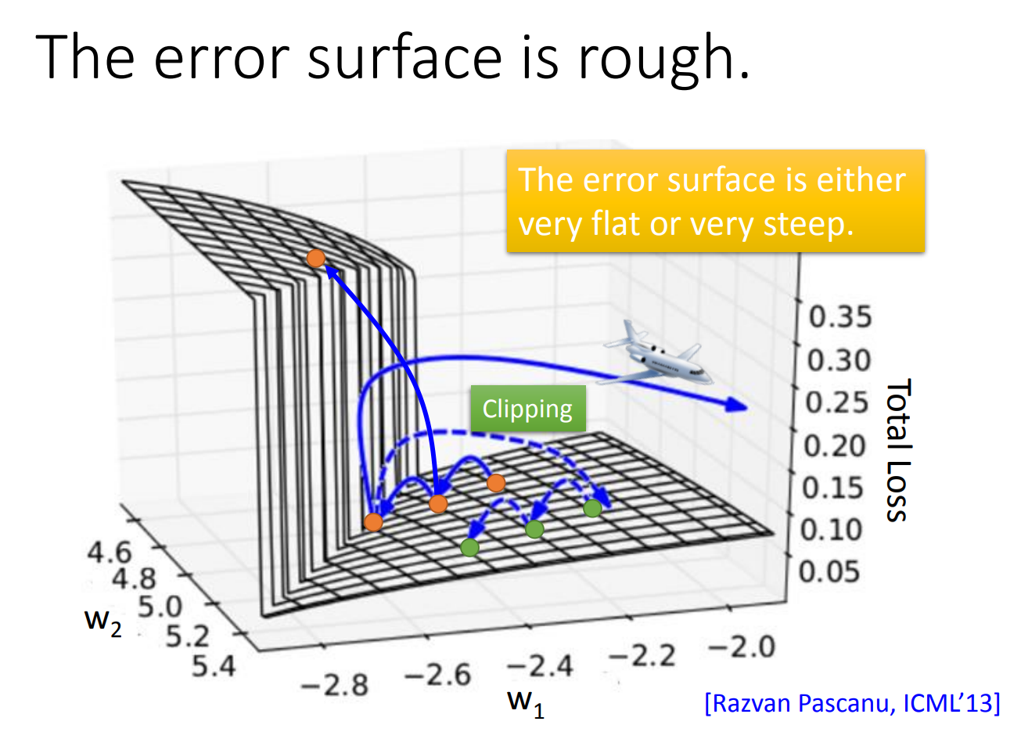

Slide 15
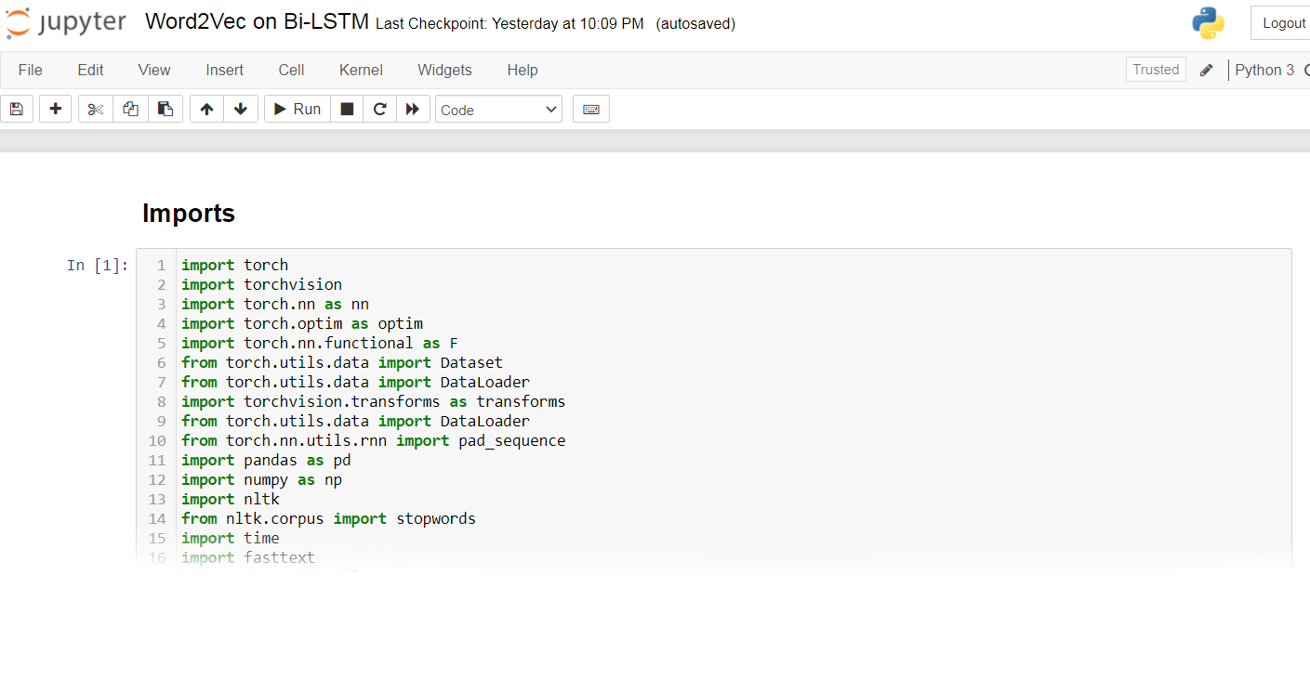
Hands-on examples

Slide 16

Next Step ?
．Transformer :
Seq2seq model with "self-attention"

Slide 17
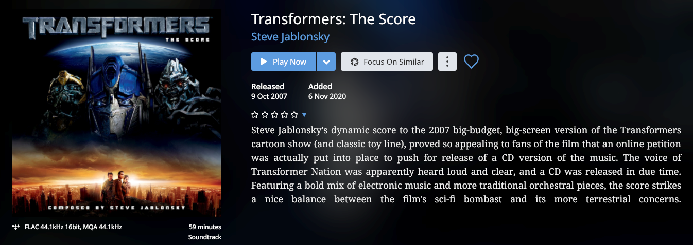

Slide 18
A word can have multiple senses.
．Have you paid that money to the bank yet ?
．It is safest to deposit your money in the bank.
．They stood on the riverbank to fish.
．The hospital has its own blood bank.

Slide 19
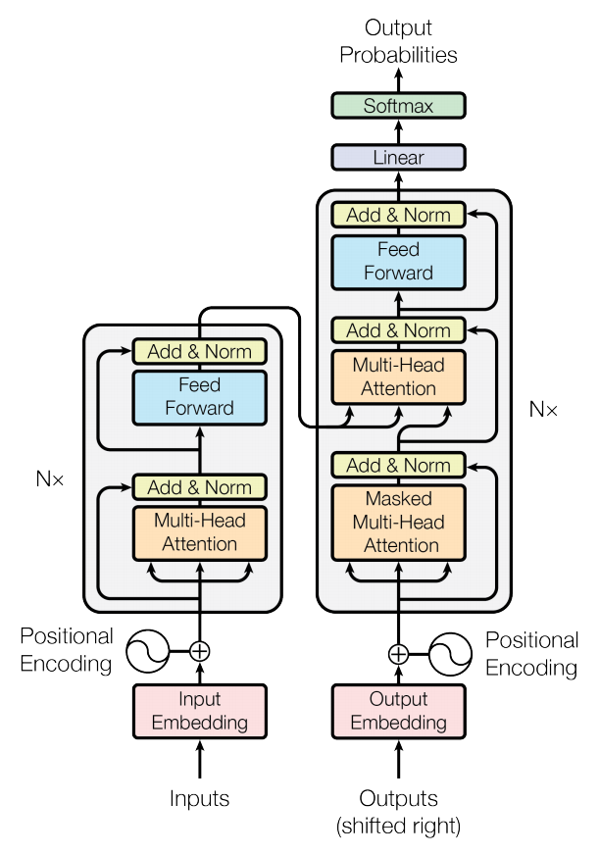

Slide 20
Embeddings from Language Model (ELMO)
． RNN-based language models (trained from lots of sentences)
Bidirectional Encoder Representations from Transformers
(BERT)
． BERT = Encoder of Transformer

Slide 21


Slide 22
Reference
．http://speech.ee.ntu.edu.tw/~tlkagk/index.html
． https://fasttext.cc/docs/en/english-vectors.html
．https://radimrehurek.com/gensim/models/word2vec.html
．https://github.com/facebookresearch/fastText/issues/475
．https://docs.google.com/presentation/d/1zyuwCx7knqnP-LJswlDfWSmk5FhFgFmYJGqdEZn8yhc/edit#slide=id.g33c734b7fb_0_7

