Slide 1

NCKU Programming Contest Training Course Vector, Map, String 2018/02/23
Jheng – Huang Hong
a0987856762@gmail.com
Department of Computer Science and Information Engineering
National Cheng Kung University
Tainan, Taiwan
NCKU CSIE Programming Contest Training Course
made by a711186

Slide 2
Outline
Vector
Map
String
made by a711186

Slide 3
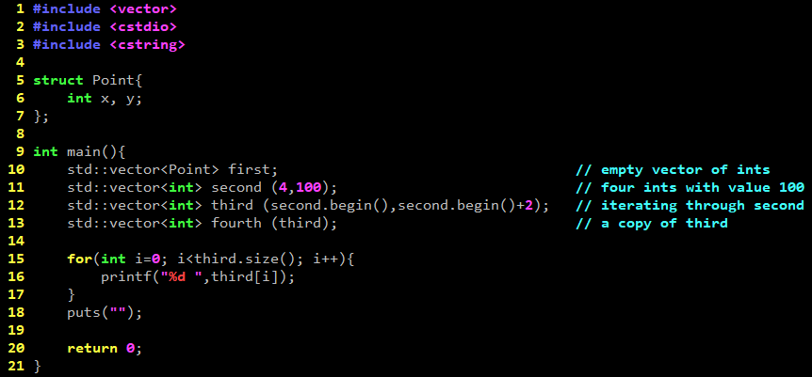
Constructor
made by mike199250 & a711186
Notes:
動態增減大小，避免segmentation fault
提 erase by cplusplus
3

Slide 4
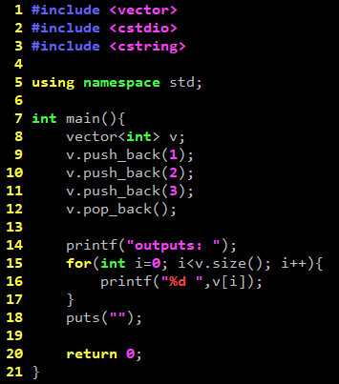
Push, Pop
made by mike199250 & a711186
Notes:
動態增減大小，避免segmentation fault
提 erase by cplusplus
4

Slide 5
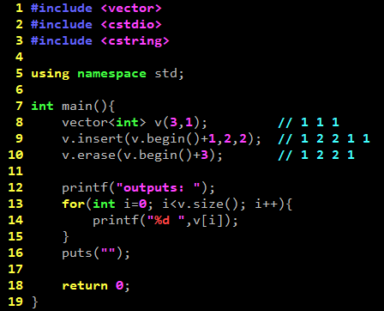
Insert ,Erase
made by mike199250 & a711186
Notes:
Erase到空的vector會segmentation fault
5

Slide 6
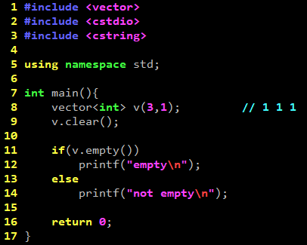
Clear
多筆測資時很好用
made by mike199250 & a711186
Notes:
動態增減大小，避免segmentation fault
提 erase by cplusplus
6

Slide 7
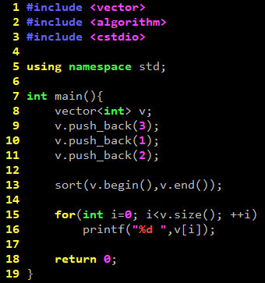
Combine with Sort
made by mike199250 & a711186
Notes:
動態增減大小，避免segmentation fault
提 erase by cplusplus
7

Slide 8
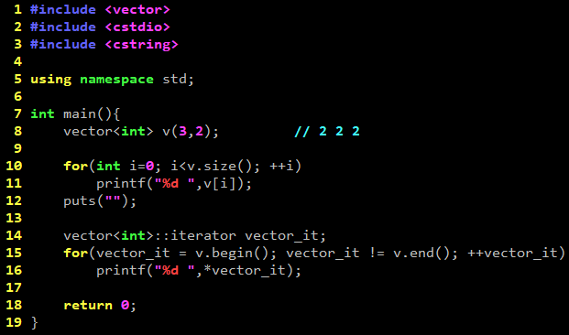

Iterator
made by mike199250 & a711186
Notes:
動態增減大小，避免segmentation fault
提 erase by cplusplus
8

Slide 9
Vector
Array
大小開到題目最大範圍
使用memset(快)或for(慢)初始化
移除陣列中某一元素，需將其後往前搬運
made by a711186

Slide 10
Vector
Vector
不需宣告大小
Constructor
插入/移除方便
made by a711186

Slide 11
C++ Reference
http://www.cplusplus.com/reference/
made by a711186

Slide 12
Uva - 11462
Problem Description
You are given the ages (in years) of all people of a country with at least 1 year of age. You know that no individual in that country lives for 100 or more years. Now, you are given a very simple task of sorting all the ages in ascending order.
made by a711186

Slide 13
Uva - 11462
Input
There are multiple test cases in the input file. Each case starts with an integer n (0 < n ≤ 2000000), the total number of people. In the next line, there are n integers indicating the ages. Input is terminated with a case where n = 0. This case should not be processed.
Output
For each case, print a line with n space separated integers. These integers are the ages of that country sorted in ascending order.
Warning: Input Data is pretty big (∼ 25 MB) so use faster IO.
made by a711186

Slide 14
Uva - 11462
Sample Input
5
3 4 2 1 5
5
2 3 2 3 1
0
Sample Output
1 2 3 4 5
1 2 2 3 3
made by a711186

Slide 15
Outline
Vector
Map
String
made by a711186

Slide 16
Map
Maps are associative containers that store elements formed by a combination of a key value and a mapped value, following a specific order.
made by mike199250 & a711186
Notes:
16

Slide 17
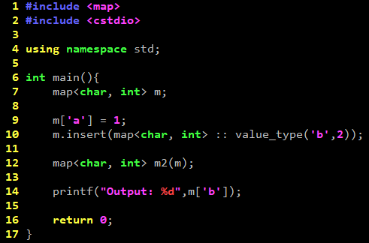
Constructor, Insert
made by mike199250 & a711186
Notes:
動態增減大小，避免segmentation fault
提 erase by cplusplus
17

Slide 18
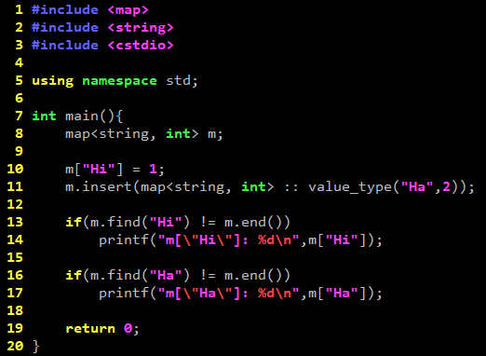

Find
made by mike199250 & a711186
Notes:
動態增減大小，避免segmentation fault
提 erase by cplusplus
18

Slide 19
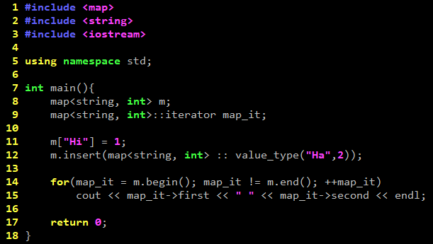

Iterator
made by mike199250 & a711186
Notes:
動態增減大小，避免segmentation fault
提 erase by cplusplus
19

Slide 20
Practice
Uva - 10420
made by a711186

Slide 21
Outline
Vector
Map
String
made by a711186

Slide 22
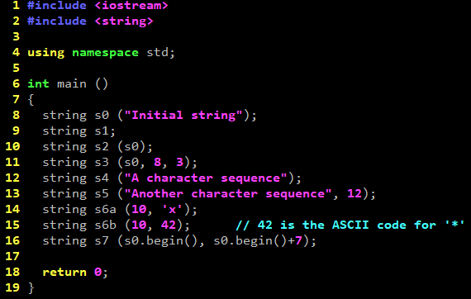
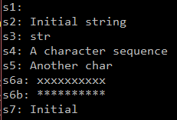
Constructor
made by mike199250 & a711186
Notes:
動態增減大小，避免segmentation fault
提 erase by cplusplus
22

Slide 23
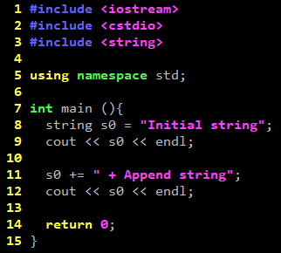

Operator
made by mike199250 & a711186
Notes:
動態增減大小，避免segmentation fault
提 erase by cplusplus
23

Slide 24
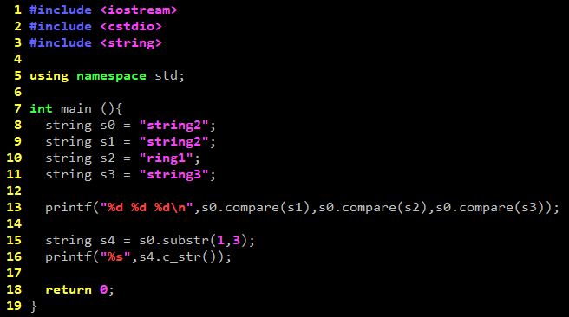

Comapre, Substring
made by mike199250 & a711186
Notes:
動態增減大小，避免segmentation fault
提 erase by cplusplus
24

Slide 25
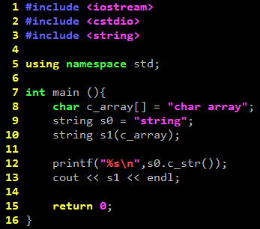

String <-> Char array
made by mike199250 & a711186
Notes:
動態增減大小，避免segmentation fault
提 erase by cplusplus
25

Slide 26
Practice
Uva – 10340
made by a711186

