Slide 1

NCKU Programming Contest Training Course Disjoint set 2018/02/23
Chun-Chi, Fang
khtp91113@gmail.com
Department of Computer Science and Information Engineering
National Cheng Kung University
Tainan, Taiwan
NCKU CSIE Programming Contest Training Course
made by electron & free999

Slide 2
Disjoint Set
After classifying elements, we have several disjoint sets.
Group 1
Group 3
8
10
1
2
3
4
Group 2
9
11
6
5
7
made by electron & free999

Slide 3
Disjoint Set
We want to know which group elements belonged to
Element 1 in group 1
Element 2 in group 1
Element 5 in group 2
Element 10 in group 3
…
made by electron & free999

Slide 4
Disjoint Set
Main Operation
Union
Find
made by electron & free999

Slide 5
Disjoint Set
Initial State
1
2
3
4
5
made by electron & free999

Slide 6
Disjoint Set
Find(1) : return 1
1
2
3
4
5
made by electron & free999

Slide 7
Disjoint Set
Union(1, 2)
2
1
3
4
5
made by electron & free999

Slide 8
Disjoint Set
Union(3, 4)
2
4
1
3
5
made by electron & free999

Slide 9
Disjoint Set
Union(1, 3)
4
2
3
1
5
made by electron & free999

Slide 10
Disjoint Set
Find(1) => 4
Find(5) => 5
4
2
3
1
5
made by electron & free999

Slide 11
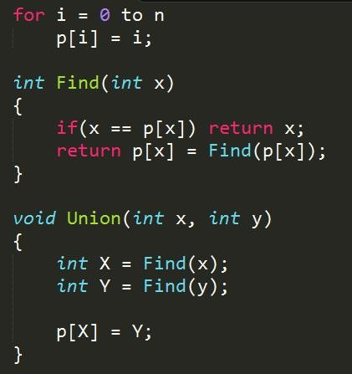
Disjoint Set
Find
Find the root of each group
Union
Combine two group
made by electron & free999

Slide 12
Disjoint Set
Find(7) :
X = 7
5
6
7
made by electron & free999

Slide 13
Disjoint Set
Find(7) :
X = 6
5
6
7
made by electron & free999

Slide 14
Disjoint Set
Find(7) : return 5
X = 5
5
6
7
made by electron & free999

Slide 15
Disjoint Set
Find(7) : return 5
X = 6
5
6
7
made by electron & free999

Slide 16
Disjoint Set
Find(7) : return 5
X = 7
5
6
7
made by electron & free999

Slide 17
Disjoint Set
Union(2, 4)
1
3
2
4
made by electron & free999

Slide 18
Disjoint Set
Union(2, 4)
1
3
2
4
made by electron & free999

Slide 19
Disjoint Set
Union(2, 4)
1
3
2
4
made by electron & free999

Slide 20
Disjoint Set
Union(2, 4)
1
3
2
4
made by electron & free999

Slide 21
Disjoint Set
Union(2, 4)
1
3
2
4
made by electron & free999

Slide 22
Disjoint Set
Union(2, 4)
3
1
4
2
made by electron & free999

Slide 23
Example 1
UVa 10583 - Ubiquitous Religions
Problem Description
There are so many different religions in the world today that it is difficult to keep track of them all. You are interested in finding out how many different religions students in your university believe in. You know that there are n students in your university (0 < n ≤ 50000). It is infeasible for you to ask every student their religious beliefs. Furthermore, many students are not comfortable expressing their beliefs. One way to avoid these problems is to ask m (0 ≤ m ≤ n(n − 1)/2) pairs of students and ask them whether they believe in the same religion (e.g. they may know if they both attend the same church). From this data, you may not know what each person believes in, but you can get an idea of the upper bound of how many different religions can be possibly represented on campus. You may assume that each student subscribes to at most one religion.
NCKU CSIE Programming Contest Training Course
made by electron & free999

Slide 24
Example 1
Input
The input consists of a number of cases. Each case starts with a line specifying the integers n and m. The next m lines each consists of two integers i and j, specifying that students i and j believe in the same religion. The students are numbered 1 to n.The end of input is specified by a line in which n = m = 0.
Output
For each test case, print on a single line the case number (starting with 1) followed by the maximum number of different religions that the students in the university believe in.
NCKU CSIE Programming Contest Training Course
made by electron & free999

Slide 25
Example 2
UVa 879 – Circuit Nets
Problem Description
An electronic circuit consists of components, pins, and wires. Figure 1 shows a circuit with the three components A, B, and C. Each wire connects a pair of pins. Two pins a and b are electrically equivalent if they are either connected by a wire or there is a sequence a1, a2, . . . , ak of pins such that a, a1; a1, a2; . . . ; ak−1, ak; and ak, b are all connected by wires. A net is a maximal set of electrically equivalent pins. Maximal means that no pin outside the net is electrically equivalent to a pin in the net.
Given a set of pins and a set of wires your task is to determine the number of nets defined within the circuit. The figure below illustrates the circuit with three nets described in the sample input section.
NCKU CSIE Programming Contest Training Course
made by electron & free999

Slide 26
Example 2
Input
The input begins with a single positive integer on a line by itself indicating the number of the cases following, each of them as described below. This line is followed by a blank line, and there is also a blank line between two consecutive inputs. The sequence of pins is always numbered from 1 to N. The first input value is the value of N. The sequence of wires is described by pairs of pin values. It is given at the input as sequence of numbers, separated by a space. The first two numbers define the first pair, the two numbers that follow define the second pair, and so on. The input ends with the end of file mark.
Output
For each test case, the output must follow the description below. The outputs of two consecutive cases will be separated by a blank line. The output is just the number of nets found.
NCKU CSIE Programming Contest Training Course
made by electron & free999

Slide 27
Exercise
Uva(4)
– 793, 10583, 10685, 10158
POJ(1)
– 1703
made by electron & free999

