Slide 1

NCKU Programming Contest Training Course
Course
2018/03/08
LAO CHON LAM
nckuacm@imslab.org
Department of Computer Science and Information Engineering
National Cheng Kung University
Tainan, Taiwan

Slide 2
Outline
Graph
Tree
DFS
BFS

Slide 3
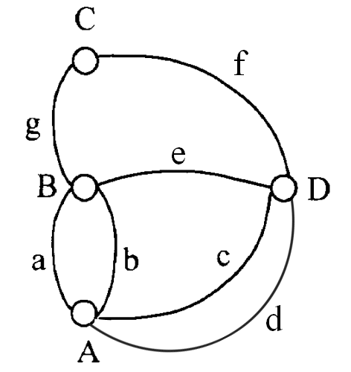
Graph
Vertex (V)
A, D, B, D
Edge (E)
BC, CD,…
degree (deg)
The Branch of a Vertex
Path (P)
Non-duplicate Vertex Connected Sequence
ADCB
Cycle (C)
A Cycle whose Two Ending Points are the Same

Slide 4
Graph
Undirected Graph – G1, G2
Directed Graph – G3
deg: in-degree and out-degree
1
1
2
3
2
3
4
4
5
6
7
G1
G2
1
2
3
G3

Slide 5
Graph
Multiple Edge
Complete Graph
1
4
2
3
G4
1
2
3
4
G1

Slide 6
Graph
Representation
adjacent list
1
頂點1
2
3
4
2
3
頂點2
1
3
4
4
頂點3
1
2
4
G1
頂點4
1
2
3

Slide 7
Graph
Representation
adjacent matrix
1 2 3 4
1 0 1 1 1
2 1 0 1 1
3 1 1 0 1
4 1 1 1 0
1
2
3
4
G1

Slide 8
Outline
Graph
Tree
DFS
BFS

Slide 9


Slide 10
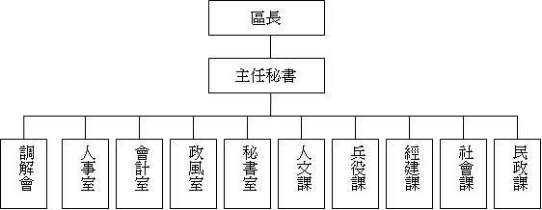

Slide 11
Tree
A data structure consists of nodes. (at least two)
0
1
2
3
4
5
8
6
7

Slide 12
Tree
A data structure consists of nodes. (at least two)
Every pair of nodes must have one and only one path.(connected)
0
1
2
3
4
5
8
6
7

Slide 13
Tree
A data structure consists of nodes. (at least two)
Every pair of nodes must have one and only one path.(connected)
Each tree has a root. (root can be any nodes)
0
1
2
3
4
5
8
6
7

Slide 14
Tree
Relations: (using node 0 as root )
-Leaf : nodes with no branch. (3,4,5)
0
1
2
3
5
4

Slide 15
Tree
Relations: (using node 0 as root )
-Leaf : nodes with no branch.
-Parent/Children : has succesor nodes –Parent (1)
has predecessor node-children (3,4)
0
1
2
3
5
4

Slide 16
Tree
Relations: (using node 0 as root )
-Leaf : nodes with no branch.
-Parent/Children : has succesor nodes -Parent
has predecessor node-children
-Sibling: children with same parent (1,2)
0
1
2
3
5
4

Slide 17
Tree
Relations: (using node 0 as root )
-Leaf : nodes with no branch.
-Parent/Children : has succesor nodes -Parent
has predecessor node-children
-Sibling: children with same parent
-Ancestor: nodes that are on the path
from root to itself.
(3’s ancestor: 0,1)
0
1
2
3
5
4

Slide 18
Tree
Tree Level: according to the distance to the root.
Level 0
Level 1
Level 2
Level 3

Slide 19
Tree
Tree Height(Depth): the maximum distance from the root.
Height=3
0
2
3
1
6
7
4
5
8

Slide 20
Tree
SubTree: nodes that are not the root can form a subtree
(become a root)

Slide 21
Tree
Feature:
-no cycle
-every pair of nodes are connected
-every pair of nodes has only one path

Slide 22
Tree
Forest: n trees are disjoint (n ≧ 0)
➔can be empty

Slide 23
Outline
Graph
Tree
DFS
BFS

Slide 24
DFS
(D)epth-(F)irst-(S)earch

Slide 25
DFS
(D)epth (F)irst (S)earch
Stack

Slide 26
DFS
0
1
2
3
4
5
6
7

Slide 27
DFS
0
1
2
3
4
5
6
7

Slide 28
DFS
0
1
2
3
4
5
6
7

Slide 29
DFS
0
1
2
3
4
5
6
7

Slide 30
DFS
0
1
2
3
4
5
6
7

Slide 31
DFS
0
1
2
3
4
5
6
7

Slide 32
DFS
0
1
2
3
4
5
6
7

Slide 33
DFS
0
1
2
3
4
5
6
7

Slide 34
DFS
0
1
2
3
4
5
6
7

Slide 35
DFS
0
1
2
3
4
5
6
7

Slide 36
DFS
0
1
2
3
4
5
6
7

Slide 37
DFS
0
1
2
3
4
5
6
7

Slide 38
DFS
0
1
2
3
4
5
6
7

Slide 39
DFS
0
1
2
3
4
5
6
7

Slide 40
DFS
0
1
2
3
4
5
6
7

Slide 41
DFS
0
1
2
3
4
5
6
7

Slide 42
DFS
0
1
2
3
4
5
6
7

Slide 43
DFS
Stack
1
2
3
4
5
6

Slide 44
DFS
Stack
1
2
3
4
5
6
1

Slide 45
DFS
Stack
1
2
3
4
2
5
6
1

Slide 46
DFS
Stack
1
2
3
4
3
2
5
6
1

Slide 47
DFS
Stack
1
2
5
3
4
3
2
5
6
1

Slide 48
DFS
Stack
1
2
3
4
3
2
5
6
1

Slide 49
DFS
Stack
1
2
3
4
2
5
6
1

Slide 50
DFS
Stack
1
2
3
4
2
5
6
1

Slide 51
DFS
Stack
1
2
3
4
4
2
5
6
1

Slide 52
DFS
Stack
1
2
6
3
4
4
2
5
6
1

Slide 53
DFS
Stack
1
2
3
4
4
2
5
6
1

Slide 54
DFS
Stack
1
2
3
4
2
5
6
1

Slide 55
DFS
Stack
1
2
3
4
5
6
1

Slide 56
DFS
Stack
1
2
3
4
5
6

Slide 57
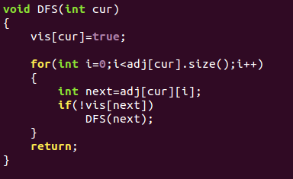
DFS
Source Code(adjacency list)

Slide 58
DFS
Practice
[UVA-572 ] Oil Deposits

Slide 59
Outline
Graph
Tree
DFS
BFS

Slide 60
BFS
(B)readth-(F)irst-(S)earch

Slide 61
BFS
(B)readth-(F)irst-(S)earch
Queue

Slide 62
BFS
0
1
2
3
4
5
6
7

Slide 63
BFS
0
1
2
3
4
5
6
7

Slide 64
BFS
0
1
2
3
4
5
6
7

Slide 65
BFS
0
1
2
3
4
5
6
7

Slide 66
BFS
Queue
1
2
3
4
5
6

Slide 67
BFS
Queue
1
1
2
3
4
5
6

Slide 68
BFS
Queue
1
1
2
3
4
5
6

Slide 69
BFS
Queue
1
1
2
2
3
4
5
6

Slide 70
BFS
Queue
1
2
2
3
4
5
6

Slide 71
BFS
Queue
1
2
2
3
4
5
6

Slide 72
BFS
Queue
1
2
3
2
3
4
5
6

Slide 73
BFS
Queue
1
2
3
4
2
3
4
5
6

Slide 74
BFS
Queue
1
3
4
2
3
4
5
6

Slide 75
BFS
Queue
1
3
4
2
3
4
5
6

Slide 76
BFS
Queue
1
3
4
5
2
3
4
5
6

Slide 77
BFS
Queue
1
4
5
2
3
4
5
6

Slide 78
BFS
Queue
1
4
5
2
3
4
5
6

Slide 79
BFS
Queue
1
4
5
6
2
3
4
5
6

Slide 80
BFS
Queue
1
5
6
2
3
4
5
6

Slide 81
BFS
Queue
1
5
6
2
3
4
5
6

Slide 82
BFS
Queue
1
6
2
3
4
5
6

Slide 83
BFS
Queue
1
6
2
3
4
5
6

Slide 84
BFS
Queue
1
2
3
4
5
6

Slide 85
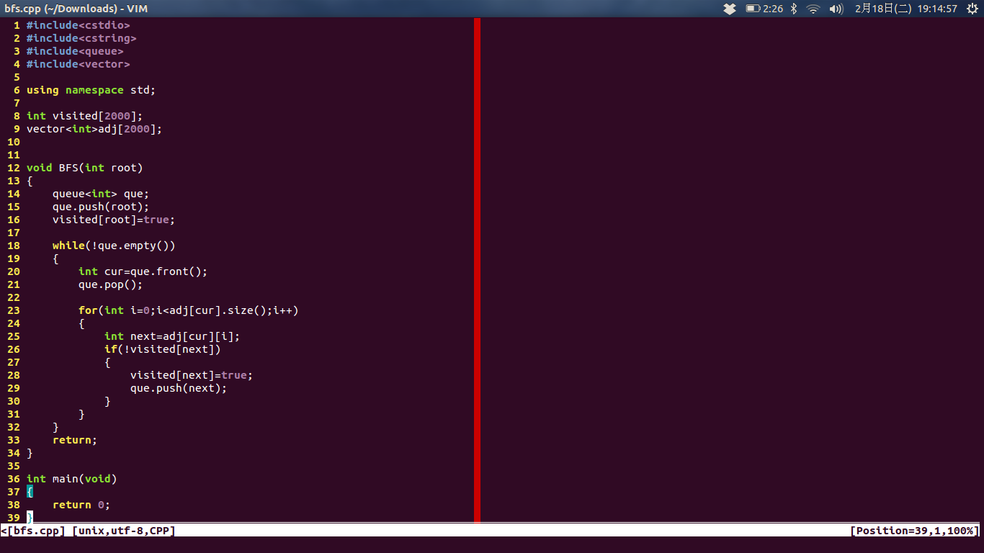
BFS
Source Code (adjacency list)

Slide 86
BFS
Practice
[UVA-532 ] Dungeon Master

Slide 87
Skill:
int dir[4][2]={ {1,0},{-1,0},{0,1},{0,-1} }
➔ search four directions

Slide 88
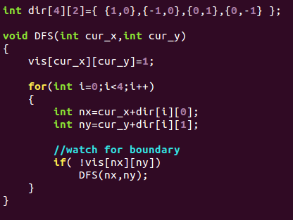
Skill:

Slide 89
Time Complexity
DFS O( V + E )
BFS O( V + E )
V: the number of nodes
E: the number of edges
(adjacency list)

Slide 90
Time Complexity
DFS O( V^2 )
BFS O( V^2 )
V: the number of nodes
E: the number of edges
(adjacency matrix)

Slide 91
HW3
Totally 30 problems
UVa:
260,336,352,383,439,532,539,567,571,601,705,
762,10004,10009,10474, 10505,10592,10603, 10946, 11624, 532, 572
POJ:
1129,1154,1416,1606,1753,1915,1979,2243

Slide 92


