Slide 1

開心廚房Group 5
組長：陳家儀
組員：邱士翔、吳婉廷、賴怡均、葉香君

Slide 2

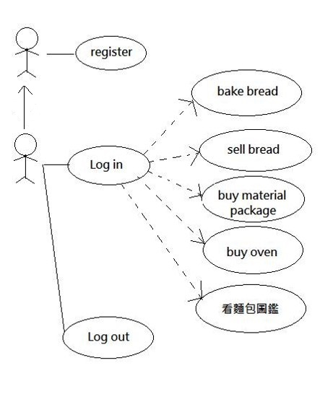
Use case
Visitor
Player

Slide 3
DFD
Pid,Pname,pwd
Coin,material,
Exp,level
Kitchen
Pid
Pname
pwd
Pid
Pname
pwd
User
Register
Player
Pid,Pname,pwd
Coin,material,
Exp,level
login
Coin
material
Material
User
Pid
pwd
Pid
pwd
Coin
Pid,Pname,pwd
Coin,material,
Exp,level
Bread圖鑑
Material
exp
Pid, Pname, pwd,
Coin, material, Exp, level
bnum
M_num
Oven
bnum
User
bnum
Playerbread
Btime,bid,status
Bid, Baketime
bakeexp
Ovenplayer
Bread
Sellmoney
avallevel

Slide 4
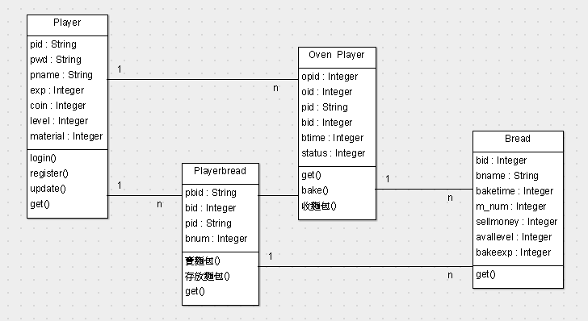
Class-diagram

Slide 5
Demo

