Slide 1


TEAM 6
Happy Farm

Slide 2
101106006 陳君櫂
102213025 江易諺
102213051 梁偉俊
102213043 張以慈
102213038 葉宸瑋
members

Slide 3
報告大綱
Use case
DFD
Class
Extra function
Demo

Slide 4
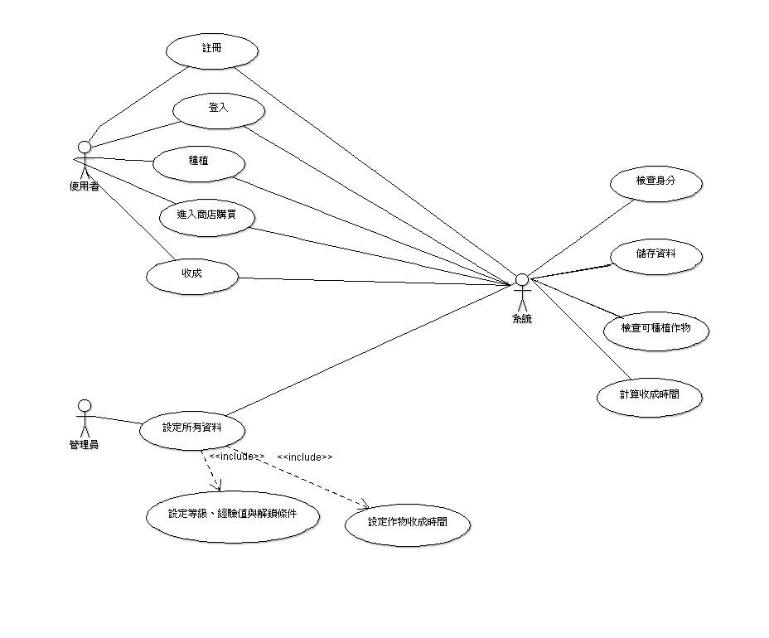
Use case

Slide 5
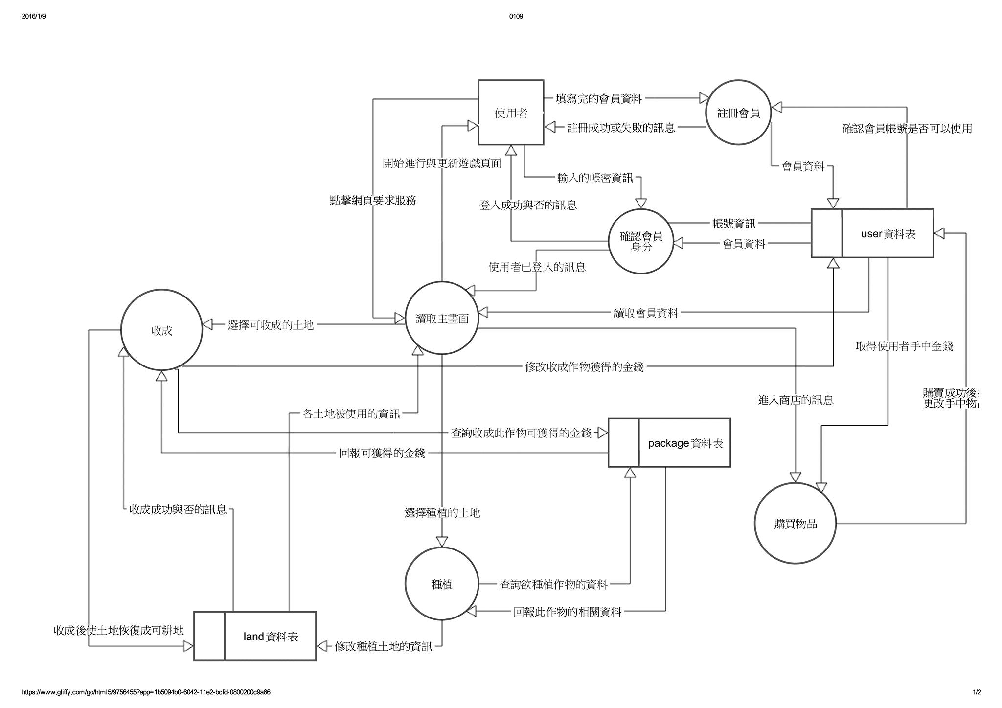
Data Flow Diagram

Slide 6
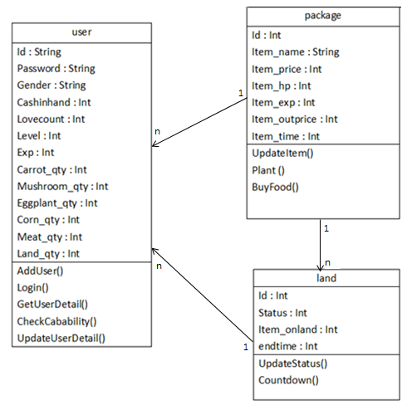
Class Design

