Slide 1
Advanced Topics in Biomedical Ontology PHI 637 SEM / BMI 708 SEM
Werner Ceusters and Barry Smith

Slide 2
Lecture 1 Werner Ceusters
Course overview
Pre-class reading test
Role of and methods for ontologies
Individual project focus

Slide 3
Lecture 1 – Part 1 Course overview
Werner Ceusters

Slide 4
Housekeeping
Syllabus updates always posted to: http://ncorwiki.buffalo.edu/index.php/Advanced_Biomedical_Ontology.
Links to papers are provided in syllabus.
Papers to read may change in the course of classes.
Slides of presentations will be made available after the class at the same location.
Be present and on time:
Some classes have pre-lecture tests which count for final scores;
Give advance notice when you cannot attend.

Slide 5
Class prerequisite: BMI508 / PHI548 or 549
If you didn’t take BMI 508 / PHI 548/549:
Look at materials here:
http://ncorwiki.buffalo.edu/index.php/Biomedical_Ontology_2016
Preparatory special topic class is offered:
For students with focus on philosophy: PHI599
For students with focus on biomedical informatics: BMI510
Weekly class 2-3PM on Thursdays,
77 Goodell street, 5th floor, room 506. (all welcome)

Slide 6
Due dates (2017)
 | Assignment / tasks | Due date
(T1) | Topic for term paper communicated | Sept 7, 7PM
T2 | Post-class assignment of Sept 21 | Sept 26, 7PM
T3 | OGMS extension post-class assignment of Oct 5 | Oct 11, 7PM
(T4) | 300-400 word abstract for term paper | Oct 12, 7PM
T5 | Individual reviews on abstracts | Oct 17, 7PM
T6 | Improved OGMS extension post-class assignment of Oct 26 | Nov 2, 7PM
(T7) | Draft term paper | Nov 9, 7PM
(T8) | Draft final PP presentation | Nov 16, 7PM
T9 | Post-class assignment of Nov 2 | Nov 23, 7PM
T10 | Final paper (including ontology components) | Nov 30, 7PM
If not delivered in time, score for this task = 0!
Deliver by email to both: wceusters@gmail.com
phismith@buffalo.edu

Slide 7
Scoring
 | Related Class | Assessment: evaluation of … | Final score %
A1 | Aug 31 | Advance reading test | 2%
A2 | Sept 21 | Post-class assignment T2 | 8%
A3 | Oct 5 | Advance reading test | 2%
A4 | Oct 5 | Post-class assignment T3 | 8%
A5 | Oct 12 | Advance reading test | 2%
A6 | Oct 19 | Individual reviews on abstracts (T5) | 5%
A7 | Oct 19 | Group assessment of term paper abstract reviews | 5%
A8 | Oct 26 | Post-class assignment T6 | 10%
A9 | Nov 2 | Post-class assignment of Nov 2 (T9) | 8%
A10 | Nov 30/Dec 7 | Final paper, including ontology components (T10) | 30%
A11 | Nov 30/Dec 7 | Final PP presentation / discussion | 20%
 |  | TOTAL | 100%

Slide 8
Course setup (1)
Course objectives:
Acquire expert insight in the principles of ontological realism for ontology design and information management;
Apply that insight to identify and solve some problem in biomedical information management relevant to your PhD or project you are (or intend to be) involved in;
Address challenges brought about by:
existing constraints in available resources you are required to use:
Protégé, Ontology for General Medical Science, … ;
the sort of collaboration you are required to engage in such that your work for your own project goal is also beneficial for the realization of your fellow students’ project goals.

Slide 9

Classes
Aug 31: Systems and techniques for representing biomedical data, information and knowledge in ontologies (WC)
Sept 7: Best practice principles for building domain ontologies, terms, and definitions (BS)
Sept 14: Basic Formal Ontology (BS) and the Ontology for General Medical Science (OGMS)
Sept 21: Introduction to the Protégé ontology editor and add-on tools (Neil Otte)
Sept 28: BFO, OGMS and the OBO Foundry (BS)
Oct 5: Using referent tracking for building ontologies (WC)
Oct 12: Team exercise: building an ontology (WC)
Oct 19: Team exercise: review of term-paper abstracts (WC, BS)
Oct 26: Principles for ontology change management in biomedical information systems (WC)
Nov 2: Ontological principles for combining healthcare data in big data repositories (WC,BS)
Nov 9: Team exercise: use OGMS to improve biomedical informatics resources (WC, BS)
Nov 16: Evaluation of ontologies (WC, BS)
Nov 30 and Dec 7: Student presentations.

Slide 10
Classes
Foundations
Aug 31: Systems and techniques for representing biomedical data, information and knowledge in ontologies (WC)
Sept 7: Best practice principles for building domain ontologies, terms, and definitions (BS)
Sept 14: Basic Formal Ontology (BS) and the Ontology for General Medical Science (OGMS)
Sept 21: Introduction to the Protégé ontology editor and add-on tools (Neil Otte)
Sept 28: BFO, OGMS and the OBO Foundry (BS)
Oct 5: Using referent tracking for building ontologies (WC)
Oct 12: Team exercise: building an ontology (WC)
Oct 19: Team exercise: review of term-paper abstracts (WC, BS)
Oct 26: Principles for ontology change management in biomedical information systems (WC)
Nov 2: Ontological principles for combining healthcare data in big data repositories (WC,BS)
Nov 9: Team exercise: use OGMS to improve biomedical informatics resources (WC, BS)
Nov 16: Evaluation of ontologies (WC, BS)
Nov 30 and Dec 7: Student presentations.
Build
Adapt
Evaluate

Slide 11
Classes
Resources
Aug 31: Systems and techniques for representing biomedical data, information and knowledge in ontologies (WC)
Sept 7: Best practice principles for building domain ontologies, terms, and definitions (BS)
Sept 14: Basic Formal Ontology and the Ontology for General Medical Science (OGMS) (BS)
Sept 21: Introduction to the Protégé ontology editor and add-on tools (Neil Otte)
Sept 28: BFO, OGMS and the OBO Foundry (BS)
Oct 5: Using referent tracking for building ontologies (WC)
Oct 12: Team exercise: building an ontology (WC)
Oct 19: Team exercise: review of term-paper abstracts (WC, BS)
Oct 26: Principles for ontology change management in biomedical information systems (WC)
Nov 2: Ontological principles for combining healthcare data in big data repositories (WC,BS)
Nov 9: Team exercise: use OGMS to improve biomedical informatics resources (WC, BS)
Nov 16: Evaluation of ontologies (WC, BS)
Nov 30 and Dec 7: Student presentations.

Slide 12
Course related constraints
Free choice of term paper topic and related ontology work, but:
must include:
an extension of OGMS,
mechanisms for quality assurance while developing your project,
demonstration of its adequacy to facilitate
combining healthcare data from various sources,
improving the quality of existing biomedical informatics resources;
form the basis for your input in the team exercises.

Slide 13
Team exercises
Aug 31: Systems and techniques for representing biomedical data, information and knowledge in ontologies (WC)
Sept 7: Best practice principles for building domain ontologies, terms, and definitions (BS)
Sept 14: Basic Formal Ontology (BS) and the Ontology for General Medical Science (OGMS)
Sept 21: Introduction to the Protégé ontology editor and add-on tools (Neil Otte)
Sept 28: BFO, OGMS and the OBO Foundry (BS)
Oct 5: Using referent tracking for building ontologies (WC)
Oct 12: Team exercise: building an ontology (WC)
Oct 19: Team exercise: review of term-paper abstracts (WC, BS)
Oct 26: Principles for ontology change management in biomedical information systems (WC)
Nov 2: Ontological principles for combining healthcare data in big data repositories (WC,BS)
Nov 9: Team exercise: use OGMS to improve biomedical informatics resources (WC, BS)
Nov 16: Evaluation of ontologies (WC, BS)
Nov 30 and Dec 7: Student presentations.

Slide 14
Team exercise 1
October 12: Building an ontology (WC)
class participants will be divided into groups. The task for each group will be:
to identify some area in which ontology methods can be of value in understanding issues related to patient well-being, along the lines illustrated in the advance readings.
to propose terms and definitions which need to be added (or linked) to OGMS to create a corresponding ontology.
to make the results available electronically by the end of class.

Slide 15
Team exercise 1
October 12: Building an ontology (WC)
class participants will be divided into groups. The task for each group will be:
to identify some area in which ontology methods can be of value in understanding issues related to patient well-being, along the lines illustrated in the advance readings.
to propose terms and definitions which need to be added to OGMS to create a corresponding ontology.
to make the results available electronically by the end of class.
Advice: form groups earlier based on your interest, term paper topic and overlap / mutual benefit therein.

Slide 16
Team exercise 2
October 19: Review of term-paper abstracts (WC, BS)
class participants will be divided into groups. The task for each group will be:
review critically the 300-400 word abstracts received from the members of other groups on or before October 12.
present the results in the style of a journal peer review, including where necessary a statement of majority and minority opinions.

Slide 17
Team exercise 3
Nov 9: use OGMS to improve biomedical informatics resources (WC, BS)
2 resources to be studied:
OMOP: http://omop.org/CDM
RDoC: https://www.nimh.nih.gov/research-priorities/rdoc/index.shtml

Slide 18
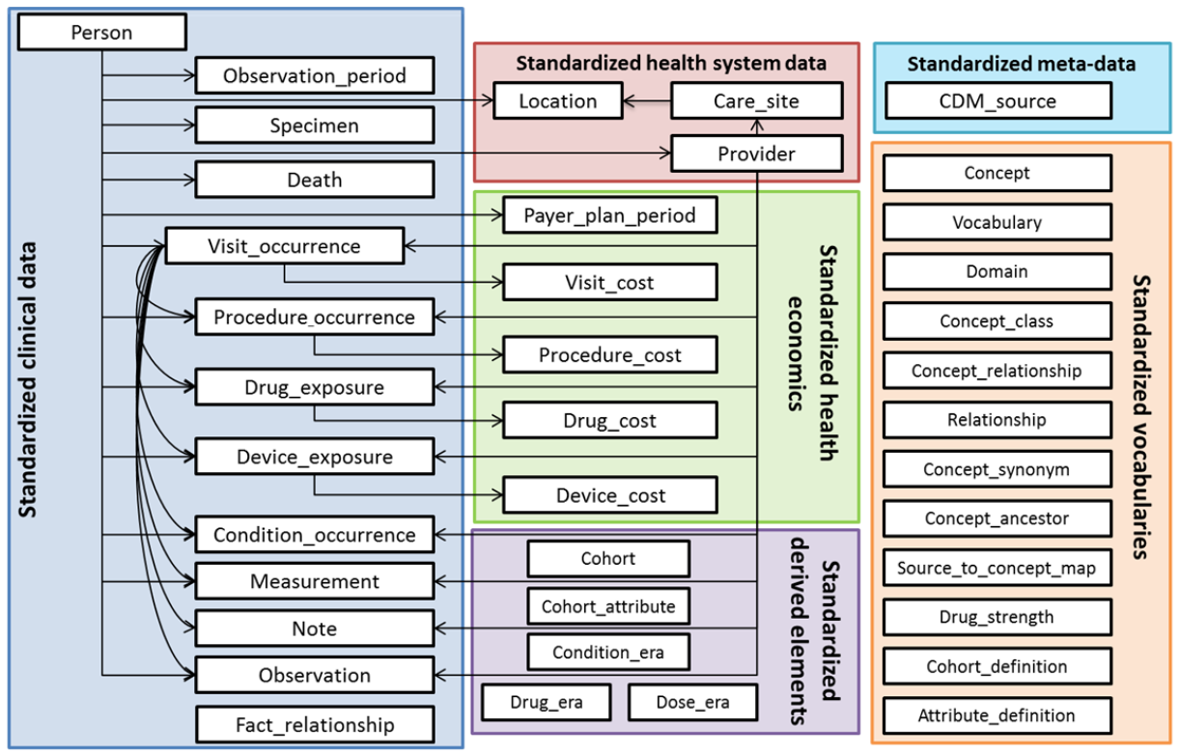
OMOP Common Data Model

Slide 19
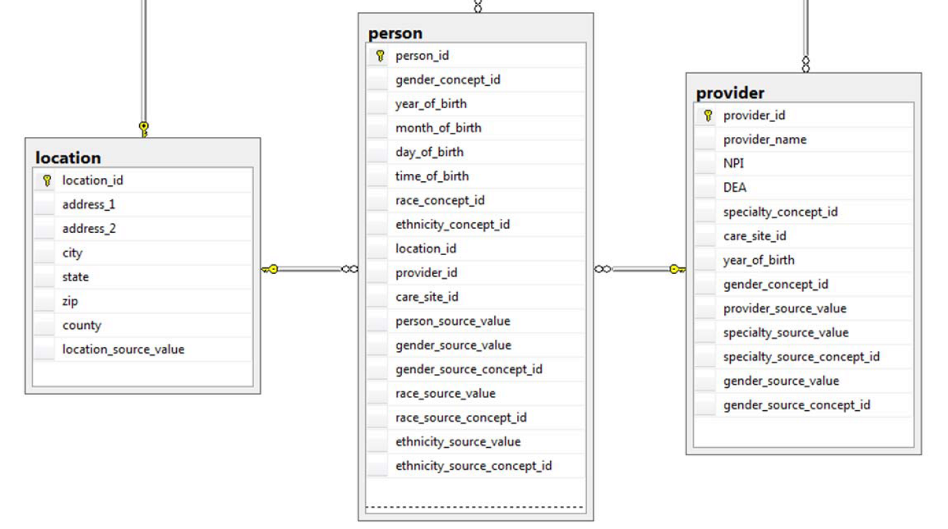
Person versus Provider

Slide 20
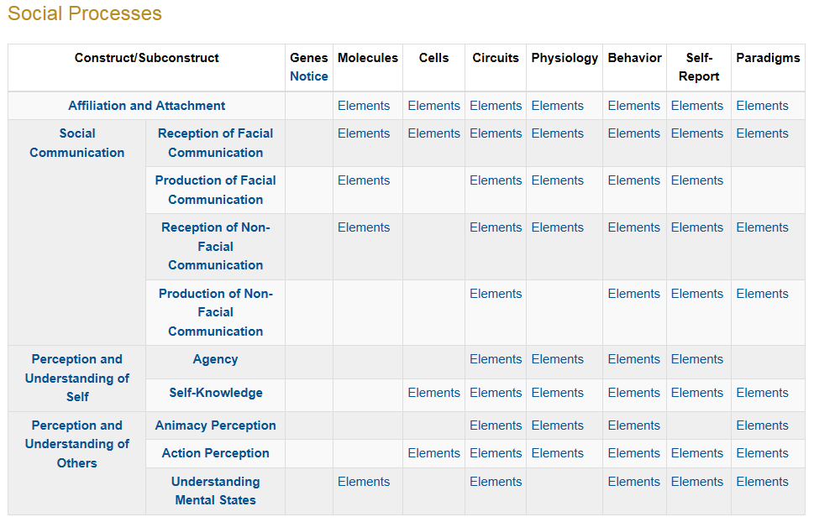
RDoC Matrix (social processes domain)

Slide 21
RDoC Subconstruct: Production of Non-Facial Communication
Description: The capacity to express social and emotional information based on modalities other than facial expression, including non-verbal gestures, affective prosody, distress calling, cooing, etc.
Circuits: R-IFG-RSTG, Songbird circuits
Behavior: Crying/laughing, Gestural/postural expressions, Interactive play, Response to distress/separation distress, Speech (affective) prosody, Vocalizations.
Self-Report: Social Responsiveness Scale
Paradigms: Multimodal Social Paradigms

Slide 22
RDoC Subconstruct: Production of Non-Facial Communication
Description: The capacity to express social and emotional information based on modalities other than facial expression, including non-verbal gestures, affective prosody, distress calling, cooing, etc.
Circuits: R-IFG-RSTG, Songbird circuits
Behavior: Crying/laughing, Gestural/postural expressions, Interactive play, Response to distress/separation distress, Speech (affective) prosody, Vocalizations.
Self-Report: Social Responsiveness Scale
Paradigms: Multimodal Social Paradigms

Slide 23
Team exercise 3
Nov 9: use OGMS to improve biomedical informatics resources (WC, BS)
2 resources to be studied:
OMOP: http://omop.org/CDM
RDoC: https://www.nimh.nih.gov/research-priorities/rdoc/index.shtml
Preliminary work done by two students resp. JB and MJ.
Tasks:
Group 1 with JB studies RDoC, group 2 with MJ studies OMOP (free choice for others, roughly equal size);
1st ½ time: each group proposes improvements;
2nd ½ time: presentation of results, discussion and, where needed, defense by JB and MJ.

Slide 24
After-class exercises
Implement in Protégé terms and definitions from OGMS (Scheuermann et al. 2009) (Due date: Sept 26.);
* Or: from your own set of entities for your project mapped to OGMS
Read the alert fatigue paper and propose terms and definitions which need to be mapped to OGMS to create an ontology to address alert fatigue in EHRs. Due date: Oct 11;
* Or: terms and definitions for entities mapped to OGMS needed for some alert mechanism relevant to your project.
Improve your project ontology by implementing a method for change management (class Oct 26, due Nov 2);
Adapt your work for applicability towards combining instance data in ‘big data’ repositories.
* prior agreement needed

Slide 25
Questions ?

Slide 26
Lecture 1 – Part 2 Readings test
Werner Ceusters

Slide 27
Three views on what ‘ontology’ denotes
A representation of categories existing independently of human perception, of which the quality depends on the degree to which it represents (is true of) a certain portion of reality;
A system of categories which as cognitive artifacts are dependent on human perception and that as a whole accounts for a particular way of seeing the world;
An artifact specified in a particular logically regimented vocabulary to describe a certain reality, and where a set of statements are made regarding the intended meaning of the words in the vocabulary.
Q1: Which view can deal with the other views and why?

Slide 28
Q2. What are ontologies useful for?
Give 4 mutually exclusive, non-overlapping, domain-independent applications.

Slide 29
Foundational Model of Anatomy Old definition of Anatomical Structure
Anatomical structure
is a material physical anatomical entity
which has inherent 3D shape;
is generated by coordinated expression of the organism’s own structural genes;
consists of parts that
are anatomical structures
spatially related to one another in patterns
determined by coordinated gene expression.

Slide 30
New definition for Anatomical Structure
Material anatomical entity which is generated by coordinated expression of the organism's own genes that guide its morphogenesis; has inherent 3D shape; its parts are connected and spatially related to one another in patterns determined by coordinated gene expression.

Slide 31
Q3: Which problem with the old definition does the new one solve?
Old: a material physical anatomical entity which has inherent 3D shape; is generated by coordinated expression of the organism’s own structural genes; consists of parts that are anatomical structures, [which are] spatially related to one another in patterns and determined by coordinated gene expression.
New: Material anatomical entity which is generated by coordinated expression of the organism's own genes that guide its morphogenesis; has inherent 3D shape; its parts are connected and spatially related to one another in patterns determined by coordinated gene expression.

Slide 32
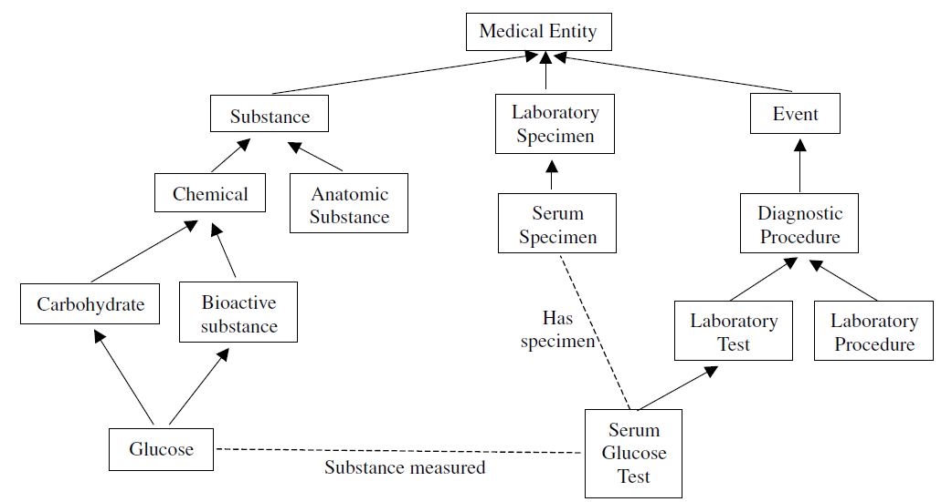
Q4. What is problematic here?

Slide 33
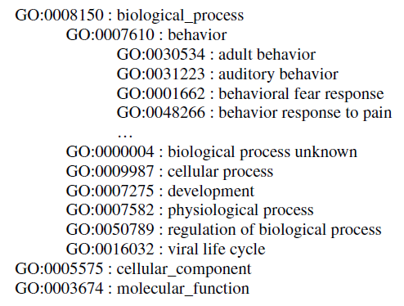
Q5. What is problematic here?

Slide 34
Q6. Bonus question: What are the 4 meta-properties upon which OntoClean is based?
Give their names and what they stand for.

Slide 35
Lecture 1 – Part 3 Systems and techniques for representing biomedical data, information and knowledge in ontologies
Werner Ceusters

Slide 36
Lecture 1 – Part 3 Systems and techniques for representing biomedical data, information and knowledge in ontologies
Something wrong with this title?
Werner Ceusters

Slide 37
Lecture 1 – Part 3 Systems and techniques for representing biomedical data, information and knowledge in ontologies
Something wrong with this title?
Something wrong with this question?
Werner Ceusters

Slide 38
An ontology’s ideal lifecycle
Design
maintenance
Development
Use
Implementation
Validation
Verification

Slide 39
Design
maintenance
Development
Domain
Ontology
Use
Implementation
Validation
Verification

Slide 40
Merging / Aligning Mapping
Upper Level
Ontology

Slide 41
Uses
By themselves:
Representation of what is general in reality
Includes knowledge
Clarity about terminology
In relation to other representational artifacts:
Annotation
Data integration
Reasoning
Data mining
Decision support

Slide 42
IHI current data aggregation and use
Operational
systems
IHI Clinical
Integrated
Data Repository
Secondary
use
Cohort selection
EHR
Data Marts
EHR
EHR
EHR
Cost effectiveness
research
Common Data Models
Bio Bank
Decision support
Health
Insurers
Referent Tracking
Data Repository
Quality assurance
Health
Insurers
Health
Insurers

Slide 43
IHI intended data aggregation and use
Operational
systems
IHI Clinical
Integrated
Data Repository
Secondary
use
Cohort selection
EHR
Data Marts
EHR
EHR
EHR
Cost effectiveness
research
Common Data Models
Bio Bank
Decision support
Health
Insurers
Referent Tracking
Data Repository
Quality assurance
Health
Insurers
Health
Insurers

Slide 44
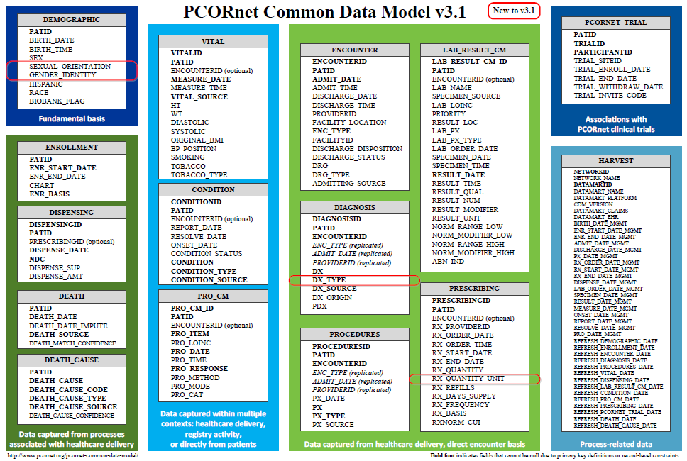
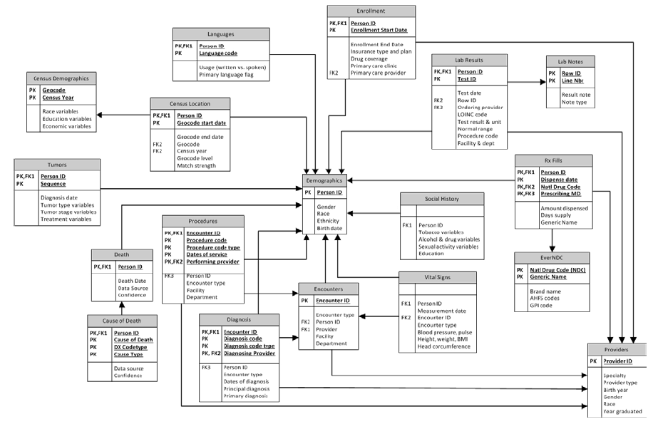
Common Data Models for Secondary Use
The Observational Medical Outcomes Partnership (OMOP)
Health Care Systems Research Network (HCSRN)
The National Patient-Centered Clinical Research Network (PCORNet)

Slide 45
Experiences with CDMs
OMOP scores best:
Garza M, Del Fiol G, Tenenbaum J, Walden A, Zozus M. Evaluating common data models for use with a longitudinal community registry. J Biomed Inform. 2016 Oct 28.
Ogunyemi OI, Meeker D, Kim HE, Ashish N, Farzaneh S, Boxwala A. Identifying appropriate reference data models for comparative effectiveness research (CER) studies based on data from clinical information systems. Medical care. 2013 Aug;51(8 Suppl 3):S45-52.
CDMs lead to information loss:
Hersh WR, Weiner MG, Embi PJ, Logan JR, Payne PR, Bernstam EV, et al. Caveats for the use of operational electronic health record data in comparative effectiveness research. Medical care. 2013 Aug;51(8 Suppl 3):S30-7.
Rijnbeek PR. Converting to a common data model: what is lost in translation? : Commentary on "fidelity assessment of a clinical practice research datalink conversion to the OMOP common data model". Drug Saf. 2014 Nov;37(11):893-6.
Yoon D, Ahn EK, Park MY, Cho SY, Ryan P, Schuemie MJ, et al. Conversion and Data Quality Assessment of Electronic Health Record Data at a Korean Tertiary Teaching Hospital to a Common Data Model for Distributed Network Research. Healthc Inform Res. 2016 Jan;22(1):54-8.
Streamlining of CDM evaluation methods is needed:
Garza M, Del Fiol G, Tenenbaum J, Walden A, Zozus M. Evaluating common data models for use with a longitudinal community registry. J Biomed Inform. 2016 Oct 28.
Huser V, Cimino JJ. Desiderata for healthcare integrated data repositories based on architectural comparison of three public repositories. AMIA Annual Symposium proceedings / AMIA Symposium AMIA Symposium. 2013;2013:648-56.
None use realism-based ontology for information modeling.

Slide 46
Results
Three sorts of count errors, resp. due to:
cardinality and attribute restrictions,
inconsistent normalization,
confusing data with what it is about.
Ceusters W, Blaisure J.
A Realism-Based View on Counts in OMOP’s Common Data Model.
14th International Conference on Wearable, micro & Nano Technologies (pHealth 2017), Eindhoven, The Netherlands, May 14-16, 2017. Studies in Health Technology and Informatics 2017;237:55-62.

Slide 47
PERSON table
Allows for each unique patient only
one location,
one gender,
one primary care provider, and
one care site.
Although:
‘patients over time can have distinct locations, genders’;
‘it is the responsibility of the data holder to select the one value to use in the CDM’.
What criteria to use?
What with the multiple observation periods?

Slide 48
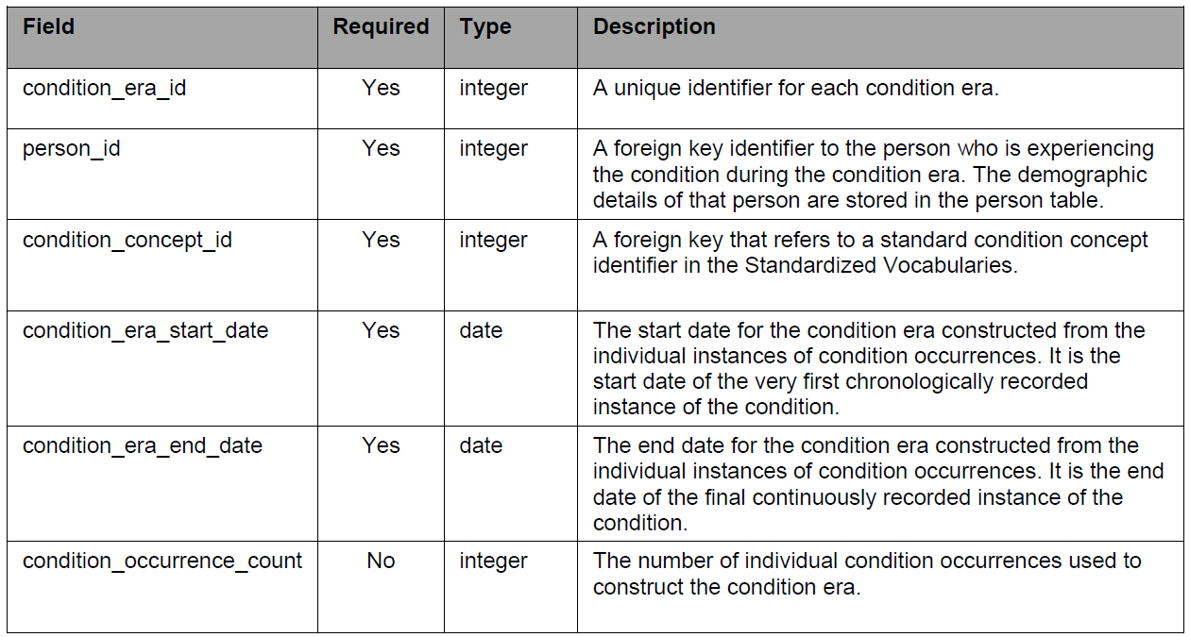
Condition-occurrences versus eras

Slide 49
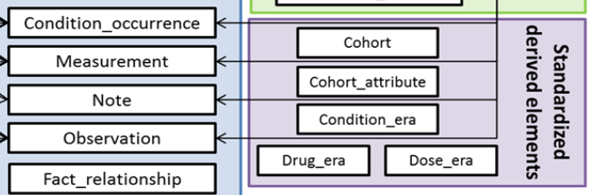
Conventions
Condition Era records will be derived from the CONDITION_OCCURRENCE table using a standardized algorithm.
Each Condition Era corresponds to one or many CONDITION_OCCURRENCE records that form a continuous interval and contain the same drug condition-occurrence.

Slide 50
Conventions
The condition_concept_id field contains Concepts that are identical to those of the CONDITION_OCCURRENCE table records that make up the Condition Era.
The Condition Era Start Date is the start date of the first Condition Occurrence.
The Condition Era End Date is the end date of the last Condition Occurrence.

Slide 51
An erroneous example
‘a Condition Era representing ICD-9 code 410.01
(Acute Myocardial Infarction (AMI) of anterolateral wall, initial episode)
would be aggregated to a Condition Era representing ICD-9 code 410.41
(AMI inferior wall, initial episode)
occurring within 30 days
as both of these ICD-9 codes annotate to the same Condition Concept, Acute Myocardial Infarction, within the MedDRA hierarchy’.
Reisinger SJ, Ryan PB, O'Hara DJ, Powell GE, Painter JL, Pattishall EN, et al. Development and evaluation of a common data model enabling active drug safety surveillance using disparate healthcare databases.
J Am Med Inform Assoc. 2010 Nov-Dec;17(6):652-62, p656

Slide 52
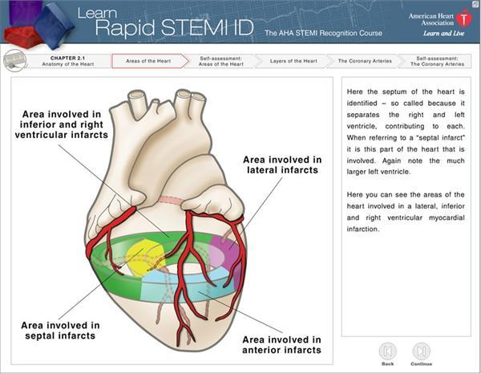
http://myheart.net/articles/stemi/

Slide 53
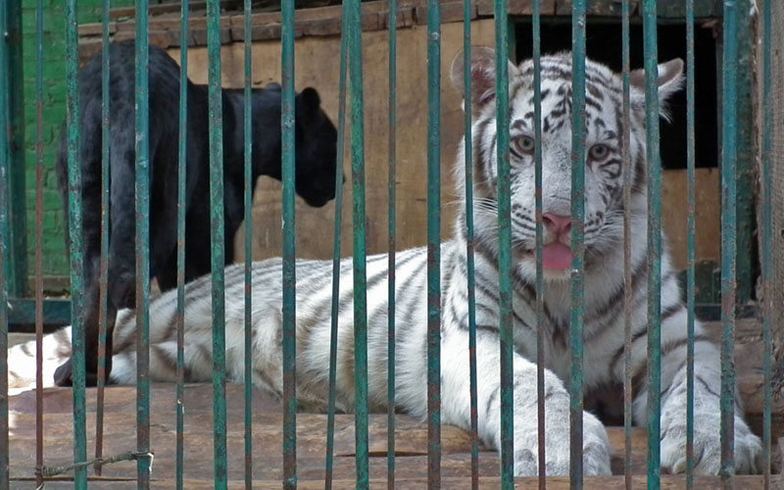
feline
isa
isa
panther
tiger
Instance-of
Instance-of
Only one feline in this cage?

Slide 54
Discuss …
It has become a central problem to find ways to seamlessly integrate information and data from the clinical and biological domains
Alexander C. Yu. Methods in biomedical ontology. Journal of Biomedical Informatics 39 (2006) 252–266.

Slide 55
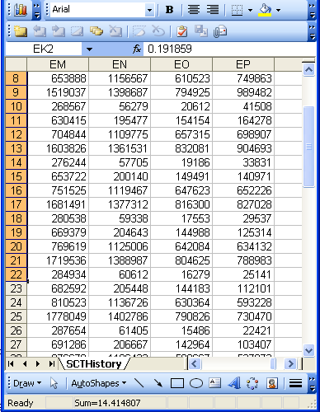
The focus on (big) data …

Slide 56
Current mainstream thinking
wisdom
(- representation)
knowledge
- representation
information
- representation
data
- representation

Slide 57
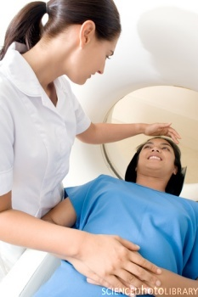
… makes one forget what data – ideally – are about
Referents
References

Slide 58
Current mainstream thinking
wisdom
(- representation)
References
knowledge
- representation
information
- representation
data
- representation
Questions not often enough asked:
What part of our data corresponds with something out there in reality ?
What part of reality is not captured by our data, but should because it is relevant ?
Reality
What is there on the side of the patient
Referents

Slide 59
A non-trivial relation
Referents
References

Slide 60
Three views on what ‘ontology’ denotes
A representation of categories existing independently of human perception, of which the quality depends on the degree to which it represents (is true of) a certain portion of reality;
A system of categories which as cognitive artifacts are dependent on human perception and that as a whole accounts for a particular way of seeing the world;
An artifact specified in a particular logically regimented vocabulary to describe a certain reality, and where a set of statements are made regarding the intended meaning of the words in the vocabulary.
Adapted from:
Alexander C. Yu. Methods in biomedical ontology. Journal of Biomedical Informatics 39 (2006) 252–266.

Slide 61
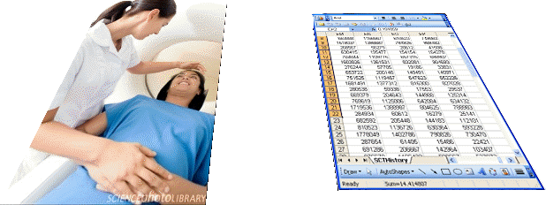
What makes it non-trivial?
Referents
are (meta-) physically the way they are,
relate to each other in an objective way,
follow ‘laws of nature’.
Window on reality
restricted by:
what is physically and technically observable,
fit between what is measured and what we think is measured,
fit between established knowledge and ‘laws of nature’.
References
follow, ideally, the syntactic-semantic conventions of some representation language,
are restricted by the expressivity of that language,
reference collections need to come, for correct interpretation, with documentation outside the representation.
Correspondence with levels of reality?
L1: what is real L2: beliefs L3: representations

Slide 62
Discuss …
The term ‘class’ refers to what is general in reality (broadly equivalent to ‘concept’, and ‘universal’ or ‘type’).
‘instance’ (‘token’ or ‘individual’) refers to what is particular in reality plays a fundamental role in the definition of what it means for one class to stand in relation to another.
Alexander C. Yu. Methods in biomedical ontology. Journal of Biomedical Informatics 39 (2006) 252–266.

Slide 63
Discuss: Principles of classification
1. Each hierarchy must have a single root.
2. Each class (except for the root) must have at least one parent.
3. Non-leaf classes must have at least two children.
4. Each class must differ from each other class in its definition. In particular, each child must differ from its parent and siblings must differ from one another.
5. Subclasses should be mutually exclusive and jointly exhaustive.
Bodenreider O, Smith B, Kumar A, Burgun A.
Investigating subsumption in DL-based terminologies: a case study in SNOMED CT.
In: Hahn U, editor. KR-MED 2004; 2004. Whistler, Canada: AMIA; 2004. p. 12–20.

Slide 64
Discuss …
Ontologies provide identifiers for classes and relations that represent phenomena within a domain, thereby enabling integration of data.
Robert Hoehndorf, Paul N. Schofield and Georgios V. Gkoutos.
The role of ontologies in biological and biomedical research: a functional perspective.
Briefings in Bioinformatics, 16(6), 2015, 1069–1080.

Slide 65
Q5. What is problematic here?

Slide 66
Discuss …
Ontologies provide identifiers for classes and relations that represent phenomena within a domain, thereby enabling integration of data.
Ontologies provide labels for classes and relations, thereby providing a domain vocabulary.
Robert Hoehndorf, Paul N. Schofield and Georgios V. Gkoutos.
The role of ontologies in biological and biomedical research: a functional perspective.
Briefings in Bioinformatics, 16(6), 2015, 1069–1080.

Slide 67
Q4. What is problematic here?

Slide 68
Discuss …
Ontologies provide identifiers for classes and relations that represent phenomena within a domain, thereby enabling integration of data.
Ontologies provide labels for classes and relations, thereby providing a domain vocabulary.
Ontologies provide metadata associated with classes and relations that allows human users to understand their meaning and contribute to consistent use in annotation and other applications.
Robert Hoehndorf, Paul N. Schofield and Georgios V. Gkoutos.
The role of ontologies in biological and biomedical research: a functional perspective.
Briefings in Bioinformatics, 16(6), 2015, 1069–1080.

Slide 69
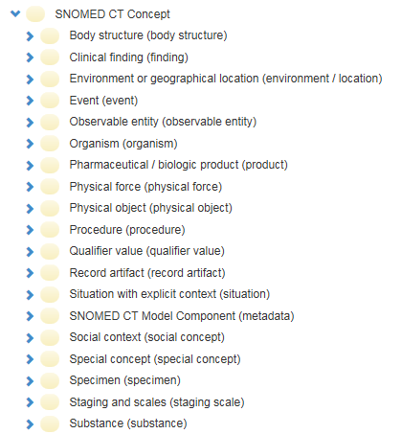
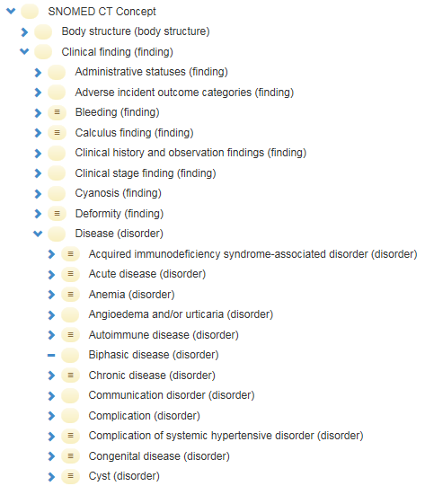
SNOMED CT’s ‘semantic tags’

Slide 70
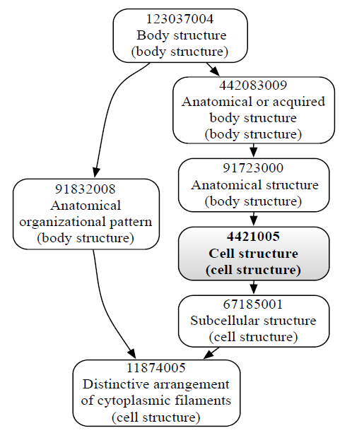
Multiple inheritance and semantic tags
This would be a mistake!

Slide 71
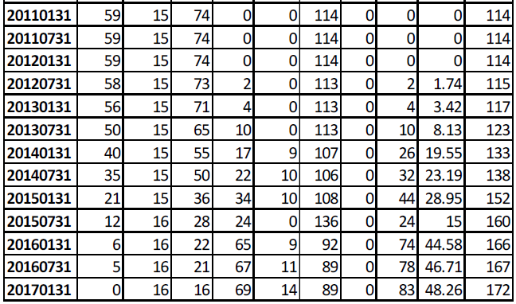
Mismatches between ‘disorder’ tag and ‘disease’ class
Bona J, Ceusters W. Scrutinizing the relationships between SNOMED CT concepts and semantic tags. International Conference on Biomedical Ontology (ICBO 2017), Newcastle upon Tyne, UK, Sept 13-15, 2017.

Slide 72
Discuss …
One of the crucial decisions in ontology construction is to select the formalism in which the ontology will be implemented.
Alexander C. Yu. Methods in biomedical ontology. Journal of Biomedical Informatics 39 (2006) 252–266.

Slide 73
Discuss …
Ontologies provide axioms and formal definitions that enable computational access to some aspects of the meaning of classes and relations.
Robert Hoehndorf, Paul N. Schofield and Georgios V. Gkoutos.
The role of ontologies in biological and biomedical research: a functional perspective.
Briefings in Bioinformatics, 16(6), 2015, 1069–1080.

Slide 74
SNOMED CT: Elevated liver enzymes level due to cystic fibrosis (disorder)
Relationship | Destination | Type
Is a | Elevated liver enzymes level (finding) | Stated
Due to | Cystic fibrosis (disorder) | Stated
Is a | Elevated liver enzymes level (finding) | Inferred
Due to | Cystic fibrosis (disorder) | Inferred
Interprets | Measurement of liver enzyme (procedure) | Inferred
Has interpretation | Outside reference range (qualifier value) | Inferred
Has interpretation | Above reference range (qualifier value) | Inferred
Interprets | Measurement procedure (procedure) | Inferred

Slide 75
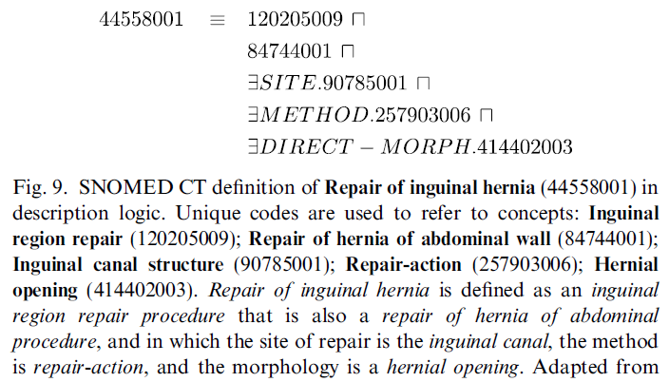
Formal definitions in SNOMED CT

Slide 76
Q3: Which problem with the old definition does the new one solve?
Old: a material physical anatomical entity which has inherent 3D shape; is generated by coordinated expression of the organism’s own structural genes; consists of parts that are anatomical structures, [which are] spatially related to one another in patterns and determined by coordinated gene expression.
New: Material anatomical entity which is generated by coordinated expression of the organism's own genes that guide its morphogenesis; has inherent 3D shape; its parts are connected and spatially related to one another in patterns determined by coordinated gene expression.

Slide 77
Discuss …
Combining the four main features of ontologies (1.identifiers, 2.labels, 3.metadata, 4.axioms and formal definitions) facilitates semantic integration of heterogeneous, multimodal data within and across domains, and enables novel data mining methods that span traditional boundaries between domains and data types.
Robert Hoehndorf, Paul N. Schofield and Georgios V. Gkoutos.
The role of ontologies in biological and biomedical research: a functional perspective.
Briefings in Bioinformatics, 16(6), 2015, 1069–1080.

Slide 78
Lecture 1 – Part 4 Individual projects focus
Werner Ceusters

