Slide 1
STOP
Barry Smith
http://ifomis.de

Slide 2
Smart Terminologies via Ontological Principles

Slide 3
Thanks to
Anand Kumar
Steffen Schulze-Kremer
Jane Lomax

Slide 4
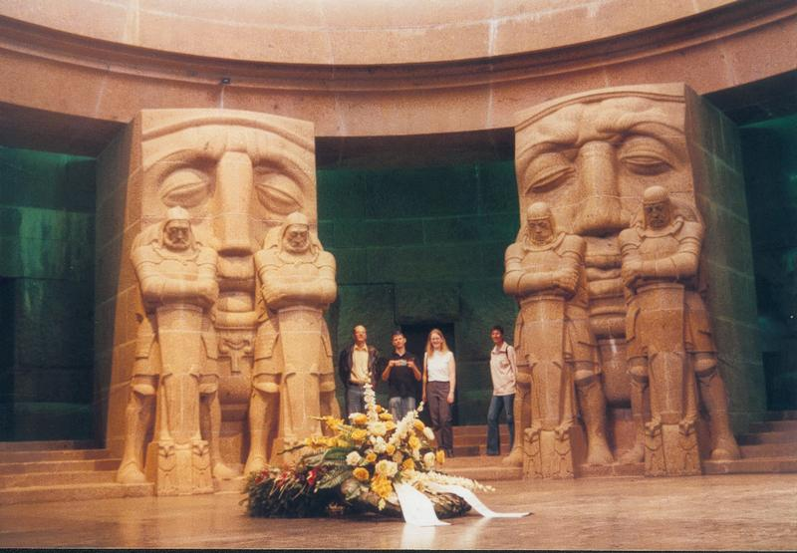
Part One
Introduction

Slide 5
GO here an example
of the sorts of problems confronting life science data integration
of the degree to which philosophy and logic are relevant to the solution of these problems

Slide 6
When a gene is identified
three important types of questions need to be addressed:
1. Where is it located in the cell?
2. What functions does it have on the molecular level?
3. To what biological processes do these functions contribute?

Slide 7
GO’s three ontologies
molecular functions
biological processes
cellular components

Slide 8
Each of GO’s ontologies
is organized in a graph-theoretical structure involving two sorts of links or edges:
is-a (= is a subtype of )
(copulation is-a biological process)
part-of
(cell wall part-of cell)

Slide 9
Part Two
GO as ‘Controlled Vocabulary’

Slide 10
Principle of Univocity
terms should have the same meanings (and thus point to the same referents) on every occasion of use

Slide 11
Principle of Compositionality
The meanings of compound terms should be determined
1. by the meanings of component terms
together with
2. the rules governing syntax

Slide 12
Principle of Syntactic Separateness
Do not confuse sentences with terms
If you want to say:
No As are Bs
do not invent a new class of non-Bs and say
A is_a non-B
Holliday junction helicase complex
is-a
unlocalized

Slide 13
Principle of Objectivity
which classes exist in reality is not a function of our biological knowledge.
(Terms such as ‘unclassified’ or ‘unknown ligand’ or ‘not otherwise classified as peptides’ do not designate biological natural kinds, and nor do they designate differentia of biological natural kinds)

Slide 14
Keep Epistemology Separate from Ontology
If you want to say that
We do not know where As are located
do not invent a new class of
A’s with unknown locations
(A well-constructed ontology should grow linearly; it should not need to delete classes or relations because of increases in knowledge)

Slide 15
GO:0008372 cellular component unknown cellular component unknown is-a cellular component

Slide 16
binding is_a molecular function
binding is_a English noun

Slide 17
Principle of Meta-Data
Do not include meta-data as if it were just more data
Do not confuse meta-data with data about classes in the ontology itself

Slide 18
Principle of Meta-Data
obsolete molecular function
- list of molecular function terms declared obsolete
obsolete molecular function is_a molecular function
obsolete molecular function (obsolete)

Slide 19
obsolete molecular function (obsolete) (obsolete)

Slide 20
meta-data
data
reality

Slide 21
meta-data comments on terms
data terms
reality natural kinds

Slide 22
meta-data comments on terms
data terms
‘is_a’, ‘part_of ’
reality natural kinds
is_a, part_of

Slide 23
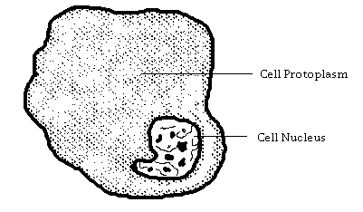
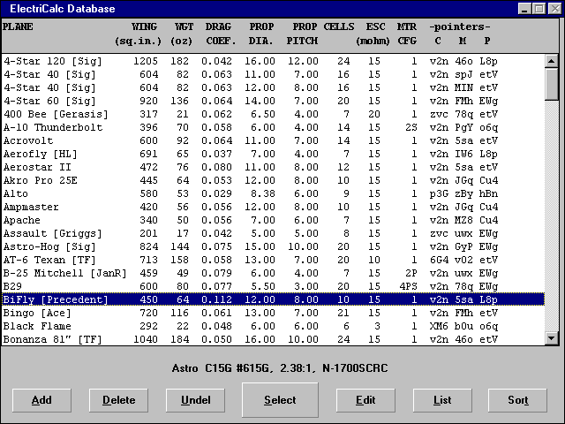
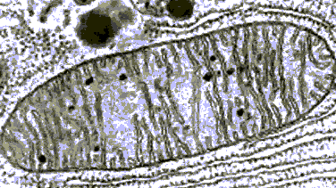
data: nucleus part_of cell
reality: <
cellular component part_of Gene Ontology
reality: <

Slide 24
data: nucleus part_of cell
reality: <
cellular component part_of Gene Ontology
reality: <

Slide 25
Russell’s Paradox
GO names itself
SwissProt does not name itself
Consider:
the database of all biological databases that do not name themselves
this names itself if and only if it does not name itself

Slide 26
Part Three
GO’s Relation

Slide 27
Principle of Single Inheritance
every non-root class in a classificatory hierarchy has exactly one parent
no classificatory diamonds:

Slide 28
Linnaeus

Slide 29
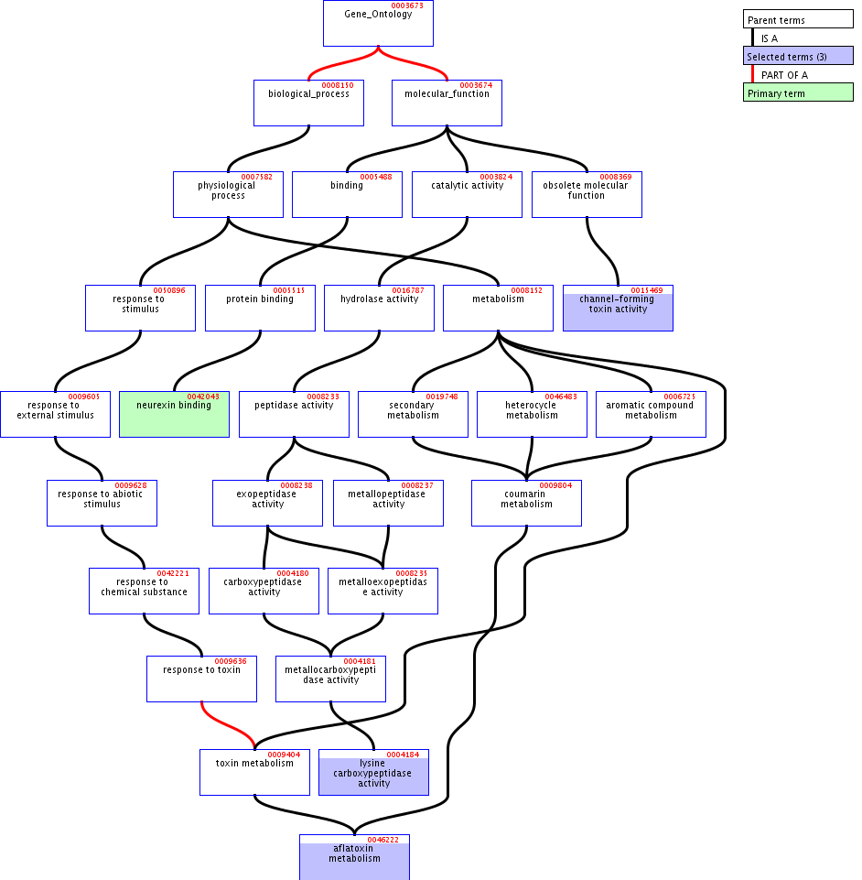

Slide 30
Uses of multiple inheritance associated with errors in coding
B C
is-a₁ is-a₂
A
because ‘is-a’ no longer univocal

Slide 31
e.g. is_a is pressed into service to express location
is-located-at and similar relations are expressed by creating special compound terms using:
site of …
… within …
… in …
extrinsic to …
yielding associated errors

Slide 32
‘is-a’ overloading
an obstacle to integration with other ontologies
and causes other problems

Slide 33
e.g. problems with ‘within’
lytic vacuole within a protein storage vacuole
lytic vacuole within a protein storage vacuole is-a protein storage vacuole
time-out within a baseball game is-a baseball game
embryo within a uterus is-a uterus

Slide 34
similar problems with part_of
extrinsic to membrane part_of membrane
.

Slide 35
two distinct terms in GO’s cellular component ontology
GO:0005716 synaptonemal complex (obsolete)
GO:0000795: synaptonemal complex

Slide 36
‘synaptonemal complex’
GO:0005716 synaptonemal complex
Definition OBSOLETE. A structure that holds paired chromosomes together during prophase I of meiosis and that promotes genetic recombination.

Slide 37
GO:0005716 synaptonemal complex
This term was made obsolete because the definition is not true for every organism.
To update annotations, use the cellular component term ‘synaptonemal complex ; GO:0000795’.

Slide 38
‘synaptonemal complex’
GO:0000795 synaptonemal complex
Definition: A proteinaceous scaffold found between homologous chromosomes during meiosis.
Yet still:
synaptonemal complex part_of chromosome

Slide 39
structural constituent of bone
structural constituent of chorion (sensu Insecta)
structural constituent of chromatin
structural constituent of cuticle
structural constituent of cytoskeleton
structural constituent of epidermis
structural constituent of eye lens
structural constituent of muscle
structural constituent of myelin sheath
structural constituent of nuclear pore
structural constituent of peritrophic membrane (sensu Insecta)
structural constituent of ribosome – note possibility of confusion with ‘major ribosome unit’ (check)
structural constituent of tooth enamel
structural constituent of vitelline membrane (sensu Insecta)
Examples
of GO
Functions

Slide 40
structural constituent of bone
structural constituent of tooth enamel
are molecular functions
Not biological processes
Not cellular components

Slide 41
structural constituent of bone
structural constituent of chorion (sensu Insecta)
structural constituent of chromatin
structural constituent of cuticle
structural constituent of cytoskeleton
structural constituent of epidermis
structural constituent of eye lens
structural constituent of muscle
structural constituent of myelin sheath
structural constituent of nuclear pore
structural constituent of peritrophic membrane (sensu Insecta)
structural constituent of ribosome – note possibility of confusion with ‘major ribosome unit’ (check)
structural constituent of tooth enamel
structural constituent of vitelline membrane (sensu Insecta)
what is the relation
between
‘constituent’
and ‘component’?

Slide 42
Units, constituents, components, parts, …
What is the relation between
structural constituent of ribosome
and
large ribosomal subunit ?
How does process relate to activity ?
these are questions of ontology in the philosophical sense

Slide 43
Part Four
GO’s Definitions

Slide 44
Judith Blake:
The use of bio-ontologies … ensures consistency of data curation, supports extensive data integration, and enables robust exchange of information between heterogeneous informatics systems. ..
ontologies … formally define relationships between the concepts.

Slide 45
"Gene Ontology: Tool for the Unification of Biology"
an ontology "comprises a set of well-defined terms with well-defined relationships"
(Ashburner et al., 2000, p. 27)

Slide 46
GO’s term definitions
First problem: Circularity (and worse)
hemolysis
Definition: The processes that cause hemolysis …

Slide 47
OBO Definition of ‘part_of’:
Used for representing partonomies
The subject (child node) of the relationship is the subpart; the object (parent node) is the superpart.

Slide 48
Principle of Intelligibility
The terms used in a definition should be simpler (more intelligible, more logically or ontologically basic) than the term to be defined – for otherwise the definition would provide no assistance to the understanding
-- not enough just to avoid circularity

Slide 49
Example:
GO:0016894: endonuclease activity, active with either ribo- or deoxyribonucleic acids and producing 3'-phosphomonoesters
Definition: Catalysis of the hydrolysis of ester linkages within nucleic acids by creating internal breaks to yield 3'-phosphomonoesters,

Slide 50
Problems with GO’s definitions
GO:0003673: cell fate commitment
Definition: The commitment of cells to specific cell fates and their capacity to differentiate into particular kinds of cells.
x is a cell fate commitment =def
x is a cell fate commitment and p

Slide 51
Principle:
Don’t confuse defining the meaning of a term with providing extra information about the world

Slide 52
Request
If GO is to introduce logical definitions, please make sure that people are involved who know some logic.

Slide 53
Part Four
Is this all just
PHILOSOPHY ?

Slide 54
Is this all just philosophy ?

Slide 55
CONCLUSION (1)
Problems caused by GO’s problems with formal rigor
1. Coding errors → constant updating
2. Obstacles to ontology integration
3. Unclear what kinds of reasoning permitted

Slide 56
Conclusion (2)
Quality assurance and ontology maintenance must be automated
Automation requires robust formal architecture
Robust formal architecture requires that one respects ontological principles
(DL will go only some way to solving these problems)

Slide 57


The End

Slide 58
Why Description Logic is not enough
First reason:
semantics for DL is exclusively set-theoretic
is_a is not set-theoretic inclusion
NOT: adult is_a child
NOT: animal owned by the emperor is_a animal weighing less than 200 Kg
NOT: animal in Leipzig is_a animal

Slide 59
Why Description Logic is not enough
Second reason:
DL will not tell you how
complex
unit
subunit
constituent
component
part …
are related to each other – for that you need a philosophical analaysis

Slide 60
GO’s three ontologies are separate
molecular functions
biological processes
No links or edges defined between them
cellular components

Slide 61
Three granularities:
Molecular (for ‘functions’)
Cellular (for components)
Whole organism (for processes)

Slide 62
GO has cells
but it does not include terms for molecules or organisms within any of its three ontologies
except when it makes mistakes,
e.g. GO:0018995 host
=Df Any organism in which another organism spends part or all of its life cycle

Slide 63
Are the relations between functions and processes a matter of granularity?
Molecular activities are the ‘building blocks’ of biological processes ?
But they not allowed to be represented in GO as parts of biological processes

Slide 64
GO’s three ontologies
biological processes
molecular functions
cellular components

Slide 65
GO’s three ontologies
cellular
processes
organism-level
biological processes
molecular functions
cellular components

Slide 66
molecular functions
cellular
processes
organism-level
biological processes
molecule
complexes
cellular components
organisms
‘part-of’; ‘is dependent on’

Slide 67
molecular functions
cellular
processes
organism-level
biological processes
molecule
complexes
cellular components
organisms

Slide 68
molecular processes
cellular
processes
organism-level
biological processes
molecular functions
cellular
functions
organism-level
biological functions
molecule
complexes
cellular components
organisms

Slide 69
molecular processes
cellular
processes
organism-level
biological processes
functionings
functionings
functionings
molecular functions
cellular
functions
organism-level
biological functions
molecule
complexes
cellular components
organisms

Slide 70
molecular processes
cellular
processes
organism-level
biological processes
functionings
functionings
functionings
molecular functions
cellular
functions
organism-level
biological functions
molecule
complexes
cellular components
organisms
molecular
locations
cellular locations
organism-level
locations

