Slide 1
How formal ontology can guide the search for an appropriate description-logic-based computational ontology: parthood and containment - a case study"
Thomas Bittner, Maureen Donnelly
Institute for Formal Ontology and Medical Information Science (IFOMIS)
Saarland University

Slide 2
Overview
Properties of relations
  parthood, componenthood, containment
Representation of properties of relations in DLs

Slide 3
Partial orderings
Binary relation
  x R y
  between x and y the relation of proper partial ordering holds
Properties of ‘R’ :
  Asymmetry:
    IF x R y THEN NOT y R x
    We cannot switch the arguments
  Transitivity
    If x R y AND y R z THEN x R z
    We can form chains of partially ordered entities

Slide 4
Different kinds of parthood structures
(Proper) parthood among
arbitrary (possibly fiat) parts
Proper-part-of

Slide 5
Different kinds of parthood structures
(Proper) parthood among
arbitrary (possibly fiat) parts
Proper-part-of
(Proper) parthood among components of a complex
Component-of

Slide 6
Components
Components (roughly) : (mostly) bona fide parts that are functional units
  Examples:
    Engine of my car
    My heart
    My stomach
  Counter examples:
    The left half of my car
    The lower half of my body

Slide 7
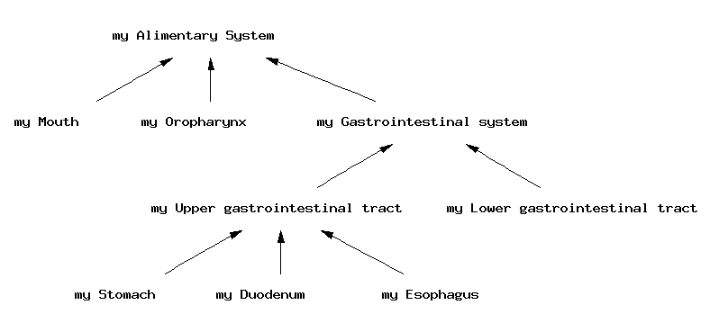
Component-of
asymmetric
transitive

Slide 8
NOT all parts of a whole are components
All components are parts of a whole
NOT all parts of a whole are components
  Fiat parts
  Left part of my car
  Etc.

Slide 9
The containment relation
Non-medical examples:
  My dollar bill is contained in my wallet
  My wallet is contained in my backpack
Medical examples
  This volume of air is contained in my lung (now)
  My lung is contained in my thorax

Slide 10
Properties of the containment relation
Asymmetry
(IF x contained-in y THEN NOT y contained-in x )
  My dollar bill is contained in my wallet but not vice versa
  his volume of air is contained in my lung (now) but not vice versa
  …

Slide 11
Examples for partial orderings: contained-in
x R y is ‘x is contained-in y’
Transitivity (If x R y AND y R z THEN x R z):
My dollar bill is contained-in my wallet
AND
my wallet is contained-in my backpack
THEREFORE
My dollar bill is contained-in my backpack

Slide 12
Containment is NOT parthood!!!
The wallet is NOT part of the backpack
The dollar bill is NOT part of the wallet
The dollar bill is NOT part of the backpack

Slide 13
Examples for partial orderings:
Proper-part-of
Asymmetric
Transitive
Component-of
Asymmetric
Transitive
Contained-in
Asymmetric
Transitive

Slide 14
Examples for partial orderings:
Proper-part-of
Asymmetric
Transitive
Component-of
Asymmetric
Transitive
Contained-in
Asymmetric
Transitive
All three relations are Partial orderings

Slide 15
The three relations are very different but cannot be distinguished in terms of partial orderings
MORE PROPERTIES NEED TO BE CONSIDERED !!!

Slide 16
Three mereological principles
‘Weak supplementation property’ (WSP)
‘Discreteness property’ (DPO)
‘No partial overlap property’ (NPO)

Slide 17
Partial ordering
relation | Partial order | WSP | NPO
Componen-of | yes
proper-part-of | yes
Contained-in | yes

Slide 18
Definition of overlap
D_{O}: O xy iff (∃z)(z ≤ x & z ≤ y)

Slide 19
Kinds of overlap
D_{O}: O xy iff (∃z)(z < x & z < y) or x = y
Partial overlap
x < y
y < x
x = y

Slide 20
Weak supplementation principle
x < y ⇒

Slide 21
Weak supplementation principle
x < y ⇒ (∃z)(z < y AND ¬O zx)

Slide 22
Weak supplementation principle for component-of
x < y ⇒
If x is a component-of y then

Slide 23
Weak supplementation principle for component-of
x < y ⇒ (∃z)
If x is a component-of y then there exists a z

Slide 24
Weak supplementation principle for component-of
x < y ⇒ (∃z)(z < y
If x is a component-of y then there exists a z such that z is a component-of y

Slide 25
Weak supplementation principle for component-of
x < y ⇒ (∃z)(z < y AND ¬O zx)
If x is a component-of y then there exists a z such that z is a component-of y and x and z do not share a common component

Slide 26
Weak supplementation principle for component-of
x < y ⇒ (∃z)(z < y AND ¬O zx)
If x is a component-of y then there exists a z such that z is a component-of y and x and z do not share a common component
There cannot be a complex with a single component

Slide 27
Weak supplementation principle for component-of
Component-of

Slide 28
Weak supplementation principle for component-of
WSP

Slide 29
Weak supplementation principle for proper-part-of
x < y ⇒ (∃z)(z < y AND ¬O zx)
If x is a proper-part-of y then there exists a z such that z is a proper-part-of y and x and z do not share a common part
There cannot be a whole with a single proper part

Slide 30
Weak supplementation principle for contained-in
x < y ⇒ (∃z)(z < y AND ¬O zx)
If x is contained-in y then there exists a z such that z is contained-in y and x and z do not share contained entities.
There cannot be a container with a single contained entity ??????
WSP does not hold for contained-in !!!!

Slide 31
The weak supplementation principle
relation | Partial order | WSP | NPO
Componen-of | yes | yes
proper-part-of | yes | yes
Contained-in | yes | no

Slide 32
No-partial-overlap principle
Partial overlap
x < y
y < x
x = y
NPO: O xy ⇒ x ≤ y OR y < x

Slide 33
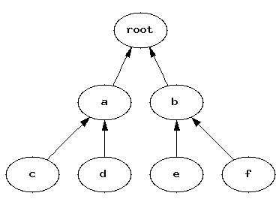
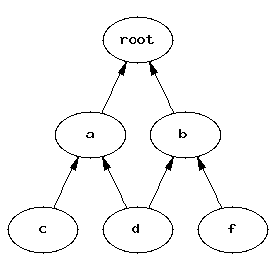
No-partial-overlap principle
NPO: O xy ⇒ x ≤ y OR y < x

Slide 34
No-partial-overlap principle for component-of
Component-of

Slide 35
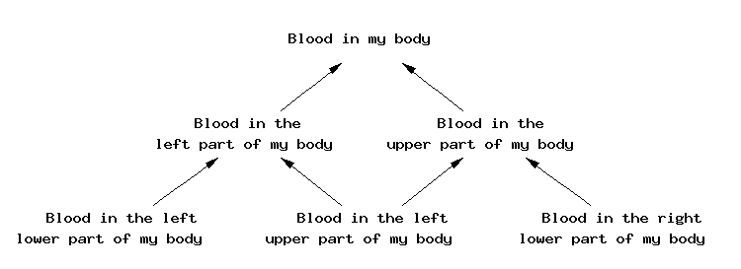
No-partial-overlap principle for mass-part-of
proper-part-of
NPO: O xy ⇒ x ≤ y OR y < x

Slide 36
No-partial-overlap principle for contained-in
Discrete Containers that share a conteniee are contained in each other
May be nested
NPO holds (in a weak form)
O xy ⇒ x ≤ y OR y < x

Slide 37
The no-partial-overlap principle
relation | Partial order | WSP | NPO
Componen-of | yes | yes | yes
proper-part-of | yes | yes | no
Contained-in | yes | no | (yes)

Slide 38
How to represent the properties of componenthood, parthood, and containment in an ontology?

Slide 39
How to express WSP and NPO in an ontology?
Formal Ontologies are logical theories
Relations are represented by symbols
  < interpreted as proper-part-of
  << interpreted as component-of
  <<< interpreted as contained-in
Properties of relations are represented by axioms

Slide 40
Properties of relations are represented by axioms
Axioms for <
  Axiom for asymmetry
  Axiom for transitivity
  Axiom for weak-supplementation property
  Axioms for no-partial-overlap property
  …

Slide 41
Properties of relations are represented by axioms
Symbol | Axioms for asymmetry, transitivity | Axiom for WSP | Axiom for NPO
< | yes
<< | yes
<<< | yes

Slide 42
Properties of relations are represented by axioms
Symbol | Axioms for asymmetry, transitivity | Axiom for WSP | Axiom for NPO
< | yes | yes
<< | yes | yes
<<< | yes | no

Slide 43
Properties of relations are represented by axioms
Symbol | Axioms for asymmetry, transitivity | Axiom for WSP | Axiom for NPO
< | yes | yes | yes
<< | yes | yes | no
<<< | yes | no | yes

Slide 44
Languages for ontologies
First order predicate logic
Very expressive
Tool for philosophers, computer scientists
Reasoning cannot be automated

Slide 45
Languages for ontologies
First order predicate logic
Very expressive
Tool for philosophers, computer scientists
Reasoning cannot be automated
Description logic
Constrained expressive power
Nice interfaces that hide the logic from the user
Automated reasoning

Slide 46
Logical representation of the
Weak supplementation principle
First order logic
x < y ⇒ (∃z)(z < y & ¬O zx)
If x is a proper-part-of y then there exists a z such that z is a proper-part-of y and x and z do not overlap
Description Logic
?????

Slide 47
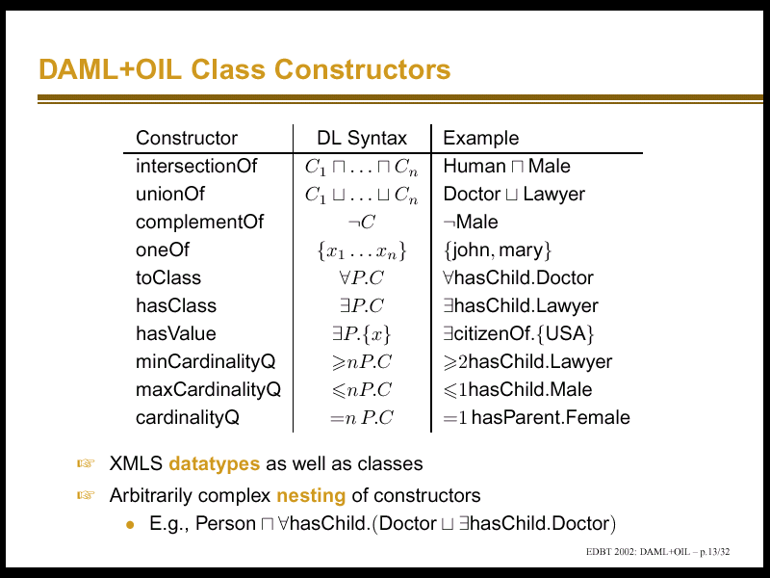

Slide 48
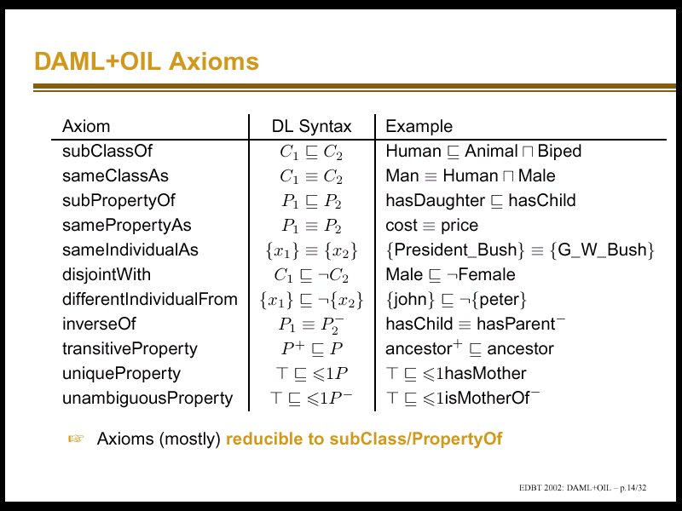

Slide 49
Role constructors
R, S, T are roles, I.e., interpreted as binary relations
Constructors:
  role union, role intersection
    Part-of ≡ proper-part-of ∪ identical-to
  role negation: problematic - blows up complexity Part-of
    ¬Overlap ≡ disjoint
  Composition: problematic – may lead to undecidability

Slide 50
Role composition
Semantics of R ° S: is the relation constructed as follows:
{ (x,y) | ∃z: R(x,z) & S(z,y) }
Examples
  hasLocation ° part-of ⊆ hasLocation
  hasLocation xz & part-of zy → hasLocation xy
  everything that is located in a part is also located in the whole

Slide 51
Logical representation of the
Weak supplementation principle
First order logic
x proper-part-of y ⇒ (∃z)(z proper-part-of y & ¬overlap zx)
DL-syntax
hasPart ⊆ hasPart ° ¬ ((hasPart ° part of) ∪ Id)
Problem: this DL is undecidable !!

Slide 52
Logical representation of the
Weak supplementation principle
First order logic
x proper-part-of y ⇒ (∃z)(z proper-part-of y & ¬overlap zx)
In FOL we can prove that
if part-of has certain properties
then WSP is equivalent to
Everything has at least two distinct immediate proper parts
DL is decidable and efficient!!

Slide 53
BUT

Slide 54
Logical representation of the
Weak supplementation principle
First order logic
x proper-part-of y ⇒ (∃z)(z proper-part-of y & ¬overlap zx)
In FOL we can prove that
if part-of has certain properties
then WSP is equivalent to
DL
Everything has at least two distinct immediate proper parts
We are not able to describe in this DL
what those properties are

Slide 55
Logical representation of the
Weak supplementation principle
First order logic
x proper-part-of y ⇒ (∃z)(z proper-part-of y & ¬overlap zx)
In FOL we can prove that
if part-of has certain properties
then WSP is equivalent to
DL
Everything has at least two distinct immediate proper parts
We cannot define immediate-proper-part-of in terms of proper-part-of

Slide 56
Logical representation of the
Weak supplementation principle
DL
Everything has at least two distinct immediate proper parts
We cannot define immediate-proper-part-of in terms of proper-part-of
We can only give some necessary conditions:
  immediate-proper-part-of is a sub-relation of proper-part-of
  In some DLs we cannot even say that immediate-proper-part-of is intransitive

Slide 57
Logical representation of the
Weak supplementation principle
First order logic
We can express WSP
We can prove that under certain assumptions there are simpler but equivalent formulations
We can express these assumptions
We cannot perform automated reasoning
Description Logic
We cannot express WSP
We can express a simplified version of WSP
We cannot express/ check if our data is consistent with our assumptions
Automated reasoning

Slide 58
Description Logic-based. simplified version of WSP
Automated reasoning
Annotate the DL-ontology
with the corresponding first
order version of the ontology
Human user of the DL-ontology
Explicit specification
the intended interpretation
of the DL-theory
Does the ontology
Apply to my domain?
Write programs that check
properties that cannot
Expressed in the DL
Check that immediate-
proper-part-of is intransitive

