Slide 1
Anatomical boundaries and immaterial objects
Stefan Schulz
Department of Medical Informatics
University Hospital Freiburg (Germany)

Slide 3

Is the fly inside or outside her body ?

Slide 4
Problem (I)
Biological objects need clearly defined boundaries to enable assertions parthood and location
Most Biological objects are sponge-like
(full of vessels, capillaries, cavities, holes
and other hollow spaces)

Slide 5
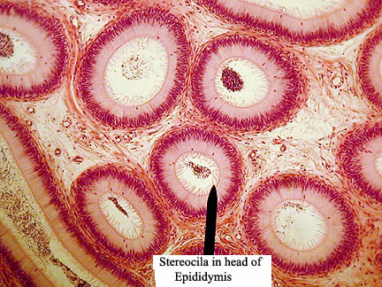
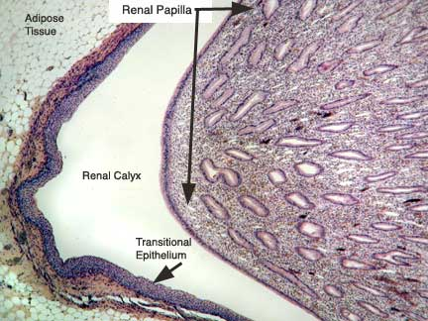
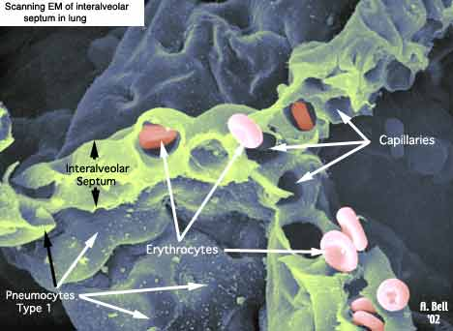
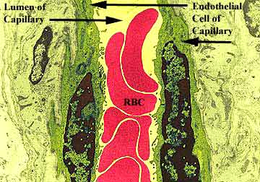
http://faculty.une.edu/com/abell/histo/histolab2.htm

Slide 6
Problem (II)
Many cavities communicate with the exterior space (e.g. respiratory system)
Common conceptualization (cf. biomedical terminologies): biological objects have immaterial parts, eg. Lumen of esophagus, alveolar lumen, many cavities and holes in bones, …

Slide 7
How to deal with hollow spaces ?
E
H
H
B
B
S
S
H is part of E, hence B is
located outside of S
H is part of S, hence B is
located inside of S

Slide 8
Topological parts
How to deal with hollow spaces ?
E
H
H
B
B
S
S
H is part of E, hence B is
located outside of S
H is part of S, hence B is
located inside of S

Slide 9
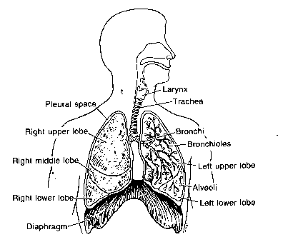
Problem
Inside or outside ?
Example: Bronchi
A foreign body
in a bronchus
is in the lung
Strict topological view
conflicts with
shared
conceptualization
B

Slide 10
Where to delimit ?

Slide 11
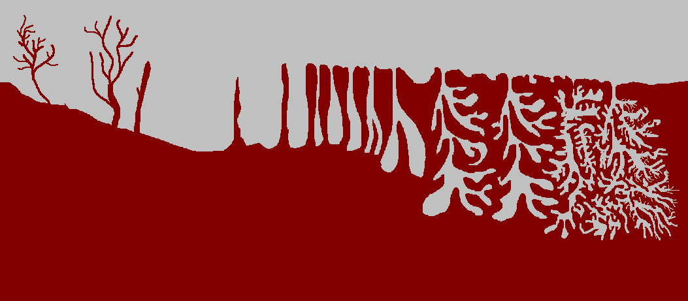
1. All hollow spaces are part of the exterior…
… but nothing can be located inside…

Slide 12
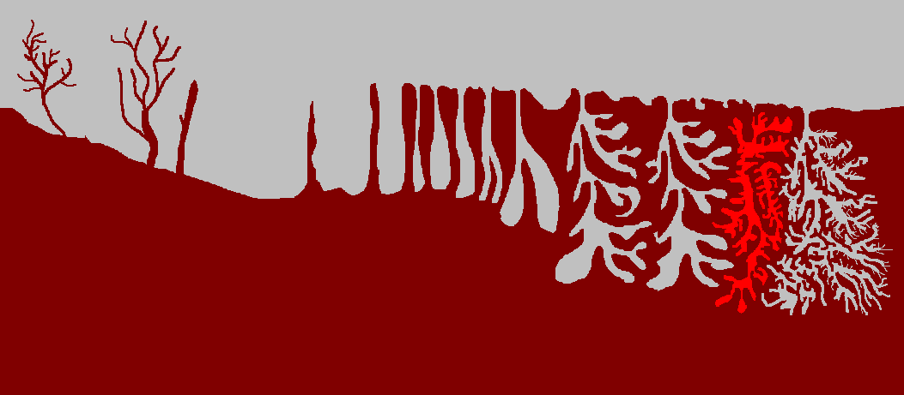
2. Those hollow spaces which communi-cate with the exterior are part of the exterior space…
… what if some spaces only temporarily communicate ?

Slide 13
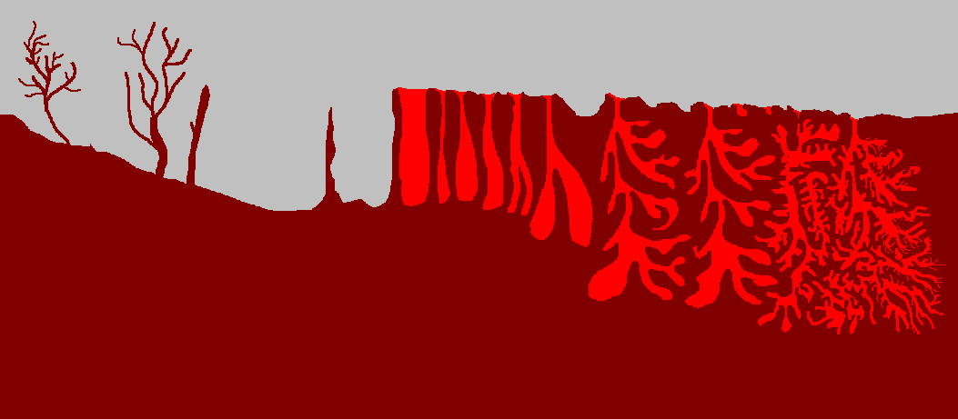
3. Only those hollow spaces which are containers something are part of the exterior space…
… how to ascertain whether they are containers ?

Slide 14
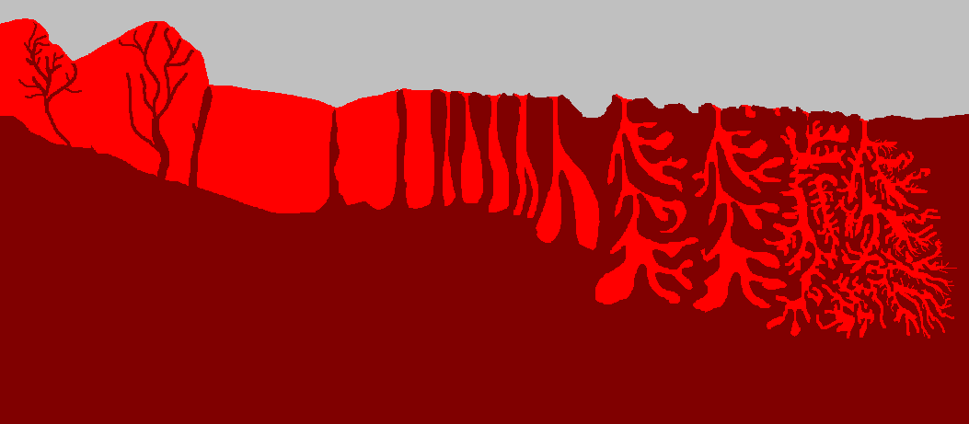
4. The complete convex hull is part of the object…
… then the body would practically spatially coincide with the vascular system !

Slide 15
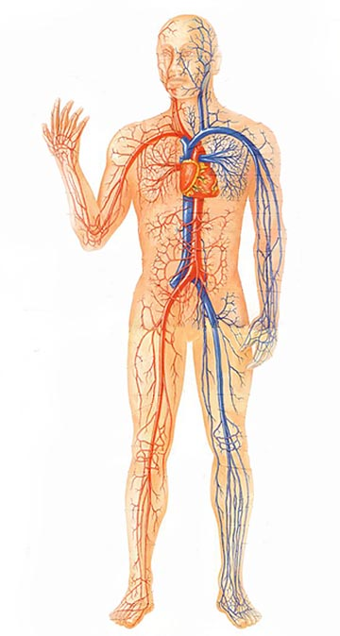

Slide 16

Anatomists draw fiat boundaries
Surface structures which have a name are considered to be inside the organ
Villus
Crypt
Gland

Slide 17
