Slide 1
Ontology in 15 Minutes
Barry Smith

Slide 2
Main obstacle to integrating genetic and EHR data
No facility for dealing with time and instances (particulars) in current ontologies

Slide 3
Why not?
Because ontologies are about word meanings
(‘concepts’, ‘conceptualizations’) cf. dictionaries

Slide 4
A is_a B =def.
‘A’ is more specific in meaning than ‘B’
meningitis is_a disease of the nervous system
unicorn is_a one-horned mammal

Slide 5
UMLS-SN: Bacterium causes Experimental model of disease
HL7: Individual Allele is_a Act of Observation
GO: Menopause part_of Death

Slide 6
Biomedical ontology integration
will never be achieved through integration of meanings or concepts
the problem is precisely that different user communities use different concepts

Slide 7
Idea: move from associative relations between meanings to strictly defined relations between the entities themselves

Slide 8
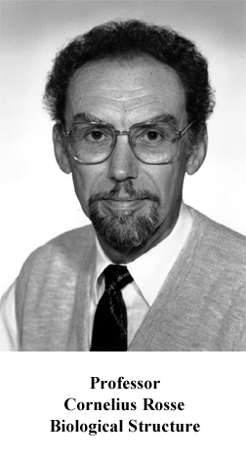
Foundational Model of Anatomy

Slide 9
The Gene Ontology
Open source
Cross-Species
Components, Processes, Functions
No logical structure
Highly error-prone
But:
NOT trans-granular
No relation time or instances

Slide 10
New GO / OBO Reform Effort
OBO = Open Biomedical Ontologies

Slide 11
New OBO Relation Ontology
suite of relations for biomedical ontology
Consistency with the Relation Ontology now criterion for admission to OBO ontology library
Under review by Genome Biology

Slide 12
The concept approach can’t cope at all with relations like
part_of = def. composes, with one or more other physical units, some larger whole
contains =def. is the receptacle for fluids or other substances

Slide 13
Key idea
To define ontological relations like
part_of, develops_from
it is not enough to look just at classes / types:
we need also to take account of instances and time
(= link to Electronic Health Record)

Slide 14
Kinds of relations
<class, class>: is_a, part_of, ...
<instance, class>: this explosion instance_of the class explosion
<instance, instance>: Mary’s heart part_of Mary

Slide 15
part_of
for component classes is time-indexed
A part_of B =def.
given any particular a and any time t,
if a is an instance of A at t,
then there is some instance b of B
such that
a is an instance-level part_of b at t

Slide 16
derives_from
(ovum, sperm → zygote ... )
C
c at t
C₁
c₁ at t₁
time
C'
c' at t
instances

Slide 17
transformation_of
same instance
C
c at t
C₁
c at t₁
time
pre-RNA → mature RNA
child → adult

Slide 18
transformation_of
C₂ transformation_of C₁ =def. any instance of C₂ was at some earlier time an instance of C₁

Slide 19
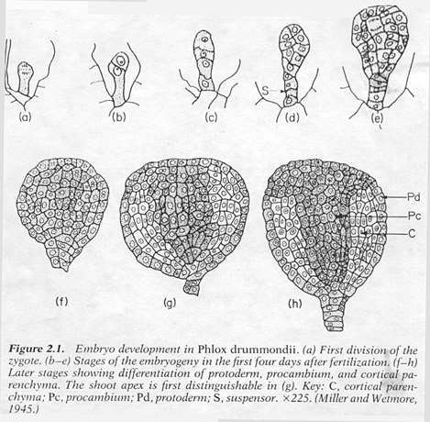
C
c at t
C₁
c at t₁
embryological development

Slide 20
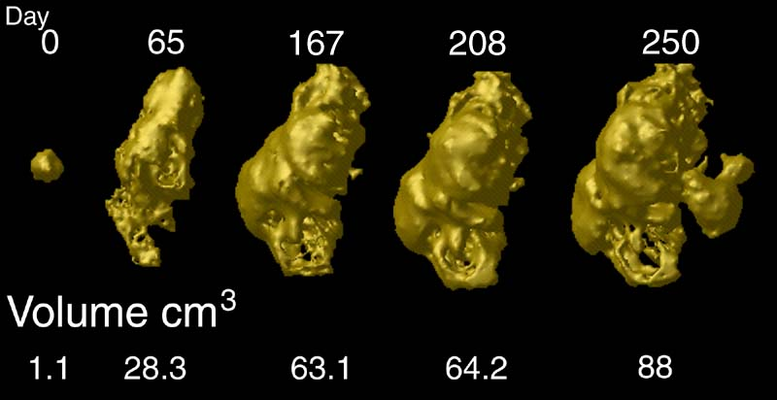
tumor development
C
c at t
C₁
c at t₁
Notes:
http://www.loni.ucla.edu/~thompson/HBM2000/tumor_volumes.jpg

Slide 21
The Granularity Gulf
most existing data-sources are of fixed, single granularity
many (all?) clinical phenomena cross granularities

Slide 22
transformation_of
C
c at t
C₁
c at t₁

Slide 23
Not only relations
we applied the same methodology to other top-level categories in ontology, e.g.
process
function
boundary
act, observation
tissue, membrane, sequence

Slide 24
Advantages of the methodology of enforcing commonly accepted coherent definitions
promote quality assurance (better coding)
guarantee automatic reasoning across ontologies and across data at different granularities
yields direct connection to times and instances in EHR

