Slide 1
Start

Slide 2
Acting as commentator for Olivier Bodenreider
Acting as commentator
and supporter
for Olivier Bodenreider
Robert Baud
Hôpitaux Universitaires de Genève
IMIA WG6 conference, Rome, April 2005

Slide 3





Ontology and Biomedical Informatics
Rome, Italy – May 1, 2005
Lexical and Statistical Approaches
to Acquiring Ontological Relations
Formal Methods for Casual Ontology?
Olivier Bodenreider
Lister Hill National Center
for Biomedical Communications
Bethesda, Maryland - USA

Slide 4

What is the meaning of casual?
Informal ?
Random, unexpected ?
Superficial ?
Does it means that a casual ontology is:
  not a totally well-formed ontology,
  acting as an initial draft,
  not following the usual constraints!
When enforcing the conditions for building formal ontologies, one immediately prepares a slot on the side in order to escape the rules!
Is casual ontology to be opposed to formal ontology?
Cf the discussion of this morning on reference ontology compared to application ontology.

Slide 5
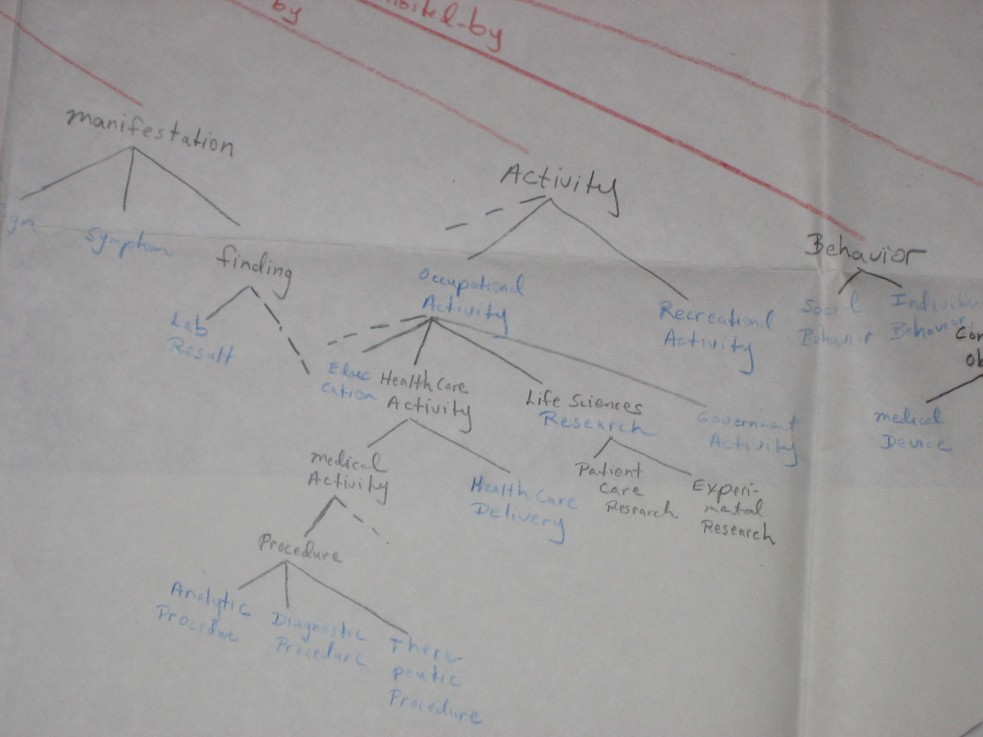
A casual Semantic Net

Slide 6
Ontology building in the Semantic net
Event
Activity
Human activity
Machine activity
Recreational activity
Ontology building activity

Slide 7
Adequate methods for seeking goals
Well defined knowledge
Automatic extraction
Heuristic approach
Fuzzy knowledge

Slide 8

Combining formal and casual
Formal ontology
  Provides a framework for building sound ontology
  Too labor-intensive for building large ontologies
  Can benefit from loosely defined ontologies
Casual ontology
  Usually unsuitable for reasoning
  Tools for automatic acquisition available
  Can benefit from formal ontology
    Organization
    Validation

Slide 9
Terminology is not ontology
We have a « long tradition of terminology building » but we lack a real culture of ontology building
Current developments on automatic knowledge extraction is mainly outside of the biomedical domain
Their authors are mainly linguists, they are terminology oriented, they are not originally ontology oriented
Terminology is language dependent
Ontology is domain dependent and language independent
An ontology acts as a structuring entity behind a terminology

Slide 10
Proposal, we should:
… avoid the term casual ontology as a kind of second-hand ontology
… recognize the mutual benefits of simultaneous developments of heuristic and automatic approaches
… clearly make the distinction between terminology and ontology, not everybody being expert in both domains
… better define the vocabulary about ontology
… educate the future authors of ontology in the medical domain
… enforce the rules for building formal ontology using both heuristic and automatic tools

Slide 11
Many thanks to Olivier

