Slide 1
FMA: a domain reference ontology
Comments on Cornelius Rosse’s talk
Anita Burgun
WG6 meeting, Rome 29 Apr- 2 May 2005

Slide 2
FMA is a reference ontology
‘Domain reference ontologies: FMA
  declare a theory about a particular domain of reality
  make use of methods of top-level ontologies
  general purpose resources
  generalize to other domains
  anatomy generalizes to physiology, surgery’
What is expected?
  Multiple domain terminologies: serve as a core ontology for terminology alignment
  Domain complexity: provide basic knowledge for reasoning about complex entities
  Applications: helpful for various purposes involving individual data

Slide 3
Terminology alignment
Role of reference ontologies

Slide 4
Reference ontology
M
A
P
P
I
N
G
terminology
-
ontology
T1
T2
mapping
terminology-terminology
T3

Slide 5
Alignment
Alignment of multiple ontologies: deriving indirect mappings from direct mappings to a reference. S Zhang, O Bodenreider (submitted AMIA)
  Cost-effective: n-1 mappings vs n(n-1)/2 pairwise mappings
  Adult Mouse Anatomical Dictionary- NCI Thesaurus: 91% direct matches found by the indirect alignment
Alignment : what can be named
  Network of cardiac myocytes
  This sulcus
  The nerve between the two layers of a ligament

Slide 6
Reasoning about complex entities
Role of reference ontologies

Slide 7
Anatomical entities and diseases:
‘a disease located in A or child-of A is a disease-of-A’
Inheritance via PART-OF: a disease of x, which is part-of z, is-a disease of z
    Ceusters W, Smith B, Flanagan J. Ontology and medical terminology: why description logics are not enough. TEPR 2003, Conf. Towards an Electronic Patient Record, San Antonio, 10-14 May 2003
    Hahn U, Schulz S, Romacker M. Part-whole reasoning: a case-study in medical ontology engineering. IEEE Intelligent Systems & their applications, 1999, 14(5), 59-67
    Rector AL. Analysis of propagation along transitive roles: Formalisation of the GALEN experience with Medical Ontologies, Workshop DL2002, Toulouse, April 19-21, 2002

Slide 8
Anatomical entities and diseases:
‘a disease located in A or child-of A is a disease-of-A’
Burgun A, Bodenreider O, Mougin F Classifying diseases wrt anatomy (submitted AMIA 2005)

Slide 9
Knowledge for applications
Role of reference ontologies

Slide 10
Knowledge for applications
Reasoning requires explicit knowledge: ‘declare a theory about a particular domain of reality’
and formal representation

Slide 11
Ontology of
Biomedical Reality (OBR)
Biological entity
Biological continuant
Biological occurrent
is-a
Extra-organismal
biological continuant
Organismal
continuant
Extra-organismal
biological occurrent
Organismal
occurrent
Independent
organismal
continuant
Dependent
organismal
continuant
Physiological
process
Pathological
process
Secreting
Secreting insulin
Transcribing RNA
Mutating
Metastasizing
Necrosing
Material
anatomical
entity
Material
pathological
entity
Immaterial
anatomical
continuant
Physiological
continuant
Immaterial
pathological
continuant
Anatomical structure
Canonical
anatomical structure
Variant
anatomical structure
Portion of canonical
body substance
Portion of blood
Portion of cytosol
Pathological structure
Neoplasm
Inflammatory structure
Degenerated structure
Portion of pathological
body substance
Portion of pus
Portion of amyloid
Anatomical space
Cavity of lysosome
Anatomical surface
E-face of plasma
membrane
Anatomical line
Anatomical point
Function
Secrete
Flex; Extend
Physiological state
Systole
Physiological role
Antagonist
Pathological space
Cavity of abscess
Pathological surface
Boundary of tumor
Malfunction
Atrial fibrillation
Pathological state
Malnutrition
Pathological role

Slide 12
Reasoning in applications (1)
‘Reasoning and managing data about individuals’
  Requires good coverage in terms of variants
  Clear distinction between canonical/variant/ pathological
    Variant in muscle insertion may cause compression of blood vessel leading to thrombosis
‘Make use of top-level ontologies’
  Inherit fundamental features
    Cardiac cycling is a kind of process
    Processes are occurrents
  Inherit some general properties
    Cyc ‘blood vessel is a kind of path’
    FMA ‘cardiac cycling is a kind of cyclic process’

Slide 13
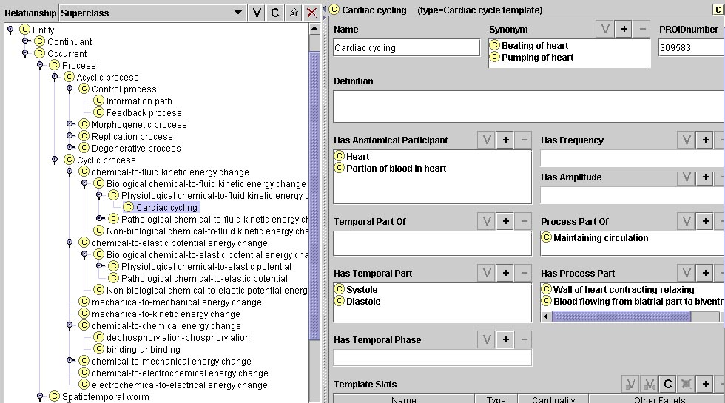
Protégé
Notes:
Cardiac cycle is a physiological chemical to fluid kinetic energy change which has its direct anatomical participants the heart and the portion of blood in the heart

Slide 14
Reasoning in applications (2)
Ontologies
  [wall of heart contracting-relaxing] is part of [cardiac cycling]
  [cardiac cycling] is part of [maintaining circulation]
  [diastole] is temporal part of [cardiac cycling]
Rules + ontologies
  If dysfunction of [wall of heart contracting-relaxing] then dysfunction of [cardiac cycling]
  If dysfunction of [cardiac cycling] then dysfunction of [maintaining circulation]
  [maintaining circulation] works well iff …
  If [diastole] lasts longer then [cardiac cycling] lasts longer

Slide 15
Reference ontologies

Slide 16
Reference ontologies
Ontology
  Formal ontologies
  Reasoning:
    General properties (patterns, e.g. path)
    Rules
Modular
  Basic entities that can be used to represent more complex ones
  “deals with the organization of reality” (B Smith)
  Anatomical structures, Chemical entities
  55% of the 17,250 Gene Ontology terms include in their names the name of some ChEBI entity

Slide 17
Use of ChEBI
Mol. function
Biol. Process
ChEBI
cation
potassium ion
transport
Potassium ion
Cation
channel
activity
mapping

Slide 18
Use of ChEBI
Mol. function
Biol. Process
ChEBI
cation
potassium ion
transport
Cation
channel
activity
Potassium ion
New relation

Slide 19
Reference ontologies (2)
Reference
  Compatible with different views of the domain
  “deals with the nature and organization of reality” B. Smith
  Limited (« body systems are conceptual entities » A. McCray)
    Is the mouth part of the digestive system?
Ability to represent individual data
  Not limited in depth
  Not limited to canonical : “deals with the nature of reality”
  Acquired from data?

