Slide 1


Comments on A.T. McCray,
“Conceptualizing the World:
Lessons from History”
Ingvar Johansson,
Institute for Formal Ontology and Medical Information Science,
Saarbrücken
The sixth IMIA Conference,
Ontology and Biomedical Informatics,
Rome 29 April – 2 May 2005

Slide 2
Thesis
It is necessarily the case that every conceptualization is biased
  This is because representing, or categorizing, the world depends on two crucial factors
    Purpose for which the conceptualization is created
    World view of the designer
      Depends on the state of general knowledge at the time and personal knowledge of designer

Slide 3
Bias
Bias is not necessarily bad, but it
  Needs to be recognized
  Needs to be made explicit

Slide 4
McCray and Me and
Gunnar Myrdal Karl Popper
Thesis: It is necessarily the case that every conceptualization
is biased.
Proposal: Recognize bias, and make it explicit.
Thesis: It is probably the case that every conceptualization contains some mismatch.
Proposal: Seek truth, but expect to find truthlikeness.
Notes:
Myrdal (1898-1987), nobelpris med Friedrich von Hayek 1974. The book “Value in Social Theory“ (1958).

Slide 5
Oddities of the
McCray-Myrdal Position
How does one know that it is the true bias that one makes explicit?
Would it have helped Einstein to know that Newton was religiously biased?
Was Newton biased?
The McCray-Myrdal thesis is self-referential and, therefore, biased. We have a biased thesis claiming that all conceptualizations are biased. Why bother?

Slide 6
Useful Fictions
Since ultimate truth is not attainable, we should proceed “as if” the constructs we are creating are true, only in this way will science advance
“It must be remembered that the object of the world of ideas as a whole is not the portrayal of reality – this would be an utterly impossible task – but rather to provide us with an instrument for finding our way about more easily in the world.”
Vaihinger, 1924

Slide 7
McCray and Me and
Hans Vaihinger Karl Popper
Thesis: Ultimate truth is not attainable.
Proposal: Regard your theories as referring to fictions; don’t care about truth and falsity.
Thesis: Probably, ultimate truth is not attainable.
Proposal: Regard your empirical theories as referring to the world; try to find out if they are false.

Slide 8
Two Neglected but
True Views
EITHER (an empiricial assertion is:
absolutely true,
truthlike, or
absolutely false)
OR (the assertion is about fictions).
Outside the philosophical seminar room, even as-if-philosophers have to make real assertions about the world.

Slide 9
Fictions may be useful, but:
Statements using so-called “useful fictions” may be statements that have a considerable degree of truthlikeness. (Prime example: the laws of classical mechanics.)
Absolute fictions that do not have a connection to terms with real reference are absolutely useless.

Slide 10
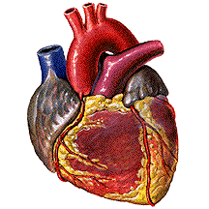
There are hearts
Notes:
I think there are mountains in a mind-independent nature.

Slide 11
Complications for Naïve Realism
When, by means of a term (e.g., ‘heart’), we are referring to something in the world, then this term may:
(i) select an aspect (e.g., medical),
(ii) select a granularity level (e.g., mesoscopic),
(iii) create boundaries (ends of the heart),
without thereby
(iv) create this aspect, the granularity level,
and what is bounded (the heart).
Notes:
The concept of “mountain” selects a geographical aspect of the world, it focuses at a certain granularity level, and it is connected with a vague conventionally drawn boundary line that tells us where mountains end. Nonetheless, it is preposterous to say that the concept “mountain” creates the mountains.

Slide 12
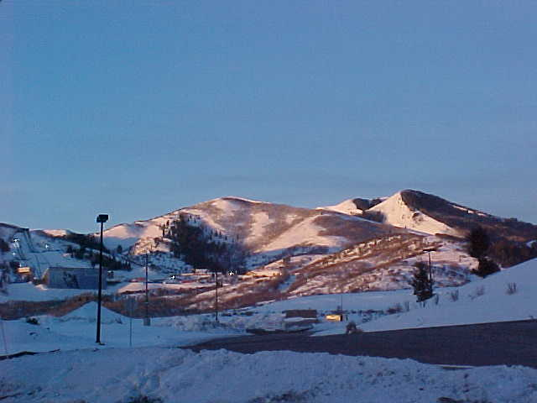
There are mountains
Notes:
But: Does there exist anything that exists independently of language?
I think there are mountains in a mind-independent nature.

Slide 13
Complications for Naïve Realism
When, by means of a term (e.g., ‘mountain’), we are referring to something in the world, then this term may:
(i) select an aspect (e.g., geographical),
(ii) select a granularity level (e.g., mesoscopic),
(iii) create boundaries (ends of the mountains),
without thereby
(iv) create this aspect, the granularity level,
and what is bounded (the mountain).
Notes:
The concept of “mountain” selects a geographical aspect of the world, it focuses at a certain granularity level, and it is connected with a vague conventionally drawn boundary line that tells us where mountains end. Nonetheless, it is preposterous to say that the concept “mountain” creates the mountains.

Slide 14


Things, Fictions, and Concepts
There is a distinction between use and mention of terms (and concepts).
The term “cat” can be used to
refer to real cats.
The term “cat” can be used to
refer to fictional cats.
The term “cat” can be mentioned as in:
“Katze” means the same as “cat”.

Slide 15
WordNet 2.0 Search: “cat”
The noun "cat" has 8 senses in WordNet.
1. cat, true cat -- (feline mammal usually having thick soft fur and being unable to roar; domestic cats; wildcats)
2. guy, cat, hombre, bozo -- (an informal term for a youth or man; "a nice guy"; "the guy's only doing it for some doll")
3. cat -- (a spiteful woman gossip; "what a cat she is!")
4. kat, khat, qat, quat, cat, Arabian tea, African tea -- (the leaves of the shrub Catha edulis which are chewed like tobacco or used to make tea; has the effect of a euphoric stimulant; "in Yemen kat is used daily by 85% of adults")
5. cat-o'-nine-tails, cat -- (a whip with nine knotted cords; "British sailors feared the cat")

Slide 16

Looking through & Looking at
We can both look at and look through lenses and telescopes.
Lenses and telescopes do not by themselves see.
Notes:
A new start; a new everyday distinction. We are looking AT a telescope, but the man in the picture is looking THROUGH it.

Slide 17

use & mention:
Looking through & Looking at
We can both look at and “look through” statements (concepts) and sentences (terms).
Statements and sentences do not by themselves refer or describe something spatiotemporally specific.
Notes:
The reader is reading ABOUT something that is distinct from the book. We, however, are looking at the book.
Of course, this distinction is related to the well-known one between the extension and the intension of a concept. When we look at a concept, we will see its intension; when look through it we will see something that belongs to the extension.
My point has been (they make changes very often) that the Gene Ontology needs to keep them more distinct.

Slide 18

Concepts are like lenses
cat
Katze
katt
Notes:
Concepts are like lenses both in representational and fictional intentionality!

Slide 19
Some views of mine
The default position for every ontology creator should be the realist position.
Conceptualizations are tools by means of which, for instance, we can classify universals and particulars that exists independently of these conceptualizations.
Nonetheless, concepts can in themselves have relations of subsumption and similarity.
Notes:
Of course, ontology constructors have to switch between looking through and looking at.
Non-default positions are ontologies about words and fictions.
Linguists may of course take it the other way round.

