Slide 1
International Standard Bad Philosophy
Barry Smith

Slide 2
New Desiderata for Biological Terminologies
Barry Smith

Slide 3
Concept Disorientation and the Life Beyond
Barry Smith

Slide 4
Cimino’s “Desiderata” of 1998
Concepts – not words – should be the units of symbolic processing in the construction of terminologies
But what are concepts?

Slide 5
Examples
Protons are concepts
Amino acid sequences are concepts
Menopause is a concept
Pneumonia is a concept
Death is a concept
Siena is a concept
The Food and Drug Administration is a concept

Slide 6
Cimino: a concept is a linguistic entity
It is ‘an embodiment of a particular meaning’
The preferred terms in a terminology
must correspond to at least one meaning (‘non-vagueness’)
must correspond to no more than one meaning (‘non-ambiguity’)
these meanings must themselves correspond to no more than one term (‘non-redundancy’).

Slide 7
Terms in a terminology should be aligned to concepts

Slide 8
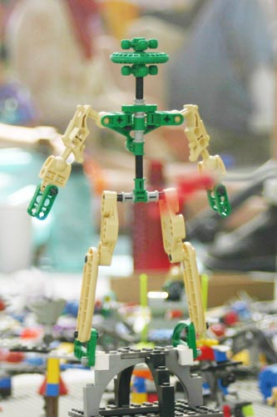
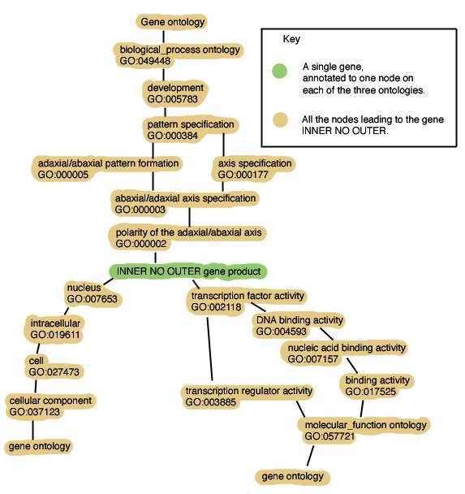
Notes:
images.burningman.com/ index.cgi?image=20466

Slide 9
Concepts stand in meaning relations
A narrower_in_meaning_than B
But they also stand in ontological relations:
A caused_by B
A site_of B
A treated_with B

Slide 10

The concept diabetes mellitus becomes ‘associated with a diabetic patient’
concept patient concept diabetes
what it is on the
side of the patient
?
?

Slide 11
The concept diabetes mellitus becomes ‘associated with a diabetic patient’
concept patient concept diabetes
what it is on the
side of the patient
?
?
what is the relation here?
not a relation between concepts

Slide 12
Nothing ethereal here
what it is on the
side of the patient
+

Slide 13
Concepts are Triply Ethereal
They represent
software proxies for entities in reality
(some ghostly diabetes counterpart is needed – because “you can’t get the diabetes itself inside the computer”)
2. the ‘knowledge’ (ideas and beliefs) in the minds of human experts
3. the meanings of the terms such experts use

Slide 14
Who dun’ it?

Slide 15
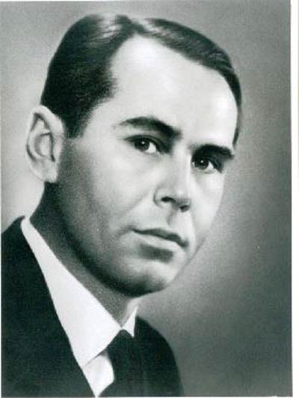
Eugen
Wüster
1935
Professor of
Woodworking
Machinery
in the Vienna
Agricultural
College

Slide 16
Eugen
Wüster
Terminology-
hobbyist
and
founder
of ISO
TC 37

Slide 17
International Standard Bad Philosophy
Eugen Wüster’s psychological view of concepts
concepts are inside people’s brains
→ ISO terminology standards

Slide 18
Wüster
a concept is a mental surrogate of a plurality of objects grouped together on the basis of perceived similarities
but what makes those objects similar is itself a concept
(Turtles all the way down)

Slide 19
Wüster / ISO on ‘objects’
object = def. anything to which human thought is or can be directed
... whether material or immaterial, real or purely imagined
ISO: In the course of producing a terminology, philosophical discussions on whether an object actually exists in reality … are to be avoided.

Slide 20
Existing approaches are top-down
FIRST concepts (meanings, words, terms)
THEN (if you’re lucky) real-world phenomena
Reasons:
Wüsterianism and the ISO terminology standards
needs of programmers (and of third-party payers)
hold-overs from the era of electronic dictionaries

Slide 21
Better: a bottom-up approach
begin with what confronts the physician at the point of care (or in the lab):
instances in reality (patients, disorders, pains, fractures, ...)
= the what it is on the side of the patient
and build up to terminologies from there

Slide 22
What happens when a new disorder first begins to make itself manifest?
physicians delineate a certain family of cases manifesting a new pattern of symptoms
... hypothesis: they are instances of a single universal or kind
(this universal still hardly understood)
but already: need for a new term

Slide 23
Agreement to use
(1) this term for
(2) these instances of
(3) this (not yet understood) kind
But then along comes
(4) a new concept, together with
(if you’re lucky)
(5) a definition

Slide 24
ISO: Terminologists should still postulate ‘concepts’ even when they have no idea of what the terms in question mean
In the domain of woodworking equipment we can see the similarities between groups of objects to which general terms are assigned.
Not so in medicine (consider: a carcinoma, or an embryo, in the successive phases of its development)

Slide 25
∴ many definitions in medicine remain at the level of instance-based specifications
Why so few definitions in SNOMED-CT? Because in the real world of real instances and of real clinical ignorance, it is often hard to reach agreement on definitions

Slide 26
‘SARS’
not: severe acute respiratory syndrome
but: this particular severe acute respiratory syndrome, instances of which were first identified in Guangdong in 2002 and caused by instances of this particular coronavirus whose genome was first sequenced in Canada in 2003

Slide 27
Users can point to instances in the lab or clinic – but not yet to universals
The terminologist plugs the gap by postulating concepts instead

Slide 28
Users can point to instances in the lab or clinic – but not yet to universals
The terminologist plugs the gap by postulating concepts instead

Slide 29
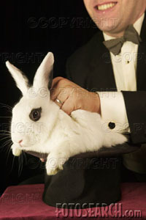
It’s sometimes hard to grasp the universals in reality to which our general terms refer.
So, let’s guarantee that every general term ‘w’ has a precisely tailored referent:
‘the concept w’
We can then forget the messy job of coming to grips with reality, and substitute instead the more pleasant job of grasping the conceptual entities we ourselves have created

Slide 31
Better: terminology building should start from the instances that we apprehend in the lab or clinic
Assertions in scientific texts pertain to universals in reality
Assertions in the EHR pertain to instances of these universals

Slide 32
Universals are those invariants in reality
which make possible the use of general terms in scientific inquiry and the use of standardized therapies in clinical care
Alexa: all scientific inquiry is biased
(all microscopes are built using distorting lenses)

Slide 33
Universals have instances
SNOMED CT comprehends universals in the realms of disorders, symptoms, anatomical structures, ...
In each case we have corresponding instances
= the what it is on the side of the patient
but poorly recorded in EHRs so far

Slide 34
The Great Task of Terminology Building in an Age of Evidence-Based Medicine
Terminology work should start with instances in reality, and seek to build up from there to align our terms with the corresponding universals
We can then abandon the detour through concepts altogether

Slide 35
Terminologies should be aligned with universals in reality
makes sense of (most of) Cimino’s desiderata:
each preferred term must correspond to at least one universal
each term must correspond to no more than one universal
each universal must itself correspond to no more than one term

Slide 36
Terminology work should start with instances in reality
How make instances visible to reasoning systems?
Create an EHR regime in which explicit alphanumerical IUIs (instance unique identifiers) are automatically assigned to each instance when it first becomes relevant to the treatment of a given patient

Slide 37
Define a node of a terminology:
<p, S_{p}, d>
with p a preferred term (string)
S_{p} a set of synonyms
d an (optional) definition
Define a terminology:
T = <N, L, v>
with N a set of nodes
L a set of links (graph-theoretical edges)
v a version number

Slide 38
The ideal: one-to-one correspond between nodes and universals in reality
Problem: bad terms (‘phlogiston’, ‘diabetes’)
At any given stage we will have:
N = N1 ∪ N> ∪ N<
where
N1 = terms which correspond to exactly one universal
N> = terms which correspond to more than one universal
N< = terms which correspond to less than one universal

Slide 39
The belief in scientific progress
with the passage of time, N> and N< will become ever smaller, so that N1 will approximate ever more closely to N *
Assumption: the vast bulk of the beliefs expressed / presupposed in biomedical texts are true. Hence N1 already constitutes a very large portion of N (the collection of terms already in general use).
*modulo the fact that the totality of universals will itself change with the passage of time

Slide 40
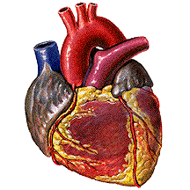
There are hearts
Notes:
I think there are mountains in a mind-independent nature.

Slide 41
But science is an asymptotic process
At all stages prior to the longed-for ideal end to our labors, we will not know where the boundaries between N1, N<, and N> are precisely to be drawn
N represents, our (putative) consensus knowledge of the universals at any given stage – not N1
The whole of N is, as far as the developers and users of a given terminology are concerned, such as to consist of names of universals

Slide 42
Against ‘knowledge representation’
more properly called
‘true-or-false belief representation’.
The terms in N< and N> reflect precisely the absence of knowledge
Not
‘KNOWLEDGE-BASED SYSTEMS’
but
‘true-or-false-belief-based systems’

Slide 43
We do not know how the terms are presently distributed between N1, N< and N>,
So: is the distinction of purely theoretical interest – a matter of abstract (philosophical) housekeeping
of no concrete significance for the day-to-day Alan-Rector-style work of terminology development and application?

Slide 44
We typically have at our disposal a whole developing series of versions of a terminology
New idea: we can create locally our own alternative developing series in order to test out alternative hypotheses regarding how to classify given particulars as instances of given types of disorders or symptoms

Slide 45
We can perform experiments with terminologies
Our referent-tracking machinery will give us the facility to experiment with different scenarios as concerns the division between N1, N<, and N>
better terminologies
better decision-support for diagnosis

Slide 46
How medical terms are introduced
we have a pool of cases (instances) manifesting a certain hitherto undocumented pattern of irregularities (deviations from the norm)
the universal kind which they instantiate is unknown – and the challenge is to solve for this unknown
(cf. the discovery of Pluto)

Slide 47
Instance vector
an ordered triple
<i, p, t>
i is a IUI, p a preferred term, and t a time
instance #5001 is associated with
SNOMED-CT code glomus tumor
at 4/28/2005 11:57:41 AM
(Coordinates in the vector can include also medically salient attributes such as temperature)

Slide 48
Instantiation of a terminology
Let D be a set of IUIs
Define an instantiation of a terminology T = <N,L,v>
I_{t}(T, D)
as the set of all instance vectors <i, p, t> for i in D and p in N
For each term p, define its t-extension
I_{t}(T, D)(p)
as the set of all IUIs i for for which <i, p, t> is included in I_{t}(T, D)

Slide 49
Tracking invariants
For each p we subject its t-extensions for varying t and D to statistical pattern-analysis and factor analysis in order to determine whether
1. p is in N1(it designates a single universal): the instances in I_{t}(T, D)(p) manifest a common invariant pattern
2. p is in N> (p comprehends a plurality of universals e.g. in a manner analogous to the term ‘diabetes’) – I_{t}(T, D)(p) is a sum of invariants
3. p is in N< (p comprehends no universals)
– I_{t}(T, D)(p) reflects no invariants at all

Slide 50
We can track patterns for I_{t}(T, D)(p)
e.g. in relation to the IUIs for patients in given geographical areas, or at given stages of development and growth
In relation to a given patient, we can track patterns e.g. for different diagnoses, e.g.
I_{t}(T, D)(p) vs. I_{t}(T, D)(q ∪ r)
to see which gives a better match

Slide 51
Diagnostic decision-support
Consider the characteristic patterns of correction which arise in the early phases of diagnosis of degenerative diseases such as multiple sclerosis.
Software should harbor alternative term-assignments for given collections of instance data ordered by greater and lesser likelihood

Slide 52
The physician should then be able to tune a terminology in relation to given signals in the form of instance data

Slide 53

The End
http://ifomis.org

