Slide 1

The Temptation of Technology
Robert Stevens
BioHealth Informatics Group
University of Manchester
Robert.stevens@manchester.ac.uk

Slide 2
Semantic Webs for Life Sciences
Pacific Symposium on
Biocomputing 2006 http://psb.stanford.edu/
The creation and use of Semantic Web appliccations

Slide 3
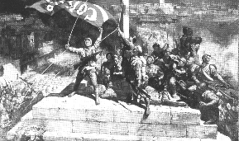
Give me convenience, or give me death

Slide 4
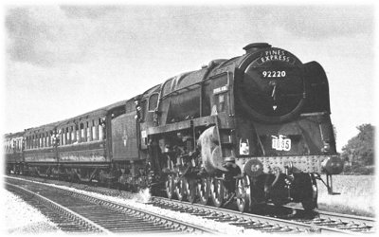
Making the Trains
Run on Time

Slide 5
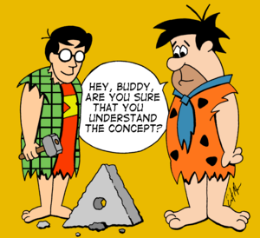
Reinventing the wheel

Slide 6
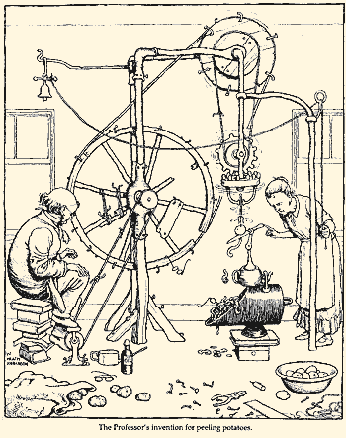
Heath Robinson

Slide 7
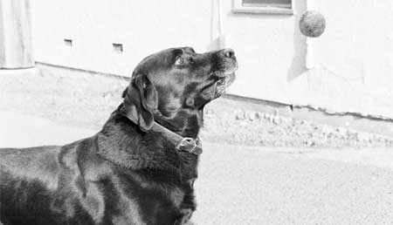
Learning New Tricks

Slide 8

Purity

Slide 9
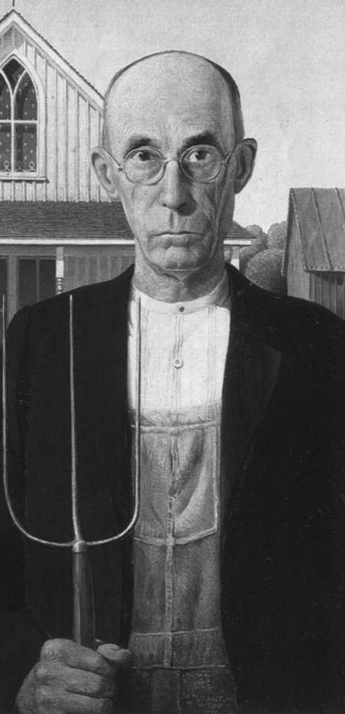
The Puritan Approach

Slide 10
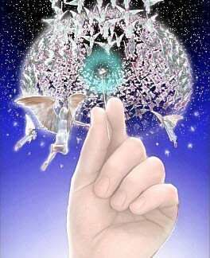
Angels on the head of a pin

Slide 11

Holy Grail

Slide 12
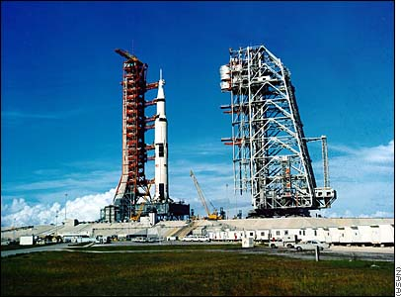
A ‘Grand Challenge’

Slide 13
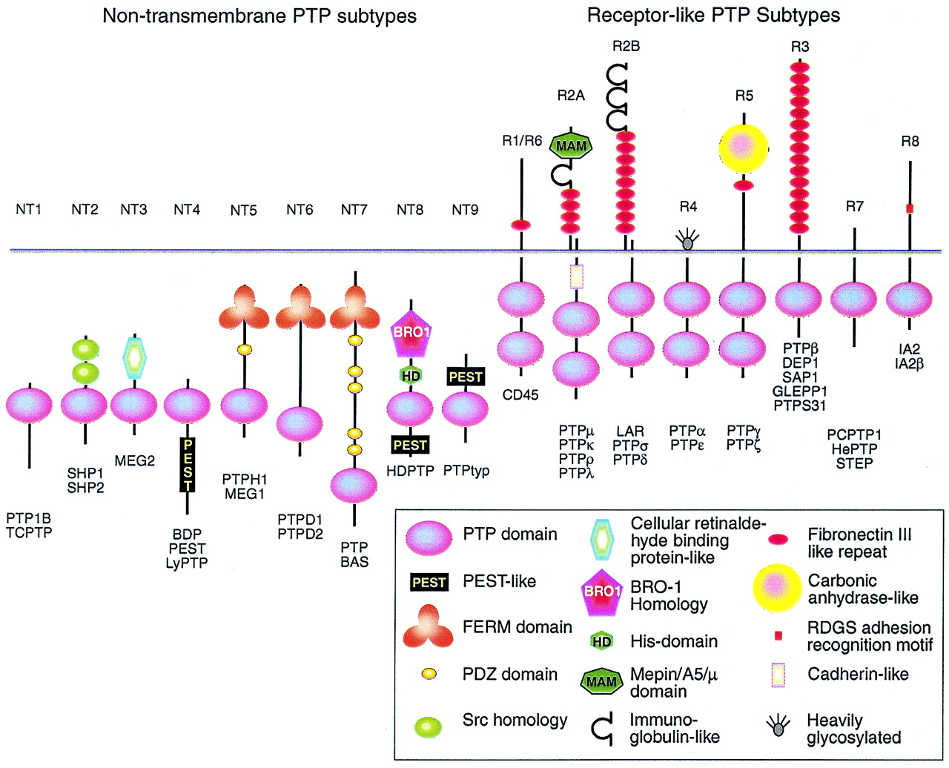
Classifying Proteins
>uniprot|Q15262|PTPK_HUMAN Receptor-type protein-tyrosine phosphatase kappa precursor (EC 3.1.3.48) (R-PTP-kappa).
MDTTAAAALPAFVALLLLSPWPLLGSAQGQFSAGGCTFDDGPGACDYHQDLYDDFEWVHV
SAQEPHYLPPEMPQGSYMIVDSSDHDPGEKARLQLPTMKENDTHCIDFSYLLYSQKGLNP
GTLNILVRVNKGPLANPIWNVTGFTGRDWLRAELAVSSFWPNEYQVIFEAEVSGGRSGYI
AIDDIQVLSYPCDKSPHFLRLGDVEVNAGQNATFQCIATGRDAVHNKLWLQRRNGEDIPV………..
InterPro
Codify
Translate
Instance Store
Reasoner
Notes:
All of which helps build better ontologies. But can we actually apply this computational amenability more
Directly to biological knowledge. In this example, which is work by Katy Wolstencroft, we have codified
Community knowledge about protein domains in phosphatases in OWL. We then take unknown protein sequences,
Pass then through interpro and stick them into the instance store, which is basically a database and reasoner tied together
Qualified Cardiniality!!!

Slide 14

Continuous Revolution

Slide 15
KISS & Tell
Keep it simple, stupid
Keep it simple and stupid
Keep it stupid
Keep it sufficiently sophisticated
Lie about the features

