Slide 1
Standards and Ontology
Barry Smith
http://ontology.buffalo.edu/smith

Slide 2
BS
Institute for Formal Ontology and Medical Information Science
Saarland University
http://ifomis.org

Slide 3
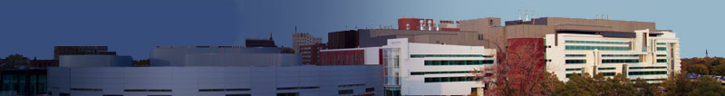
BS & WC
Ontology Research Group
Center of Excellence in Bioinformatics & Life Sciences, University at Buffalo
http://org.buffalo.edu/

Slide 4
Agenda
13.30 Introduction
13.50 HL7
14.10 SNOMED
15.00 Break
15.15 OBO
16.00 RIDE
16.15 Discussion

Slide 5
Slides available at:
http://ontology.buffalo.edu/06/MIE_Tutorial
Questions to:
phismith@buffalo.edu
ceusters@buffalo.edu

Slide 6
The enormous scope of standardization
with thanks to Tom Beale
patient
Allied
health
other
provider
PAYER
Secondary
users
portal
HILS
Imaging lab
PAS
DSS
billing
ECG etc
Security / access control
Path lab
UPDATE
QUERY
notifications
Enterprise
Comprehensive
Msg gateway
Basic
EHR
Multimedia
genetics
identity
Patient
Record
LAB
workflow
demographics
realtime
gateway
Clinical
ref data
terms
Clinical
models
guidelines
protocols
telemedicine
Online
Demographic
registries
Interactions DS
Local
modelling
Online drug,
Interactions DB
Online
terminology
Online
archetypes

Slide 7
How standardize?
by standardizing syntax
(XML, UML, HL7 V2, RDF...)

Slide 8
Problem:
data can be syntactically well-structured, yet still not be understood in the same way by sender and recipient

Slide 9
Problem:
just because we all speak Irish does not mean that we all understand each other

Slide 10
Solution:
constrain how data is to be understood via semantically well-structured ontologies

Slide 11
Solution:
create consensus acceptance of the idea that people should create terminologies, data dictionaries, ... using a single framework of interoperable high-quality ontologies

Slide 12
Solution:
maximize agreement in semantics by maximizing adequacy to the reality we are talking about

Slide 13
What is needed: ontologies with
clear, rigorous definitions
thoroughly tested in real use cases
updated in light of scientific advance
in such a way as to be maximally faithful to reality

Slide 14
ontologies are like telephone networks
Acceptance
Acceptance
Acceptance

Slide 15
ontologies are like international railway systems
Consensus
Consensus
Consensus

Slide 16
Acceptance
implies Acceptability
implies Clarity and Coherence
→ Basic Formal Ontology (BFO)
consensus core top-level ontology based on a simple set of common-sense principles

Slide 17
Three fundamental dichotomies
    types vs. instances
    continuants vs. occurrents
    dependent vs. independent

Slide 18
Three fundamental dichotomies
    types vs. instances
    continuants vs. occurrents
    dependent vs. independent

Slide 19
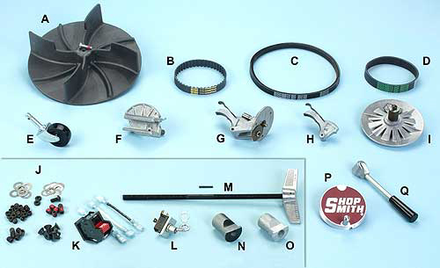
Catalog vs. inventory
A | 515287 | DC3300 Dust Collector Fan
B | 521683 | Gilmer Belt
C | 521682 | Motor Drive Belt

Slide 20
Ontology Types Instances

Slide 21
Ontology = A Representation of Types

Slide 22
An ontology is a representation of types (aka kinds, universals, categories, species, genera, ...)
We learn about types e.g. by looking at scientific theories – which describe what is general in reality

Slide 23
A reference ontology
is analogous to a scientific theory; it seeks to optimize representational adequacy to its subject matter
→ where people need to use language consistently, use the real world to foster semantic interoperability

Slide 24
Three fundamental dichotomies
    types vs. instances
    continuants vs. occurrents
    dependent vs. independent

Slide 25
Continuants (aka endurants)
  have continuous existence in time
  preserve their identity through change
Occurrents (aka processes)
  have temporal parts
  unfold themselves in successive phases

Slide 26
You are a continuant
Your life is an occurrent
You are 3-dimensional
Your life is 4-dimensional

Slide 27
Three fundamental dichotomies
    types vs. instances
    continuants vs. occurrents
    dependent vs. independent

Slide 28
Dependent entities
require independent continuants as their bearers
There is no run without a runner
There is no grin without a cat
There is no disease without an organism

Slide 29
Dependent vs. independent continuants
Independent continuants (organisms, cells, molecules, environments)
Dependent continuants (qualities, shapes, roles, propensities, functions)

Slide 30
All occurrents are dependent entities
They are dependent on those independent continuants which are their participants (agents, patients, media ...)

Slide 31
Top-Level Ontology
Continuant
Occurrent
(always dependent
on one or more
independent
continuants)
Independent
Continuant
Dependent
Continuant

Slide 32
= A representation of top-level types
Continuant
Occurrent
biological process
Independent
Continuant
Dependent
Continuant
cell component
molecular function

Slide 33
= A representation of top-level types
Continuant
Occurrent
course of disease
rise in temperature
Independent
Continuant
Dependent
Continuant
human being
disease
temperature

Slide 34
An example of a common confusion
Cancer =
an object (which can grow and spread)
a process (of getting better or worse)

Slide 35
Disease Progression (from NCIT)
Definition1
Cancer that continues to grow or spread.
Definition2
Increase in the size of a tumor or spread of cancer in the body.
Definition3
The worsening of a disease over time.

Slide 36
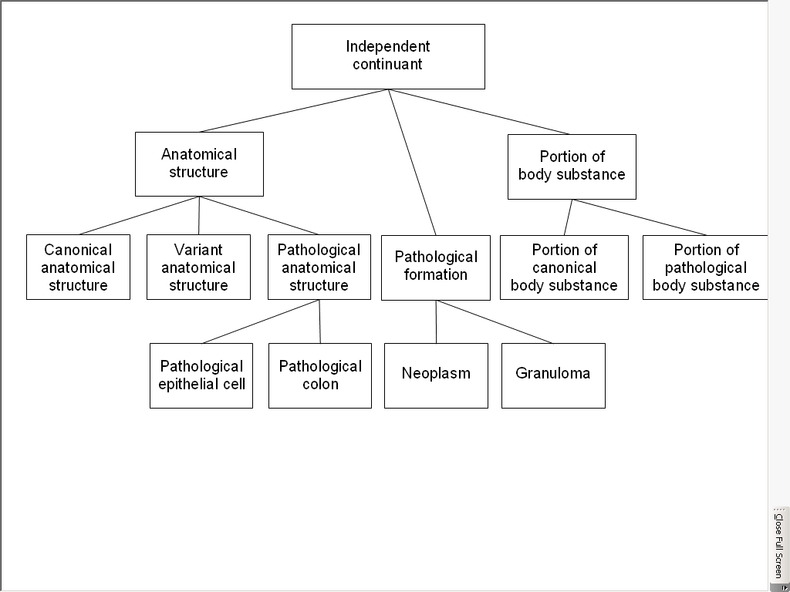
Smith B, Ceusters W, Kumar A, Rosse C. On Carcinomas and Other Pathological Entities, Comp Functional Genomics, Apr. 2006

