Slide 1
HL7 (“Health Level 7”)
An Organisation and a Standard
HL7 and its key role in NPfIT and Existing Systems Integration
Barry Smith
http://hl7-watch.blogspot.com/

Slide 2
HL7 is incredibly successful
adopted by Oracle as basis for its Electronic Health Record technology; supported by IBM, GE, Sun ...
embraced as US federal standard,
national groups in 66 countries.
chosen as central part of $35 billion program to integrate all UK hospital information systems*
*unfortunately this program failed after $12 billion had been spent)

Slide 3
Semantic interoperability
The rationale of the HL7 messaging standard:
    to ensure that health information systems can communicate their information in a form which will be understood in exactly the same way by both sender and recipient – no local dialects
HL7 is an ambitious effort to realize a laudable goal, involving dedicated user communities in many countries.
http://hl7-watch.blogspot.com/

Slide 4
Problems with HL7 V2
Multiple sub-versions (v2.# ...)
Inconsistent usage
Inconsistent interpretation by sender and recipient
Dialect formation, local extensions
How deal with terms from terminologies like SNOMED?
http://hl7-watch.blogspot.com/

Slide 5
All of these are very difficult problems
and HL7 deserves credit for attacking them
globally
systematically
exhaustively
http://hl7-watch.blogspot.com/

Slide 6
HL7’s proposed Solution
HL7 V3
based on what it calls the RIM
or “Reference Information Model”
http://hl7-watch.blogspot.com/

Slide 7
But after 8+ years
some parts of V3 are well-crafted (e.g. the CDA or Common Document Architecture)
We still see no real-world working RIM-based applications
Is this a problem?
http://hl7-watch.blogspot.com/

Slide 8
HL7 Marketing
claims V3 to be:
“The foundation of healthcare interoperability”
“The data standard for biomedical informatics”
from blood banks to Electronic Health Records to clinical genomics
http://hl7-watch.blogspot.com/

Slide 9
HL7 RIM
‘a world standard for exchange of information between clinical information systems’
but does it work?
http://hl7-watch.blogspot.com/

Slide 10
The basis of the V3 solution
Remove optionality (remove the free text option) by having the RIM serve as a master model of all health information, from blood banks to Electronic Health Records to clinical genomics
(free text will of course be allowed elsewhere; just not within RIM-conforming messages)
http://hl7-watch.blogspot.com/

Slide 11
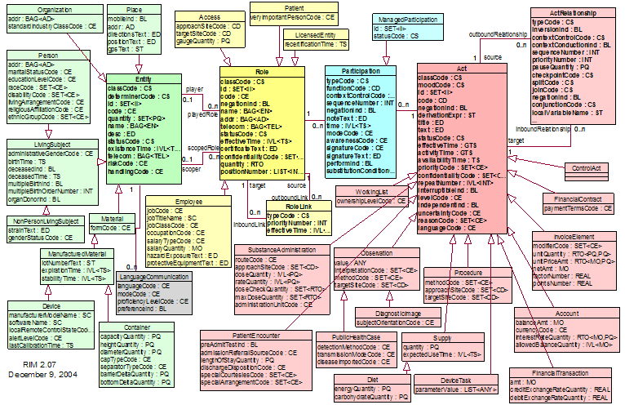
RIM NORMATIVE CONTENT
http://hl7-watch.blogspot.com/

Slide 12
to design a message, choose from here
http://hl7-watch.blogspot.com/

Slide 13
http://hl7-watch.blogspot.com/

Slide 14
The RIM methodology
defines a set of ‘normative’ classes (Act, Role, ...), with which are associated a rich stock of attributes from which one must make a selection when applying the RIM to each new domain (pharmacy, clinical genomics ...),
Compare: attempting to create manufacturing software by drawing from a store containing the bits needed for making every conceivable manufacturable thing (lawnmowers, refrigerators, crossbows, toothpicks, and so on)
http://hl7-watch.blogspot.com/

Slide 15
Too many combinations
as the traffic on HL7’s own vocabulary mailing list reveals, there is no adequate mechanism for ensuring that the vast number of combinations of coded terms within actual messages can be controlled in such a way that messages will be understood in the same way by designers, senders and receivers.
http://hl7-watch.blogspot.com/

Slide 16
These pre-defined attributes
code, class_code, mood_code,
status_code, etc.
yield a combinatorial explosion:
class_code (61 values) x mood_code (13 values) x code (estimate 200) x status_code (10 codes) = 1.58 million combinations.
Adding in the other codes this becomes 810 billion.
http://hl7-watch.blogspot.com/
Notes:
with thanks to Thomas Beale of Ocean Informatics

Slide 17
Why does the RIM embody so many combinations?
To ensure in advance that everything can be said in conformity to the standard
http://hl7-watch.blogspot.com/

Slide 18
to design a message, choose from here
http://hl7-watch.blogspot.com/

Slide 19
The RIM methodology works by deletion from a pre-established list
Is there even one example where a methodology of this sort – which breaks standard principles of object-oriented software design – has been made to work?
http://hl7-watch.blogspot.com/

Slide 20
Why is too many combinations a problem?
constraints on combinations make message-design easier and less risky
we need constraints to prevent, for instance, messages to this effect that
  your lip is fractured
  his thermometer has diabetes
  her nostrils are interrupted
http://hl7-watch.blogspot.com/

Slide 21
This methodology does not impede inconsistent usage
too many combinations means too many opportunities for divergent choices being made by different coders and by different institutions
and even within the HL7 organization itself
HL7’s own e-mail lists correspondingly refer to an ‘insidious’ process which ‘represents the summation of a series of small steps. Each is applauded on its merits, but the sum of all the changes is creating (has created?) something that cannot succeed.’
http://hl7-watch.blogspot.com/

Slide 22
This methodology does not impede the formation of local dialects
Different teams produce different message designs for the very same topic.
In the UK, the $ 35 bn. NHS National Program “Connecting for Health” applied the RIM rigorously, using all the normative elements, and it discovered that it needed to create dialects of its own to make the V3-based system work for its purposes (it still does not work)
http://hl7-watch.blogspot.com/

Slide 23
The RIM documentation
is subject to multiple and systematic internal inconsistencies and unclarities:
is marked by sloppy and unexplained use of terms such as ‘act’, ‘Act’, ‘Acts’, ‘action’, ‘ActClass’ ‘Act-instance’, ‘Act-object’
and uncertain cross-referencing to other HL7 documents
definitions of terms provided by HL7 in one document conflict with those provided in other documents
http://hl7-watch.blogspot.com/

Slide 24
The RIM
is supposed to guarantee consistent messaging across all health-care institutions
yet the HL7 organization has not succeeded in making its own glossary compatible with the ‘normative’ documentation of the RIM itself
http://hl7-watch.blogspot.com/

Slide 25
from HL7 email forum:
“I am ... frightened when I contemplate the number of potential V3ers who ... simply are turned away by the difficulty of accessing the product.
“Some of them attend V3 tutorials which explain V3 as the hugely complex process of creating a message and are turned off. [They] simply do not have the stamina, patience, endurance, time, or brain-cells to understand enough for them to feel comfortable contributing to debates / listserves, etc., so they remain silent.”
http://hl7-watch.blogspot.com/

Slide 26
Who benefits
from such complexity, and from such difficulty of understanding?
Which group forms the voting majority in the HL7 decision-making process?
http://hl7-watch.blogspot.com/

Slide 27
Why is there such fear?
– and, correspondingly, so little critical secondary literature on the RIM ?
http://hl7-watch.blogspot.com/

Slide 28
What is the RIM about?
blood pressure measurement = an information item
blood pressure = something in reality which the measurement measures
Q: Is the RIM about information, or about the reality to which such information relates?
A: There is no difference between the two
http://hl7-watch.blogspot.com/

Slide 29
No coherence, no clarity
No acceptance
Poor documentation
→ No implementation
http://hl7-watch.blogspot.com/

Slide 30
Why is HL7 V3 still finding it difficult to deal with clinical terminologies such as SNOMED CT?
http://hl7-watch.blogspot.com/

Slide 31
entity, role, role link, participation, act, act relationship
http://hl7-watch.blogspot.com/

Slide 32
HL7’s backbone Act class
Definition of Act:
A record of something that is being done, has been done, can be done, or is intended or requested to be done
http://hl7-watch.blogspot.com/

Slide 33
The RIM’s backbone Entity class
persons, places, organizations, material
http://hl7-watch.blogspot.com/

Slide 34
entity, role, role link, participation, act, act relationship
where do diseases go?
http://hl7-watch.blogspot.com/

Slide 35
What’s gone wrong?
People of good will are making mistakes because of insufficient concern for clarity and consistency
Even large ontologies are built in the spirit of the amateur hobbyist
Money is wasted on megasystems that cannot be used
http://hl7-watch.blogspot.com/

Slide 36
Lessons for Semantic Interoperability
Clear and easily accessible documentation – based on an intuitive ontology (understandable to all classes of users)
Business model should be such that those responsible for creating documentation do not have an incentive for it to be unclear
Centralized control of documentation, to ensure consistency (too much democracy is a bad thing)
http://hl7-watch.blogspot.com/

Slide 37
Lessons for Standards for Semantic Interoperability
Create standards on the basis of thorough pilot testing
(Avoid systems like the RIM, which is imposed from the top down, on a wing and a prayer)
http://hl7-watch.blogspot.com/

Slide 38
What should take the place of the RIM?
A Reference Ontology of the types of biomedical entity such as thing, process, person, disease, infection, molecule, procedure, etc.,
A Reference Ontology of the types of biomedical information entity such as message, document, record, image, diagnosis, interpretation, etc.
1. provides a high-level framework in terms of which the lower-level types captured in vocabularies like SNOMED CT could be coherently organized
2. helps to specify how information can be combined into meaningful units and used for further processing.
http://hl7-watch.blogspot.com/

