Slide 1
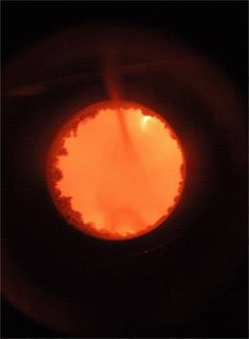
Part II. The Ontology of Biomedical Reality
Some Terminological Proposals

Slide 2
How to do better?
How to create the conditions for a step-by-step evolution towards high quality ontologies in the biomedical domain
which will serve as stable attractors for clinical and biomedical researchers in the future?

Slide 3
Answer:
Ontology development should cease to be an art, and become a science
= embrace the scientific method
If two scientists have a dispute, then they resolve it

Slide 4
Scientific ontologies have special features
Computational concerns are not considerations relevant to the truth of an assertion in the ontology
Myth, fiction, folklore are not considerations relevant to the truth of an assertion in the ontology
Every entity referred to by a term in a scientific ontology must exist

Slide 5
A problem of terminologies
Concept representations
Conceptual data models
Semantic knowledge models
...
Information consists in representations
of entities in a given domain
what, then, is an information representation?

Slide 6
Problem of ensuring sensible cooperation in a massively interdisciplinary community
concept
type
instance
model
representation
data

Slide 7
A basic distinction
universal vs. instance
science text vs. clinical document
man vs. Musen

Slide 8
Instances are not represented in an ontology built for scientific purposes
It is the generalizations that are important
(but instances must still be taken into account)

Slide 9
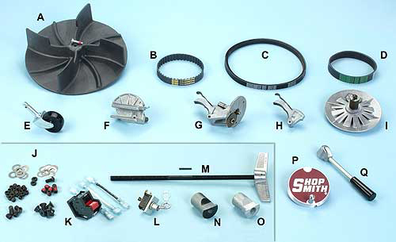
Catalog vs. inventory
A | 515287 | DC3300 Dust Collector Fan
B | 521683 | Gilmer Belt
C | 521682 | Motor Drive Belt

Slide 10
Ontology universals Instances

Slide 11
Ontology = A Representation of universals

Slide 12
Ontology = A Representation of universals
Each node of an ontology consists of:
preferred term (aka term)
term identifier (TUI, aka CUI)
synonyms
definition, glosses, comments

Slide 13
Each term in an ontology represents exactly one universal
It is for this reason that ontology terms should be singular nouns
National Socialism is_a Political Systems

Slide 14
An ontology is a representation of universals
We learn about universals in reality from looking at the results of scientific experiments in the form of scientific theories – which describe not what is particular in reality but rather what is general
Ontologies need to exploit the evolutionary path to convergence created by science

Slide 15

universals
substance
organism
animal
mammal
cat
leaf class
frog
siamese
instances

Slide 16
from Handbook of Ontology
RetailPrice hasA Denomination InstanceOf Dollar (p. 101)
SI-Unit instanceof System-of-Units (p. 40)

Slide 17
McGuinness – Noy “Ontology 101”
  An instance or a class?
Deciding whether a particular concept is a class in an ontology or an individual instance depends on what the potential applications of the ontology are.

Slide 18
Conceptual Hygeine Principle
Never use the word ‘concept’

Slide 19
McGuinness – Noy “Ontology 101”
Deciding whether a particular concept is a class in an ontology or an individual instance depends on what the potential applications of the ontology are.

Slide 20
McGuinness – Noy “Ontology 101”
Deciding where classes end and individual instances begin starts with deciding what is the lowest level of granularity in the representation. The level of granularity is in turn determined by a potential application of the ontology. In other words, what are the most specific items that are going to be represented in the knowledge base?

Slide 21
For scientific ontologies
the issue of how the ontology will be used is not a factor relevant for determining which entities in the ontology will be selected as universals
If this decision is made on the basis of each specific use, this kills reusability

Slide 22
McGuinness – Noy “Ontology 101”
Individual instances are the most specific concepts represented in a knowledge base.
For example, if we are only going to talk about pairing wine with food we will not be interested in the specific physical bottles of wine. Therefore, such terms as Sterling Vineyards Merlot are probably going to be the most specific terms we use. Therefore, Sterling Vineyards Merlot would be an instance in the knowledge base.

Slide 23
McGuinness – Noy “Ontology 101”
On the other hand, if we would like to maintain an inventory of wines in the restaurant in addition to the knowledge base of good wine-food pairings, individual bottles of each wine may become individual instances in our knowledge base.

Slide 24
McGuinness – Noy “Ontology 101”
Similarly, if we would like to record different properties for each specific vintage of the Sterling Vineyards Merlot, then the specific vintage of the wine is an instance in a knowledge base and Sterling Vineyards Merlot is a class containing instances for all its vintages.
Another rule can “move” some individual instances into the set of classes:
If concepts form a natural hierarchy, then we should represent them as classes
Consider the wine regions. Initially, we may define main wine regions, such as France, United States, Germany, and so on, as classes and specific wine regions within these large regions as instances. For example, Bourgogne region is an instance of the French region class. However, we would also like to say that the Cotes d’Or region is a Bourgogne region. Therefore, Bourgogne region must be a class (in order to have subclasses or instances). However, making Bourgogne region a class and Cotes d’Or region an instance of Bourgogne region seems arbitrary: it is very hard to clearly distinguish which regions are classes and which are instances. Therefore, we define all wine regions as classes. Protégé-2000 allows users to specify some classes as Abstract, signifying that the class cannot have any direct instances. In our case, all region classes are abstract (Figure 8).

Slide 25
from Handbook of Ontology
RetailPrice hasA Denomination InstanceOf Dollar (p. 101)
SI-Unit instanceof System-of-Units (p. 40)
The instance “2 dollars”
The universal “2 dollars”

Slide 26
Rules for formating terms
Terms should be in the singular
Terms should be lower case
Avoid abbreviations even when it is clear in context what they mean (‘breast’ for ‘breast tumor’)
Avoid acronyms
Avoid mass terms (‘tissue’, ‘brain mapping’, ‘clinical research’ ...)
Treat each term ‘A’ in an ontology is shorthand for a term of the form ‘the universal A’

Slide 27
Problem of ensuring sensible cooperation in a massively interdisciplinary community
concept
type
instance
model
representation
data

Slide 28
Karl Popper’s “Three Worlds”
Physical Reality
Psychological Reality
Propositions, Theories, Texts

Slide 29
Karl Popper’s “Three Worlds”
Physical Reality
Psychological Reality = our knowledge and beliefs about 1.
Propositions, Theories, Texts = formalizations of those ideas and beliefs

Slide 30
Three Levels to Keep Straight
Level 1: the reality on the side of the organism (patient)
Level 2: cognitive representations of this reality on the part of clinicians
Level 3: publicly accessible concretisations of these cognitive representations in textual, graphical and digital artifacts
We are all interested primarily in Level 1

Slide 31
Three Levels to Keep Straight
Level 1: the reality on the side of the organism (patient)
Level 2: cognitive representations of this reality on the part of clinicians
Level 3: publicly accessible concretisations of these cognitive representations in textual, graphical and digital artifacts
We (scientists) are all interested primarily in Level 1

Slide 32
Entity =def
anything which exists, including things and processes, functions and qualities, beliefs and actions, documents and software (Levels 1, 2 and 3)

Slide 33
Three Levels to Keep Straight
Level 1: the reality on the side of the organism (patient)
Level 2: cognitive representations of this reality on the part of clinicians
Level 3: publicly accessible concretisations of these cognitive representations in textual, graphical and digital artifacts

Slide 34
A scientific ontology
is about reality (Level 1)
= the benchmark of correctness

Slide 35
Ontology development
starts with Level 2 = the cognitive representations of clinicians or researchers as embodied in their theoretical and practical knowledge of the reality on the side of the patient

Slide 36
Ontology development
results in Level 3 representational artifacts
comparable to
clinical texts
basic science texts
biomedical terminologies

Slide 37
Domain =def
a portion of reality that forms the subject-matter of a single science or technology or mode of study;
proteomics
radiology
viral infections in mouse

Slide 38
Representation =def
an image, idea, map, picture, name or description ... of some entity or entities.

Slide 39
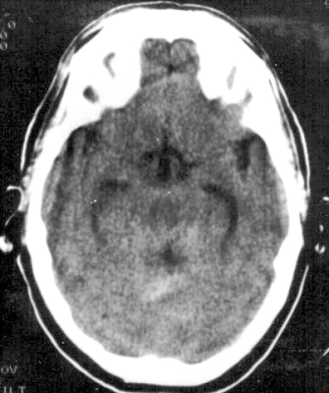
Analogue representations

Slide 40
Representational units =def
terms, icons, alphanumeric identifiers ... which refer, or are intended to refer, to entities

Slide 41
Composite representation =def
  representation
  (1) built out of representational units
  which
  (2) form a structure that mirrors, or is intended to mirror, the entities in some domain

Slide 42
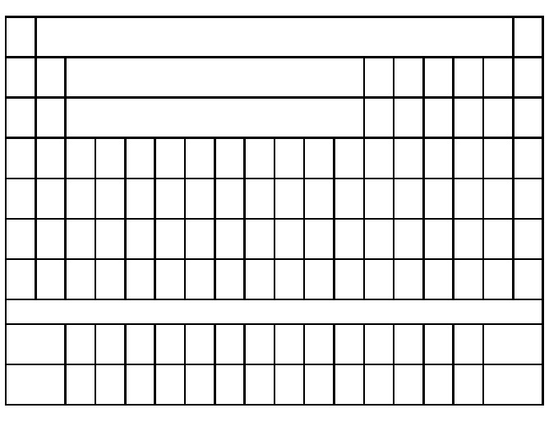
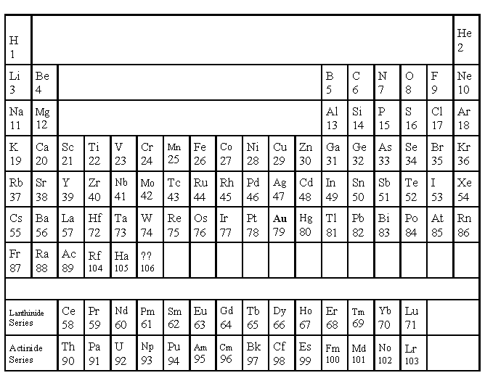
Periodic Table
The Periodic Table

Slide 43
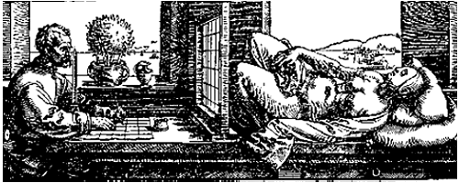
Two kinds of composite representations
Cognitive representations (Level 2)
Representational artefacts (Level 3)
The reality on the side of the patient (Level 1)

Slide 44
Ontologies are here

Slide 45
or here

Slide 46
Ontologies are representational artifacts

Slide 47
What do ontologies represent?

Slide 48
A | 515287 | DC3300 Dust Collector Fan
B | 521683 | Gilmer Belt
C | 521682 | Motor Drive Belt

Slide 49
instances
A | 515287 | DC3300 Dust Collector Fan
B | 521683 | Gilmer Belt
C | 521682 | Motor Drive Belt
universals

Slide 50
Two kinds of composite representational artifacts
Databases, inventories: represent what is particular in reality = instances
Ontologies, terminologies, catalogs: represent what is general in reality = universals

Slide 51
Ontologies do not represent concepts in people’s heads

Slide 52
Ontologies represent universals in reality

Slide 53
“lung” is not the name of a concept
concepts do not stand in
part_of
connectedness
causes
treats ...
relations to each other

Slide 54
Ontology is a tool of science
Scientists do not describe the concepts in scientists’ heads
They describe the universals in reality, as a step towards finding ways to reason about (and treat) instances of these universals

Slide 55
people who think ontologies are representations of concepts make mistakes
congenital absent nipple is_a nipple
failure to introduce or to remove other tube or instrument is_a disease
bacteria causes experimental model of disease

Slide 56
An ontology is like a scientific text; it is a representation of universals in reality

Slide 57
The clinician has a cognitive representation which involves theoretical knowledge derived from textbooks

Slide 58
Two kinds of composite representational artifacts
Databases represent instances
Ontologies represent universals

Slide 59
Instances stand in similarity relations
Frank and Bill are similar as humans, mammals, animals, etc.
Human, mammal and animal are universals at different levels of granularity

Slide 60
How do we know which general terms designate universals?
Roughly: terms used in a plurality of sciences to designate entities about which we have a plurality of different kinds of testable proposition
(compare: cell, electron ...)

Slide 61
universals
substance
organism
animal
“leaf node”
mammal
cat
frog
siamese
instances

Slide 62
Class =def
a maximal collection of particulars determined by a general term (‘cell’, ‘oophorectomy’ ‘VA Hospital’, ‘breast cancer patient in Buffalo VA Hospital’)
the class A
= the collection of all particulars x for which ‘x is A’ is true

Slide 63
Defined class =def
a class defined by a general term which does not designate a universal
the class of all diabetic patients in Leipzig on 4 June 1952

Slide 64
terminology
a representational artifact whose representational units are natural language terms (with IDs, synonyms, comments, etc.) which are intended to designate defined classes.

Slide 65
universals < defined classes < ‘concepts’
Not all of those things which people like to call ‘concepts’ correspond to defined classes
“Surgical or other procedure not carried out because of patient's decision”

Slide 66
‘Concepts’
INTRODUCER, GUIDING, FAST-CATH TWO-PIECE GUIDING INTRODUCER (MODELS 406869, 406892, 406893, 406904), ACCUSTICK II WITH RO MARKER INTRODUCER SYSTEM, COOK EXTRA LARGE CHECK-FLO INTRODUCER, COOK KELLER-TIMMERMANS INTRODUCER, FAST-CATH HEMOSTASIS INTRODUCER, MAXIMUM HEMOSTASIS INTRODUCER, FAST-CATH DUO SL1 GUIDING INTRODUCER FAST-CATH DUO SL2 GUIDING INTRODUCER
is_a HCFA Common Procedure Coding System

Slide 67
Synonyms
INTRODUCER, GUIDING, FAST-CATH TWO-PIECE GUIDING INTRODUCER (MODELS 406869, 406892, 406893, 406904), ACCUSTICK II WITH RO MARKER INTRODUCER SYSTEM, COOK EXTRA LARGE CHECK-FLO INTRODUCER, COOK KELLER-TIMMERMANS INTRODUCER, FAST-CATH HEMOSTASIS INTRODUCER, MAXIMUM HEMOSTASIS INTRODUCER, FAST-CATH DUO SL1 GUIDING INTRODUCER FAST-CATH DUO SL2 GUIDING INTRODUCER

Slide 68
OWL is a good representation of defined classes
soft tissue tumor AND/OR sarcoma
cell differentiation or development pathway
other accidental submersion or drowning in water transport accident injuring other specified person
other suture of other tendon of hand

Slide 69
Definition of ‘ontology’
ontology =def. a representational artifact whose representational units (which may be drawn from a natural or from some formalized language) are intended to represent
1. universals in reality
2. those relations between these universals which obtain universally (= for all instances)
lung is_a anatomical structure
lobe of lung part_of lung

Slide 70
The OBO Relation Ontology
Genome Biology 2005, 6:R46

Slide 71
In every ontology
some terms and some relations are primitive = they cannot be defined (on pain of infinite regress)
Examples of primitive relations:
  identity
  instantiation
  instance-level part_of

Slide 72
is_a
A is_a B =def
For all x, if x instance_of A then x instance_of B
cell division is_a biological process
Here A and B are universals

Slide 73
Part_of as a relation between universals is more problematic than is standardly supposed
heart part_of human being ?
human heart part_of human being ?
human being has_part human testis ?
testis part_of human being ?

Slide 74
two kinds of parthood
between instances:
Mary’s heart part_of Mary
this nucleus part_of this cell
between universals
human heart part_of human
cell nucleus part_of cell

Slide 75
Definition of part_of as a relation between universals
A part_of B =Def. all instances of A are instance-level parts of some instance of B
human testis part_of adult human being
but not
adult human being has_part human testis

Slide 76
part_of for processes
A part_of B =def.
For all x, if x instance_of A then there is some y, y instance_of B and x part_of y
where ‘part_of’ is the instance-level part relation
EVERY A IS PART OF SOME B

Slide 77
part_of for continuants
A part_of B =def.
For all x, t if x instance_of A at t then there is some y, y instance_of B at t and x part_of y at t
where ‘part_of’ is the instance-level part relation
ALL-SOME STRUCTURE

Slide 78
is_a (for processes)
A is_a B =def
For all x, if x instance_of A then x instance_of B
cell division is_a biological process

Slide 79
is_a (for continuants)
A is_a B =def
For all x, t if x instance_of A at t then x instance_of B at t
abnormal cell is_a cell
adult human is_a human
but not: adult is_a child

Slide 80
How to use the OBO Relation Ontology
Ontologies are representations of types and of the relations between types
The definitions of these relations involve reference to times and instances, but these references become invisible when we get to the assertions (edges) in the ontology
But curators of ontologies should still be aware of the underlying definitions when formulating such assertions

Slide 81
These definitions make reasoning possible
Whichever A you choose, the instance of B of which it is a part will be included in some C, which will include as part also the A with which you began
The same principle applies to the other relations in the OBO-RO:
located_at, transformation_of, derived_from, adjacent_to, etc.

Slide 82
A part_of B, B part_of C ...
The all-some structure of the definitions in the OBO-RO allows
cascading of inferences
(i) within ontologies
(ii) between ontologies
(iii) between ontologies and EHR repositories of instance-data

Slide 83
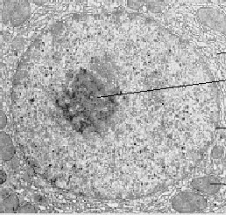
Instance level
this nucleus is adjacent to this cytoplasm
implies:
this cytoplasm is adjacent to this nucleus
universal level
nucleus adjacent_to cytoplasm
Not: cytoplasm adjacent_to nucleus

Slide 84
Applications
Expectations of symmetry e.g. for protein-protein interactions hmay hold only at the instance level
if A interacts with B, it does not follow that B interacts with A
if A is expressed simultaneously with B, it does not follow that B is expressed simultaneously with A

Slide 85
OBO Relation Ontology
Foundational | is_a part_of
Spatial | located_in contained_in adjacent_to
Temporal | transformation_of derives_from preceded_by
Participation | has_participant has_agent

Slide 86
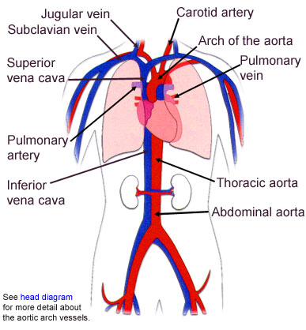
Fiat and bona fide boundaries

Slide 87
Continuity
Attachment
Adjacency

Slide 88
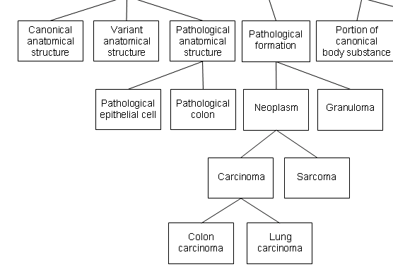
everything here is an independent continuant

Slide 89
structures vs. formations = bona fide vs. fiat boundaries

Slide 90
Modes of Connection
The body is a highly connected entity.
Exceptions: cells floating free in blood.

Slide 91
Modes of Connection
Modes of connection:
  attached_to (muscle to bone)
  synapsed_with (nerve to nerve, nerve to muscle)
  continuous_with (= share a fiat boundary)

Slide 92
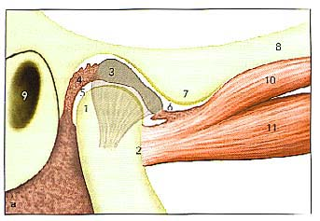
articular (glenoid)fossa
articular eminence
ANTERIOR
Attachment, location, containment

Slide 93
Containment involves relation to a hole or cavity
1: cavity
2: tunnel, conduit (artery)
3: mouth; a snail’s shell

Slide 94
Fiat vs. Bona Fide Boundaries
fiat
boundary
physical boundary

Slide 95
Double Hole Structure
Retainer
(a boundary of some
surrounding structure)
Medium
(filling the environing hole)
Tenant
(occupying the central hole)

Slide 96
head of condyle
fossa
fiat boundary
neck of condyle
the temporomandibular joint

Slide 97
a continuous_with b
= a and b are continuant instances which share a fiat boundary
This relation is always symmetric:
if x continuous_with y , then y continuous_with x

Slide 98
continuous_with
(relation between types)
A continuous_with B =Def.
for all x, if x instance-of A then there is some y such that y instance_of B and x continuous_with y

Slide 99
continuous_with is not always symmetric
Consider lymph node and lymphatic vessel:
  Each lymph node is continuous with some lymphatic vessel, but there are lymphatic vessels (e.g. lymphs and lymphatic trunks) which are not continuous with any lymph nodes

Slide 100
Adjacent_to as a relation between types is not symmetric
Consider
seminal vesicle adjacent_to urinary bladder
Not: urinary bladder adjacent_to seminal vesicle

Slide 101
instance level
this nucleus is adjacent to this cytoplasm
implies:
this cytoplasm is adjacent to this nucleus
type level
nucleus adjacent_to cytoplasm
Not: cytoplasm adjacent_to nucleus

Slide 102
Applications
Expectations of symmetry e.g. for protein-protein interactions may hold only at the instance level
if A interacts with B, it does not follow that B interacts with A
if A is expressed simultaneously with B, it does not follow that B is expressed simultaneously with A

Slide 103
transformation_of
same instance
C
c at t
C₁
c at t₁
time
pre-RNA
mature RNA
child
adult

Slide 104
transformation_of
A transformation_of B =Def.
Every instance of A was at some earlier time an instance of B
  adult transformation_of child

Slide 105
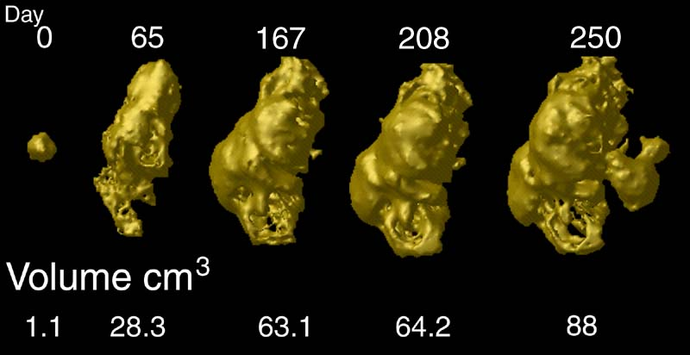
tumor development
C
c at t
C₁
c at t₁
Notes:
http://www.loni.ucla.edu/~thompson/HBM2000/tumor_volumes.jpg

Slide 106
derives_from
C
c at t
C₁
c₁ at t₁
time
C'
c' at t
instances
ovum
zygote derives_from
sperm

Slide 107
two continuants fuse to form a new continuant
C
c at t
C₁
c₁ at t₁
C'
c' at t
fusion

Slide 108
one initial continuant is replaced by two successor continuants
C
c at t
C₁
c₁ at t₁
C₂
c₁ at t₁
fission

Slide 109
one continuant detaches itself from an initial continuant, which itself continues to exist
C
c at t
c at t₁
C₁
c₁ at t
budding

Slide 110
one continuant absorbs a second continuant while itself continuing to exist
C
c at t
c at t₁
C'
c' at t
capture

Slide 111
To be added to the Relation Ontology
lacks (between an instance and a type, e.g. this fly lacks wings)
dependent_on (between a dependent entity and its carrier or bearer)
quality_of (between a dependent and an independent continuant)
functioning_of (between a process and an independent continuant)

Slide 112
New relations
instance to universal: lacks
continuant to continuant: connected_to
function to process: realized_by
process to function: functioning_of
function to continuant: function_of
continuant to function: has_function
quality to continuant: inheres_in (aka has_bearer)
continuant to quality: has_quality

Slide 113
Most important
These relations hold both within and between ontologies
For example the relations between ontologies at different levels of granularity (e.g. molecule and cell) can be captured by relations of part_of between the corresponding types

