Slide 1
Speciation and the Species Problem Processes, Patterns and Biological Ontologies
M. Brochhausen
Philosophy of Biology Conference,
September 29, 2007
Buffalo

Slide 2
The problem
One basic problem regarding the definition of species is that most end up with the problem of identifying “essential” attributes of a species.

Slide 3
Aim
The aim of this presentation is to present an ontologically credible account of species.
In order to achieve this, results from formal ontology will be applied to clarify one of the existing species concepts.

Slide 4
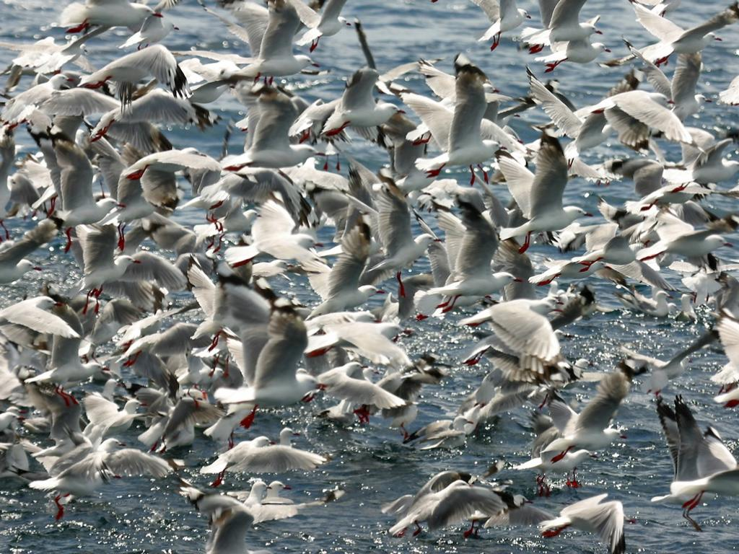
“A flock of species concepts”

Slide 5
Species concepts
Phenetic species concept
Biological species concept
Cohesion species concept
Ecological species concept
Phylogenetic species concept
Of course there are many more!

Slide 6
To each its own? (1)
Each of the species concepts has certain advantages and disadvantages which makes it the favorite of one or the other discipline of biology.
Even more important some concepts have features which prevent their use in some disciplines.

Slide 7
To each its own? (2)
Examples:
Biological SC: Zoology (only sexually reproducing)
Cohesion SC: Asexually reproducing organisms
Ecological SC: Botany
Phylogenetic SC: Paleobiology

Slide 8
Species in phylogenetics
An evolutionary species is a single lineage of ancestor-descendent populations which maintains its identity from other such lineages and which has its own evolutionary tendencies and historical fate. (Wiley, 1981)

Slide 9
Effects?
Homo heidelbergensis
Homo antecessor
Homo erectus
Homo ergaster

Slide 10
Species in phylogenetics
An evolutionary species is a single lineage of ancestor-descendent populations which maintains its identity from other such lineages and which has its own evolutionary tendencies and historical fate. (Wiley, 1981)

Slide 11
(…) the most plausible account of species is that they are lineages between speciation events. The biological species concept, perhaps supplemented by the ecological species concept (…), reemerges as an account of speciation. (Sterelny & Griffiths, 1999)

Slide 12
(…) the most plausible account of species is that they are lineages between speciation events. The biological species concept, perhaps supplemented by the ecological species concept (…), reemerges as an account of speciation. (Sterelny & Griffiths, 1999)

Slide 13
Biological species concept
Species are groups of actually or potentially interbreeding natural populations, which are reproductively isolated from other such groups. (Mayr, 1942)

Slide 14
Ecological species concept
A species is a lineage (or closely related set of lineages) which occupies an adaptive zone minimally different from that of any other lineages in its range and which evolves separately from all lineages outside its range. (Van Valen, 1976)

Slide 15
Process-oriented taxonomy
Speciation is a process universal.
Speciation is the core of taxonomy since speciation processes provide the most plausible criteria for species definition.

Slide 16
Basic Formal Ontology (BFO)
is a result of formal ontology development.
is a top level ontology.
is a useful tool in reality representation.
has been used widely in biomedical ontologies.

Slide 17
The basic divide (in BFO)
bfo:Entity
snap:Continuant
span:Occurrent

Slide 18
The basic divide (in BFO)
bfo:Entity
snap:Continuant
span:Occurrent
span:Process

Slide 19
Process-universals
…belong in an ontology that distinguishes continuants from occurrents
…are patterns in aggregations of processes
Therefore, it makes perfect sense to talk of sub-processes.

Slide 20
Sub-processes: Candidates
Separation
Adaptation
Hybridisation
= regular biological processes!

Slide 21
Evolutionary processes in general
It is important to note that evolutionary processes appear in populations, not in individuals.
The sub-processes of speciation, likewise, occur in populations.

Slide 22
Pattern

Slide 23
Conclusions
The species problem arises, because species is not the central ontological entity.
The central ontological entity is speciation.
Speciation is a process in the terminology of Basic Formal Ontology

Slide 24
Conclusions
The pattern (sum) of all speciation processes identify a species distinctively.
A fixed definition of a species is only possible after it ceased to exist.
Mayr’s and Van Valen’s concept can help to recognize whether a speciation process has already taken place.

Slide 25
Realist concerns
Some realists hold that this is not a realist account of species/speciation since it is based on our representation of phylogeny.
Phylogeny shows a certain amount if arbitrariness (these critics say).

Slide 26
Realist answers
If we are realists with respect to speciation (which we should be), we are realists about species.

Slide 27
Ghiselin’s concerns
Ghiselin holds that taking speciation as the prior ontological unit leads to the problem of how the first species came into existence.

Slide 28
If we take all consequences from Wiley’s position, there is no species prior to the first speciation,

Slide 29
This presentation was prepared under the auspices of the Volkswagen Foundation within the project "Forms of Life".

