Slide 1
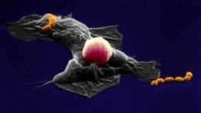

Welcome to the Second Annual Infectious Disease Ontology Workshop
Generously supported by

Slide 2
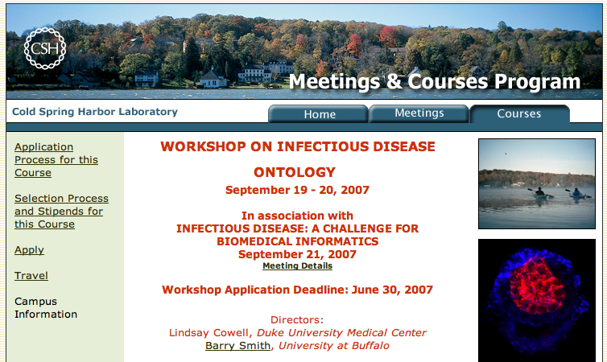
IDO 2007

Slide 3
IDO Development Strategy
Allows parallel development of multiple interoperable ontologies
  Distributed development
    rapid progress
    curation by subdomain experts
  Terminological consistency
    term names and meanings
    classification
Prevent common mistakes

Slide 4
IDO Development Strategy
Disease- and organism-specific ontologies
Built as refinements to a template infectious disease ontology with terms relevant to a large number of infectious diseases
a la CARO (or UBERON?)
Influenza
Tuberculosis
IDO
Plasmodium
falciparum
S. aureus

Slide 5
Disease-specific IDO test projects
IMBB/VectorBase – Vector borne diseases (A. gambiae, A. aegypti, I. scapularis, C. pipiens, P. humanus)
  Christos Louis
Colorado State University – Dengue Fever
  Saul Lozano-Fuentes
Duke – Tuberculosis, Staph. aureus
  Carol Dukes-Hamilton, Vance Fowler
Cleveland Clinic – Infective Endocarditis
  Sivaram Arabandi
MITRE, UT Southwestern, Maryland – Influenza
  Joanne Luciano, Richard Scheuermann, Burke Squires, Lynn Schriml
University of Michigan – Brucellosis
  Yongqun He

Slide 6
Goals for IDO 2008
Progress
  Core IDO
  Test cases
Revisions to IDO
How will the cross-disease comparability of data created by the IDO template framework help infectious disease research?
Development and maintenance issues

Slide 7
Participant Introductions

