Slide 1
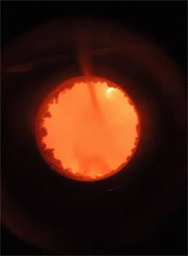
AN INTRODUCTION TO
BIOMEDICAL ONTOLOGY
Barry Smith
University at Buffalo
http://ontology.buffalo.edu/smith

Slide 2
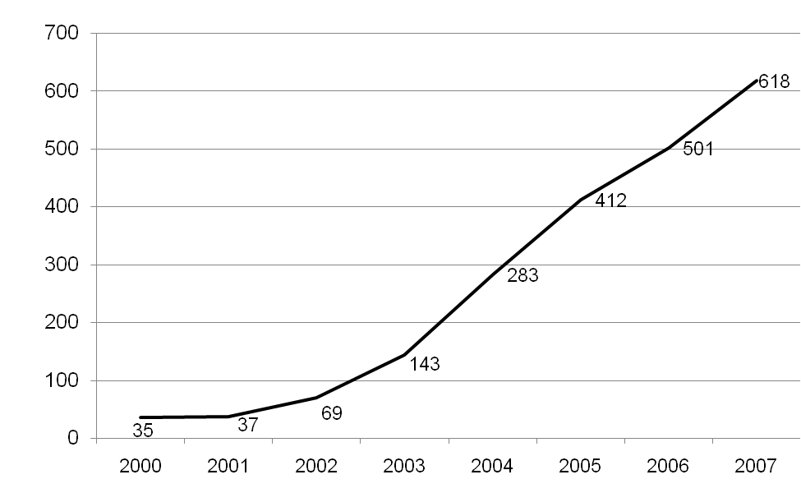
Uses of ‘ontology’ in PubMed abstracts

Slide 3
The problem
There are many ways to create databases, creating silos
Multiple terminologies will not solve these silo problems
We need to constrain terminologies so that they converge
How?

Slide 4
Evidence-based terminology development
Q: What is to serve as constraint?
A: Reality, as revealed by experimentally based science

Slide 5
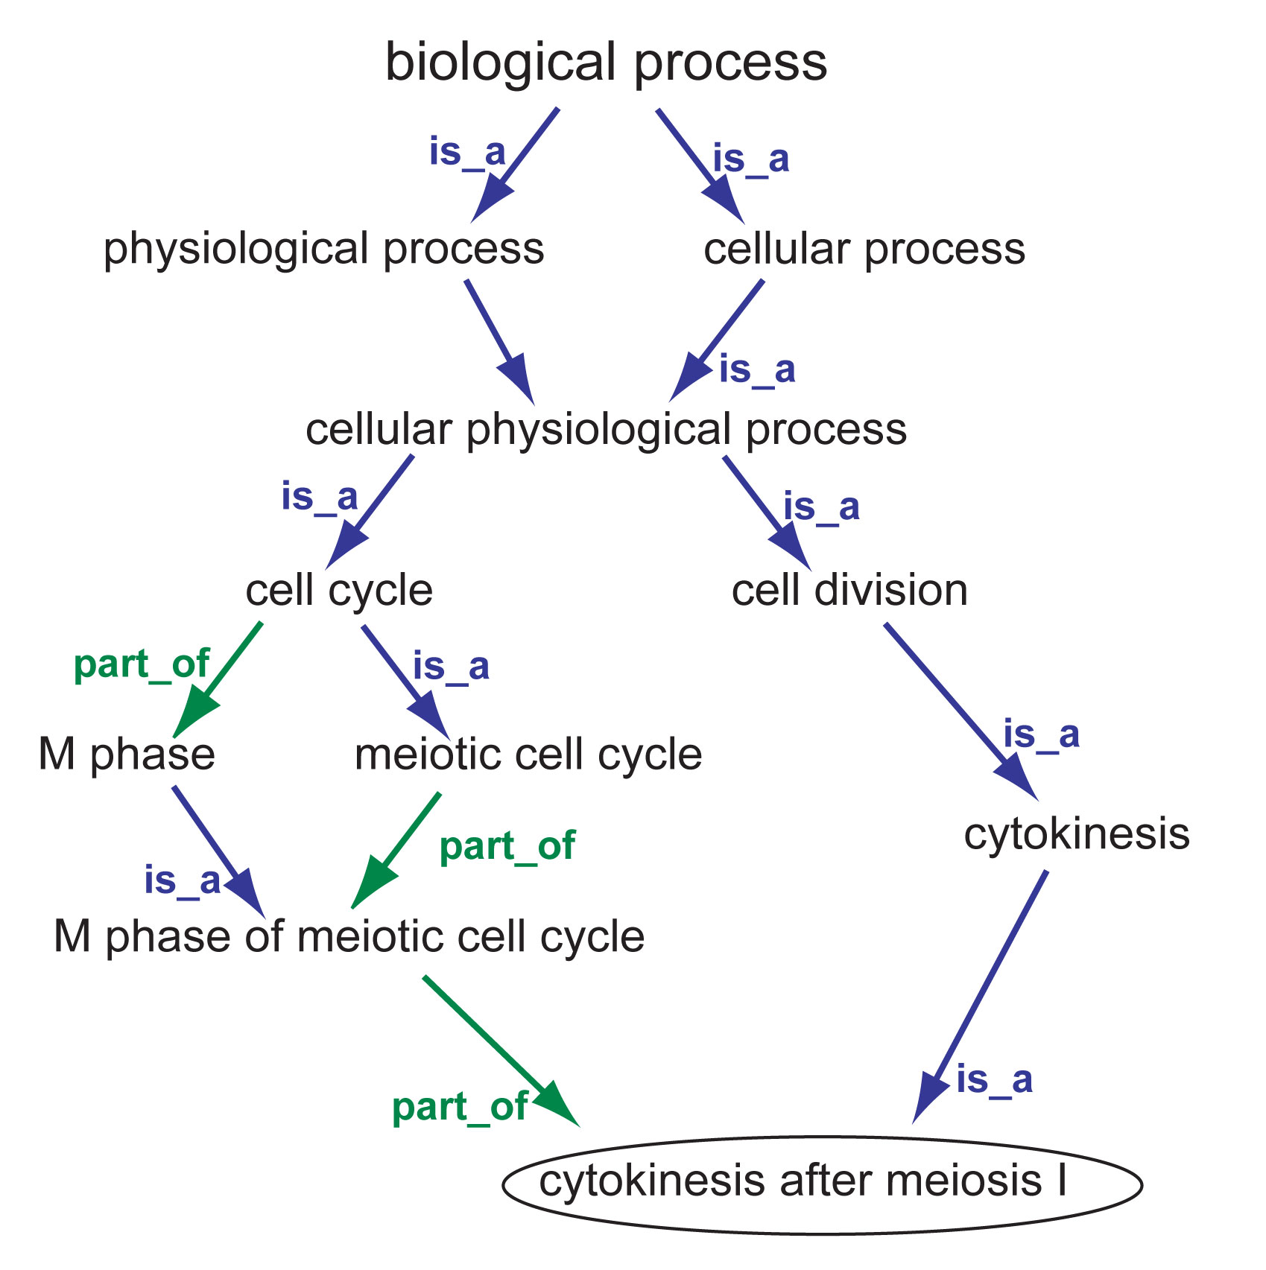
The Gene Ontology
an example from
the Gene Ontology
Notes:
http://www.yeastgenome.org/help/images/cytokinesisDAGrels.jpg

Slide 6
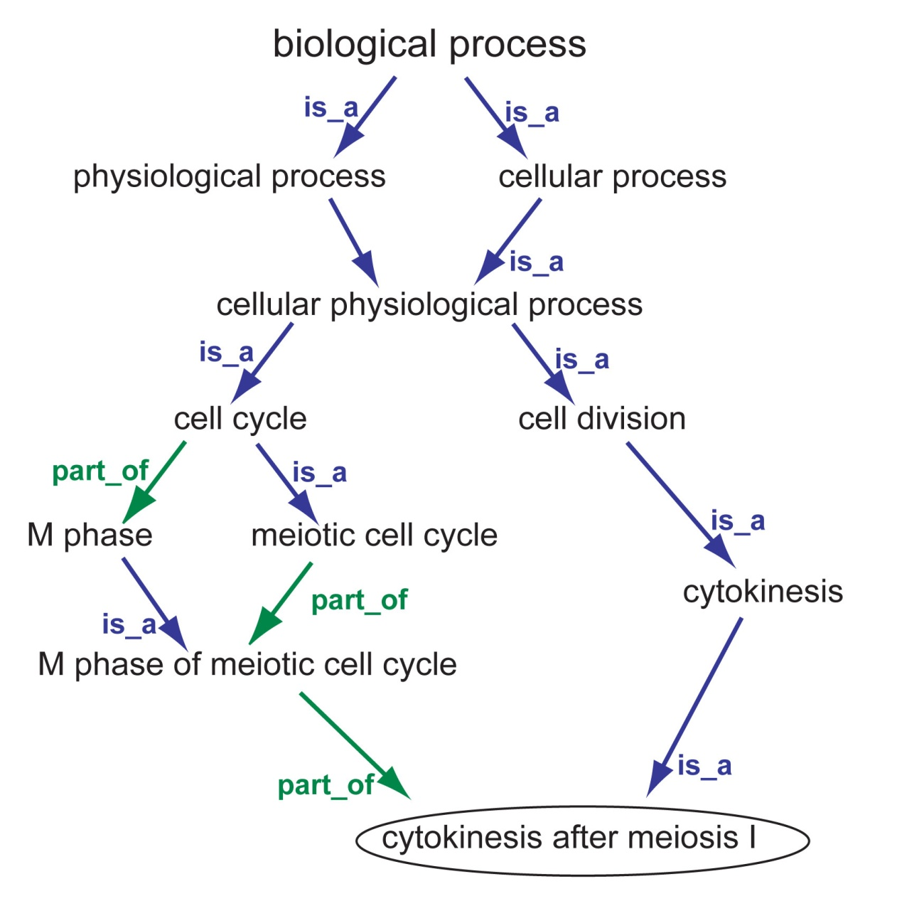

particulars
Notes:
http://www.yeastgenome.org/help/images/cytokinesisDAGrels.jpg

Slide 7
One aspect of the problem
how link different
ontologies together?
how ensure that they are developed in tandem?
Notes:
http://www.yeastgenome.org/help/images/cytokinesisDAGrels.jpg

Slide 8
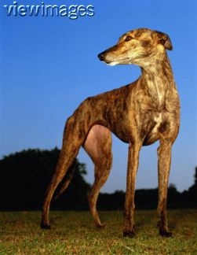
Things and processes exist in time in different ways
t i m e
process
substance

Slide 9
Continuants vs occurrents
In preparing an inventory of reality
we keep track of these two different kinds of entities in two different ways

Slide 10
The very top
Continuant
Occurrent
(always dependent
on one or more
independent
continuants)
Independent
Continuant
Dependent
Continuant
cellular component
molecular function
biological process

Slide 11
Continuant entities
- have continuous existence in time
- preserve their identity through change
Occurrent entities
- have temporal parts
- exist only in their phases/stages

Slide 12
You are a substance
Your life is a process
You are 3-dimensional
Your life is 4-dimensional

Slide 13
Dependent entities
require independent continuants as their bearers
There is no run without a runner
There is no grin without a cat

Slide 14
Dependent continuants
Functions, qualities, roles …

Slide 15
Qualities
are dependent continuants
temperature
weight
height
color

Slide 16
Realizable dependent continuants
function
role
disposition

Slide 17
Realizations are processes
the expression of a function
the exercise of a role
the realization of a disposition

Slide 18
All occurrents are dependent on their bearers/participants
One-place vs. relational processes
One-place processes:
a thing’s getting warmer
a thing’s getting hungrier

Slide 19
Relational processes
fusings, signallings, capturings
bearers joined together into collectives of greater or lesser duration

Slide 20
Part-Whole
Basic relation on the level of particulars
John’s heart is part of John
John’s death is part of John’s dying

Slide 21
Relations crossing the continuant-occurrent border are never part-relations
John
John’s life
sustaining in existence
physiological processes

Slide 22
Parts of processes are always processes
thing
process

Slide 23
is_a
A is_a B =def.
‘A’ is more specific in meaning than ‘B’
meningitis is_a disease of the nervous system
unicorn is_a one-horned mammal
cancer documentation is_a cancer

Slide 24
The problem
We need to constrain terminologies so that they converge
How?

Slide 25
Integration of biomedical data
will never be achieved through integration of meanings or concepts
because different user communities use different concepts
and express them in uncontrolledly different ways

Slide 26
Kinds of relations
<type, type>: is_a, part_of, ...
<particular, type>: this explosion instance_of the type explosion
<particular, particular>: Mary’s heart part_of Mary

Slide 27
part_of
as a relation between particulars
as a relation between types

Slide 28
part_of
for continuant types is time-indexed
A part_of B =def.
given any particular a and any time t,
if a instantiates A at t,
then there is some particular b
such that b instantiates B
and a is an part_of b at t on the level of particulars

Slide 29
derives_from
(ovum, sperm → zygote ... )
C
c at t
C₁
c₁ at t₁
time
C'
c' at t
particulars

Slide 30
Advantages of the methodology of enforcing commonly accepted coherent definitions
promote quality assurance (better coding)
promote automatic reasoning across ontologies and across data at different granularities

Slide 31


Slide 32
Are pathways continuants or occurrent?
what happens if we take the definitions from google and classify the biologically relevant cases into two groups, according to whether they implied that pathways are continuants (roughly: the road travelled) or occurrents (the actual travelling event)?
Notes:
http://www.google.com/search?hl=en&lr=&rls=com.microsoft:en-US&defl=en&q=define:pathway&sa=X&oi=glossary_definition&ct=title

Slide 33
continuant
nerve pathway: a bundle of myelinated nerve fibers following a path through the brain
a trodden path (wordnet.princeton.edu/perl/webwn )
Network of interacting proteins used to carry out biological functions such as metabolism and signal transduction. www.inproteomics.com/nwglospq.html
The physical course a chemical or pollutant takes from its source to the exposed organism. www.waterquality.de/hydrobio.hw/PTERMS.HTM
The "route" a hazardous substance takes from its point of release (the "target") to a person, plant or animal (the "receptor"). www.deq.state.or.us/wmc/cleanup/glossary.htm
A series of consecutive valid linkages in a Pathways Diagram. www.ceaa-acee.gc.ca/013/0001/0004/a_e.htm
Potential route for exposure to radioactive or hazardous materials. www.comrad.org/glossary/glos2.htm
The path traced as movement proceeds through space. A pathway may be either on the floor or through the air and is constructed of straight and/or curved lines. www.ncpublicschools.org/curriculum/artsed/scos/dance/glossary
The route along which a chemical substance or hazardous material moves in the environment www.ec.gc.ca/etad/csmwg/pub/fed_aprch/en/glossary_e.htm

Slide 34
occurrent
1. A series of related biochemical reactions.
  www.genpromag.com/Glossary~LETTER~P.html
  2. Process for how patient moves through continuum of care. There may be multiple guidelines for a patient, depends on what you are managing. Workflow management describes what is done, how, by whom, and with what means.
  informatics.medicine.dal.ca/w4/glossary.html

