Slide 1
Using Ontologies to Represent Immunological Networks
Lindsay G. Cowell, Anne Lieberman, Anna Maria Masci
Duke University Center for Computational Immunology

Slide 2
Periphery
Secondary Lymphoid Tissue
Periphery

Slide 3
Periphery
Secondary Lymphoid Tissue
Periphery
binding
migration
migration
secretion
Ag presentation
Process
signaling
maturation
T cell differentiation
secretion
T cell activation
Ag processing
Cell
dendritic
cell
dendritic
cell
dendritic cell
dendritic cell
memory T cell
endothelial cell
naïve T cell
effector T cell
effector T cell
molecular
pattern
cytokine
adhesion
molecule
MHC
CD69
CD44
CD25
chemokine
Molecule
TCR
chemokine
receptor
pattern
recognition
receptor
chemokine
chemokine
cytokine

Slide 4
Periphery
Secondary Lymphoid Tissue
Periphery
X
X
X
Tightly regulated: expansion/suppression
qualitatively different responses to different pathogens

Slide 5
Periphery
Secondary Lymphoid Tissue
Periphery
dendritic
cell
naïve CD4+
T cell
CD4+ T
helper cell
CD4+ T
helper cell
IL-4
IL-5
IL-6
IL-10
IL-13
IL-8
IL-10
IL-23p19
TLR2
Type 2
B cell
IL-12p70
IP-10
IFNb
IL-15
IFNg
TNFb
macrophage
TLR4
Type 1

Slide 6
Periphery
Secondary Lymphoid Tissue
Periphery
Multiple levels of granularity
Temporal ordering of processes
Modularity and transitioning between modules

Slide 7
Ligation of TLR2 expressed on dendritic cells induces secretion of IL-10.
(Binding has participant (TLR2 part of dendritic cell) )
followed by
(secretion has participant (dendritic cell and IL-10) )

Slide 8
RELATION TO TIME GRANULARITY | CONTINUANT |  |  |  | OCCURRENT
 | INDEPENDENT |  | DEPENDENT
ORGAN AND ORGANISM | Organism (NCBI Taxonomy?) | Anatomical Entity (FMA, CARO) | Organ Function (FMP, CPRO) | Phenotypic Quality (PaTO) | Organism-Level Process (GO)
CELL AND CELLULAR COMPONENT | Cell (CL) | Cellular Component (FMA, GO) | Cellular Function (GO) |  | Cellular Process (GO)
MOLECULE | Molecule (ChEBI, SO, RnaO, PrO) |  | Molecular Function (GO) |  | Molecular Process (GO)
Macrophage
B lymphocyte
Lymph node
Spleen
IL-12
TLR-4
Phagocytosis
Homing
Antigen
processing
Relation Ontology

Slide 9
Ligation of TLR2 expressed on dendritic cells induces secretion of IL-10.
(Binding has participant (TLR2 part of dendritic cell))
followed by
(secretion has participant (dendritic cell and IL-10))
GO BP
RO
PRO
CL

Slide 10
Benefits to Using OBO Foundry Ontologies
Utilize the ontologies’ hierarchies
Interoperability with other databases and knowledge sources
Principles of development improve consistency and reduce errors
Underlying formalism supports long-term goal of computing over this information

Slide 11
Dendritic cell
TLR2 signaling
has_part
has_part
has_part
TLR2:TLR2
ligand binding
followed_by
TLR2-MyD88
binding
TLR2
has_part
has_lower_level_granularity
has_part
TIR domain
TIR domain
TIR:TIR
binding

Slide 12
has_output
TLR2:MyD88
complex
TLR2:MyD88
binding
has_participant
has_disposition
TLR2
LTA binding
has_participant
MyD88
preceeded_by
regulated_by
has_lower_level_granularity
TLR2:TLR2
ligand
binding
process
has_part
TIR:TIR
binding
has_participant
TIR domain

Slide 13
TLR2:MyD88 complex
– IRAK4 binding
has_output
preceeded_by
has_participant
has_participant
has_participant
TLR2-MyD88
binding
has_output
TLR2:MyD88
complex
IRAK4
TLR2
has_participant
MyD88
preceeded_by
has_lower_level_granularity
has_part
TLR2:TLR2
ligand
binding
TIR domain
has_participant
TIR-TIR
binding

Slide 14
TLR2:MyD88 complex
– IRAK4 binding
has_output
preceeded_by
has_participant
has_participant
has_participant
TLR2-MyD88
binding
has_output
TLR2:MyD88
complex
IRAK4
TLR2
has_participant
MyD88
preceeded_by
has_lower_level_granularity
MyD88 – IRAK4
binding
has_part
TLR2:TLR2
ligand
binding
has_participant
has_participant
has_part
TIR domain
TIR:TIR
binding
has_lower_level_granularity

Slide 15
Acknowledgements
Anna Maria Masci, Duke University Center for Computational Immunology
Anne Lieberman, Duke University Center for Computational Immunology
Barry Smith, University at Buffalo
Fabian Neuhaus, NIST
OBO Ontology Community (Alex Diehl, Jamie Lee, Onard Mejino, Chris Mungall, Richard Scheuermann, Alan Ruttenberg)
Burroughs Wellcome Fund, NIAID - DAIT

Slide 16
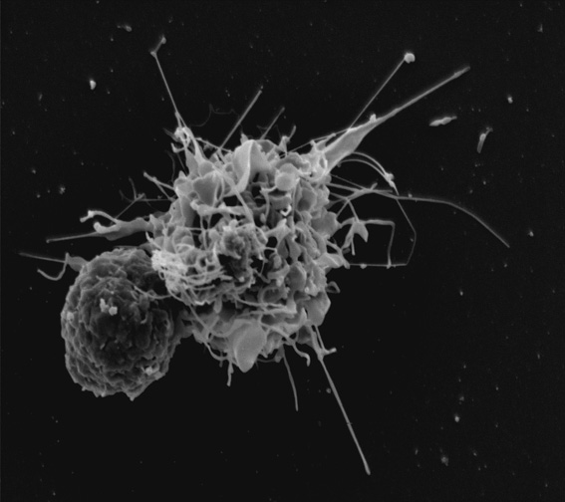

Slide 17
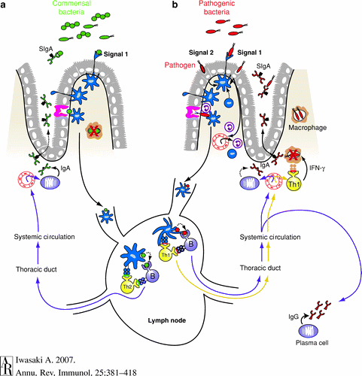

Slide 18
continuant
has_output
ability to participate in a process
has_participant
continuant
has_disposition
process
has_agent
continuant
preceeded_by
regulated_by
has_lower_level_granularity
process
process
has_part
process
has_participant
continuant
Types of regulated_by
amplified_by
suppressed_by
initiated_by
stopped_by

