Slide 1
Representing laboratory information and other findings in clinical ontologies
Anita Burgun, MD, PhD
EA 3888- IFR140 Faculté de Médecine – Université de Rennes1 - France
Signs, Symptoms and Findings: First Steps Toward an Ontology of Clinical Phenotypes Workshop, Sept 3-4, 2008 - Dallas, TX

Slide 2
Two issues
Interoperability
  Mapping vocabularies (Olivier)
  Metadata (Olivier)
Integrate this information
  Databases (interoperability)
  Knowledge bases
  Ontology??

Slide 3
LOINC and other terminologies
Names and codes
6-axis template
‘parts’
  the name of the component or analyte measured
  its property (substance concentration, mass, volume)
  the timing of the measurement
  the system (serum, urine, etc.)
  the scale of measurement (qualitative vs. quantitative, etc.)
  the method (if it is relevant-RIA, Immune Blot, etc.).
Laboratory tests
  Sodium:SCnc:Pt:Ser/Plas:Qn
  Sodium:SerumConcentration:point-in-time:Serum-or-plasma: quantitative
  Component : Property : Time : System : Scale : Method

Slide 4
LOINC and other terminologies
37,000 laboratory tests
44,000 ‘parts’
Overlap between LOINC and comprehensive medical terminologies such as SNOMED CT
Mapping
  Not lexical
  Based on the relations
    Component + system 20%
Bodenreider O. Issues in mapping LOINC laboratory tests to SNOMED CT, AMIA 2008

Slide 5
LOINC and others
Observable
  UMLS SGs : Concepts & Ideas - Physiology combination
  Cigarettes smoked, total (pack/yr) (C0489470)
  RR interval (C0489636)
  understood as temporal, qualitative, or quantitative concepts as well as physiological items.
Role played by observable

Slide 6
Enrich disease ontologies with manifestations (inc lab test results)
Diabetes mellitus (disorder)
  Is a Disorder of endocrine pancreas
  Is a Disorder of glucose metabolism
  Is a Disorder of glucose regulation
  Finding site Endocrine pancreatic structure (body structure)
  Finding site Structure of digestive system (body structure)
Ectopic hyperinsulinism (disorder)
  Is a Disorder of endocrine pancreas
  Is a Disorder of glucose regulation
  Finding site Endocrine pancreatic structure (body structure)
  Finding site Structure of digestive system (body structure)
WHO diagnostic criteria for diabetes: fasting plasma glucose >= 7.0mmol/l (formerly 7.8) or 2-h plasma glucose >= 11.1mmol/l).
American Diabetes Association criteria
IFT : Impaired Fasting Glycemia (6.1-7)
IGT : Impaired Glucose Tolerance

Slide 7
SNCT Rheumatoid arthritis (disorder) 69896004 (primitive)
Is a Arthropathy associated with a hypersensitivity reaction (disorder)
Is a Autoimmune disease (disorder)
Is a Delayed hypersensitivity disorder (disorder)
Due to Immune hypersensitivity reaction (disorder)
Has definitional manifestation Immune system finding (finding)
Pathological process Autoimmune (qualifier value)
Associated morphology Inflammation (morphologic abnormality)
Finding site Joint structure (body structure)

Slide 8
Medical description of RA
Arnett FC, et al. The American Rheumatism Association 1987 revised criteria for the classification of rheumatoid arthritis. Arthritis Rheum. 1988 Mar;31(3):315-24.
  morning stiffness in and around joints lasting at least 1 hour before maximal improvement
  soft tissue swelling (arthritis) of 3 or more joint areas observed by a physician
  swelling (arthritis) of the proximal interphalangeal, metacarpophalangeal, or wrist joints
  symmetric swelling (arthritis)
  rheumatoid nodules
  the presence of rheumatoid factor
  radiographic erosions and/or periarticular osteopenia in hand and/or wrist joints.
Modality of acquisition
ignore the observer and focus on the swelling
Reference ontologies
right/left count for 2

Slide 9
Arnett FC, et al. The American Rheumatism Association 1987 revised criteria for the classification of rheumatoid arthritis. Arthritis Rheum. 1988 Mar;31(3):315-24.
formulated from an analysis of 262 patients with RA and 262 control subjects with rheumatic diseases other than RA (non-RA).
  morning stiffness in and around joints lasting at least 1 hour before maximal improvement
  soft tissue swelling (arthritis) of 3 or more joint areas observed by a physician
  swelling (arthritis) of the proximal interphalangeal, metacarpophalangeal, or wrist joints
  symmetric swelling (arthritis)
  rheumatoid nodules
  the presence of rheumatoid factor
  radiographic erosions and/or periarticular osteopenia in hand and/or wrist joints.
RA is defined by the presence of 4 or more criteria.
demonstrated 91-94% sensitivity and 89% specificity for RA when compared with non-RA rheumatic disease control subjects.

Slide 10
Representing criteria : parallel with staging systems and grading systems
Kumar, Dameron
Gliomas: WHO grading system
Formal definitions of WHO grades
 | Cellular density | Nuclear atypia | Mitotic activity | Endothelial proliferation | Necrosis
Grade II | Moderately increased | Occasional | Absent or 1 mitosis | Absent | Absent
Grade III | Increased | Distinct | Marked | Absent | Absent
Grade IV | High | Marked | High | Present | Present
Marquet G, et al. Grading glioma tumors using OWL-DL and the NCI Thesaurus, AMIA 2007

Slide 11
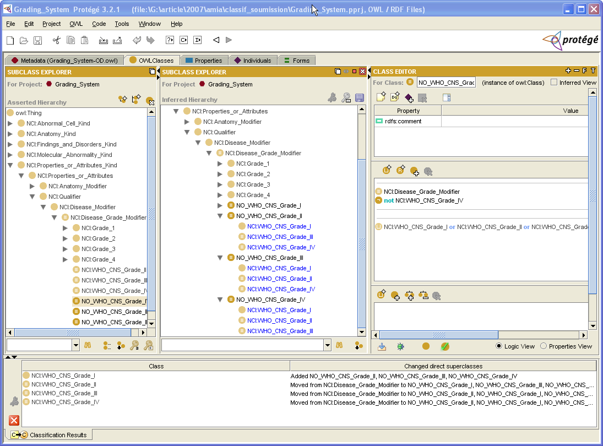
signs -> excludes (negative predictive value)
« NoGrade » IV
Grade I or grade II
or grade III

Slide 12
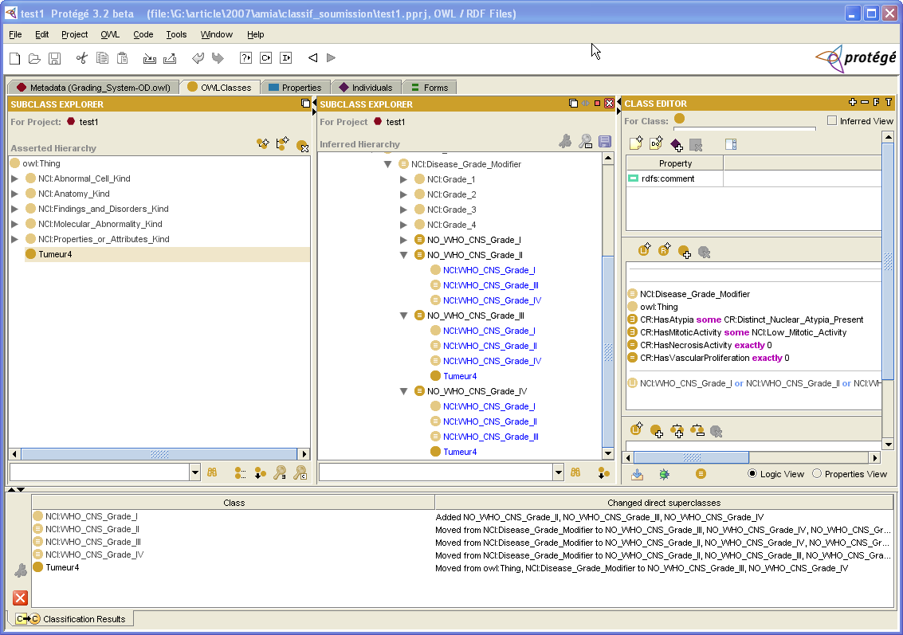

Slide 13
Take into account semiology in ontology
  Burgun A, Bodenreider O, Jacquelinet C. Issues in the classification of disease instances with ontologies. Stud Health Technol Inform. 2005;116:695-700.
Need to be represented
  Automatize +++
  Modularize : clinical signs (warmth, swelling), biological (ESR > 40), pathology (leukocytes inflitration), radiological
    the major criteria for diagnosis of OA is joint pain. This is contrasted to radiographic criteria, in which many patients do not report joint pain
Formal definitions
  Grades
  Disorders such as anemia
Organize defined classes as subclasses of primitive classes
  Criteria demonstrated 91-94% sensitivity and 89% specificity for RA
  Rheumatoid-Arthritis [Primitive]
    Subclass Rheumatoid-Arthritis [Defined: classification A]
    Subclass Rheumatoid-Arthritis [Defined: classification B]
  Meta-reasoning : several classifications with different Se, Sp

Slide 14
Acknowledgements
O. Dameron, PhD, EA 3888 - description logics
Julie Chabalier, PhD, EA 3888 - description logics
Régis Duvauferrier, MD, EA 3888; Service d’Imagerie Médicale - clinician
Olivier Bodenreider, MD, PhD - MIE paper, comments

