Slide 1


Clinical signs and findings in neonatology
Andrew James MBChB MBI FRACP FRCPC
Neonatology, The Hospital for Sick Children
University of Toronto, Toronto, ON

Slide 2
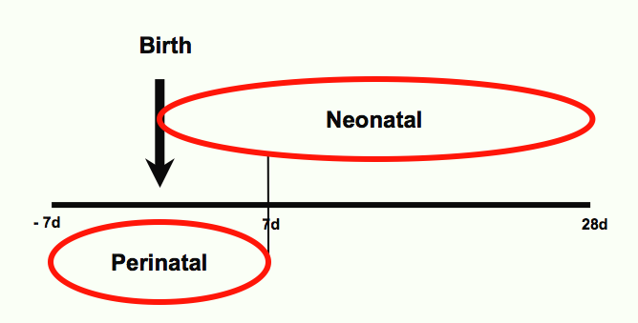
The neonatal period . . .

Slide 3
Care of the newborn infant
Perinatal events [labour and delivery, postnatal transition to extrauterine environment]
Immaturity
Respiratory distress
Jaundice
Infection
Low birthweight [preterm infant, small mature infant ]
Congenital malformations

Slide 4
Representation of care of the neonate
Disorders/Diseases
Clinical features {symptoms, signs, results of investigations including images}
Interventions [therapeutic]
Knowledge representation must be current, accurate, precise, and unambiguous
Integration of ‘new’ knowledge, retirement of ‘old’ knowledge
Relationships important

Slide 5
Challenges for representation
Disorders unique to the newborn infant
Origin in embryonic, fetal or neonatal period
Outcome of a disorder that no longer exists
Transient disturbances of function
Intervention to prevent an occurrence
Resolution of disorder but persistence of consequences into infancy, childhood, and beyond
Genetically determined conditions usually asymptomatic at birth

Slide 6
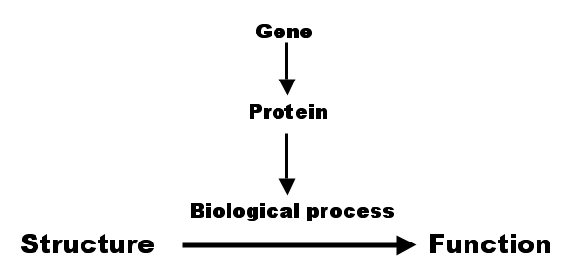
Emphasis upon structure . . .

Slide 7
Structural perspective
Disorder of the respiratory system . . .
Disorder of the upper respiratory tract . . .
Disorder of the lower respiratory tract
Disorder of the trachea . . .
Disorder of the bronchi . . .
Disorder of the lung . . .
Meconium aspiration
Respiratory distress syndrome
Pneumonia

Slide 8
Emphasis upon function . . .
Abnormal

Slide 9
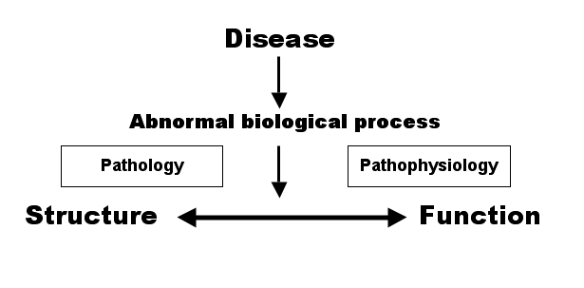
Functional perspective . . .

Slide 10
Abnormal function has a finding
Abnormality of the respiratory system
Abnormality of breathing . . .
Abnormality of gas distribution . . .
Abnormality of gas exchange . . .
Mapping abnormal function to symptoms and signs . . .
Breathing rate
Respiratory noise
Cyanosis

Slide 11
Respiratory distress . . .
Commonest presenting problem in neonatal period
Constellation of respiratory signs
  tachypnoea
  grunting
  chest wall indrawing [subcostal, intercostal . . .]
  cyanosis
Clinical features of a disorder — respiratory, cardiovascular, or something else?

Slide 12
Respiratory distress . . .
Commonest presenting problem in neonatal period
Constellation of respiratory signs
  tachypnoea
  grunting
  chest wall indrawing [subcostal, intercostal . . .]
  cyanosis
Clinical features of a disorder — respiratory, cardiovascular, or something else?

Slide 13
Tachypnoea
is_a increased rate of breathing
is_a abnormality of breathing rate
is_a abnormality of breathing
is_a sign of the respiratory system
is_a sign
is_a finding

Slide 14
Grunting
is_a respiratory noise at the end of expiration
is_a respiratory noise of expiratory phase of breathing
is_a respiratory noise
is_a abnormality of breathing
is_a sign of the respiratory system
is_a sign
is_a finding

Slide 15
Subcostal indrawing
is_a indrawing of the subcostal chest wall muscles
is_a indrawing of the chest wall muscles
is_a abnormality of breathing
is_a sign of the respiratory system
is_a sign
is_a finding

Slide 16
Cyanosis
is_a excess of reduced haemoglobin in the blood
is_a abnormality of systemic oxygenation
is_a sign of the circulatory system
is_a sign
is_a finding

Slide 17
Cyanosis
is_a excess of reduced haemoglobin in the blood
is_a abnormality of systemic oxygenation
is_a sign of the circulatory system
is_a sign
is_a finding
Circulatory system — to supply all the organs of the body with blood [oxygen]
Respiratory system — to breath

Slide 18
More on cyanosis . . .
Abnormal function within respiratory system
Abnormal breathing
Abnormal gas distribution
Abnormal gas exchange
Abnormal function within circulatory system
Abnormal pulmonary blood flow
Abnormal intracardiac mixing of blood
Abnormal binding of oxygen to blood to haemoglobin

Slide 19
Respiratory distress due to RDS
is_a maturational deficiency of surfactant
is_a loss of stability of the alveolus
is_a abnormality of alveolar function
is_a abnormality of pulmonary gas exchange
is_a abnormality of pulmonary oxygenation
is_a disorder of the respiratory system
is_a disorder
is_a finding

Slide 20
Subdiaphragmatic TAPVD
is_a obstruction to pulmonary venous drainage
is_a abnormality of pulmonary venous drainage
is_a abnormality of pulmonary perfusion
is_a abnormality of systemic oxygenation
is_a disorder of the circulatory system
is_a disorder
is_a finding

Slide 21
A couple of questions . . .
Does an ontological approach provide a rigorous method for the representation of the care of the newborn infant?
Can a family of ontologies define relationships between:
  structure and function
  disease and abnormal and/or function
  genotype and phenotype

Slide 22


