Slide 1
Signs, Symptoms and Findings:
First Steps Toward an Ontology of Clinical Phenotypes
September 3 - 4, 2008
Dallas, TX

Slide 2
Wireless
Select ibahn_conference
Launch browser
Type ibahn in address bar
Enter conference code: 02AEF7

Slide 3
Administrative
Agenda
Format
Workshop Organization
Support
Introductions
Notes:
Agenda
clinical perspective of how examinations and findings are used for patient management
approaches for how these entities are represented in the medical record
how this information is used for clinical research
how do we achieve convergence between existing and emerging approaches to support the variety of uses by the variety of stakeholders
Format - stimulate dialog (10 min for formal presentation)
identify problems and develop solutions
Workshop Organization
Barry, Richard and Sandra
Support
NCBO, UT Southwestern CTSA, Lead Horse Technologies, Cleveland Clinic Foundation
Introductions - go around the room

Slide 4
Pre-workshop Comments
Try to answer two questions:
  1) What are the fundamental types of things for which we need ontological categories? (Do we really need to differentiate “signs” from “symptoms”?)
  2) What are the criteria by which we can judge whether we have good categories and good definitions?
    the degree to which ordinary clinicians can understand and reproducibly apply the definitions.
  --Kent Spackman
I have two comments:
  Phenotypes (as well as observable entities) may be normal. It's interesting to mention that in MPO the synonyms for normal phenotype are 'viable' and 'fertile'....
  Some distinctions are difficult to get. For example, the distinction between chronic disorder and progressive disorder is difficult in practice as many chronic diseases end up with complications.
  --Anita Burgun-Parenthoine
Overall, I think clarification is very much needed regarding the distinction among observations (already between the process of observing and its result), what is observed, and the link between observations and diseases (or, more generally, phenotypes). The link between ontology/terminology (e.g., LOINC) and information model (e.g., HL7 messages) would also need to be discussed. Finally, I believe there is no absolute (ontological) relationship between signs/symptoms and diseases, at least for most signs, symptoms and diseases, which raises the issue of the distinction between ontology and clinical knowledge bases.I agree very much with Kent on the point that reproducibility, not dogma should be considered when attempting to make some of these distinctions. Lack of reproducibility was the reason for SNOMED CT to go back to "clinical finding" as the parent category encompassing findings, diseases and other categories. The same phenomenon is present in the UMLS through multiple categorization of entities such as some anatomical abnormalities (anatomical structure + disease).On the terminology font, I believe your "bodily features" correspond to what is called "Organism attribute" in the UMLS Semantic Network.
  --Olivier Bodenreider
I can see that the discussion is already getting off the ground and want to add a couple of thoughts. The workshop and the definitions of terms here (like 'Normal Homeostasis', 'Disorder' etc) are focused with the context 'human beings'. However the terms themselves are equally applicable in the more general sense to all animals. It may be useful to provide a broader definition because of the interplay between humans and animals (infectious diseases and their accompanying signs and symptoms - eg. rabies) as well as translational research.thanks,
  --Sivaram Arabandi
I would like to suggest to add a concept of Homeostatic Profile. The current concept of Homeostatic Range is good for a single measure of a sign, symptom or finding. Homeostatic Profile is good for a collection of homeostatic ranges of a homeostatic state.
  --Ashley Xia
From the content of the document you distributed involving disorders, findings, signs, symptoms, and processes, I gather that we will be facing some difficult conceptual issues related to classifying subsumption relations for which there do not appear to be intuitive child-parent links (e.g. those relating findings and disorders.) This is a constant challenge we face at Lead Horse Technologies, whether we are browsing SNOMED-CT or developing and editing our own, proprietary ontologies. There are approaches aimed at solving this dilemma, used by us and others, but they often can involve labor intensive curation and constant editing. If it’s not too late, I’d like to propose that topics discussed at the workshop this week include the idea that dilemmas like the one described here may be approached through tying the curation of intraontological relations not to intelligent design but to evolution – that is, linking the curation of subsumption relationships to actual clinical enquiries received from practicing clinicians rather than to the efforts of ontology development professionals such SNOMED-CT editors. This would boil down to applying a wiki-approach to ontology evolution and it is one that we are working on at Lead Horse. Food for discussion, even if only over a glass of wine.
  --John Armstrong

Slide 5
Motivation
Better clarity to how the relevant information relates to each other
Better support for use in the context of patient care, clinical research and translational research
Extensibility

Slide 6
Constraints
We need to be accurate
We need to be practical (reproducibility vs dogma)
  What can we expect the clinicians to understand and provide?
  Is the distinction between chronic and progressive easily determined?
We need to leverage and harmonize existing and emerging standards

Slide 7
Goals
What are the fundamental types of things for which we need ontological categories (what’s the domain)?
  disease initiation, progression, pathogenesis, signs, symptoms, assessments, clinical and laboratory findings, disease diagnosis, treatment, treatment response and outcome
  normal phenotype, homeostatic (normal) profile
What are the fundamental relationships between the types of things?
  between the process of observing, the results of the observation and what is being observed
  between signs/symptoms and disease (no absolutes?)
  between clinical and pre-clinical pathological processes, their manifestations and their representations in the EHR
How should ontologies be developed - intelligent design or natural selection (evolution)?
What is the relationship between the ontologies/terminologies and the information models?
Notes:
Answer the following questions.

Slide 8
Outcome Assessment
What are the criteria by which we can judge whether we have good categories and good definitions?
  The degree to which ordinary clinicians can understand and reproducibly apply the definitions.
  The degree to which entities can be easily mapped between humans and animal models.
  The degree to which the categories can accommodate new diagnostic technologies (e.g. proteomics).
  The degree to which electronic medical record data can be integrated with clinical and translational research data.

Slide 9
An ontology-based approach for connecting disease pathogenesis with clinical/laboratory data
Richard Scheuermann

Slide 10
Motivation
Use of medical record information in support for clinical and translation research
Consistent, logical and extensible framework

Slide 11
Big Picture
What we observe
etiological event
progressive pathological process
therapeutic response
bodily
features
clinical
phenotype
What we treat
person
disorder
disorder
w/symptom
disorder
w/sign
homeostatic
profile
self
assessment
self
assessment
physical
exam
specimen
isolation
treatment
representation
of symptom
clinical
finding
lab
test
lab
finding
clinical
picture
interpretive
process
diagnosis
plan
What we record
patient management
plan development

Slide 12
Key concepts
Bodily features
Normal/Abnormal
Homeostasis
Types of disorders
Types of pathological processes (dynamics)
Signs and symptoms
Assessments and laboratory tests
Representations of signs, symptoms and test results
Diagnosis

Slide 13
Definitions Document

Slide 14
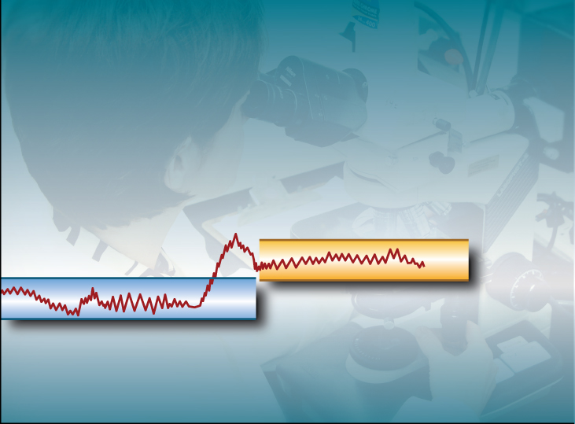
Normal Adaptation
State
Etiological
Event
Normal Homeostatic
Range
Normal Homeostatic
Range
Time

Slide 15
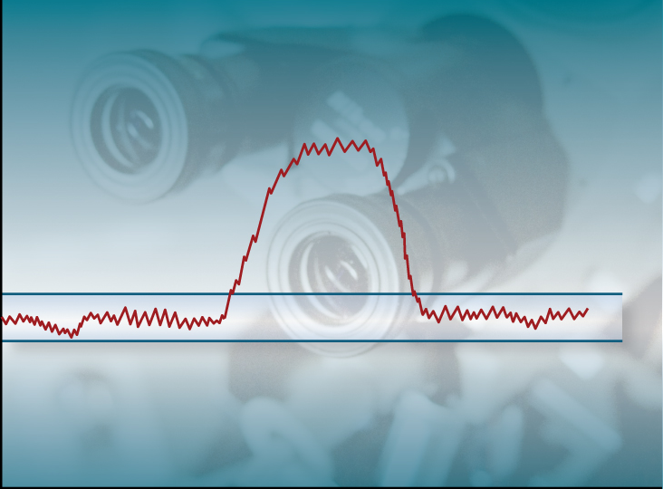
Acute Pathological Process
State
Etiological
Event
Normal Homeostatic
Range
Time

Slide 16
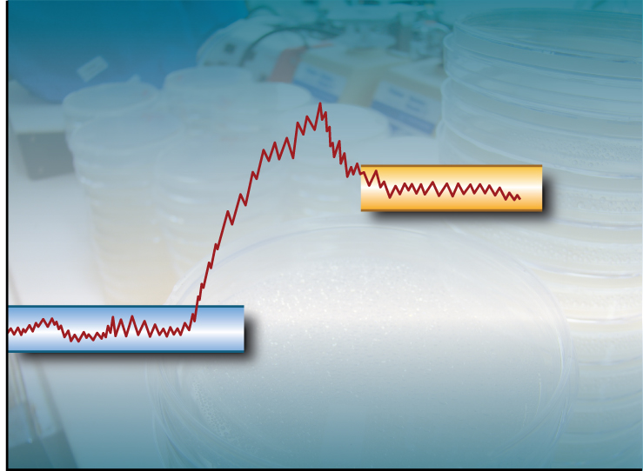
Chronic Pathological Process
State
Abnormal
Homeostatic
Range
Etiological
Event
Normal Homeostatic
Range
Time

Slide 17
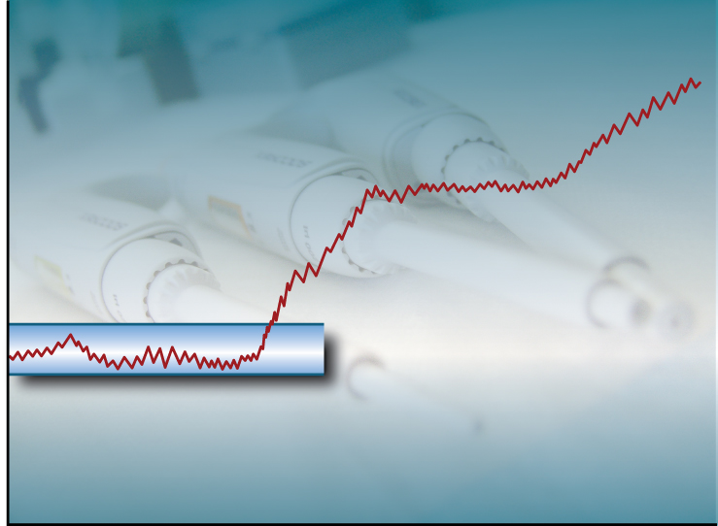
Progressive Pathological Process
State
Etiological
Event
Normal Homeostatic
Range
Time

Slide 18
Feasibility Use Case
1. Find all patients who are
    at average risk for colorectal cancer [?normal disposition],
    undergoing colon cancer screening by colonoscopy [physical exam], and
    age 50 and older [bodily feature].
2. Find all SLE [disorder => diagnosis] patients with stable, mildly active disease [chronic pathological process] and up-to-date immunization history [bodily features].
3. Find all patients with diagnosis of active rheumatoid arthritis [diagnosis] that have
    failed to respond positively to at least 1 disease modifying anti-rheumatic drug due to toxicity or lack of efficacy [type of disorder],
    and have either
      C-reactive Protein (CRP) >2.0 mg/dL [laboratory finding],
      or Erythrocyte Sedimentation rate (ESR) ≥28 mm/hour [laboratory finding],
      or morning stiffness for ≥45 minutes [clinical finding].
4. Find all normal volunteer adult subject with
    BMI of ≥22 kg/m2 [bodily feature], and
    a desire to lose weight [?normal disposition].
5. Find all males and females [bodily feature] with
    ages 6 to 20 years [bodily feature], and
    a diagnosis of asthma or asthma symptoms [diagnosis] for at least 1 year,
    and who are
    able to perform spirometry (breathing test) [?normal disposition], and
    are either themselves willing to sign the written Informed Consent or assent prior to initiation of any study procedure [disposition], or whose parent or legal guardian is willing to sign the written Informed Consent prior to initiation of any study procedure, and
    have some form of insurance which covers costs of medications [??].

