Slide 1
Room for Lunch: Arlington Room
Room for Evening Reception: Grand Prairie Room

Slide 2
NCBO
National Center for Biomedical Ontology

Slide 3
Open Biomedical Ontologies (OBO)
Foundry
http://obofoundry.org

Slide 4
Session 2: Ontological approaches to describing the clinical phenotype

Slide 5
Background
No common standards of representation for molecular biology for diseases
Biomedical ontologies don’t interoperate
Most health data focused on billing needs
EHR systems don’t interoperate
Personalized medicine requires computer-aided selection from ever larger populations of candidates for clinical trials

Slide 6
RELATION TO TIME GRANULARITY | CONTINUANT |  |  |  | OCCURRENT
 | INDEPENDENT |  | DEPENDENT
ORGAN AND ORGANISM | Organism (NCBI Taxonomy) | Anatomical Entity (FMA, CARO) | Organ Function (FMP, CPRO) | Phenotypic Quality (PaTO) | Biological Process (GO)
CELL AND CELLULAR COMPONENT | Cell (CL) | Cellular Component (FMA, GO) | Cellular Function (GO)
MOLECULE | Molecule (ChEBI, SO, RnaO, PrO) |  | Molecular Function (GO) |  | Molecular Process (GO)
Clinical phenotype (SNAPSHOT)

Slide 7
RELATION TO TIME GRANULARITY | CONTINUANT |  |  |  | OCCURRENT
 | INDEPENDENT |  | DEPENDENT
ORGAN AND ORGANISM | Organism (NCBI Taxonomy) | Anatomical Entity (FMA, CARO) | Organ Function (FMP, CPRO) | Phenotypic Quality (PaTO) | Biological Process (GO)
CELL AND CELLULAR COMPONENT | Cell (CL) | Cellular Component (FMA, GO) | Cellular Function (GO)
MOLECULE | Molecule (ChEBI, SO, RnaO, PrO) |  | Molecular Function (GO) |  | Molecular Process (GO)
Clinical phenotype (SNAPSHOT)

Slide 8
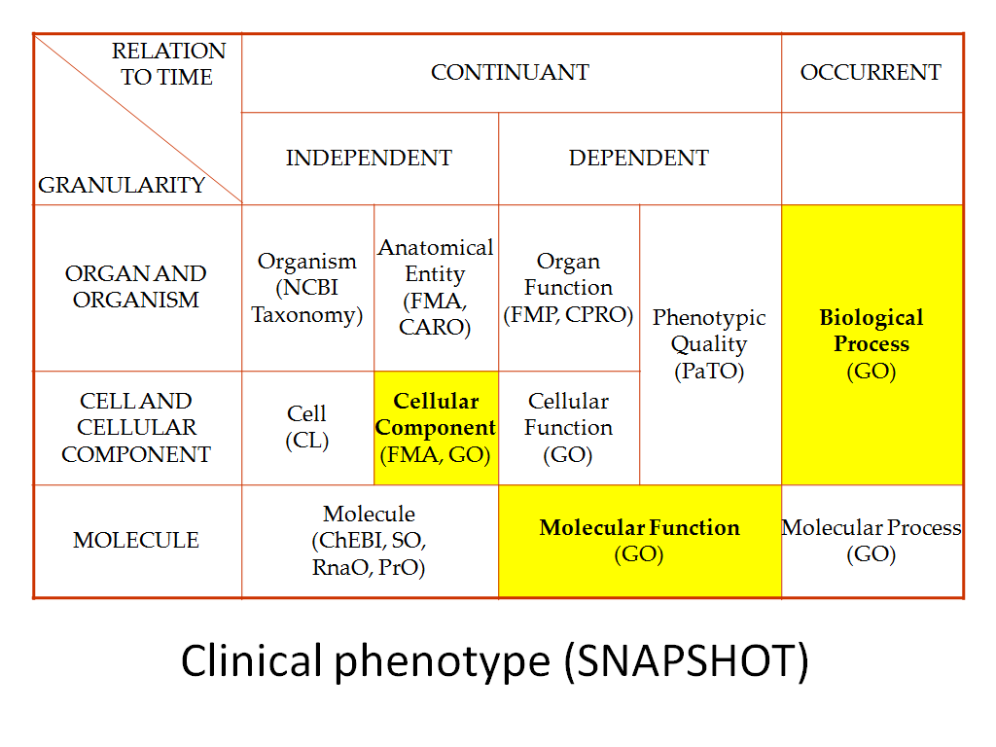
time
pre-clinical clinical

Slide 9
RELATION TO TIME GRANULARITY | CONTINUANT |  |  |  | OCCURRENT
 | INDEPENDENT |  | DEPENDENT
ORGAN AND ORGANISM | Organism (NCBI Taxonomy) | Anatomical Entity (FMA, CARO) | Organ Function (FMP, CPRO) | Phenotypic Quality (PaTO) | Biological Process (GO)
CELL AND CELLULAR COMPONENT | Cell (CL) | Cellular Component (FMA, GO) | Cellular Function (GO)
MOLECULE | Molecule (ChEBI, SO, RnaO, PrO) |  | Molecular Function (GO) |  | Molecular Process (GO)
To address the problem of too many standards: impose orthogonality

Slide 10
Strategy for adoption
Build on success of Gene Ontology
Create and test guidelines on the basis of what works
Find champions of good practice in use of terminology in clinical domains
who demonstrate research success and clinical success (“quality measures”)

Slide 11
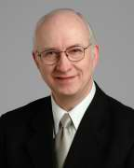
Cleveland Clinic Semantic DB
40 years of legacy data of Cleveland Clinic Thoracic and Cardiovascular Surgery
Gene Blackstone

Slide 12
Sivaram Arabandi:
Reasoning with clinical exam and laboratory findings
Examples
Measure outcomes of different types of surgical procedures in a standard way
Provide resource to personalized medicine to identify ever larger populations of candidates for clinical trials

