Slide 1
Universal Core Semantic Layer (UCore SL)
An Ontology-Based Supporting Layer for UCore 2.0
Barry Smith (NCOR)
Lowell Vizenor (NCOR)
Jim Schoening (ANCDS-CoE)
September 23, 2009

Slide 2
UCore SL
An incremental strategy for achieving semantic interoperability
Leaves UCore 2.0 as is, but provides a logical definition for each term in UCore 2.0 taxonomy and for each UCore 2.0 relation
UCore SL is designed to work behind the scenes in UCore 2.0 application environments as a logical supplement to the UCore messaging standard

Slide 3
UCore SL
Initiative of NCOR and Army Net-Centric Data Strategy Center of Excellence with contributions from the Intelligence Community and multiple Army COIs

Slide 4
XML vs. OWL DL
XML → syntactic interoperability
OWL DL → semantic interoperability

Slide 5
UCore 2.0 Taxonomy
Owl:Thing
Entity
Event
Alert Event
Criminal Event
Communication Event
Cyberspace Event
Disaster Event
Economic Event
Emergency Event
Environmental Event
Evacuation Event
Exercise Event
Financial Event
Hazardous Event
Humanitarian Assistance Event
Infrastructure Event
Law Enforcement Event
Migration Event
Military Event
Natural Event
Planned Event
Political Event
Public Health Event
Security Event
Social Event
Terrorist Event
Transportation Event
Weather Event
Cargo
Collection of Things
Cyber Agent
Document
Environment
Equipment
Facility
Financial Instrument
Geographic Feature
Group of Organizations
Group of Persons
Information Source
Infrastructure
Living Thing
Micro Organism
Animal
Person
Plant
Organization
Political Entity
Vehicle
Aircraft
Spacecraft
Ground Vehicle
Watercraft
Sensor

Slide 6
UCore Entity Taxonomy
Cargo
Collection of Things
Cyber Agent
Document
Environment
Equipment
Facility
Financial Instrument
Geographic Feature
Group of Organizations
Group of Persons
Information Source
Infrastructure
Living Thing
Organization
Political Entity
Vehicle
Sensor
Micro Organism
Animal
Plant
Ground Vehicle
Watercraft
Aircraft
Spacecraft
Person

Slide 7
UCore Event Taxonomy
Alert Event
Criminal Event
Communication Event
Cyber Space Event
Disaster Event
Economic Event
Emergency Event
Environmental Event
Evacuation Event
Exercise Event
Financial Event
Hazardous Event
Humanitarian Assistance Event
Infrastructure Event
Law Enforcement Event
Migration Event
Military Event
Natural Event
Observation Event
Planned Event
Political Event
Public Health Event
Security Event
Social Event
Terrorist Event
Transportation Event

Slide 8
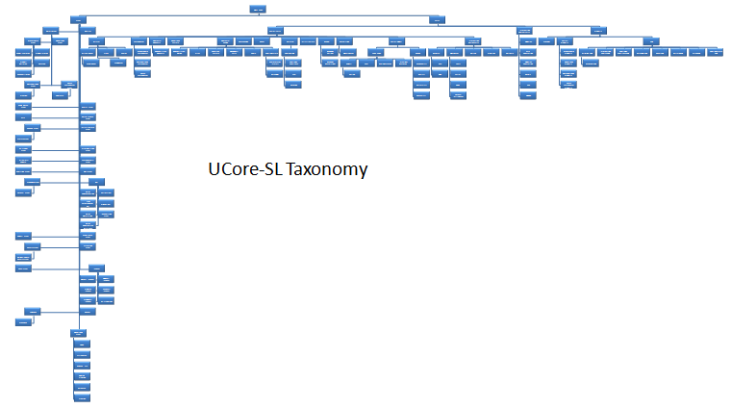
UCore-SL Taxonomy showing logical factoring of UCore terms

Slide 9
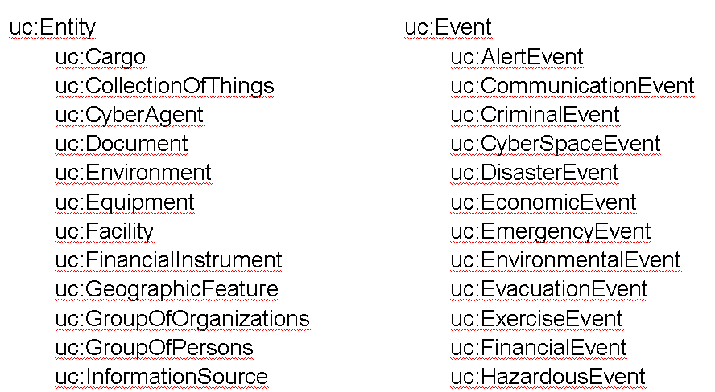
fragment of UCore 2.0 Taxonomy

Slide 10
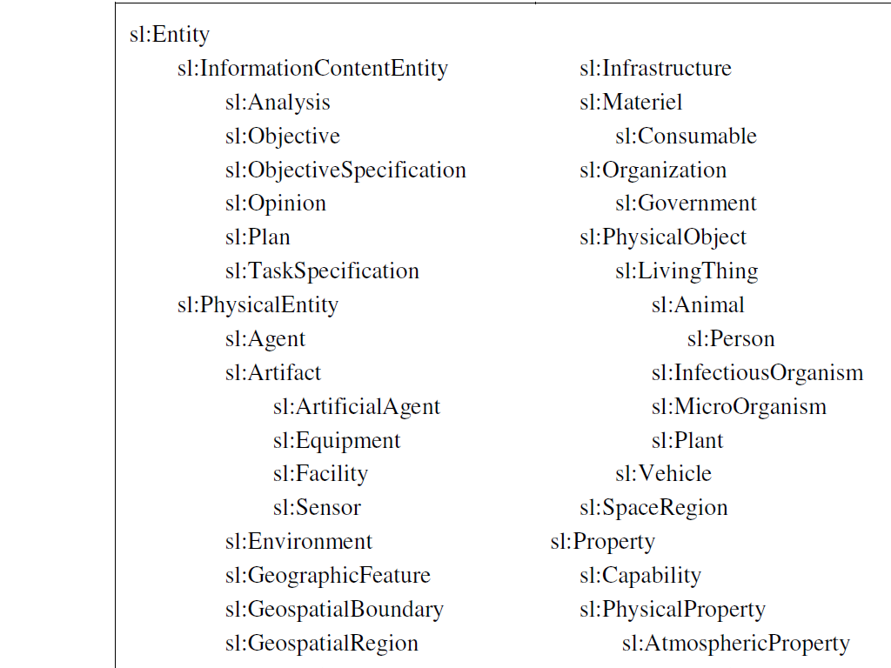
fragment of UCore SL Taxonomy

Slide 11
XML vs. OWL
UCore 2.0 is an XML artifact; definitions are logically unarticulated
UCore SL is an OWL DL artifact; definitions are logically articulated

Slide 12
OWL DL allows use of UCore SL
To leverage UCore 2.0 by facilitating consistent merging with other OWL DL resources
To support use of W3C-standards-based software providing:
Enhanced reasoning with UCore message content
Enhanced quality assurance
Consistent evolution of UCore
Reliable and consistent extension modules

Slide 13
Potential Benefits for UCore 2.0
Provide automatic warnings e.g. for potential ambiguities in UCore 2.0 terms and definitions
Automatic consistency checking when extensions to UCore 2.0 are proposed
Identify logical gaps in UCore 2.0 taxonomy and relations
Allow integration of UCore 2.0 XML-based techology with W3C (Semantic Web) content

Slide 14
Potential Benefits for UCore Users
Provide flexible refactoring of UCore 2.0 for different (DoD, IC, DoJ, …) purposes, while preserving interoperability
Allow development of standards-based tools to support and enhance verification of UCore messages for correctness
Application of more powerful logic-based tools e.g. in identifying referents of terms using in messages
Help UCore users work more effectively in retrieving and processing messages

Slide 15
What NCOR can do for UCore users
NCOR has several years experience applying semantic technology to terminology resources across multiple domains, including
biosurveillance
geospatial information
multi-source data and information fusion
infectious disease
petrochemical industry
vaccine research

Slide 16
What NCOR can do for UCore users
NCOR offers its services in three areas:
training in use of semantic technology
evaluation of terminology resources
creating consistent extensions of core resources that work well across multiple domains
use of semantic technology to support reasoning with data

Slide 17
Benefits of coordination
Each new COI
can profit from lessons learned at earlier stages and avoid common mistakes
can more easily reuse tested software resources
can collect data in forms which will make it automatically comparable with data already collected
No need to reinvent the wheel

