Slide 1
PRIME Program for Research on Immune Modeling and Experimentation PI: Stuart Sealfon, Mount Sinai School of Medicine

Slide 2
PRIME TEAM
Yale University
Ohio State University
Princeton University
Contur Software AB: Electronic Laboratory System (ImmunELN)
BioAnalytics Group LLC
University at Buffalo (ontologies)

Slide 3
PRIME Objectives
Modelling: Develop user-friendly models of dendritic cell (DC) responses to pandemic, seasonal and modified H1N1 influenza viruses
Experimentation: Measure human and mouse DC responses to test model predictions
Informatics / Ontology:
point of experiment data capture
sharing of data within and without PRIME
automated deposition into Immport

Slide 4
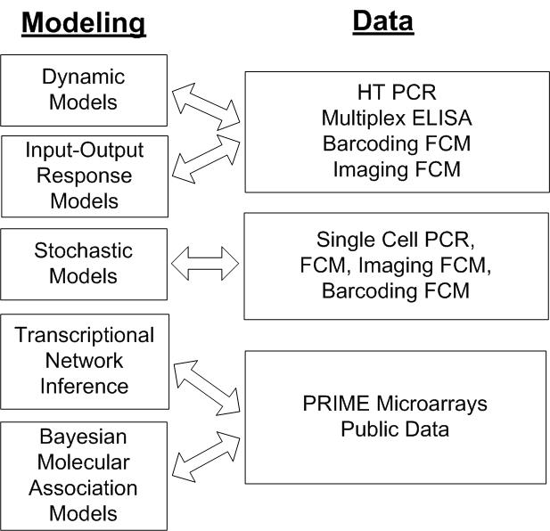

Slide 5
Modeling Overview
response of DCs
involves combinatorial effects of many variables
time
cytokine microenvironment
virus immune antagonist characteristics and variation between cells
forming a high-dimensional experimental space that can only be sparsely explored by specific experiments
→ need for powerful informatics background framework

Slide 6
Experimental Program for Model Validation

Slide 7
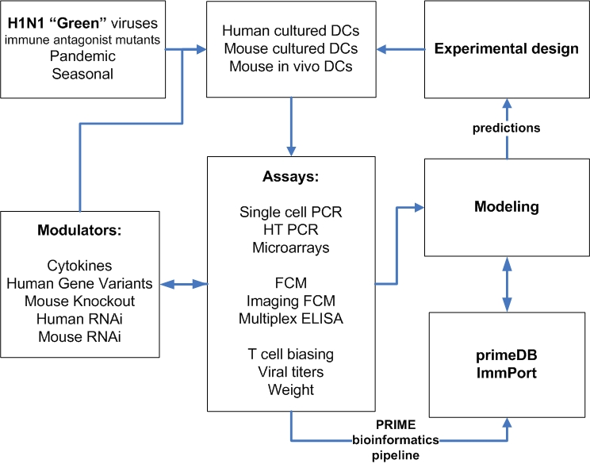

Slide 8
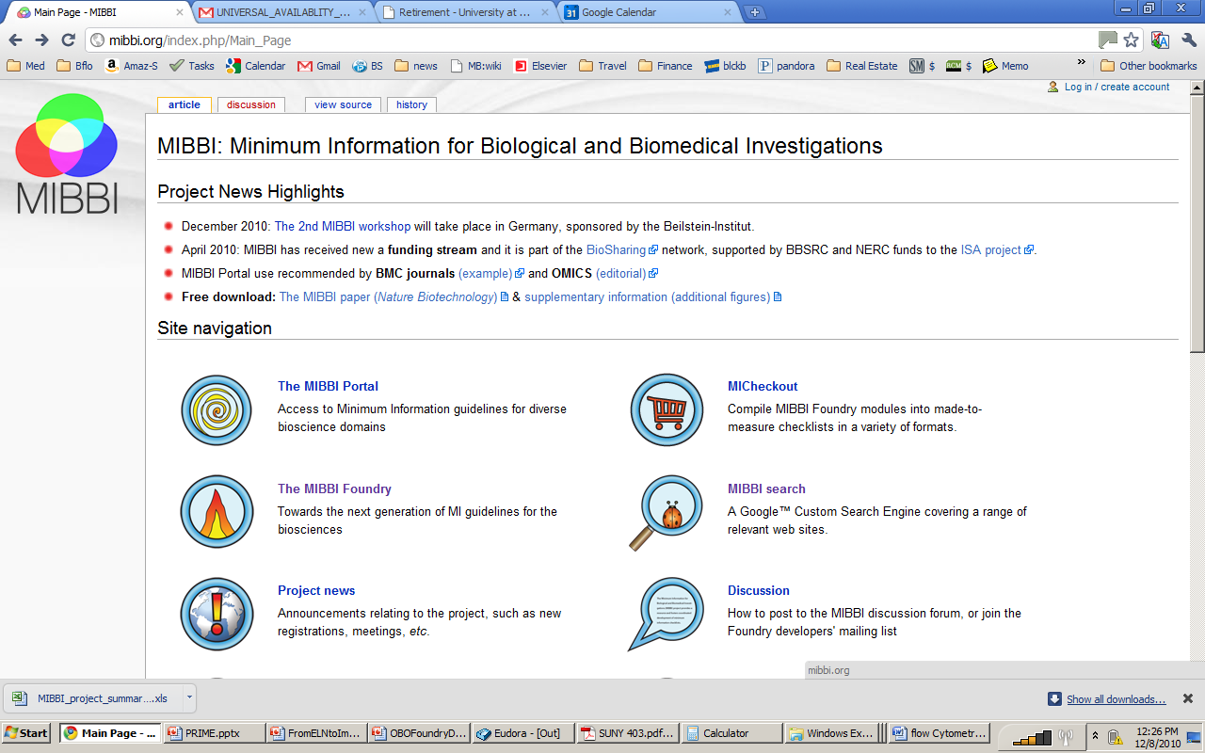

Slide 10
RELATION TO TIME GRANULARITY | CONTINUANT |  |  |  | OCCURRENT
 | INDEPENDENT |  | DEPENDENT
ORGAN AND ORGANISM | Organism (NCBI Taxonomy) | Anatomical Entity (FMA, CARO) | Organ Function (FMP, CPRO) | Phenotypic Quality (PaTO) | Biological Process (GO)
CELL AND CELLULAR COMPONENT | Cell (CL) | Cellular Component (FMA, GO) | Cellular Function (GO)
MOLECULE | Molecule (ChEBI, SO, RNAO, PRO) |  | Molecular Function (GO) |  | Molecular Process (GO)

Slide 11
Overview of MIFlowCyt Standard
Experiment overview Purpose Experiment variables, e.g. ±treatment Organization Primary contact, Date Conclusions Quality control measures Flow Sample/Specimen Details Biological sample description Sample type, source, taxonomy ... Sample treatment description Fluorescence reagent description Characteristic(s) being measured Analyte, e.g. intracellular IL-2 Analyte detector, e.g. anti-IL-2 Ab Reporter, e.g. FITC Manufacturer, Catalog # | Instrument Details Instrument manufacturer Instrument model Instrument configuration and settings Excitation optics configuration: - optical filters - optical detectors - optical paths (see Data Analysis Details Data files, e.g. FCS files Compensation details Data transformation details (when no compensation) Gating (Data filtering) details

Slide 12
ImmPort’s Minimum information guidelines
“MIFlowCyt is the recommended standard for flow cytometry results.”
Six Metadata transfer templates
Protocols.xls [linked to protocol file(s)]
Reagents.xls
SubjectsHuman.xls or SubjectsAnimal.xls
Experiments.xls
BioSamples.xls
ExperimentSamples.xls
Flow cytometry data deposition:
Flow cytometry results template “FCM_derived_data.xls”
FCS files to be provided
For further details, go to:
https://www.immport.org/immportWeb/display.do?content=DataTemplates

Slide 13
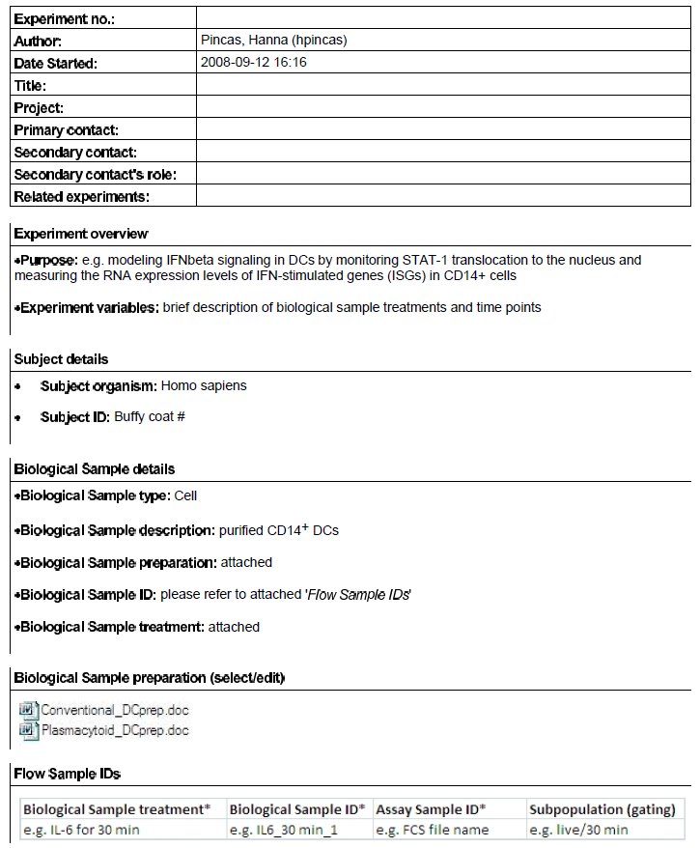
Latest ELN template for a Flow Cytometry experiment

Slide 14
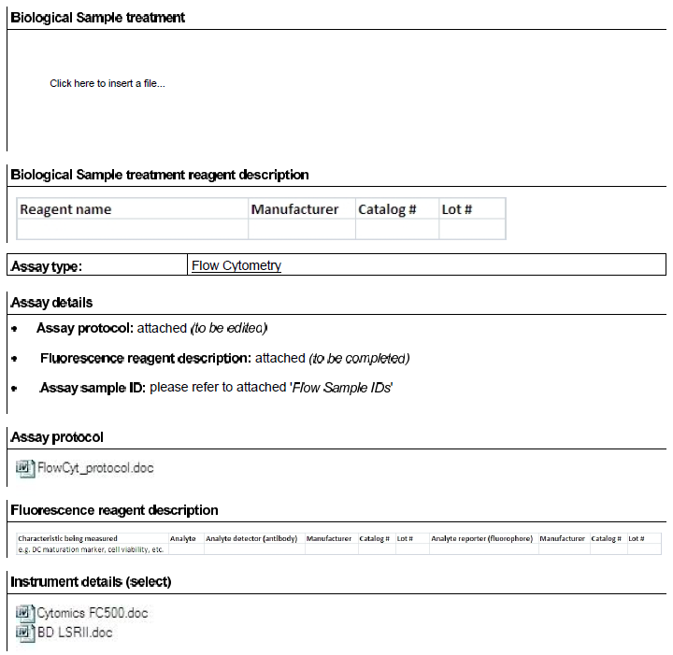
Latest ELN template for a FCM experiment (continued)

Slide 15
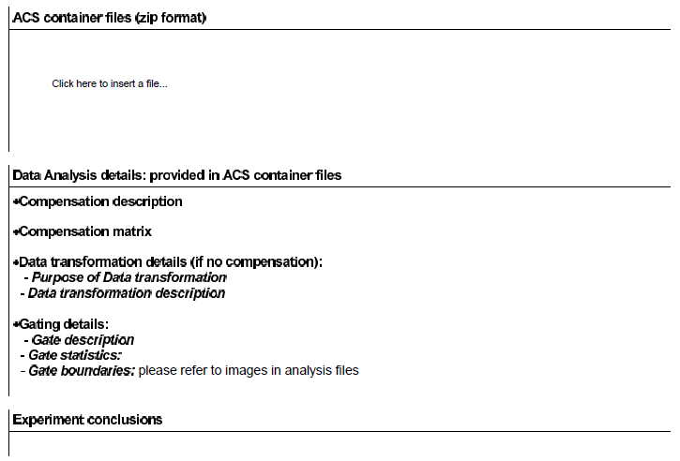
Latest ELN template for a FCM experiment (continued)
ACS = Analysis Cytometry Standard
For more details on the Analysis Cytometry Standard (ACS), go to:
http://flowcyt.sourceforge.net/acs/
http://sourceforge.net/projects/flowcyt/files/Analytical%20Cytology%20Standard/

Slide 16
What is needed
Common Ontologies
MIBBI Foundry
Netcentric Templates for Experiment Description
Governance

