Slide 1


IDO Extensions Alignment
Zuoshuang “Allen” Xiang, Yongqun “Oliver” He
University of Michigan Medical School
12/08/2010

Slide 2
Outline
Goal: compare/align IDO core and IDO extensions
Methods:
3+1 ontologies: FLU, BO, IDOMAL & IDO core
OntoBee extension:
Web interface + RDF store + SPARQL + PHP
Tree structure display
Some basic statistics
Demo of OntoBee/Compasion page
Results

Slide 3
Ontologies Compared
IDO
http://purl.obolibrary.org/obo/ido/2010-12-02/ido.owl
BO
http://sourceforge.net/projects/bo-ontology/
FLU
http://sourceforge.net/projects/influenzo/
IDOMAL
http://anobase.vectorbase.org/idomal/IDOMAL.obo
Converter: oboformat
Retrieved on 12/5/2010

Slide 4
Basic Characters
IDOMAL vs FLU/BO
obo format vs. owl(RDF/XML)
Plain text vs. xml
OBO-Edit vs Protege
Structure glue: part_of, participate_in etc. vs. is_a
Term mapping vs import
New IDs vs. imported IDs

Slide 5
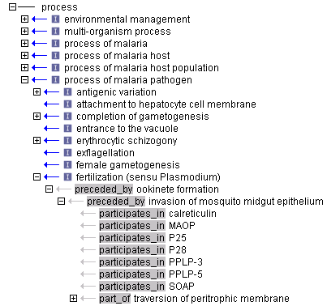
part_of, participate_in etc.

Slide 6
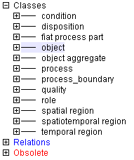
IDOMAL in OBO-Edit
IDOMAL has own IDs for all the root classes

Slide 7
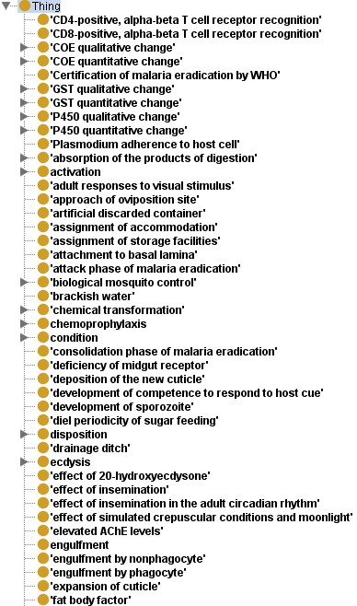
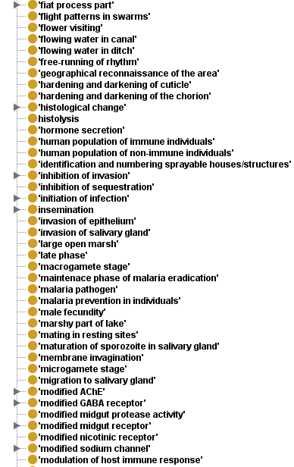
IDOMAL in Protege
Many terms do not have asserted/inferred parents

Slide 8
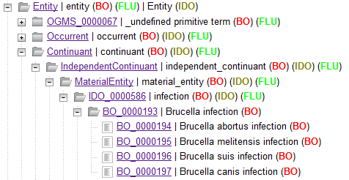
Ontologies Alignment
http://www.ontobee.org/compare/index.php

Slide 9
Term Statistics
Ontology | Number of terms (including imported) | Number of terms (excluding imported)
IDO | 612 | 414
BO | 1302 | 446
FLU | 1221 | 315
IDOMAL | 2442 | 1420
Terms shared by BO, FLU and IDOMAL: 0
Terms shared by BO & FLU (minus 5): 587
Terms shared by BO & IDOMAL (minus 5): 0
Terms shared by FLU & IDOMAL (minus 5): 0
Terms shared by IDO & IDOMAL: 0
Online at http://www.ontobee.org/compare/stat.php

Slide 10
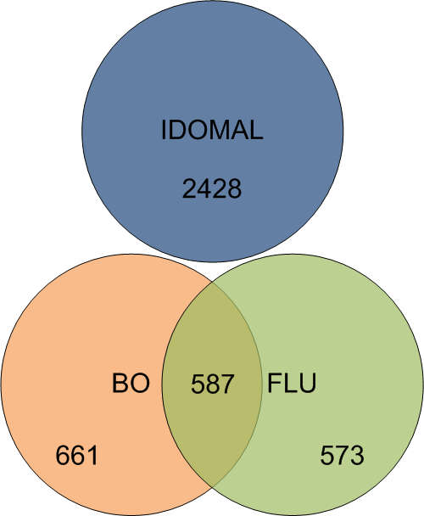
Venn Diagram

Slide 11
Terms with Duplicate IDs
virulence: IDO_0000466; IDOMAL_0000004;
immune response: GO_0006955; IDOMAL_0002357;
population: OBI_0000181; IDOMAL_0001254;
anatomical entity: CARO_0000000; OBI_0100015;
organism: OBI_0100026; IDOMAL_0000640;
infectious disease: IDO_0000436; IDOMAL_0001051;
pathogen: IDO_0000528; IDOMAL_0000063;
vaccine: VO_0000001; IDOMAL_0000262;
protein complex: GO_0043234; IDOMAL_0000732;
host exposure to infectious agent: IDO_0000594; IDO_0000658;
protein: PRO_000000001; IDOMAL_0001067;
B cell receptor complex: GO_0019815; IDOMAL_0000064;
host: IDO_0000531; IDOMAL_0000055;
enzyme: OBI_0000427; IDOMAL_0000729;
author role: IAO_0000442; FLU_0000899;
disposition: http://www.ifomis.org/bfo/1.1/snap#Disposition; IDOMAL_0001050;
object: http://www.ifomis.org/bfo/1.1/snap#Object; IDOMAL_0000003;
quality: http://www.ifomis.org/bfo/1.1/snap#Quality; IDOMAL_0000002;
role: http://www.ifomis.org/bfo/1.1/snap#Role; IDOMAL_0000001;
process: http://www.ifomis.org/bfo/1.1/span#Process; IDOMAL_0000000;
process_boundary: http://www.ifomis.org/bfo/1.1/span#ProcessBoundary; IDOMAL_0002437;
doxycycline: BO_0000113; IDOMAL_0000229;
……. (76 in total)

Slide 12
IDO Terms w/ Child in BO or FLU
IDO_0000568: zoonosis
IDO_0000547: virulence factor
IDO_0000460: infected host
IDO_0000460: infected organism
IDO_0000453: zoonotic disposition
IDO_0000562: antibiotic
IDO_0000425: virulence factor disposition
IDO_0000586: infection
IDO_0000495: infectious disease course
IDO_0000405: pathogen role
IDO_0000436: infectious disease
IDO_0000508: virion
IDO_0000559: antiviral
IDO_0000603: process of establishing an infection

Slide 13
Acknowledgements
IDO
OBI
FLU
IDOMAL
BO

