Slide 1
Is Money a “Product of Massive Fantasy” (MSW, p. 201)
Barry Smith
http://ontology.buffalo.edu/smith

Slide 2
That is, [disputes] about the Nazi expropriation of property, or disputes about the ownership of a painting, or about the boundary line between two countries, are real life disputes among people competing for the right to assign status functions to objects. (Searle, in: Smith and Searle 2003)
see my Eruv paper

Slide 3
Promise on note
Why believe it

Slide 4
Here in Tanzania you need the most recently dated US currency. A 1996 $50 or $100 US note is worthless in exchange for anything. The gray market is discounting these notes by 20%. Right now the reason is primarily the excellent quality of counterfeits being printed by countries not wishing the USA well. Yet here is another milestone that says if you travel often and far, you must have no less than 7 one ounce gold coins in your pocket. Your paper may be worthless. Your plastic stands on continued functioning technology and the solvency of the credit card company.

Slide 5
Argumentum ad obviosum
If somebody tells you that “consciousness doesn’t exist, or that we really can’t communicate with each other, or that you can’t mean ‘rabbit’ when you say ‘rabbit,’ I know that’s false.”
Gustavo Faigenbaum, Conversations with John Searle (Montevideo: Libros En Red, 2001), p. 29.

Slide 6
Proposal
The same applies if someone tells you that money is a ‘product of massive fantasy’

Slide 7
Making the Social World, p. 201
“The recent economic crisis makes it clear that [money and other such instruments] are products of massive fantasy. As long as everyone shares the fantasy and has confidence in it, the system will work just fine. But when some of the fantasies cease to be believable ..., then the whole system begins to unravel.”

Slide 8
The institution exists = The system works (!?)
since the creation of an institutional fact “is really just words, words, words. How do we manage to get away with it? ... to the extent that we can get other people to accept it. As long as there is collective recognition ... of the institutional facts, they will work.” (p. 106)

Slide 9
Can there be non-working institutional facts?
What if you created a bank, or a trade union
... but no one came?

Slide 10
philosophy of society / social ontology
studies “the mode of existence of social entities such as governments, ...trade unions, ... and passports.” (p. 5)

Slide 11
status functions exist
“we (or I) make it the case by Declaration that the status function Y exists” (p. 13)

Slide 12
rights are created
“I say, ‘This one is Sally’s; this one is Marianne’s; and this one is mine.’ ... this has remarkable properties. By making these utterances, I have in fact created new rights. ... I created a reality according to which Sally has certain rights that Marianne does not have.”

Slide 13
One world
“Our task is to give an account of how we live in exactly one world, and how all of these different phenomena, from quarks and gravitational attraction to cocktail parties and governments, are parts of that one world.” (p. 3)
plus many ‘created realities’?

Slide 14
“A corporation is just a placeholder ...”
In other words, talk of corporations is just a shorthand way of talking about a set of actual power relations among actual people ... ?
How is iteration of the counts as Y possible on this basis? (corporation Q counts as defendant in a lawsuit ...) ← Searle: this is the one important point; do get the system off the ground we need nouns for cognitive reasons

Slide 15
In CSR (p. 49) Searle refers to the powers of the king in chess
In MSW he suggests that Y terms sometimes bottom out in people: “A corporation is just a placeholder for a set of actual power relationships among actual people (president, etc.) .. . The same holds for electronic money and blindfold chess. The owner of the money and the possessor of the queen have the relevant powers.” (p. 22)
Is this true for all money?

Slide 16
“A corporation is just a placeholder ... The same holds for electronic money and blindfold chess. The owner of the money and the possessor of the queen have the relevant powers.” (p. 22)
What happens if I take my money to the bank, where it is credited to my account and the paper money is shredded. To powers hop from paper to person?

Slide 17
Suppose I am a really good forger
I put a large amount of (fake) money in a tin box and die.
The (fake) money circulates for hundreds of years and no one notices that it is fake. The system works. Was it ever money?
Suppose McX finds the (fake) money and spends it on mafia lawyers, who help him found a fake charitable corporation, the Verein zur Förderung der Philosophie Hans Vaihingers.

Slide 18
Two possible worlds
A. After 3 weeks the fake corporation is exposed by the Vereinspolizei ...
B. It is never exposed. Gullible people invest their life savings in realizing its mission. After 300 years it has 1000s of investors all of whom believe that it was properly registered with the appropriate authorities.
_________________________________________________________________________________________________________
What, then, was the ontological status of the corporation after 2 weeks?

Slide 19
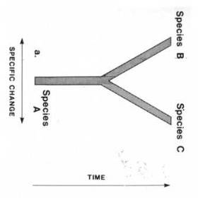
Speciation

Slide 20
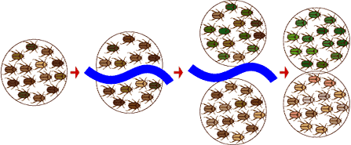
Speciation
Species A
Fritz
Species B
Notes:
http://cpedia.com/wiki?q=Speciation&guess_ambig=Seth+Young+Associate+Professor+Speciation+Froze+Mark+Kleffner

Slide 21
4 ways the truth in the present can be changed because of something that happens in the future
time machine
Catholic marriage
Mayrian speciation
Searlean institutions (incl. money)

Slide 22
at week 2
the corporation is a real corporation if it turns out that, at some stage in the future, the system works and people recognize it as a real corporation
the corporation is not a real corporation if it turns out that, at some stage in the future, the Vereinspolizei expose it as being fake

Slide 23
the so-called “United States of America”
is a real country because the system worked and people recognized it as a real country
the CSA (Confederate States of America), on the other hand, was never a real country, because Ulysses S. Grant captured Richmond in 1865.

Slide 24

But no;

Slide 25
all corporations (including the USA) are fictitious
“when you actually [sic] create a corporation, here is what it looks like:
  We make it the case by Declaration that an entity Y exists that has status function(s) F in C
We have to put it that way because we need to specify not just that the functions exist but that there is an entity Y, the corporation, that has the functions, even though the entity is, as they say, a ‘fictitious’ entity.’ (p. 100)

Slide 26
[More in like confused vein on money on same page]

Slide 27
but on the other hand:
In a sense, there is an element of imagination in the existence of private property, marriage, and government, because in each case we have to treat something as something that it is not intrinsically. ... Small children can say to each other, “Okay, I’ll be Adam, you be Eve” (p. 121)

Slide 28
Searle’s argument why money is a ‘product of massive fantasy’
Various commercial instruments experienced a sudden loss of value. (“The recent economic crisis makes it clear ...”)
Would an increase in value be evidence that money really exists?
What loses value? Pieces of paper? Blips in computers?
Can the degree of being a product of fantasy go up or down?
Can the degree of being a product of fantasy be measured simultaneously in Swiss Francs and Euros?

Slide 29
Searle does not deal with the price of money
Does he deal with prices at all?
There are reciprocal powers (two-sided dependence relations) as between dollar bill and person who owns it. If the dollar bill is paid into the bank, the powers on the money side still remain. To deny this is rather like trying to understand the behavior of the Irish Protestants without taking Catholics into account.

Slide 30
als ob
... money, debts, rights, etc. are not really entities in reality at all. There are no such things. Persons are real, their powers are real – but money does not exist. We just pretend.

Slide 31
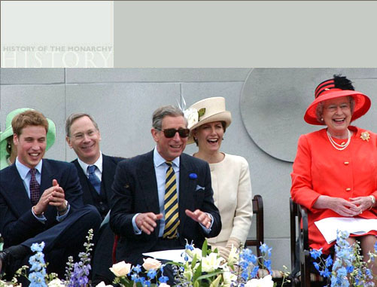
The Monarchic System of Government

Slide 32
Prediction of how Searle will respond
Nothing of philosophical significance turns on any of these questions.
Either the USA existed (as it were) in 1803 or it did not.
Basta

Slide 33
... and my response
Concluding Remarks: The Ontological Founda-tions of the Social Sciences....................200
... an understanding of the basic ontology of any discipline will deepen the understanding of issues within that discipline. [I am attempting to offer] a logical analysis of the fundamental ontology of the social sciences. ... the whole investigation gets a greater depth if one is acutely conscious of the ontology of the phenomena being investigated ...

Slide 34
For instance
What does it mean to say that a ‘placeholder’ (X), for talk about powers of changing groups of people, can serve as the starting point for iterative applications of the X counts as Y formula?

Slide 35
SPARE SLIDES

Slide 36
Money loses value over time.
Degrees of imagination.
Degrees of power of owners to spend. ...
Dirty mafiosi type offers you dollar bills
Dirty mafiosi type offers to sell you access to his bank account

Slide 37
Local money
Local debts are negative money
To have local money = to have positive powers to make payment (in the simplest case because you have physical money in the form of banknotes)

Slide 38
but what about the money in your (digital) bank account?
Searle (1998): ‘all sorts of things can be money, but there has to be some physical realization, some brute fact – even if it is only a bit of paper or a blip on a computer disk – on which we can impose our institutional form of status function.’
But you can’t use a blip on a computer disk to buy a horse.

Slide 39
 | Local | Extended (floats free of its initiating bearers)
Positive | Asset
 | Local money | Extended money
Negative | Liability
 | Local debt | Extended debt

Slide 40
Searle’s dilemma
His goal is to produce an ontology of social reality
but some entities at the very heart of social reality, including money in bank accounts and CDOs, seem not to be ‘entities described by physics and chemistry’

Slide 41
Searle corrects himself
1998: Blips on computers can be money.
2003: Blips in computers rather represent money – in much the way that mortgage documents represent an underlying debt.
But then what is (digital) money, from Searle’s naturalistic perspective?
And what are debts, claims, property rights, laws? These, too, seem to fall outside the world of physics and chemistry

Slide 42
Searle’s new proposed solution:
Making the Social World. The Structure of Human Civilization (2010)
‘the most general logical form of the creation of institutional reality’:
We make it the case by Declaration that a Y status function exists in a context C.
for example, when Jim is promoted to police captain, we make it the case that he has the powers to issue instructions to his constables or to fine you if you behave in certain ways.

Slide 43
Captain Jim is still a physico-biological object
but, in result of the declaration, we all accept that he has these and those positive and negative powers
For each kind of putative non-physical social object, there will be corresponding persons who bear corresponding powers.

Slide 44
A giant web of persons and their socially ascribed powers
  Searle: The universe consists ‘entirely of physical particles in fields of force’ (Making the Social World, p. 3)
  a person possesses money = he has certain powers
  a corporation transacts business = multiple specific persons exercise specific powers
  (All these powers to be resolved, somehow, into physicobiological powers cashed out in terms of fields of force)

Slide 45
Towers of social objects
Searle’s story works, he says, because the formula
We make it the case by Declaration that a Y status function exists in a context C.
can be applied recursively:
‘nearly all of human civilization, is created in its initial existence and maintained in its continued existence by [this] single logico-linguistic operation. …’

Slide 46
Powers of Babel
All the bearers of social powers are persons = entities described by physics and chemistry
The enormous diversity and complexity of human civilization is explained by the fact that the operation … can be applied over and over … to the outcomes of earlier applications and with various and interlocking subject matters (Making the Social World, p. 201).

Slide 47
One consequence
All of this comes at the price of asserting that money, debts, rights, etc. are not really objects at all. Indeed there are no such things. Persons are real, their powers are real – but money does not exist:
Searle: ‘The recent economic crisis makes it clear that [money and other such instruments] are products of massive fantasy.’ (Making the Social World, p. 201)

Slide 48
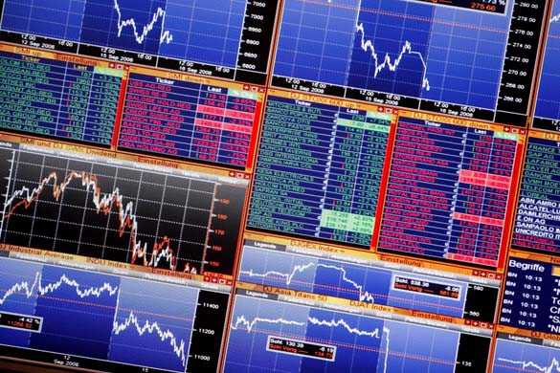
The ontology of stocks and shares

Slide 49
Stocks and shares are indispensable to ensure coordination of the actions of people exercising financial powers
But stocks and shares do not exist. They are products of massive fantasy.

Slide 50
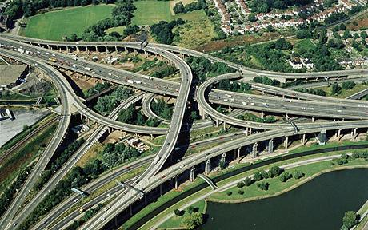
Compare: The ontology of roads

Slide 51
Roads are indispensable to ensure coordination of the actions of people exercising transporting powers
But roads do not exist. They are products of massive fantasy.
(all that exists are e.g. molecules of concrete, and associated fields of force)

Slide 52
The plague does not exist
Don Ferrante was one of the most resolute, and ever afterwards one of the most persevering, in denying it
In rerum natura, he used to say, there are but two species of things, substances and accidents; and if I prove that the contagion cannot be either one or the other, I shall have proved that it does not exist that it is a mere chimera.
(Manzoni, I Promessi Sposi)

Slide 53
Where did Searle go wrong
First, he confuses the two dimensions of loss of value and loss of existence: CDOs do not just cease to exist when their value collapses.
Second, he makes a false analogy between CDOs, the Euro, the doctrines of communism, etc., and what goes on in the theater (all of these things are products of massive fantasy)
Third, he contradicts his own principles of robust realism à la John Wayne.

Slide 54
p. 9
power to vote depends on act of registration

Slide 55
macro-economic fallouts
p. 23 that the economy is currently in a recession is a fact about a whole lot of other institutions.

Slide 56
New ideas
Standing Permanent Speech Acts
p. 19 Status Function Declarations essential for creating and maintaining social acts
p. 86 Think of money as a kind of standing permanent speech act. (Sometimes the speech act is spelled out: On American paper currency it says: “This note is legal tender for all debts public and private.”)
see also p. 88, lines 10f.; on documents pp. 97f. (creation of corporations)
p. 13 Constitutive rules [e.g. of chess] of the form “X counts as Y in C” are what we might think of as standing Declarations.
p. 49 of Construction of Social Reality refers to the powers of the king in chess

Slide 57
New ideas
Blind chess
p. 21f. blindfold chess: in normal chess knight has powers, in blind chess players have powers (?)

Slide 58
macro-economic fallouts
p. 23 that the economy is currently in a recession is a fact about a whole lot of other institutions.

Slide 59
Does anything turn on the answer to such questions?
Money is fictitious
2 kinds of fiction?
Real dollar bills and you do get away with it.
Fake dollar bills and you do get away with it.
Fake dollar bills and you don’t get away with it.
Real dollar bills and you don’t get away with it.

