Slide 1
Immunology Ontology Workshop
Buffalo, NY
June 11-13, 2012

Slide 2

http://www.bioontology.org/wiki

Slide 3
Ontologies
GO-IP Gene Ontology – Immunological Process
CL Cell Ontology immune branches
PRO Protein Ontology
OGMS Ontology for General Medical Science
OBI Ontology for Biomedical Investigations
IO Immunology Ontology
IDO Infectious Disease Ontology
VO Vaccine Ontology
AO Allergy Ontology
IEO Immune Epitope Ontology
ND Neurological Disease Ontology – Autoimmune

Slide 4
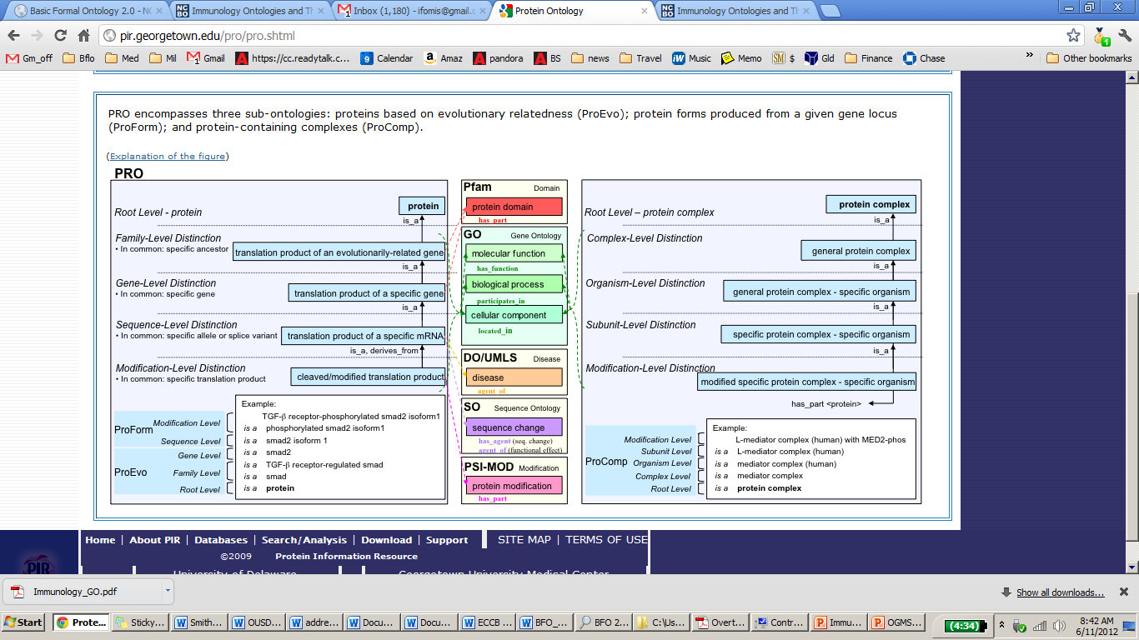
Open Biomedical Ontologies Foundry (obofoundry.org)

Slide 5
Day 1
Reactome Knowledgebase of biological pathways
GO-IP
IO Immunology Ontology
AO Allergy Ontology
IDO Infectious Disease Ontology Core
IDO Staph Aureus
IDO Malaria
IDO Brucellosis
VO Vaccine Ontology

Slide 6
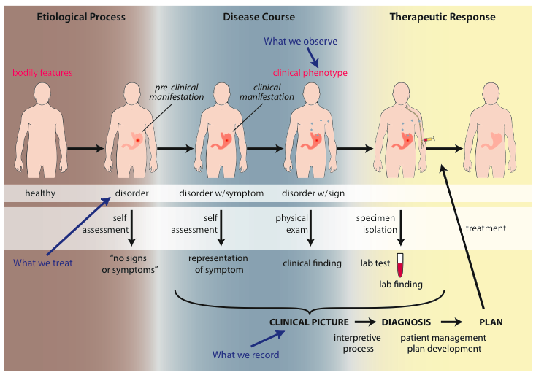
OGMS – Ontology for General Medical Science

Slide 7
Day 2
Ontologies and Flow Cytometry Informatics
Driving Biological Project
Define cell types in CL in terms of surface proteins using relations to terms of the Protein Ontology

Slide 8
Day 3
OBI Ontology for Biomedical Investigations
Representation of immunology experiments
IEDB Immune Epitope Database
ND Auto-Immune Disease Ontology
Clinical Ontologies
Working session on OGMS

