Slide 1
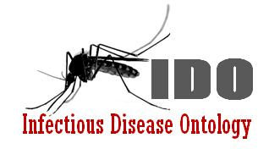
IDO-Staph:
An Ontology of Staphylococcus aureus Infectious Disease
Albert Goldfain, Ph.D.
Researcher, Blue Highway, Inc.
agoldfain@blue-highway.com
Problems in Ontology Invited Talk
November 5, 2012

Slide 2
Outline
Motivation: Disease ontologies for precision medicine
The IDO-Staph extension
Differentiating Staph aureus infectious diseases
A lattice of Staph aureus infectious diseases
A blocking-disposition account of antibiotic resistance
(Time permitting) Complimentary and collective dispositions in IDO.

Slide 3
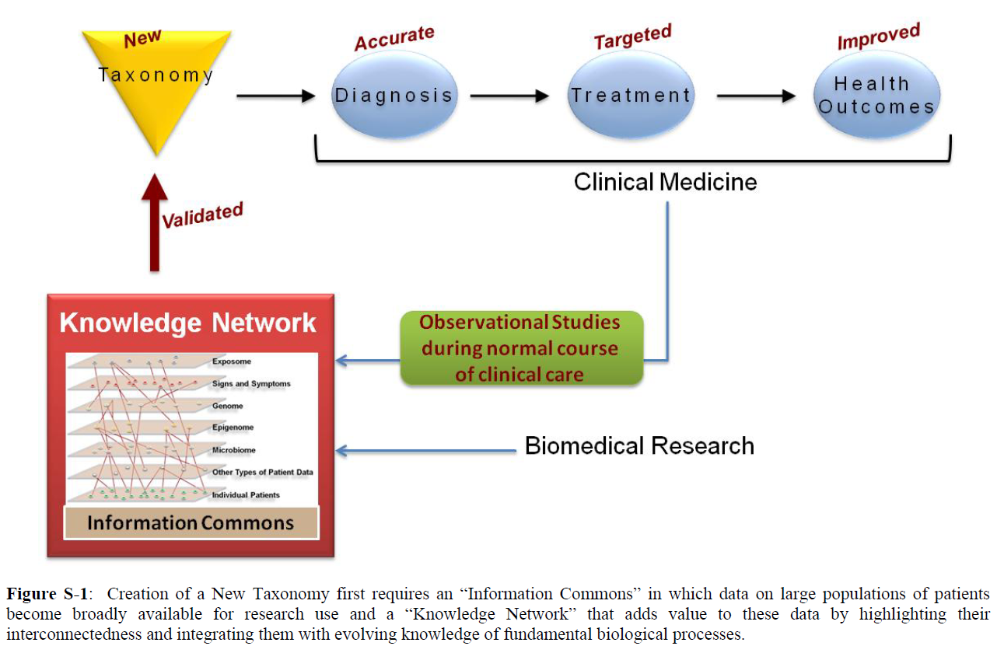
Motivation: “Toward Precision Medicine: Building a Knowledge Network for Biomedical Research and a New Taxonomy of Disease”
Notes:
Personalization

Slide 4
International Classification of Diseases
Versions:
ICD-9 (1977)
ICD-10 (1992)
ICD-11 (2015)
Lag time in releases → lag time in incorporating new knowledge about disease
Not suited for continuous integration of molecular, genetic information…
…which is now being generated at an increasing pace
Coding-systems used for billing should not be repurposed for meaningful information interchange and clinical decision support
Notes:
Meaninful information exchange for clinical decision support
and evolve for

Slide 5
ICD 9: Catch-all Codes and Scattered Exclusions
041 Bacterial infection in conditions classified elsewhere and of unspecified site
Note: This category is provided to be used as an additional code to identify the bacterial agent in diseases classified elsewhere. This category will also be used to classify bacterial infections of unspecified nature or site.
Excludes: septicemia (038.0-038.9)
041.1 Staphylococcus
041.10 Staphylococcus, unspecified
041.11 Methicillin susceptible Staphylococcus aureus
MSSA
Staphylococcus aureus NOS
041.12 Methicillin resistant Staphylococcus aureus
Methicillin-resistant staphylococcus aureus (MRSA)
041.19 Other Staphylococcus
038 Septicemia
038.1 Staphylococcal septicemia
038.10 Staphylococcal septicemia, unspecified
038.11 Methicillin susceptible Staphylococcus aureus septicemia
MSSA septicemia
Staphylococcus aureus septicemia NOS
038.12 Methicillin resistant Staphylococcus aureus septicemia
038.19 Other staphylococcal septicemia
Notes:
No code system should be extended to do the job of an ontology. Not every taxonomy is a good ontology.
Additional Code: Good, a partial description.
Differentiation by drug resistance
Exclusions: septicemia
Coverage based: ‘other’ ‘unspecified’
Lacks any links to genotypic info.

Slide 6
ICD 9: Catch-all Codes and Scattered Exclusions
041 Bacterial infection in conditions classified elsewhere and of unspecified site
Note: This category is provided to be used as an additional code to identify the bacterial agent in diseases classified elsewhere. This category will also be used to classify bacterial infections of unspecified nature or site.
Excludes: septicemia (038.0-038.9)
041.1 Staphylococcus
041.10 Staphylococcus, unspecified
041.11 Methicillin susceptible Staphylococcus aureus
MSSA
Staphylococcus aureus NOS
041.12 Methicillin resistant Staphylococcus aureus
Methicillin-resistant staphylococcus aureus (MRSA)
041.19 Other Staphylococcus
038 Septicemia
038.1 Staphylococcal septicemia
038.10 Staphylococcal septicemia, unspecified
038.11 Methicillin susceptible Staphylococcus aureus septicemia
MSSA septicemia
Staphylococcus aureus septicemia NOS
038.12 Methicillin resistant Staphylococcus aureus septicemia
038.19 Other staphylococcal septicemia
[041.19] Other Staphylococcus
[041] Bacterial infection in conditions classified elsewhere and of unspecified site.
Notes:
No code system should be extended to do the job of an ontology. Not every taxonomy is a good ontology.
Additional Code: Good, a partial description.
Differentiation by drug resistance
Exclusions: septicemia
Coverage based: ‘other’ ‘unspecified’
Lacks any links to genotypic info.

Slide 7
Motivation: The Antibiotic Race
Year | Antibiotic Effectiveness
1943 | Penicillin available
1947 | First resistant strains reported
1960s | Switch to methicillin
1961 | Methicillin-resistant strain found in Cairo
1980s | Methicillin resistance rising, vancomycin used as a last resort
1992 | 15% methicillin-resistant
1996 | 35% methicillin-resistant
2000 | 50% methicillin-resistant
2002 | Vancomycin resistance reported
(from Knobler et al, 2003)

Slide 8
Motivation: IDO Extension ontologies in the BFO/OGMS/IDO framework
What makes ontologies like IDO and IDO-Staph interesting from the perspective of ontology development?
Host-Pathogen Interactions: The parts and processes of two organisms must be modeled.
Co-evolution of biological functions
Transmission processes and the chain of infection
Horizontal gene transfer and clonal nature of Staph aureus
Pace of scientific discoveries about pathogenic strains will stress test the universals.

Slide 9
IDO-Staph: Introduction
Initial Release Candidate: http://purl.obolibrary.org/obo/ido/sa.owl
Google Code Page: http://code.google.com/p/ido-staph/
Scope
Entities specific to Staphylococcus aureus (Sa) infectious diseases at multiple granularities
Biological and clinical terms describing host-Sa interactions
An IDO extension ontology
Extends IDO-Core, OGMS
BFO as an upper ontology
Built on OBO Foundry principles
Applications
Annotation of clinical case report forms
Lattice of infectious diseases

Slide 10
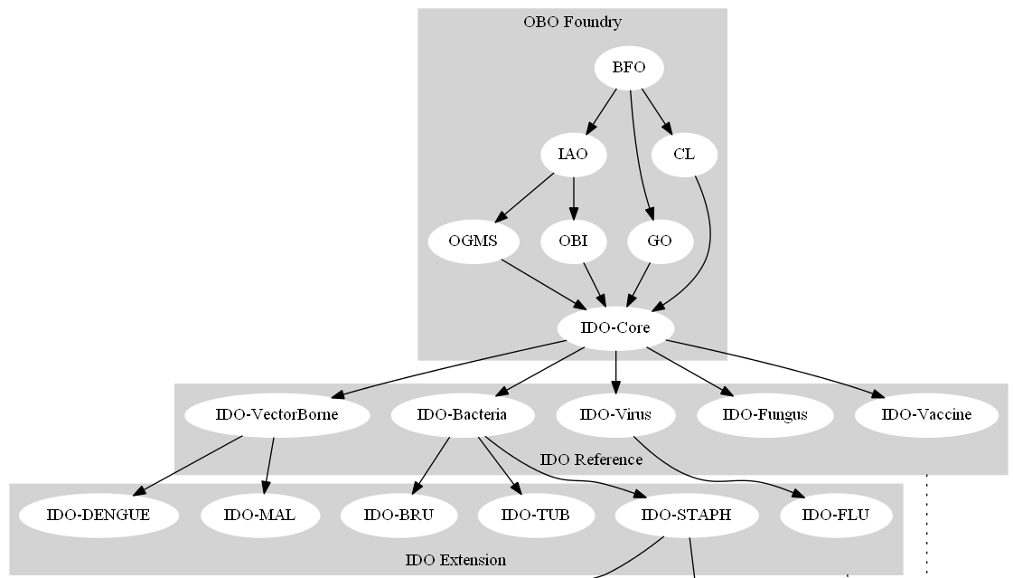
IDO: Core and Extensions Framework

Slide 11
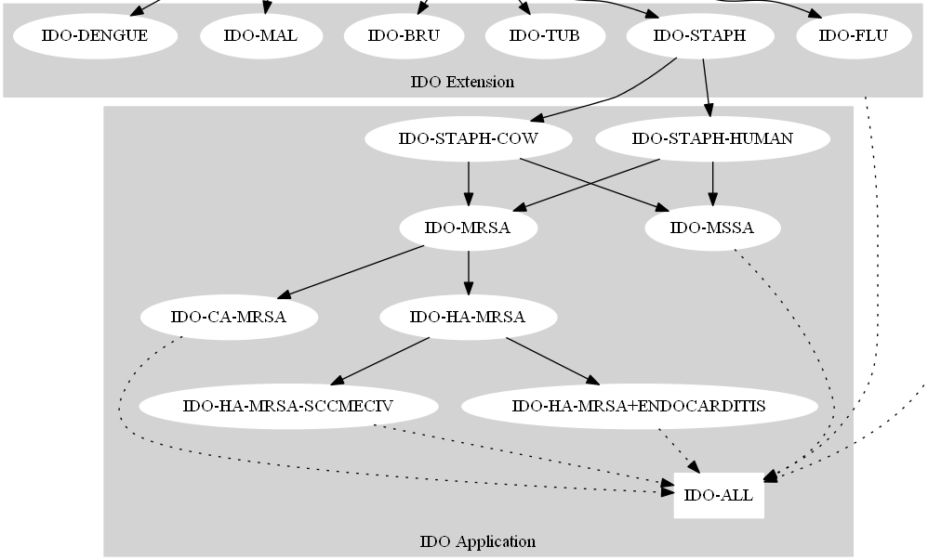
A Lattice of Lightweight Application-Specific Ontologies

