Slide 1
Representing Mental Functioning: Ontologies for mental health and disease
ICBO MFO Workshop, 22 July 2012
Janna Hastings^{1,2}
Werner Ceusters³
Mark Jensen³
Kevin Mulligan²
Barry Smith³
¹ Cheminformatics and Metabolism, European Bioinformatics Institute, UK
² Swiss Center for Affective Sciences, University of Geneva, Switzerland
³ National Center for Ontological Research, University at Buffalo, USA

Slide 2
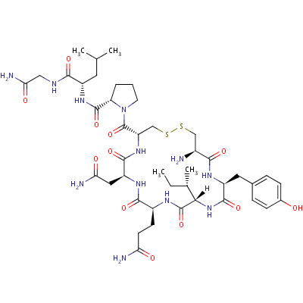

Why mental functioning?
I want…
Oxytocin is believed to play a role in various behaviors, including orgasm, social recognition, pair bonding, anxiety … it is sometimes referred to as the "love hormone".
The inability to secrete oxytocin and feel empathy is linked to sociopathy, psychopathy, narcissism and general manipulativeness.
I think…

Slide 3
How does mental functioning actually work?
Biology
EEG
Mouse
Psychology
Cognitive Science
Human
fMRI
PET
Genetic profiling
Neuroscience
Gene expression analysis
Psychiatry
Chemistry
Metabolic analysis
Self-reports
Questionnaires
Notes:
(Not the million dollar question, but the many billion dollars question!)
We’re drowning in data and starving for knowledge! Not only different domains BUT different methods and different subjects (model organisms etc)
Huge piles of different sorts of information coming out of different research areas. DIFFERENT PERSPECTIVES: if you try to get people to agree on names, they just don’t. But give them semantics-free identifiers and their own preferred (scoped) synonyms and you can get agreement on the definitions.
Nobody is an expert in everything, most scientists are stuck in their narrow area of focus and expertise (which is a good thing for progress because you HAVE to become that specialised)

Slide 4
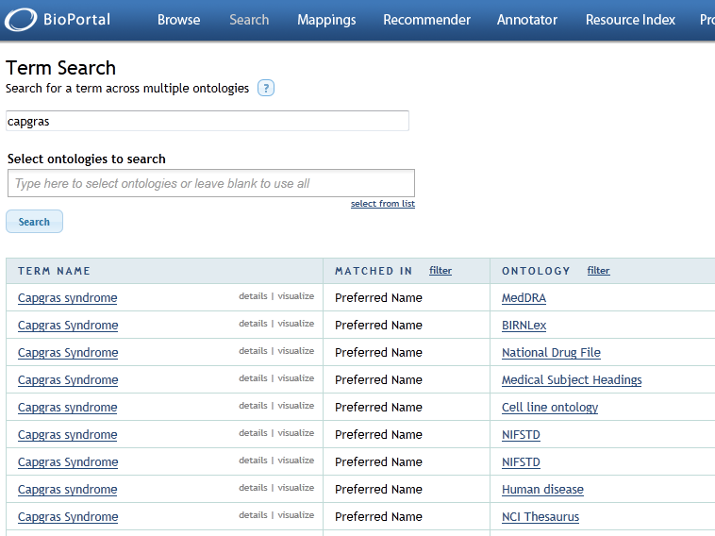
Existing vocabularies don’t include computable definitions
Notes:
SNOMED, MeSH, ICD, ICF, Cognitive Atlas, Cognitive Paradigm Ontology,
We will build on these vocabulary resources as sources, but maintain links so that we don’t lose mappings which have already been annotated to these sources.
Most of these sources maintain controlled vocabularies but not real ontologies. There is a shortage of explicit relationships and formal (computable) definitions, so you can’t make computational inferences.

Slide 5
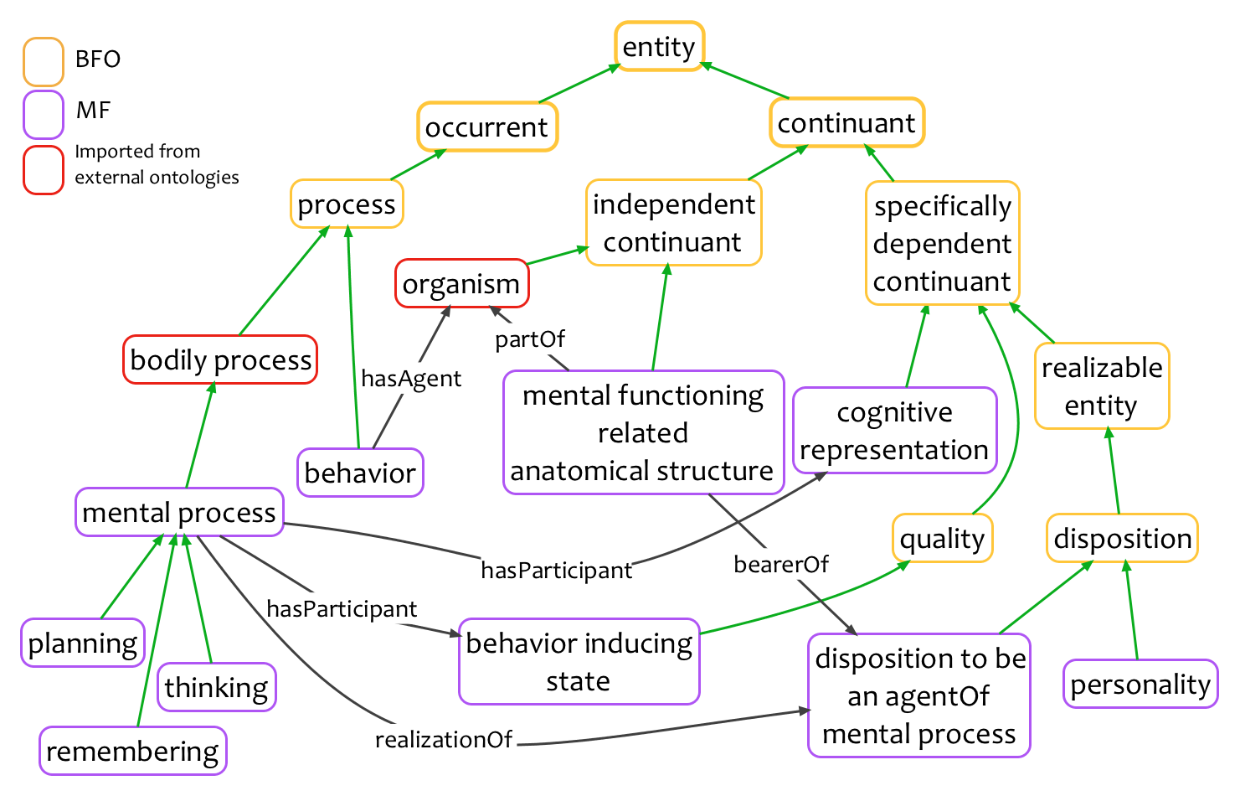
Mental Functioning Ontology (MF)
Notes:
Mental functioning related anatomical structure: an anatomical structure in which there inheres the disposition to be the agent of a mental process
Behaviour inducing state: a bodily quality inhering in a mental functioning related anatomical structure which leads to behaviour of some sort
Affective representation: a cognitive representation sustained by an organism about its own emotions
Cognitive representation: a representation which specifically depends on an anatomical structure in the cognitive system of an organism
Mental process: a bodily process which brings into being, sustains or modifies a cognitive representation or a behaviour inducing state

Slide 6
Modules under development: Mental diseases and emotions
Domain-neutral ontological upper level
BFO
OGMS
MF
Mental Functioning Ontology
Ontology for General Medical Science
MFO-EM
Emotion Ontology
MD
Mental Disease Ontology (Current focus on affective disorders and addiction)
Notes:
Arrows show ‘imports’ relationships between ontologies

Slide 7
Modern scientific research relies on computational support
Patient histories, EHR
For each question:
Data
Synthesis
Caregiver, pscyhiatric reports
Analysis
Data
Genomic and metabolomic profiles
Reporting
Data
Questionnaires and self-reports
Publication
…
Brain scans

Slide 8
Ontology is used for standardisation
Semantics-free unique identifiers that are stable and maintained CODE (MD) indicates WHICH ONTOLOGY A numeric identifier is unique per term
MD:0000901 substance abuse
is a
MD:0000902 marijuana abuse
Unambiguous preferred label together with a textual definition guide the annotation of this ontology term to associated data
is abuse of substance
S:09090909 marijuana --------------------------- Synonym: cannabis Synonym: THC Synonym: dronabinol
Synonyms and other metadata are collected
to facilitate searching, disambiguation and text processing
Synonyms may be in several languages or reflect differing naming practices in different disciplines

Slide 9
Population-wide science depends on aggregation of data
Are there genes significantly enriched in all people who suffer from some addiction?
Are there differences between those people who suffer from substance addiction compared to those who suffer from process addictions?
Are there differences between those people who suffer from opiate substance addictions and those who suffer from addictions to benzodiazepines?
Notes:
Obviously, these questions leave aside the complexities of co-occurrences, but for the higher-level questions that would present no problem as long as aggregation occurred with the count of instances not the count of types. For the comparative questions at the lower level, you would want to exclude co-occurrences from the analysis if you were looking for genes that comparatively differed between the different classes.

Slide 10
Ontology is used for aggregation
MD:0000046 addiction
MD:0000053 process addiction
MD:0000053 substance addiction
MD:0000054 gambling addiction
MD:0000066 benzodiazepine addiction
MD:0000065 opiate addiction
MD:0000055 sex addiction
MD:0000067 diazepam addiction
MD:0000059 heroin addiction
MD:0000064 internet addiction
MD:0000068 morphine addiction
Every ‘sex addiction’ is a ‘process addiction’, every ‘process addiction’ is an ‘addiction’
Every ‘heroin addiction’ is an ‘opiate addiction’, every ‘opiate addiction’ is a ‘substance addiction’, every ‘substance addiction’ is an ‘addiction’. And so on.

Slide 11
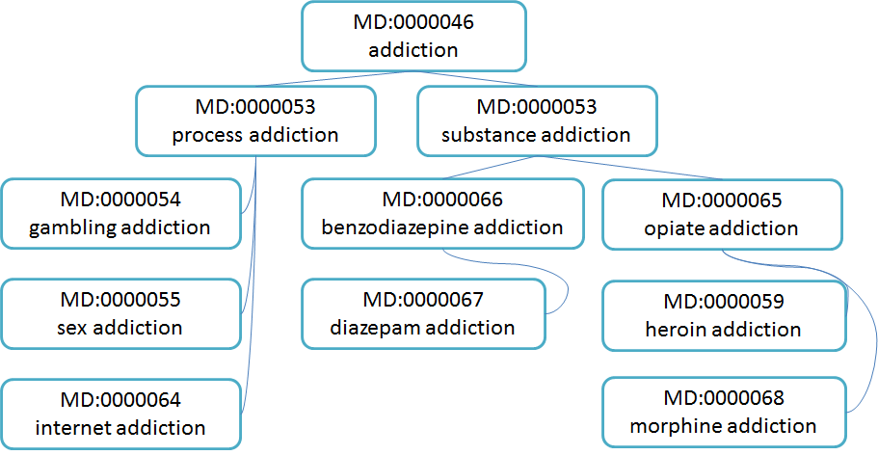
A shared community ontology for annotation allows unified searching across databases (e.g. GOA)
BrainMap
RIKEN Neuroimaging Platform
Brede
Nifti
fMRI Data Center
OpenfMRI
NeuroSynth
Notes:
This desideratum may sound like wishful thinking but in fact it is ALREADY IN PLACE for the Gene Ontology and most biological databases.
Databases listed here are a small selection of those that include fMRI coordinate data.
For a discussion of the various brain imaging methods and results in studies of addiction, see:
http://www.ncbi.nlm.nih.gov/pmc/articles/PMC2851068/ ‘Imaging the addicted human brain’

Slide 12
Computers can’t “see” implicit relationships between entities
Substance addiction is characterised by symptoms such as preoccupation with substance and repeated failed attempts to control the use of the substance. These are non-canonical thinking and planning activities.
But, there is no easy way to automatically compare with data from other conditions that have similar symptoms.
Patient data – addicted patients
Patient data – impaired rational control of actions or planning
Patient data – preoccupation or other compulsive thinking
?
?
Notes:
It would be useful, therefore, to compare data for addicted patients with data for patients with other preoccupations or failed goal-directed behaviours. But no computational methods facilitate this type of cross-searching at present. Again, it comes down to human effort to find or create the right sort of data. Targeted studies can be designed that do this on a one-by-one basis: see, for example, http://jnnp.bmj.com/content/68/6/731.full – which compares data on dysexecutive syndrome with patients who have alcoholism. Good study design is always a good idea, but the availability of published data on various conditions would allow re-use of that data in other contexts, if the links from symptoms to disorders were made more explicit.

Slide 13
Ontologies capture explicit computable relationships between entities
MD:0001002 non-canonical (impaired) thinking process
MD:0001001 non-canonical (impaired) planning process
MD:0001012 preoccupation with substance use
MD:0001011 failed attempts to stop substance use
Relationships are named and have
definitions
They are used for automated reasoning and question answering
has part
MD:0000053 substance addiction
realized in
MD:0001053 substance addiction disease course

Slide 14
Related entities are themselves used in annotations
Patient data on symptom assessment (Addiction)
Patient data on symptom assessment (Dysexecutive syndrome)
MD:0001002 non-canonical (impaired) thinking process
MD:0001001 non-canonical (impaired) planning process
… which allows patient data from disparate diseases (and research into normal functioning) to be compared
Notes:
Psychological standard test for ‘dysexective syndrome’ => failure of normal executive functions such as planning, organising, initiating … =>
http://www.dwp.gov.uk/docs/no2-sum-03-test-review-2.pdf
Footnote: data should be compared only if it makes sense to do so! That’s the reason for explicitly characterising and classifying symptoms

Slide 15
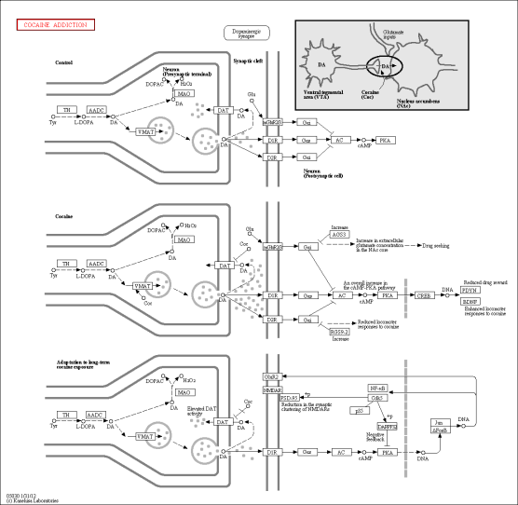
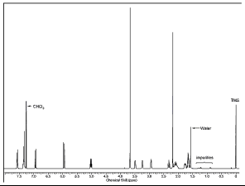

Different domains operate at different levels of granularity and focus
METABOLIC DATA (e.g. NMR)
GENE EXPRESSION DATA
PATHWAYS, biological processes
Notes:
Pathway illustration sourced from KEGG: http://www.kegg.jp/kegg-bin/highlight_pathway?scale=1.0&map=map05030&keyword=addiction
NMR spectrum illustration (of a derivative of cocaine) comes from http://www.justice.gov/dea/programs/forensicsci/microgram/journal_v4_num14/pg5.html

Slide 16
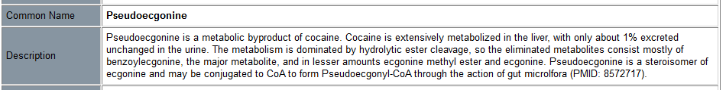
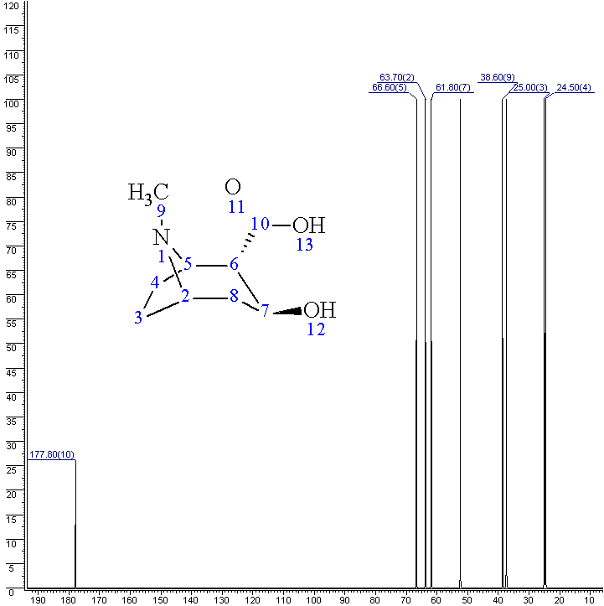
NMR data for metabolites of cocaine is found in metabolomics databases -- indexed by small molecules
Urine samples of addicted patients reveal metabolites
Notes:
This data on metabolites of cocaine was sourced from the Human Metabolome Database (HMDB): http://www.hmdb.ca/metabolites/HMDB06348

Slide 17
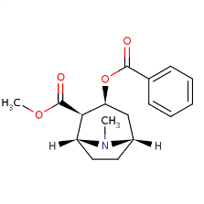
Ontology relationships can explicitly bridge across different ontologies at different levels
MD:0000071 cocaine addiction
realized in
MD:0010071 cocaine addiction
disease course
has part
S:00100100 portion of cocaine
has input
MD:0020071 use of cocaine
has granular part
Chemical and metabolic data
CHEBI:27958 cocaine

Slide 18
(Part of) the biochemical basis of emotion is in ChEBI
Emotions are effected in part by neurotransmitters such as dopamine, tryptophan
molecular entity (CHEBI:25375)
biological role (CHEBI:24432)
Molecular function (GO:0003674)
emotion (MFOEM:1)
subtype
neurotransmitter receptor activity (GO:0030594)
happiness (MFOEM:42)
dopamine (CHEBI:25375)
neurotransmitter (CHEBI:25512)
has role
realized in
part of
Notes:
This is, of course, just one tiny part of the story. The overall story would have to be built up out of many, many cross-ontology links.

Slide 19
Biological processes in affective disorders
Some mental diseases involve altered emotional functioning. (E.g. depression, bipolar disorder)
Disposition
Process
mental disease
emotion
biological process
Mechanism of action: complex disturbances in underlying systems
down-regulation of dopaminergic system (GO:0032227)
depression
non-canonical sadness
realized in
has part
Notes:
Depression and bipolar disorder are paradigm affective disorders.

Slide 20
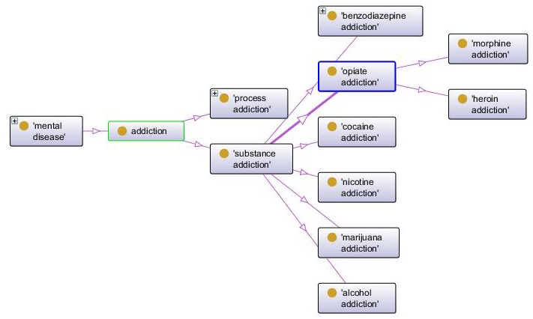
Addiction in MDO

Slide 21
Availability, Contacts
Mental Functioning Ontology available at:
http://mental-functioning-ontology.googlecode.com/svn/trunk/ontology/MF.owl
Discussion mailing list:
mfo-discuss@googlegroups.com

Slide 22




Acknowledgements Thanks!
Emotion Researchers in Geneva
Kevin Mulligan, David Sander, Julien Deonna
Chemistry, Biology, Neuroscience
Christoph Steinbeck, Nicolas le Novère, Colin Batchelor, David Osumi-Sutherland, Jane Lomax, Gwen Frishkoff, Jessica Turner, Angela Laird

