Slide 1
The Ontology for General Medical Science
Barry Smith
11/5/2012

Slide 2
The 3 Gene Ontologies (GO)
Continuant
Occurrent
Independent
Continuant
Dependent
Continuant
cell component
molecular function
biological process

Slide 3
Basic Formal Ontology
Continuant
Occurrent
(Process)
Independent
Continuant
(molecule,
cell, organ,
organism)
Dependent
Continuant
(quality,
function,
disease)
..... ..... .... .....

Slide 4
Blinding Flash of the Obvious
Continuant
Occurrent
(Process)
Independent
Continuant
(molecule,
cell, organ,
organism)
Dependent
Continuant
(quality)
e.g.
Functioning
e.g.
Side-Effect,
Stochastic
Process, ...
..... ..... .... .....

Slide 5
Basic Formal Ontology
Continuant
Occurrent
(Process)
Independent
Continuant
(molecule,
cell, organ,
organism)
Dependent
Continuant
(quality)
e.g.
Functioning
e.g.
Side-Effect,
Stochastic
Process, ...
..... ..... .... .....

Slide 6
human
in nature, no sharp boundaries here
embryo
fetus
neonate
infant
child
adult
instantiates at t₁
instantiates at t₂
instantiates at t₃
instantiates at t₄
instantiates at t₅
instantiates at t₆
John (exists continuously)

Slide 7
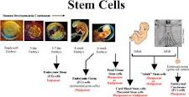
continuants
occurrents
human
course of development
embryo
fetus
neonate
infant
instantiates at t₁
instantiates at t₂
instantiates at t₃
instantiates at t₄
John (continuant)
course of John’s
development

Slide 8
temperature
in nature, no sharp boundaries here
in nature, no sharp boundaries here
37°C temperature quality
38°C temperature quality
39°C temperature quality
40°C temperature quality
41°C temperature quality
instantiates at t₁
instantiates at t₂
instantiates at t₃
instantiates at t₄
instantiates at t₅
John’s temperature (exists continuously through time)

Slide 9
continuants
occurrents
temperature
course of temperature
37ºC
37.1ºC
37.2ºC
37.3ºC
instantiates at t₁
instantiates at t₂
instantiates at t₃
instantiates at t₄
John’s temperature
the course of John’s
temperature
has_participant

Slide 10
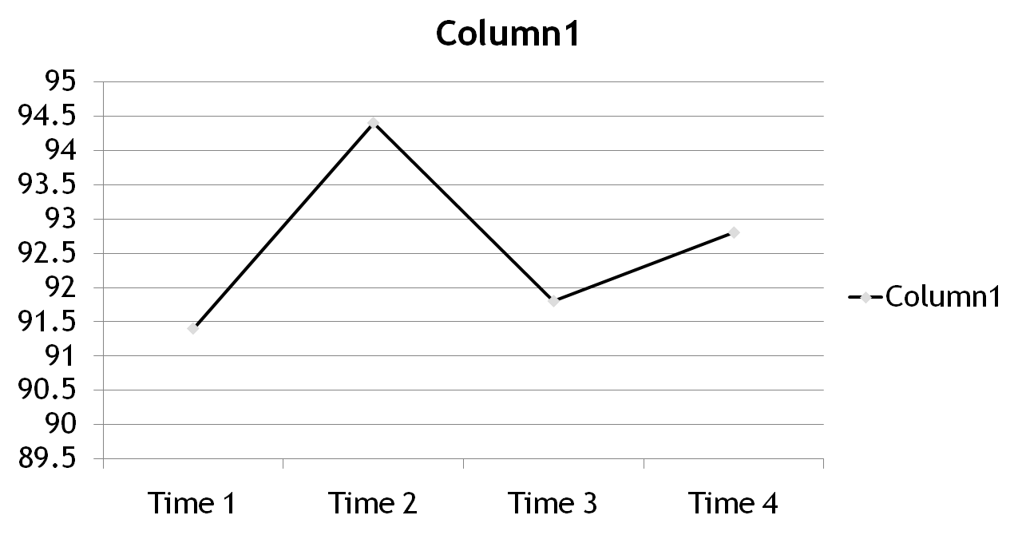
A Chart representing how John’s temperature changes

Slide 11
A Chart representing how John’s temperature changes

Slide 12
BFO: The Very Top
continuant
occurrent
independent
continuant
dependent
continuant
quality
temperature

Slide 13
Blinding Flash of the Obvious
independent
continuant
dependent
continuant
quality
organism
temperature
types
John
John’s
temperature
instances

Slide 14
Blinding Flash of the Obvious
independent
continuant
dependent
continuant
quality
organism
temperature
types
John
John’s
temperature
instances

Slide 15
Blinding Flash of the Obvious
inheres_in
.
organism
temperature
types
John
John’s
temperature
instances

Slide 16
independent
continuant
dependent
continuant
quality
organism
temperature
types
John
John’s
temperature
instances

Slide 17
independent
continuant
dependent
continuant
occurrent
quality
process
organism
course of temperature changes
temperature
John
John’s
temperature
John’s
temperature history

Slide 18
independent
continuant
dependent
continuant
occurrent
quality
process
organism
temperature process profile
temperature
John
John’s
temperature
John’s
temperature history

Slide 19
independent
continuant
dependent
continuant
occurrent
quality
process
organism
life of an organism
temperature
John
John’s
temperature
John’s
life

Slide 20
BFO: The Very Top
continuant
occurrent
independent
continuant
dependent
continuant
quality
disposition
Notes:
with thanks to Robert Arp

Slide 21
Disposition
- of a glass vase, to shatter if dropped
- of a human, to eat
- of a banana, to ripen
- of John, to lose hair

Slide 22
Disposition
if it ceases to exist, then its bearer and/or its immediate surrounding environment is physically changed
its realization occurs when its bearer is in some special physical circumstances
its realization is what it is in virtue of the bearer’s physical make-up

Slide 23
Function - of liver: to store glycogen - of birth canal: to enable transport - of eye: to see - of mitochondrion: to produce ATP functions are dispositions which are designed or selected for

Slide 24
independent
continuant
dependent
continuant
occurrent
function
process
eye
process of seeing
to see
John’s eye
function of John’s
eye: to see
John seeing

Slide 25
OGMS
Ontology for General Medical Science
http://code.google.com/p/ogms

Slide 26
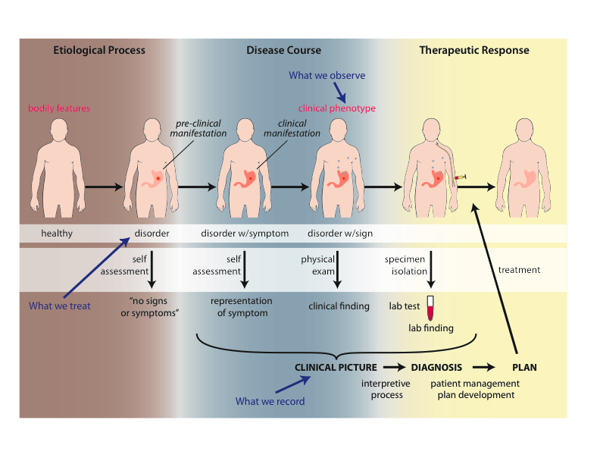
Big Picture (with thanks to Richard Scheuermann)

Slide 27
Physical Disorder

Slide 28
Physical Disorder
– independent continuant
fiat object part
A causally linked combination of physical components of the extended organism that is clinically abnormal.

Slide 29
Clinically abnormal
(1) not part of the life plan for an organism of the relevant type (unlike aging or pregnancy),
(2) causally linked to an elevated risk either of pain or other feelings of illness, or of death or dysfunction, and
(3) such that the elevated risk exceeds a certain threshold level.*
*Compare: baldness

Slide 30
Disorder
person
– independent continuant
objects
fiat object part
object aggregate

Slide 31
Disorder
A fiat object part of an organism which serves as the bearer of a disposition of a certain sort
This fiat object may have no determinate boundaries
(compare: Downtown Santa Barbara)

Slide 32
Big Picture (with thanks to Richard Scheuermann)

Slide 33
Elucidation of Primitive Terms
‘bodily feature’ - an abbreviation for a physical component, a bodily quality, or a bodily process.
disposition - an attribute describing the propensity to initiate certain specific sorts of processes when certain conditions are satisfied.
clinically abnormal - some bodily feature that
(1) is not part of the life plan for an organism of the relevant type (unlike aging or pregnancy),
(2) is causally linked to an elevated risk either of pain or other feelings of illness, or of death or dysfunction, and
(3) is such that the elevated risk exceeds a certain threshold level.*
*Compare: baldness

Slide 34
Definitions - Foundational Terms
Disorder =def. – A causally linked combination of physical components that is clinically abnormal.
Pathological Process =def. – A bodily process that is a manifestation of a disorder and is clinically abnormal.
Disease =def. – A disposition (i) to undergo pathological processes that (ii) exists in an organism because of one or more disorders in that organism.

Slide 35
Dispositions and Predispositions
All diseases are dispositions; not all dispositions are diseases.
A predisposition is a disposition.
Predisposition to Disease of Type X =def. – A disposition in an organism that constitutes an increased risk of the organism’s subsequently developing the disease X.
HNPCC is caused by a
disorder (mutation) in a DNA mismatch repair gene that
disposes to the acquisition of additional mutations from defective DNA repair processes, and thus is a
predisposition to the development of colon cancer.

Slide 36
coronary heart disease
disease associated with early lesions and small fibrous plaques
disease associated with asymptomatic (‘silent’) infarction
disease associated with surface disruption of plaque
unstable angina
stable angina
instantiates at t₁
instantiates at t₂
instantiates at t₃
instantiates at t₄
instantiates at t₅
John’s coronary heart disease
time

Slide 37
independent
continuant
dependent
continuant
occurrent
disposition
process
heart
disease course
coronary heart disease
John’s heart
John’s coronary
heart disease
course of John’s coronary heart disease

Slide 38
Cirrhosis - environmental exposure
Etiological process - phenobarbitol-induced hepatic cell death
produces
Disorder - necrotic liver
bears
Disposition (disease) - cirrhosis
realized_in
Pathological process - abnormal tissue repair with cell proliferation and fibrosis that exceed a certain threshold; hypoxia-induced cell death
produces
Abnormal bodily features
recognized_as
Symptoms - fatigue, anorexia
Signs - jaundice, splenomegaly
Symptoms & Signs
used_in
Interpretive process
produces
Hypothesis - rule out cirrhosis
suggests
Laboratory tests
produces
Test results - elevated liver enzymes in serum
used_in
Interpretive process
produces
Result - diagnosis that patient X has a disorder that bears the disease cirrhosis

Slide 39
Huntington’s Disease - genetic
Etiological process - inheritance of >39 CAG repeats in the HTT gene
produces
Disorder - chromosome 4 with abnormal mHTT
bears
Disposition (disease) - Huntington’s disease
realized_in
Pathological process - accumulation of mHTT protein fragments, abnormal transcription regulation, neuronal cell death in striatum
produces
Abnormal bodily features
recognized_as
Symptoms - anxiety, depression
Signs - difficulties in speaking and swallowing
Symptoms & Signs
used_in
Interpretive process
produces
Hypothesis - rule out Huntington’s
suggests
Laboratory tests
produces
Test results - molecular detection of the HTT gene with >39CAG repeats
used_in
Interpretive process
produces
Result - diagnosis that patient X has a disorder that bears the disease Huntington’s disease

Slide 40
HNPCC - genetic pre-disposition
Etiological process - inheritance of a mutant mismatch repair gene
produces
Disorder - chromosome 3 with abnormal hMLH1
bears
Disposition (disease) - Lynch syndrome
realized_in
Pathological process - abnormal repair of DNA mismatches
produces
Disorder - mutations in proto-oncogenes and tumor suppressor genes with microsatellite repeats (e.g. TGF-beta R2)
bears
Disposition (disease) - non-polyposis colon cancer
realized in
Symptoms (including pain)

Slide 41
Arterial Aneurysm
Disposition – atherosclerosis
realized in
Pathological process – fatty material collects within the walls of arteries
produces
Disorder – artery with weakened wall
bears
Disposition – of artery to become distended
realized_in
Pathological process – process of distending
produces
Disorder – arterial aneurysm
bears
Disposition – of artery to rupture
realized in
Pathological process – (catastrophic event) of rupturing
produces
Disorder – ruptured artery, arterial system with dangerously low blood pressure
bears
Disposition – circulatory failure
realized in
Pathological process – exsanguination, failure of homeostasis
produces
Death

Slide 42
Influenza - infectious
Etiological process - infection of airway epithelial cells with influenza virus
produces
Disorder - viable cells with influenza virus
bears
Disposition (disease) - flu
realized_in
Pathological process - acute inflammation
produces
Abnormal bodily features
recognized_as
Symptoms - weakness, dizziness
Signs - fever
Symptoms & Signs
used_in
Interpretive process
produces
Hypothesis - rule out influenza
suggests
Laboratory tests
produces
Test results - elevated serum antibody titers
used_in
Interpretive process
produces
Result - diagnosis that patient X has a disorder that bears the disease flu
But the disorder also induces normal physiological processes (immune response) that can results in the elimination of the disorder (transient disease course).

