Slide 1
Introduction to the Population and Community Ontology (PCO)
Ramona Walls
rlwalls2008@gmail.com
http://code.google.com/p/popcomm-ontology/
popcomm-ontology@googlegroups.com

Slide 2
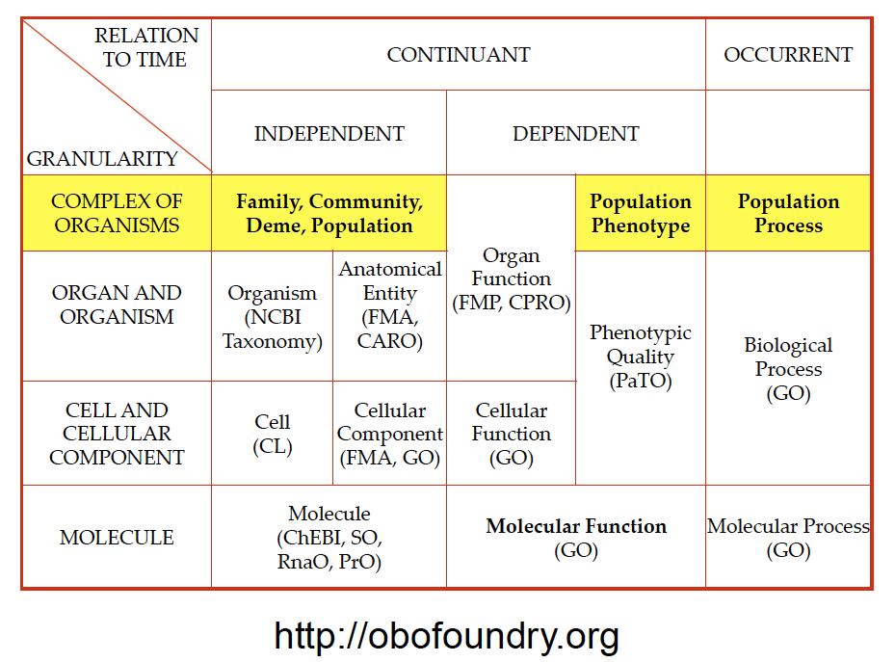
Notes:
Image courtesy of Barry Smith

Slide 3
The PCO:
is rooted in the Basic Formal Ontology.
covers material entities, qualities, and processes that pertain to collections of organisms.
imports terms from and exports terms to other OBO library ontologies, such as CARO, PATO, GO.

Slide 4
Domain of the PCO:
collections of organisms (populations and communities)
qualities of collections of organisms (with PATO)
processes that have collections of organisms as participants (with GO)

Slide 5
Why study collections of organisms?
Ecology and Evolution:
intra- and interspecific interactions
population as the unit of evolution
Medicine:
collections of humans, pathogens, vectors
epidemiology, disease transmission, sociology
Agriculture:
plant pathology, animal diseases, weeds

Slide 6
Examples of collections of organisms:
A unicellular colony
A microorganism infection (the bacteria in a bacteremia, the viruses in a viremia)
A herd (bunch of big animals living in close proximity)
The sum of the infectious agents in a herd's infection (all potentially eradicated with the same antibiotic)
A the occupants of a biological niche (most susceptible to an pan-species toxin)
My microbiome
Ashkenazi jews (some common genetic elements due to being a herd at some earlier part of history)
People with malaria
People immune to HIV
(Thanks to Alan Ruttenberg)

Slide 7
Diverse definitions of population on BioPortal:
SNOMED: A social condition (no text definition)
MESH: The total number of individuals inhabiting a particular region or area.
OBI: a population is a collection of individuals from the same taxonomic class living, counted or sampled at a particular site or in a particular area
Experimental Factor Ontology: A population is a group of material entities consisting of individuals which share a particular characteristic such as inhabiting a particular region or area or ability to interbreed.
NIFSTID: A collection of independent organismal entities engaged in some form of spatio-temporal interaction or aggregate behavior
Malaria Ontology: An aggregate of organisms.
NCI Thesaurus (population group): A group of individuals united by a common factor (e.g., geographic location, ethnicity, disease, age, gender)
ICF: Groups of people living in a given environment who share the same pattern of environmental adaptation.

Slide 8
Definitions of population from some evolutionary biologists:
Gotelli’s A Primer of Ecology: A group of individuals, all of the same species, that live in the same place. Although it is sometimes difficult to define the physical boundaries of a population, the individuals within a population have the potential to reproduce with one another during the course of their lifetimes.
Futuyma’s Evolution: A group of conspecific organisms that occupy a more or less well defined geographic region and exhibit reproductive continuity from generation to generation; ecological and reproductive interactions are more frequent among these individuals than with members of other populations of the same species.

Slide 9
Essential elements of the definition of a population:
More than one organism (or virus or viroid)
All members of the same species
Geographical proximity – potential for reproductive and other ecological interactions
Maximal
a random sub-sample of a population is not a population in the biological sense (but is in statistical sense)
sub-populations and meta-populations are populations

Slide 10
Examples of (possible) populations:
A herd of cattle
The sunfish living in Roth Pond
The lady slipper orchids living in Kettle Hole County Park
The pigeons in Central Park
The people of Buffalo
Notes:
These may be divided into subpopulations, for example, the north and south populations of lake fish.
Often, genetic studies are used to determine the boundaries of a population.

Slide 11
Collections of organisms of a single species that are not populations:
People with malaria
People immune to HIV
Every oak tree in Pennsylvania
Five sunfish chosen randomly from Roth Pond

Slide 12
Definitions of ecological community from some ecologists:
From Morin’s Community Ecology (paraphrased): A collection of organisms of at least two different species, living in a particular area.
From Begon et al.’s Ecology: The species that occur together in space and time.

Slide 13
Essential elements of the definition of an ecological community:
More than one organism
Members of at least two species
Geographical proximity – living in the same area
Definitions disagree on whether or not:
the organisms must interact with each other (but generally some interaction is assumed)
a community must include all organisms present at a location
Notes:
If there is not interaction, why would someone bother to study it.

Slide 14
The borders of an ecological community may be defined by:
discrete physical or habitat boundaries
the biota of a pond, a decaying carcass, your gut
the presences of a dominant species
beech forest community
tall grass prairie community
statistically similar species composition in multidimensional space
significant interactions among members

Slide 15
Some important subsets (sub-classes) of ecological community
guild: A collection organisms of different species that use resources in a similar way.
Often used in the sense of a trophic guild or trophic level (herbivores, detritivores, primary producers, etc.)
taxonomically-defined community: A set of taxonomically related species within a community (plant community, insect community, bird community, etc.)

Slide 16
Communities, ecosystems, and biomes
An ecosystem is an ecological community plus the abiotic (physical) environmental features (soil, air, water, sunlight, slope).
Many ecologists consider a biome to be a type of large-scale ecological community.

Slide 17
Biome and its subclasses are covered by the Environment Ontology (EnvO)
biome (EnvO:00000428)
def.: A major class of ecologically similar communities of plants, animals, and other organisms. Biomes are defined based on factors such as plant structures (such as trees, shrubs, and grasses), leaf types (such as broadleaf and needleleaf), plant spacing (forest, woodland, savanna), and other factors like climate...
(http://www.environmentontology.org)
examples include: tundra biome, Mediterranean forest biome, small river biome, estuarine biome
Notes:
Need to discuss how ENVO:biome should relate to PCO:ecological community

Slide 18
Qualities of collections of organisms
Population quality: A quality that inheres in a population.
carry capacity
population birth rate, death rate, growth rate, etc.
sex ratio
Ecological community quality: A quality that inheres in a community
diversity
species richness
stability, resilience
community structure
number of trophic levels
Notes:
A population or community quality may depend on the qualities of individual organisms in the population or community, but cannot be measured or described for a single individual.

Slide 19
Population and community qualities are being developed in collaboration with PATO
population quality (PATO:0002003) =def. A quality that inheres in an entire population or part of a population.
Has two subclasses: mixed sex (PATO:0001338) and morbidity (PATO:0001415).
organismal quality (PATO:0001995) =def. A quality that inheres in an entire organism or part of an organism.
Suggest that PATO redefine organismal quality as a quality that inheres in an entire CARO:organism or a PCO:collection of organisms, possibly get rid of these terms.
should PATO have categories of qualities that are defined only by the entity in which they inhere?

Slide 20
Processes that have collections of organisms as participants
Population process
Community process
sub-classes of BFO: process
may move to GO: biological process

Slide 21
PCO: population process
def.: A process that has as primary participant a population.
Population processes may depend on the processes of individual organisms {e.g., population growth reflects the cumulative multicellular organism reproduction (GO:0032504) and death (GO:0016265) of all individuals in a population} but cannot be described for an individual organism.
Some processes (e.g., evolution, extinction) can also occur at both the species and the population level, so PCO distinguishes between, for example, population extinction and species extinction.

Slide 22
PCO: population process
Examples:
population growth
exponential population growth
logistic population growth
population extinction
evolution
selection
adaptation
immigration, emigration

Slide 23
Community processes in the context of the GO
biological process (GO:0008150): Any process specifically pertinent to the functioning of integrated living units: cells, tissues, organs, and organisms. A process is a collection of molecular events with a defined beginning and end.
multi-organism process (GO:0051704): Any process in which an organism has an effect on another organism of the same or different species.
ecological community process (PCO:0000014): A process that has as primary participants organisms of two different species.
may be replaced by more specific GO terms (next slide)
Notes:
A population or community could be considered an integrated living unit.

Slide 24
Community processes in the context of the GO
sub-classes of multi-organism process:
interspecies interaction between organisms (GO:0044419): Any process in which an organism has an effect on an organism of a different species.
intraspecies interaction between organisms (GO:0051703): Any process in which an organism has an effect on an organism of the same species.
behavioral interaction between organisms (GO:0051705): Any process in which an organism has a behavioral effect on another organism of the same or different species.

Slide 25
PCO: community process
examples:
competition
predation
facilitation
mutualism
parasitism
pollination
Some of these terms are already in the GO. PCO will work with GO to define new terms, then import them into PCO as needed.
Notes:
Some of these terms are already in the GO. PCO will work with GO to define new terms, then import them into PCO.

Slide 26
Applications: Other ontologies that need terms from the PCO
Ontology for Biomedical Investigations (OBI)
Any ontology that studies interactions between people or other organisms (social ontology)
Infectious Disease Ontology (IDO)
Any biomedical ontology that describes groups of pathogens, hosts, or vectors
NCBO-BioPortal lists results for 45 ontologies for “population” and 21 for “community”, with variable definitions. Terminology should be unified across ontologies.

Slide 27
Application of the PCO: ecological modeling
spider sp.
+
has positive effect
has negative effect
has stage
has quality
unknown effect
+
-
sex ratio
predation
-
?
-
-
-
deer
bee sp.1
competition
bee sp.2
+
+
+
herbivory
pollination
+
-
+
seed
recruitment
seedling
vegetative
reproductive
reproduction
mutualism
populations quality
+
population
community process
?
Trillium
?
life cycle stage
population process
leaf size
flower color
Notes:
Qualities link out to databases of traits.

