Slide 1
Information Ontologies
Ron Rudnicki
November 19, 2012

Slide 2
Preface
Why were the information ontologies created?
Where are the points of similarity and disparity between the information ontologies and the IAO?
What is the scope and content of the ontologies?
How, if at all, should the information ontologies and IAO be merged?

Slide 3
Information Sources as Objects
There is a need for applications to communicate while processing information sources
Examples of assertions needing a common vocabulary:
The information source being processed is a database || list || message || journal article || spreadsheet ||…
The database contains a table named “tbl_emp” that has 7 columns and 2104 rows
The column named “col_gender” allows null values
The column named “col_date_of_hire” contains datetime values
The report titled “Multistate outbreak of fungal meningitis and other infections” contains 9 paragraphs
The section of text “the FDA's Drug Information Line at 855-543-DRUG (3784)” has an offset of 2495 and a length of 54

Slide 4
Information Content Entities and Their Bearers
The BFO/IAO Description
Generically Dependent Continuant
Specifically Dependent Continuant
subclass of
Ashburner, Michael, et al. "Gene Ontology: tool for the unification of biology." Nature genetics 25.1 (2000): 25.
Information Content Entity
concretized_by
instance of
subclass of
Quality
The pattern of ink on the pages of a printed copy of Ashburner, Michael, et al. “Gene Ontology: tool for the unification of biology.” Nature genetics 25.1 (2000): 25.
generically
depends on
Independent Continuant
subclass of
subclass of
instance of
Information Carrier
specifically
depends on
A printed copy of Ashburner, Michael, et al. “Gene Ontology: tool for the unification of biology.” Nature genetics 25.1 (2000): 25.
Material Entity
subclass of
instance of
Material Information Bearer

Slide 5
Information As Object
The BFO/IAO Description
By definition, the information carrier is specifically dependent upon the same entity as the information content entity is generically dependent.
b concretizes c at t means:
b is a specifically dependent continuant &
c is a generically dependent continuant &
for some independent continuant that is not a spatial region d,
b s-depends_on d at t &
c g-depends on d at t &
if c migrates from bearer d to another bearer e than a copy of b will be created in e. (axiom label in BFO2 Reference: [075-002])

Slide 6
Information As Object
The BFO/IAO Description
The examples are not optimal for understanding what this common entity is: "a hard drive, a piece of paper with writing on it, a brain”
The definition suggests that it is the media (hard drive, piece of paper, air, optical disk) + the bearer of the pattern (writing, sound waves, pits and lands): An information bearer is a material_entity in which a concretization of an information content entity inheres.
If a hard drive is reformatted the copy of journal article no longer exists, but the hard drive does

Slide 7
Information as Object
The BFO/IAO Description
At its current state of development, information carrier adds little value to the annotation of information resources
Every instance of a material information bearer will have a information carrier at some time
But as there are no subtypes the quality can’t be used for querying or inference
Similar to querying for or reasoning about patients having a temperature rather than those having a temperature within a certain range

Slide 8
Information as Object
The BFO/IAO Description
What kind of differences constitute a genuine subtype of information carrier?
Today is November 19, 2012
Today is November 19, 2012
Today’s date is 11/19/12
November 19, 2012 is today’s date
Hoy es 19 de noviembre 2012
If the same information content entity is expressed in different media is the pattern type the same or different?
In some cases it seems that instances of the same pattern type impart different information content: “Today is the day after yesterday.”

Slide 9
Information Technology Ontology
Scope: A domain ontology that describes the objects and relationships related to the structure of data sources
Main Types: common information artifacts but also their qualities and actions related to their production
Miscellaneous:
333 local classes
245 equivalence class axioms
4 local object properties
2 datatype properties
CUBRC - Proprietary

Slide 10
Information Technology Ontology
Information Bearing Types
bfo:Object
Information Bearing Entity
Database
Relational Database
Data Table
Code List
XML Document
Journal Article
Journal Issue
Message
Ontology
Report
Spreadsheet
Transcript
Definition: An Information Bearing Entity is a type of Object upon which an Information Content Entity generically depends (Derived from: http://purl/obolibrary.org/obo/IAO_0000178).
These are defined classes of objects combining the IAO’s material information bearer and information carrier

Slide 11
Information Technology Ontology
Information Source Parts
bfo:Object
Information Bearing Entity
Data Column
Data Element
Database Name Bearer
Journal Article Title Bearer
Version Number Ordinal Measurement Bearer
Data Row
Document Part
Dateline
Document Body
Document Footer
Document Header
Note
Endnote
Footnote
Page
Paragraph
Sentence
Table of Contents
Document Part
Definition: A defined class that consists of any meaningful part of some type of document.
Subclass of: Information Bearing Entity and bearer of some document part location
Equivalent Class: Information Bearing Entity and part of some Document

Slide 12
Information Technology Ontology
Information Source Qualities
Data Element Quality
Comment: For now this is a bag of attributes used to define a data element, normally those data elements that are part of a database. It would be a matter of following best practices to take each attribute and analyze what type of entity it really is, however, time does not permit such analysis.
bfo:Quality
Classification Level
Morphological Quality
Data Element Quality
Character Encoding
ASCII Encoding
EBCDIC Encoding
Unicode Encoding
Data Element Format
Data Element Length
Data Precision
Data Scale
Fixed Length
Data Element Type
Binary Type
Boolean Type
Date Time Type
Integer Type
Nullability
NonNullable
Nullable
Document Part Location
Document Part Order of Appearance
Article Order
Line Order
Page Order
Size
Component Count
Data Column Count
Data Row Count
Structure
Data Structure
Flat Data Structure
Hierarchical Data Structure
Relational Data Structure

Slide 13
Information Technology Ontology
Part Structure and Qualities Substitute for Information Carrier
Data Column Count
Data Column Count Ratio Measurement
Data Column Count Ratio Measurement Bearer
rdf:type
rdf:type
rdf:type
URI:5
info:is_measured_by_ratio
URI:6
ero:inheres_in
URI:7
info:has_integer_value
7
ero:has_quality
Database
Data Table
Data Table Name
Data Table Name Bearer
rdf:type
rdf:type
rdf:type
rdf:type
URI:1
ro:has_part
URI:2
info:designated_by
URI:3
ero:inheres_in
URI:4
info:has_text_value
“tbl_emp”
ro:has_part
URI:11
ero:has_quality
URI:8
URI:9
URI:10
“col_gender”
info:designated_by
ero:inheres_in
info:has_text_value
rdf:type
rdf:type
rdf:type
rdf:type
Nullable
Data Column
Data Column Name
Data Column Name Bearer

Slide 14
Information Sources as Information
There is a need to link information as objects to the entities those objects are about
Examples of assertions needing a common vocabulary:
The database contains employment records of persons employed at ABC Corp.
The data element “09/01/2006” designates John Q. Public’s date of hire at ABC Corp.
The table named “tbl_employee” that is part of the abc_db contains the same information as does the table named “tbl_person” that is part of the xyz_db.

Slide 15
Information Sources as Information
The BFO/IAO Description
The IAO characterizes an Information Content Entity as a subclass of Generically Dependent Continuant
The IAO defines an Information Content Entity as: an entity that is generically dependent on some artifact and stands in relation of aboutness to some entity

Slide 16
Information Sources as Information
The BFO/IAO Description
Some of the subclasses of Information Content Entity seem to be describing Material Information Bearers:
CRID: An information content entity that consists of a CRID symbol and additional information about which CRID registry it belongs.
Footnote: A part of a document that is about a specific other part of the document. Usually footnotes are spatially segregated from the rest of the document.

Slide 17
Information Sources as Information
The BFO/IAO Description
Heatmap: A report graph which is a graphical representation of data where the values taken by a variable(s) are shown as colors in a two-dimensional map
Table: A textual entity that contains a two-dimensional arrangement of texts repeated at regular intervals across a spatial range, such that the spatial relationships among the constituent texts expresses propositions

Slide 18
Information Sources as Information
The BFO/IAO Description
Other subclasses of Information Content Entity are more clearly distinguish from their bearers:
Directive Information Entity: An information content entity whose concretizations indicate to their bearer how to realize them in a process.
Textual Entity: a part of a manifestation (Functional Requirements for Bibliographic Records sense), a generically dependent continuant whose concretizations are patterns of glyphs intended to be interpreted as words, formulas, etc.

Slide 19
Information Entity Ontology
Scope: Entities that are generically dependent on some Information Bearing Entity and stand in a relation of aboutness to some Entity (Derived from: http://purl.obolibrary.org/obo/IAO_0000030).
Main Types: InformationContentEntity, InformationBearingEntity.
InformationContentEntity is a subtype of bfo:GenericallyDependentContinuant
InformationBearingEntity is a subtype of bfo:Object
Miscellaneous:
72 local classes
21 equivalence class axioms
24 local object properties
8 datatype properties
CUBRC - Proprietary

Slide 20
Information Entity Ontology
Information Content Types
bfo: Generically Dependent Continuant
Information Content Entity
Descriptive Information Content Entity
Designative Information Content Entity
Directive Information Content Entity
Measurement Information Content Entity
Representational Information Content Entity
Agent Name
Telecommunication Network Address
Database Name
Journal Article Title
Artifact Model
Objective
Plan Specification
Definition: An Information Content Entity is a type of Generically Dependent Continuant that is generically dependent on some Information Bearing Entity and stands in relation of aboutness to some Entity (Derived from: http://purl.obolibrary.org/obo/IAO_0000030).

Slide 21
Information Entity Ontology
Major Axis of Information Content Types
A Descriptive Information Content Entity is a type of Information Content Entity that consists of a set of propositions that describe some Entity (Derived from: http://purl.obolibrary.org/obo/IAO_0000006).
A Designative Information Content Entity is a type of Information Content Entity that denote some Entity.
A Directive Information Content Entity is a type of Information Content Entity that consists of a set of propositions or images that prescribe some Entity.

Slide 22
Information Entity Ontology
Defined Classes
Many of the subclasses of the Information Entity Ontology share the apparent conflation of content and concretization:
Document Part Heading: A Descriptive Information Content Entity that describes the content of some Document Part
Ground Vehicle Registration Identifier: A Designative Information Content Entity that designates some Ground Vehicle

Slide 23
Information Entity Ontology
Defined Classes
The defined classes are not true subtypes of information content entities
Have, possibly many, concretizations in bearers but are not themselves concretized.
The defined classes of the IEO are differentiated by the entities they are about whereas those of the IAO are differentiated by the way in which they are concretized.

Slide 24
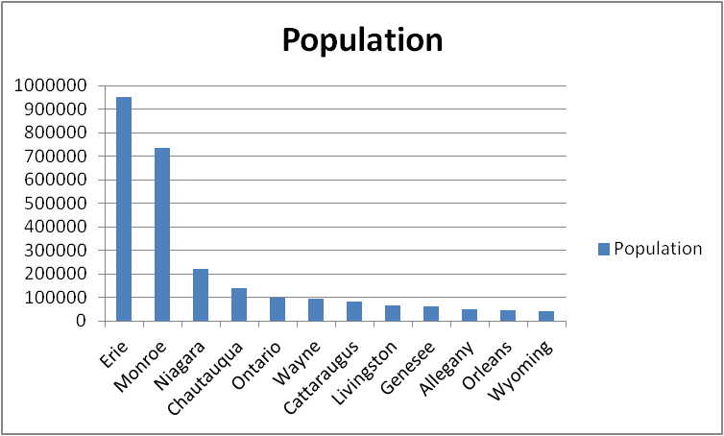
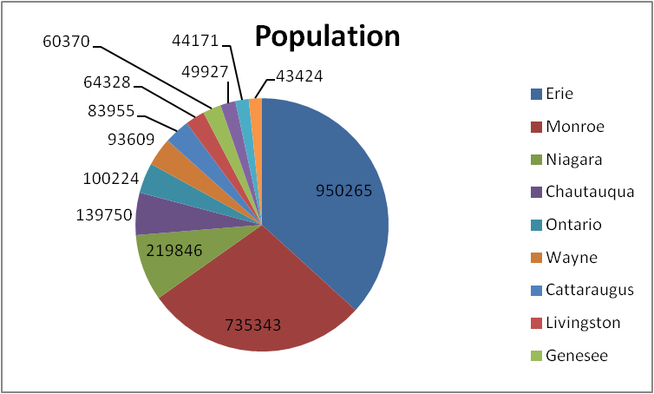
IAO - Problems with Counting
One too many Information Content Entities
Bar Chart
Pie Chart
instance of
instance of
URI:1
URI:2
Generically depend on
Generically depend on
instance of
instance of
Material Information Bearer
Material Information Bearer

Slide 25
Information Ontologies Alternative
One Information Content Entity
Ratio Measurement of State Region Population
instance of
URI:1
Generically depend on
Generically depend on
instance of
instance of
Material Information Bearer
Material Information Bearer

Slide 26
Merging the IAO and Information Ontologies
Settle upon some major axis on which information content entities are differentiated
Replace Information Carrier with Qualities of Information Bearers
Agree upon definition and instances of Information Bearer
Retain only those defined classes of information content entities that are common across many domains
Create extensions of the IAO/IEO that contain the defined classes that are useful for particular domains

