Slide 1




The CTSAconnect project and social entities
Shahim Essaid, Melissa Haendel, Carlo Torniai, Jon Corson-Rikert
The project and the rest of the team can be seen at:
http://www.ctsaconnect.org/

Slide 2
Overview
The CTSAconnect project
The eagle-i and VIVO projects and their ontologies
An overview of Searle’s use of “intention” to explain (or model) social entities
An open discussion of few social entities from the CTSAconnect project and how they could fit under the BFO

Slide 3

The CTSAConnect project
A multi-institute project
Builds on and extends two existing ontology-based platforms and integrates their linked data
Delivers an integrated semantic framework (with a single but modular common ontology)

Slide 4

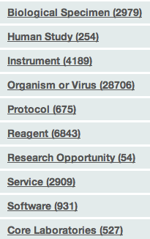
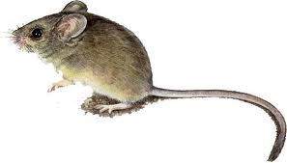



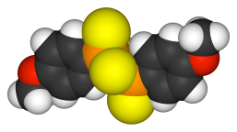
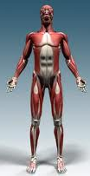

An ontology-driven framework for biomedical resource discovery
www.eagle-i.net
A deep lab “inventories” and institutional resources based on the shared eagle-i “catalog”
Over 51,000 resources currently in eagle-i

Slide 5

Vivoweb.org
Primarily focused on people, activities, and outcomes typically associated with research networking
Eager to represent more diverse components of expertise, across domains
e.g., exhibits, courses, specifics about research
Started collaborating with eagle-i to go further with research resources

Slide 6
The CTSAconnect project
Semantic
People
VIVO
VIVO
Integrated
Coordination
Framework
eagle-i
eagle-i
Clinical
activities
Resources
eagle-i is an ontology-driven application . . . for collecting and searching research resources.
VIVO is an ontology-driven application . . . for collecting and displaying information about people.
Both publish Linked Data. Neither addresses clinical expertise.
CTSAconnect will produce a single Integrated Semantic Framework, a modular collection of ontologies (with new classes and properties in the ARG namespace) — that also includes clinical expertise

Slide 7
Current status
Integrating the eagle-i and VIVO ontologies
Struggling with the abstract, social, or intentional aspects of entities
One of the first areas to be developed in the ISF ontology is the area of “credentials”
VIVO has a representation for credentials. We are developing a more detailed and ontological model of credentials but it is becoming difficult.
We have not addressed issues such as eligibility, validity, context, etc.

Slide 8
Searle’s approach
An intention (not intending to act) is some content or representation, and it relates to the world in a specific way
Intention + direction of fit = fact/statement, guess, wish, order, promise, declaration, expression, etc.
To communicate intentions, we developed a system of symbols (language) that we intentionally and collectively recognize as having specific meanings
We then “use” these symbols to communicate our intentions

Slide 9
Searle’s approach
Speech acts do things because of the intentions expressed in them. Few types of speech acts that do different things:
Directive or commissive: Make a wish, an order, or a promise (how things should or will be) “I vote my intention for a president X to exist”
Declarative: declare a president. Adds an “intentional status” to an existing object or creates a free standing abstract entity. “I/We declare an instance of a president in the US in the inauguration process”
Assertive: assert a fact or a belief (how things are). “There is a specific instance of a president at this moment”
The above examples are based on the expression of a representation of the world (aboutness), a direction of fit, and a strength (and possibly an attitude towards the aboutness, the expressive type)

Slide 10
Searle’s approach
He also explains how intentions can do things in the world
Distinguishes between cause and effect, and function
Creating and assigning a function is an intentional act
Assigning a function to a naturally occurring cause and effect represents our values or understanding of a system, assigns responsibilities, and allows for normal/abnormal judgments. This is a non-agentative function. (BFO’s function vs. realized function in a process) (white blood cells)
Assigning a function in order to create a cause and effect in a world is how intentions can do things in a world. This is an agentative function. (BFO’s roles) (policeman)
The assignment of functions is how we organize our world and distribute powers (positive or negative) to have a functioning system (the social/institutional world) beyond the natural system (the brute fact world).

Slide 11
Examples of Searle’s approach
Getting married:
A specific agent with a social or institutional status and function
Declares the existence of a new “marriage” entity
A couple becomes “married”
Becoming “married” is a status assignment and it usually has related functions that imply certain cause and effect in the world. Searle calls this an assignment of a “status function”
Winning a game of cards (at home) and being called a “winner” is mostly a status without a real function. In a tournament (an institutional context) the status does have clear functions.

Slide 12
Searle’s approach
Additional elements:
Ontologically objective (BFO) vs. subjective
Epistemically objective vs. subjective
Speakers, hearers, preconditions, conditions of satisfaction, lying, misspeaking, etc.
Rights, obligations, etc.

Slide 13
Social entities could exist as qualities (with document acts) in BFO 2?
“married” as a relational quality (BFO 2)
“John’s role of husband to Mary is dependent on Mary’s role of wife to John, and both are dependent on the object aggregate comprising John and Mary as member parts joined together through the relational quality of being married.”
Are BFO qualities to be used to indirectly represent intentional/social entities?
These types of qualities are not internal to the continuants as in the case for most of the PATO qualities. They are external (as in roles) but they come into existence without requiring processes. However, they do require intentions or beliefs.
There appears to be a complicated interplay of roles, qualities, and objects. Is this necessary?

Slide 14
Social entities as qualities in BFO
This could explain “married” but what about “marriage”?
A “marriage”, as a social and legal entity, can outlast the continuants. Does “married” also outlast the continuants?
Why not have the husband/wife roles, their realizations, and the quality of “married” somehow depend on, or be derived from, the “marriage” entity?
The existence of “marriage” is prior to these roles and qualities. Isn’t it?
Is this a modeling decision to avoid dealing with abstract social entities such as “marriage”?

Slide 15
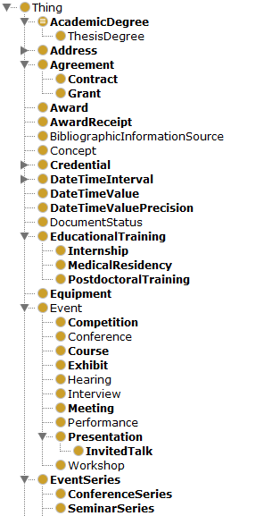
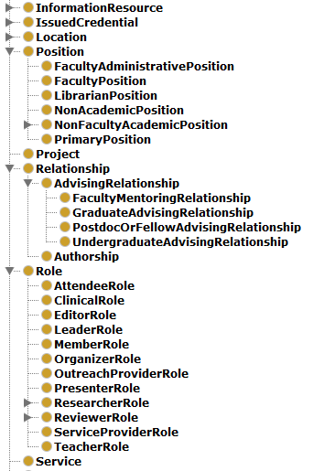
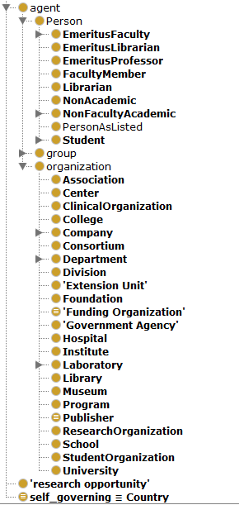
VIVO examples of social/intentional entities

Slide 16
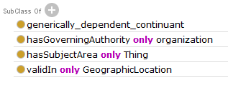
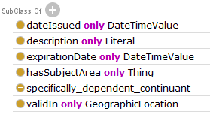
VIVO credential-related entities
Credential (GDC)
An attestation of qualification, competence, or authority issued to an individual by a third party with a relevant or de facto authority or assumed competence to do so.
Issued credential (SDC)

Slide 17
Possible credential related entities
An agent X decides/intends to certify other agents. It establishes an instance of “credentialing program” (VIVO credential) as a standing intention to issue other intentions.
An agent Y desires to be “credentialed”
Agent Y has to be “eligible”
Agent X eventually acts and asserts/declares a “credential” instance for Y (VIVO issued credential)
Agent Y becomes “credentialed”
Agent Y’s “credential” is only recognized or effective in on or more “contexts” and the contexts are usually other complex social contexts
“credentialed” is a status function of Y (as seen by X) but “credential” is a new and more independent entity. Neither are typical SDCs as defined in BFO.
Agent X (re)issues a “credential token”

Slide 18
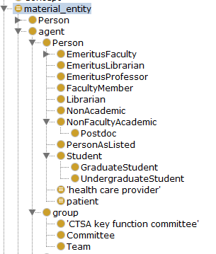
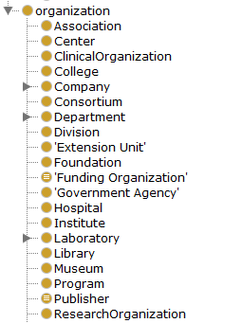
Agents in CTSAconnect

Slide 19
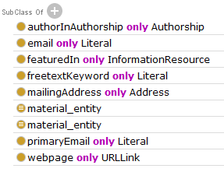
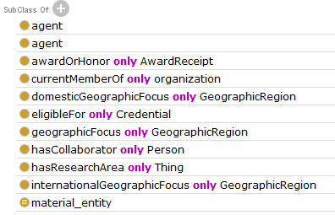
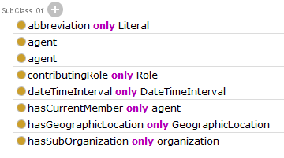
Agents (instance-level properties/information rather than definitions)
agent
person
organization

Slide 20
What is an agent?
A material entity?
Able to develop intentions (aboutness content)?
Able to act?
An independent vs. dependent entity?
A role?
Is a Person a Human + Agentness?
Is a Person or Organization a material entity or a free-standing Y term (a GDC)?

Slide 21
Author vs. Authorship
There is interest in capturing “authorship” without having to model or assert the processes it is realized in
The “authorship” can also be asserted without having to participate in a process (i.e. giving an “authorship” without a realization of an author role.)
Should “authorship” be a quality in an ontology in addition to the “author” role?
Were do we draw the line?
Is this similar to the husband vs. married vs. marriage case?
This type of modeling is simple in other models such as SPAR…

Slide 22
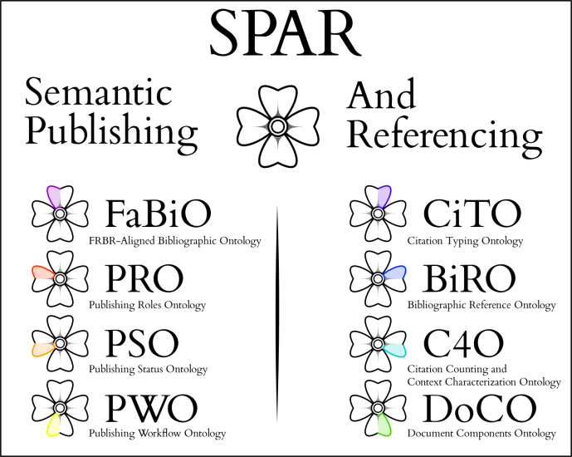
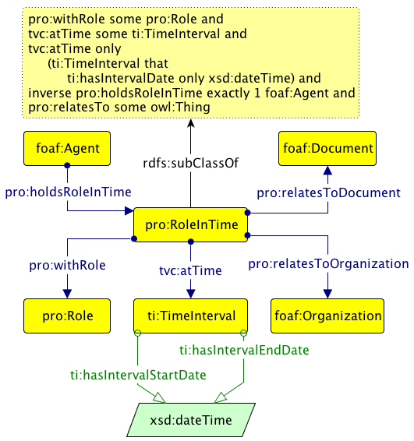
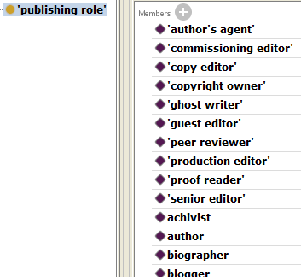
Author/authorship in SPAR
http://opencitations.wordpress.com/2010/10/14/introducing-the-semantic-publishing-and-referencing-spar-ontologies/

Slide 23
Other abstract (social?) entities in CTSAconnect
Expertise areas
MeSH headings, ICD9 codes
Topics and subject areas
For credentials, publications, etc.
Positions
An alternative to using roles to represent institutional positions because there could be a position without it’s bearer
And a position can explicitly capture the relationship between the thing filling a position and the thing offering it. This could probably be replaced with a relational quality in BFO2.
These are abstract independent entities that are very similar to numbers
They should probably be instances instead of classes
They need a place under the BFO
It can be said that they are about something and should fit under the IAO. However, it seems that there is always some aboutness to the various social or abstract entities and putting them all under the IAO is probably not the best option.

Slide 24
We need a general model for abstract entities (some of which are social or informational)
It should subsume the IAO
It should subsume intentions and intentional entities
It does not have to truly explain or represent mental functions, mind-body-world issues, etc.
Searle’s work, and the recent modifications and additions, appears very promising in this area. Could it be adopted by the BFO, or some extension of it?

Slide 25
End
Questions?
Do you know of any existing work or interest in formalizing social entities (to collaborate with)?
Searle’s framework appears promising but do you know of any important criticisms or alternatives?

