Slide 1
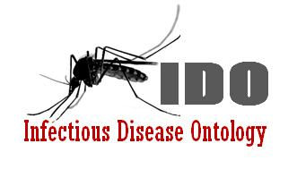
IDO-Staph: An IDO Extension for Staph aureus Infectious Disease
Albert Goldfain, Barry Smith, Lindsay G. Cowell
Immunology Ontologies and Their Applications in
Processing Clinical Data Workshop
June 11, 2012
Notes:
IDO-Staph vs SaIDO

Slide 2
Outline
Introduction: IDO-Staph
Staphylococcus aureus (Sa) Organism
Sa Parts and Products (Toxins)
Sa Infectious Disorders
Sa Diseases by Anatomical Site
Sa Syndromes

Slide 3
IDO-Staph: Introduction
Scope
Entities specific to Staphylococcus aureus (Sa) infectious diseases at multiple granularities
Biological and clinical terms describing host-Sa interactions
An IDO extension ontology
Extends IDO-Core, OGMS
BFO as an upper ontology
Built on OBO Foundry principles
Applications
Duke Staph aureus Bacteremia Group case report data annotation
Lattice of infectious diseases

Slide 4
Development Status
Status: OWL-DL implementation underway
Google Code Page: http://code.google.com/p/ido-staph/
Currently using BFO 1.1, BFO+RO 2.0 Ready
URI scheme: http://purl.obolibrary.org/obo/ido/Sa_NNNNNNN

Slide 5
Position in the IDO Lattice
OBO Foundry
IDO Core
Core Reference
Extension
Application
IDO Bacteria
IDO-Staph
IDO-MRSa

Slide 6
Staphylococcus aureus Phenotypic Characteristics
Gram-positive bacteria
Cluster-forming, spherical cells (-coccus)
Golden yellow-pigmented colony on agar (aureus)
Catalase positive, oxidase negative, coagulase positive
Normal flora in humans: nasal passages, skin, and mucus membranes.
Pathogenic to humans

Slide 7
Sa in IDO-Staph
Imported from NCBI Taxonomy
Necessary Conditions
ncbit:bacteria
has_disposition SOME
(realized_by SOME go:‘aerobic respiration’)
has_disposition SOME
(realized_by SOME go:fermentation)
has_part SOME
go:‘gram-positive-bacterium-type cell wall’
has_part SOME
(has_disposition SOME go:‘catalase activity’)

Slide 8
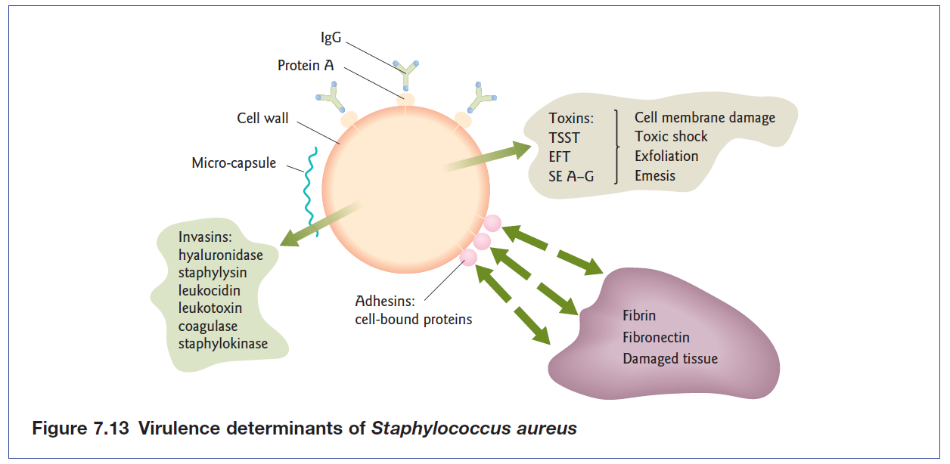
Sa Organism: Parts and Products
Molecular Entities: Toxins, Invasins, Adhesins
from Shetty, Tang, and Andrews, 2009
Notes:
What determines the course of a disease

Slide 9
Toxins in IDO
bfo:‘material entity’
chebi:‘molecular entity’
ido:toxin
ido:cytotoxin
ido:endotoxin
ido:exotoxin
ido:enterotoxin
ido:neurotoxin

Slide 10
Toxins in IDO Staph
ido:cytotoxin
leukocidin
Panton-Valentine leukocidin (PVL)
leukotoxin
ido:exotoxin
Alpha toxin (alpha-hemolysin)
Beta toxin (phospholipase C, beta-lysin)
Delta toxin (delta-hemolysin)
Exfoliatin (Staphylococcal exfoliative toxin)
Toxic-shock syndrome toxin (TSST-1)
ido:enterotoxin
Staphylococcal enterotoxin B (SEB)

Slide 11
Inferred Hierarchy
ido:‘invasion factor’
(has_disposition SOME invasion disposition)
PVL
Coagulase
Leukotoxin
Staphylokinase
Adhesion factors and virulence factors inferred the same way.
Notes:
Invasion disposition ~ facilitates invasion?

Slide 12
Sa Infectious Disorders
Infection~ A part of an extended organism that has as part a population of infectious agents.
Sa Infection: An infection that has as part organisms of the species Sa.
Sa bacteremia: A bacteremia that has as part organisms of the species Sa.
Infectious Disorder: An infection that is clinically abnormal.
Sa Infectious Disorder: A Staphylococcus aureus infection that is clinically abnormal.

Slide 13
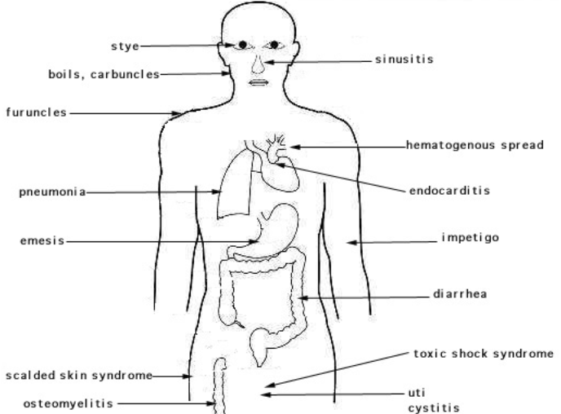
Source: http://textbookofbacteriology.net/themicrobialworld/staph.html

Slide 14
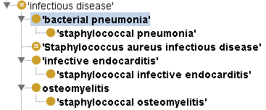
Sa Diseases: Asserted Hierarchy
Primary classification of staphylococcal diseases
These are first and foremost infectious diseases
Use DOIDs for disease terms
Assert ido:‘infectious disease’ as a parent term for these diseases

Slide 15

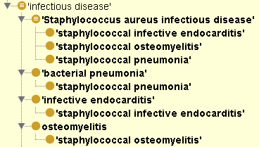
Sa Diseases: Inferred Hierarchy
Secondary classification as Sa Infectious Diseases

Slide 16
Staphylococcal Pneumonia
A bacterial pneumonia whose material basis is a Staphylococcus aureus infectious disorder in the lungs. Staphylococcal pneumonia is realized by a disease course that includes inflammation of the lungs.

Slide 17
Example: Staphylococcal Pneumonia
doid:‘bacterial pneumonia’
has_material_basis SOME
(‘Sa infectious disorder’ AND
(located_in SOME (part_of SOME fma:‘lung’))
realized_by SOME
(has_part SOME ogms: ‘inflammation process’))
Inferred: Staphylococcal pneumonia is a Sa Infectious Disease
Similarly for Sa Infective endocarditis, Sa osteomyelitis, etc.

Slide 18
Modeling Issue: Sa Infectious Disease or Complication of Sa Infectious Disease
Realization of a predisposition conferred by Staph aureus
Predisposition to Pneumonia
Inflammed part of lung as material basis / underlying disorder
Staph aureus as the material basis
Going back in the causal chain

Slide 19
Staphylococcal Toxic Shock Syndrome
TSS (syndrome), caused by several bacteria
TSS co-occuring signs and symptoms:
Body temperature > 38.9 °C
Systolic blood pressure < 90 mmHg
Diffuse rash, intense erythroderma, blanching with subsequent desquamation, especially of the palms and soles
Involvement of three or more organ systems
Sa TSS: Could be classified as a disease with a known cause (TSST-1 in Sa)

Slide 20
Staphylococcal Scalded Skin Syndrome
Signs: Widespread formation of fluid filled blisters that are thin walled and easily ruptured.
Sa SSS: Like TSS, there is a known cause, (exfoliatin in Sa), so could be classified as a disease.

Slide 21
Conclusions
IDO-Staph is an extension covering Staphylococcus aureus infectious diseases
Utilizes many terms from IDO-Core and the rest of the OBO Foundry
http://code.google.com/p/ido-staph/
Friday Talk:
Sa Genotypic Information
Drug Resistance
Annotating Sa Clinical Data

Slide 22
Thanks!

