Slide 1
Maintaining Ontologies as They Scale Across Multiple Species
Darren A. Natale
Protein Information Resource

Slide 2
The Issue
Many ontologies are designed, at least in part, to address entities in a cross-species manner
Examples: GO, IDO, PRO
How does one account for species with disparate biological mechanisms?
Regardless of solution chosen, the problem becomes more acute as we try to account for more and more species

Slide 3
The Approaches: GO ~40000 terms
Originally, used “sensu” (“in the sense of”) to indicate that there are differences based on taxa (these have been removed)
e.g., secretin (sensu Bacteria is a protein transporter, sensu Mammalia is a hormone)
Currently, definitions are refined to ensure that they can apply to all species (by removing any taxa-specific information)
GO strives to have no species-specific terms at all

Slide 4
GO:0007089 traversing start control point of mitotic cell cycle
OLD def: "Passage through a cell cycle control point late in G1 phase of the mitotic cell cycle just before entry into S phase; in most organisms studied, including budding yeast and animal cells, passage through start normally commits the cell to progressing through the entire cell cycle."
NEW def: “A cell cycle process by which a cell commits to entering S phase via a positive feedback mechanism between the regulation of transcription and G1 CDK activity.”

Slide 5
The Approaches: IDO ~500 terms + 2500,800,1700…
IDO does have both generic and specific terms, but are separately maintained:
IDO-Core is restricted to those terms that can apply to anything
e.g., host, toxin
IDO extensions contain terms specific to a particular species or closely-related species
e.g., Malaria, Influenza, Brucellosis
organism
IDO-core
host
malaria host
IDOMAL

Slide 6
The Approaches: PRO
PRO also allows for both generic and specific terms, but these are maintained together
For the most part only the generic (organism non-specific) terms are explicit; the classification of species-specific terms are inferred

Slide 7
Eh?
PR:000012035 explicitly states that ORC6 = A protein that is a translation product of the human ORC6L gene or a 1:1 ortholog thereof.

Slide 8
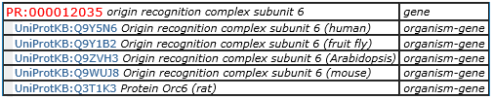
Eh?
PR:000012035 explicitly states that ORC6 = A protein that is a translation product of the human ORC6L gene or a 1:1 ortholog thereof.
Thus, if we can identify 1:1 orthologs of the human ORC6L gene, we can infer that the resulting proteins are instances of this class

Slide 9
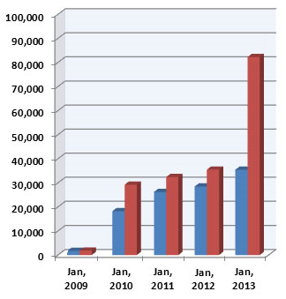
Growth of PRO
mapped entities
(inferred)
main PRO

Slide 10
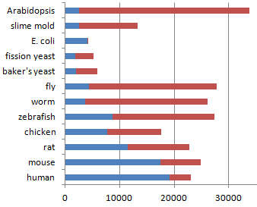
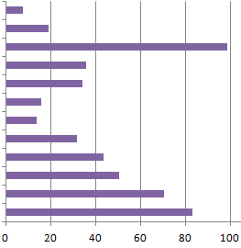
What was mapped
12 reference organisms:
7.5% = pitiful

Slide 11
Filling the Gaps
Fit UniProtKB entries into the PRO hierarchy
genes and isoforms
Possible approaches:
Allow generation skipping (i.e., not require mapping to 1:1 ortholog) and allow mapping to family-level terms
We’ll need a good relation from protein -> family
Define some classes based on paralogs (to handle lineage-specific expansions in plants)
Add function-based hierarchy in addition to evolution-based hierarchy

Slide 12
The New Relation?
x sequence_matches_hmm y = [def] if x is a linear sequence of letters and y is a hidden Markov model (HMM) that describes the probability of observing a particular sequence, then, given the parameters of the model, the probability of observing x (or some significant portion thereof) falls above the threshold defined for y.
x matches_hmm y= [def] if x is an amino acid chain with a sequence representation s and y is a hidden Markov model (HMM) that describes the probability of observing a particular sequence, then, given the parameters of the model, the probability of observing s (or some significant portion thereof) falls above the threshold defined for y.
x belongs_to y = [def] if x is an amino acid chain with a sequence representation s and y is a protein family for which a hidden Markov model h has been derived, then s sequence_matches_hmm h, and there is no other HMM o for which s exhibits a better match over the part of s that sequence_matches_hmm h.
x has_domain y = [def] if x is an amino acid chain with a sequence representation s and y is a protein domain for which a hidden Markov model h has been derived, then s sequence_matches_hmm h, and there is no other HMM o for which s exhibits a better match over the part of s that sequence_matches_hmm h.

Slide 13
Problems
The calculation of 1:1 orthology when based on proteins strongly depends on the protein set used
The accession for the mapped entities (from UniProtKB) sometimes cease to exist
In some cases, they disappear completely
In some cases, they change (e.g., when a TrEMBL entry is merged into a Swiss-Prot entry to become a new isoform)

