Slide 1

Claire O’Donovan
EMBL-EBI

Slide 2
In UniProtKB, we aim to provide…
A high quality protein sequence database
A non redundant protein database, with maximal coverage including splice isoforms, disease variants and PTMs. Sequence archiving essential.
Easy protein identification
Stable identifiers and consistent nomenclature/controlled vocabularies
Thorough protein annotation
Detailed information on protein function, biological processes, molecular interactions and pathways cross-referenced to external sources

Slide 3
UniProtKB sequence sources
INSDC – ENA/GenBank/DDBJ entries with CDS annotations
ENSEMBL – Vertebrates and now Genomes including plants
RefSeq – all mapping done, now comparing what is additional/more up to date/better supported
Open to new collaborations!!

Slide 4
Canonical sequence concept (1)
UniProtKB/Swiss-Prot policy is to describe all the protein products encoded by one gene in a given species in a single entry.
Criteria for choosing the canonical sequence -
It is most prevalent
It is the most similar to orthologous sequences in other species
By virtue of its length or amino acid composition, it allows the clearest description of domains, isoforms, polymorphisms, post-translational modications etc
In absence of any information, we choose the longest sequence

Slide 5
Canonical sequence concept (2)
Differences to other sequence sources and alternative protein products are documented in the ‘Sequence annotation (Features)’ section
In this context: CHAIN, PROPEP, PEPTIDE, VAR_SEQ
Annotation for these are in the alternative products and general annotation sections of the UniProtKB record.
The various UniProtKB distribution formats (flat text, XML, RDF) display only the canonical sequence but the website displays the canonical sequences and the isoforms.

Slide 6
Canonical sequence concept (3)
Isoform sequences can be downloaded in FASTA format from our FTP download index page (choose the file: Isoform sequences)
Query-derived sets of canonical sequences along or canonical and isoform sequences can also be downloaded in FASTA format through the website (see FAQ 30)
This is done using our sequence and feature identifiers.

Slide 7
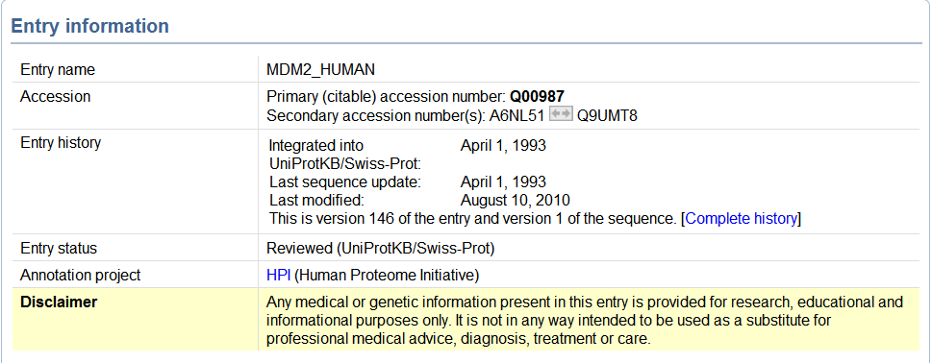
Sequence identifiers

Slide 8
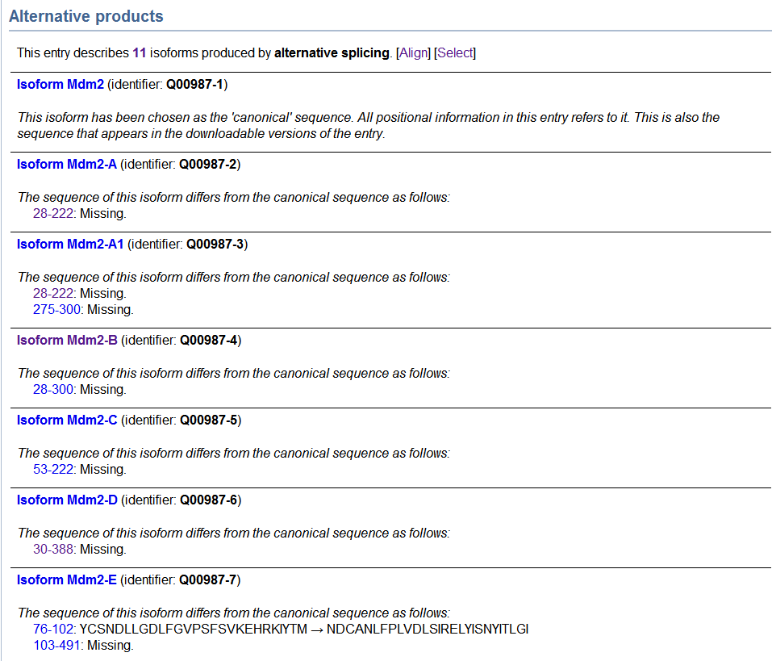
Notes:
Next we have the Alternative Products section where all isoforms are listed.
To align all isoforms simply click on the Align link at the top.
Each has a specific accession for identification
The differences between each isoform to the master entry is stated.

Slide 9
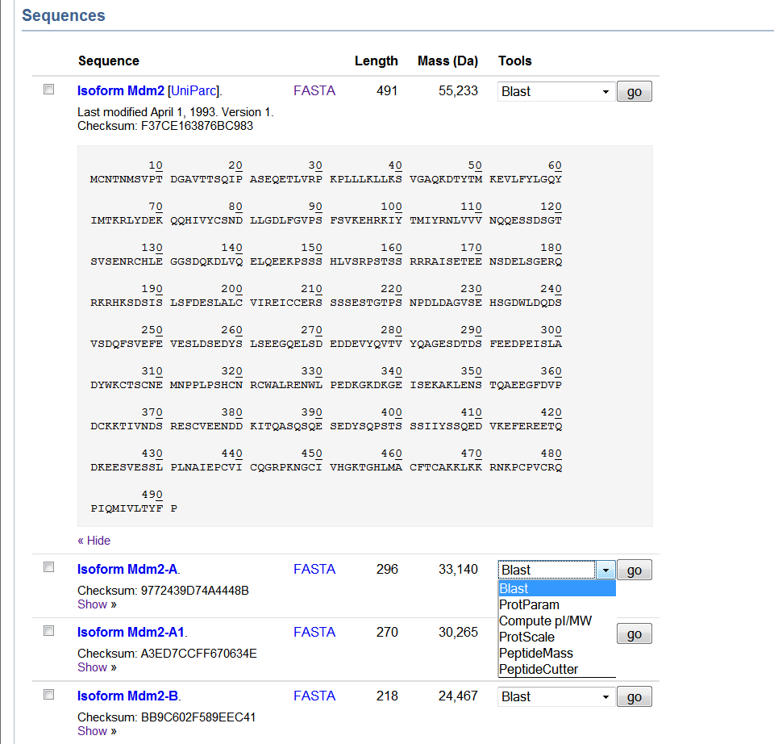

Slide 10
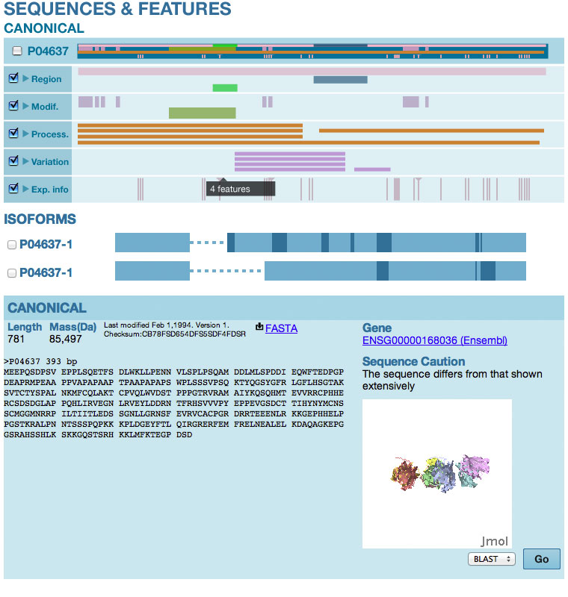

Slide 11
Feature identifiers
Some features are associated with a unique and stable feature identifier (FTId), which allows us the possibility to construct links directly from position-specific annotation in the feature table to specialized protein-related databases and to generate the alternative sequences

Slide 12
Feature identifiers
Key name | Format of the FTId | Availability
CARBOHYD | CAR_number | Currently only for residues attached to an oligosaccharide structure annotated in the GlycoSuiteDB database
CHAIN, PEPTIDE | PRO_number | Any mature polypeptide
PROPEP | PRO_number | Any processed propeptide
VARIANT | VAR_number | Currently only for protein sequence variants of Hominidae (great apes and humans)
VAR_SEQ | VSP_number | Any sequence with a VAR_SEQ feature

Slide 13
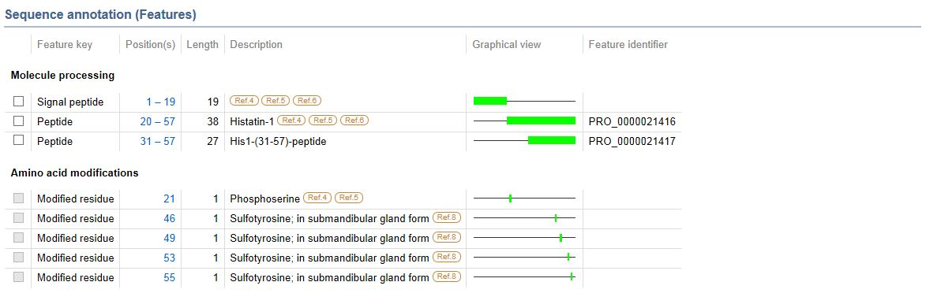
Feature identifiers

Slide 14
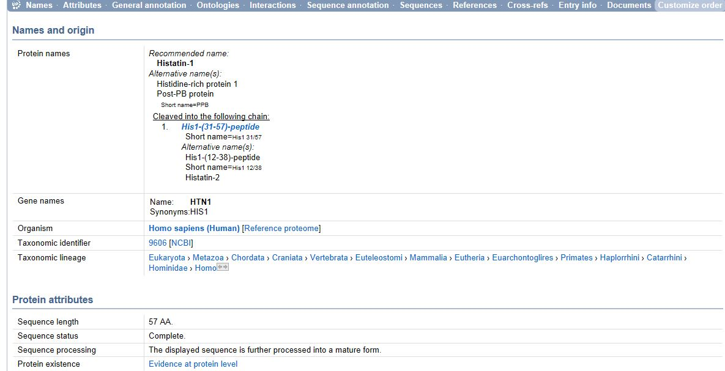
Identifiers and nomenclature and other annotation

Slide 15
Summary on UniProtKB identifiers
There are identifiers for various protein products
UniProt is planning to provide more “child” entries like we do for the isoforms right now based on the propep and chain features
UniProt is planning to attach the specific annotation for those alternative protein products in these child entries
If you use Protein2GO, you can already annotate to UniProtKB Q4CVS5, a specific isoform Q4CVS5-1 or feature IDs P62987:PRO_0000396434

Slide 16
UniProt/EBI and ontologies
Really want to learn all about the available ontologies in order
To structure more and more of our UniProtKB annotation into ontologies both for our curators to do the annotation “better” and to import/export annotations with other resources
To give guidance at the EBI about the availability of ontologies and the potential use cases for our resources – consistency being key for operability of course!

Slide 17
Finally
Acknowledgements to all the UniProt staff at EMBL-EBI, PIR and SIB and our funders especially NIH, EMBL and the Swiss Government.
Thanks for a really interesting meeting so far
Looking forward to working with you

