Slide 1
GO/PO interconnections
Tanya Berardini
GO Ontology Developer
TAIR Annotator

Slide 2
GO terms with PO references
Biological Process: esp. Developmental Process
Ex. flower development
Cellular Component
Ex. root hair tip

Slide 3
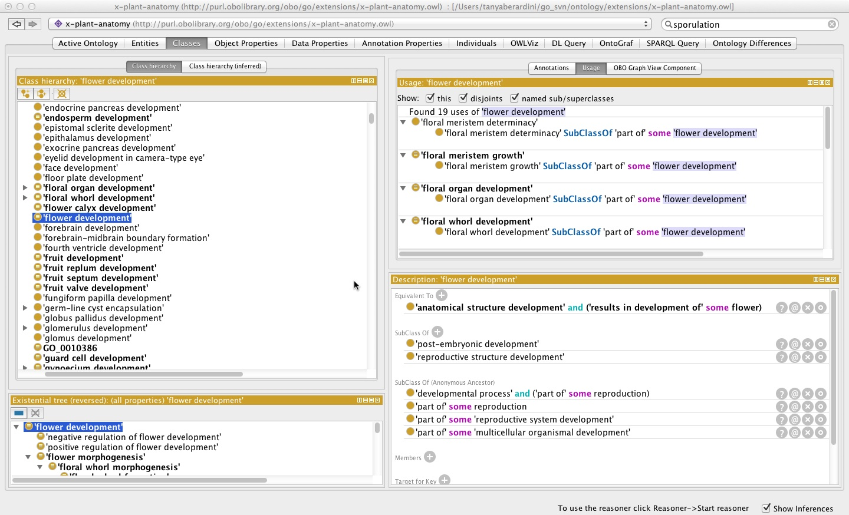
Protégé 4.3

Slide 4
GO logical definitions using PO
Biological Process
[Term]
id: GO:0009908 ! flower development
subset: goslim_plant
intersection_of: GO:0048856 ! anatomical structure development
intersection_of: RO:0002296 PO:0009046 ! results in development of flower
Cellular Component
[Term]
id: GO:0035619 ! root hair tip
intersection_of: GO:0044463 ! cell projection part
intersection_of: BFO:0000050 PO:0025164 ! part_of root epidermal cell

Slide 5
Current Status
152 logical definitions in file that is separate from the main GO

Slide 6
Future Plans
Integrate GO/PO logical definitions into main GO file
Add a new TermGenie template/s for PO-related GO terms
go.termgenie.org
TG templates will facilitate automatic placement of such terms in the GO hierarchy based on existing related GO terms and the current PO structure
Changes in the PO will be reflected by changes in the related GO terms, if such changes are necessary

