Slide 1
The Population and Community Ontology (PCO)
presentation by Ramona Walls at PRO-PO-GO meeting
May 15, 2013
http://code.google.com/p/popcomm-ontology/
popcomm-ontology@googlegroups.com

Slide 2
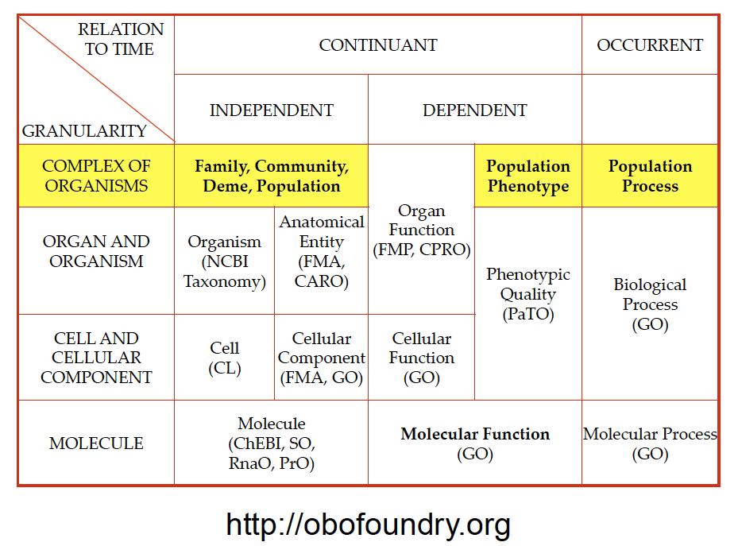
Notes:
Image courtesy of Barry Smith

Slide 3
Domain of the PCO:
collections of organisms (populations, communities, family groups)
qualities of collections of organisms (with PATO)
processes that have collections of organisms as participants (with GO)
roles for organisms within a collection of organisms (e.g., parent, sibling, predator, herbivore, pollinator, pathogen)

Slide 4
The PCO can be used to describe:
Ecology and Evolution
intra- and interspecific interactions, interactions with environment
population as the unit of evolution
Medicine
collections of humans, pathogens, vectors
epidemiology, disease transmission, sociology
Agriculture
crop breeding, plant pathology, animal diseases, weeds

Slide 5
Examples of collections of organisms:
A unicellular colony
A microorganism infection (the bacteria in a bacteremia, the viruses in a viremia)
A herd (bunch of big animals living in close proximity)
The sum of the infectious agents in a herd's infection (all potentially eradicated with the same antibiotic)
The occupants of a biological niche (most susceptible to an pan-species toxin)
My microbiome
Ashkenazi jews (some common genetic elements due to being a herd at some earlier part of history)
People with malaria
People immune to HIV
(Thanks to Alan Ruttenberg)

Slide 6
Essential elements of the definition of a population:
More than one organism (or virus or viroid)
All members of the same species
Geographical proximity – potential for reproductive or other ecological interactions
Maximal?
a random sub-sample of a population is not a population in the evolutionary sense (but is in statistical sense)
sub-populations and meta-populations are populations

Slide 7
Essential elements of the definition of an ecological community:
More than one organism
Members of at least two species
Geographical proximity – living in the same area
Ecologists disagree on whether or not:
the organisms must interact with each other (but generally some interaction is assumed)
a community must include all organisms present at a location
Notes:
If there is not interaction, why would someone bother to study it.

Slide 8
Qualities of collections of organisms
Population quality: A quality that inheres in a population.
carry capacity (quality of a population or its environment?)
population birth rate, death rate, growth rate, etc.
sex ratio
population structure
Are these BFO:qualities?
Ecological community quality: A quality that inheres in a community
diversity
species richness
stability, resilience
community structure (distribution of species)
number of trophic levels
Notes:
A population or community quality may depend on the qualities of individual organisms in the population or community, but cannot be measured or described for a single individual.

Slide 9
Phenotypes of collections of organisms
agronomists measure traits as average (or some other statistic) of a field, not one individual
e.g., yield, drought tolerance
qualities are assigned to a clades (species or populations)
e.g., maples have alternate leaves

Slide 10
PATO
population quality (PATO:0002003) =def. A quality that inheres in an entire population or part of a population.
The phrase “part of a population” is problematic – includes qualities that inhere in organisms or their parts.
Has two subclasses: mixed sex (PATO:0001338) and morbidity (PATO:0001415).
organismal quality (PATO:0001995) =def. A quality that inheres in an entire organism or part of an organism.
Suggest that PATO redefine organismal quality as a quality that inheres in an entire CARO:organism or a PCO:collection of organisms, or possibly get rid of these terms.
Should PATO have categories of qualities that are defined only by the entity in which they inhere?
Don’t all qualities in PATO inhere in an organism?

Slide 11
PCO: population process
Examples:
population growth
exponential population growth
logistic population growth
population extinction
evolution
selection
immigration, emigration

Slide 12
PCO: population process
=def.: A process that has as primary participant a population.
Population processes may depend on the processes of individual organisms [e.g., population growth reflects the cumulative multicellular organism reproduction (GO:0032504) and death (GO:0016265) of all individuals in a population] but cannot be described for an individual organism.
Some processes (e.g., evolution, extinction) can occur at both the species and the population level, so PCO distinguishes between, for example, population extinction vs. species extinction.

Slide 13
Population and community processes in the context of the GO
biological process (GO:0008150): Any process specifically pertinent to the functioning of integrated living units: cells, tissues, organs, and organisms. A process is a collection of molecular events with a defined beginning and end.
multi-organism process (GO:0051704): Any process in which an organism has an effect on another organism of the same or different species.
Notes:
A population or community could be considered an integrated living unit.

Slide 14
Community processes in the context of the GO
sub-classes of multi-organism process:
interspecies interaction between organisms (GO:0044419): Any process in which an organism has an effect on an organism of a different species.
intraspecies interaction between organisms (GO:0051703): Any process in which an organism has an effect on an organism of the same species.
behavioral interaction between organisms (GO:0051705): Any process in which an organism has a behavioral effect on another organism of the same or different species.

Slide 15
PCO: community process
examples:
competition
predation
facilitation
mutualism
parasitism
pollination
Some of these terms are already in the GO. PCO will work with GO to define new terms, then import them into PCO as needed.
Notes:
Some of these terms are already in the GO. PCO will work with GO to define new terms, then import them into PCO.

Slide 16
Definitions of population from some evolutionary biologists:
Gotelli’s A Primer of Ecology: A group of individuals, all of the same species, that live in the same place. Although it is sometimes difficult to define the physical boundaries of a population, the individuals within a population have the potential to reproduce with one another during the course of their lifetimes.
Futuyma’s Evolution: A group of conspecific organisms that occupy a more or less well defined geographic region and exhibit reproductive continuity from generation to generation; ecological and reproductive interactions are more frequent among these individuals than with members of other populations of the same species.

Slide 17
Definitions of ecological community from some ecologists:
From Morin’s Community Ecology (paraphrased): A collection of organisms of at least two different species, living in a particular area.
From Begon et al.’s Ecology: The species that occur together in space and time.

Slide 18
Interactions with EnvO
An ecosystem is an ecological community plus the abiotic (physical) environmental features (soil, air, water, sunlight, slope).
Many ecologists consider a biome to be a type of large-scale ecological community.
Need to collaborate with ENVO on these terms.
Need to define:
niche
habitat
biome (e.g., as the area in which forms suitable habitat for a particular community)

