Slide 1
BioPortal Slices
Trish Whetzel
PRO-PO-GO Workshop
May 15-16, 2013

Slide 2
What is a Slice?
Subset of ontologies in BioPortal
Ontology content selection is customizable
Provides a custom URL to access BioPortal
Accessible content is filtered on all BioPortal pages, e.g. Browse, Search, Mappings etc.
Created based on user request

Slide 3
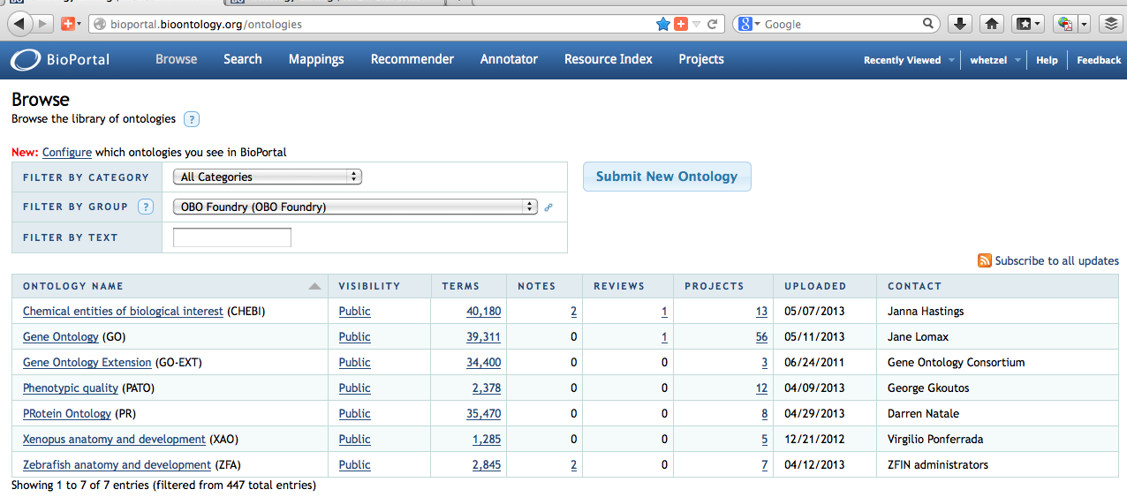
BioPortal
General URL
Filtered by Group
Group filters display only

Slide 4
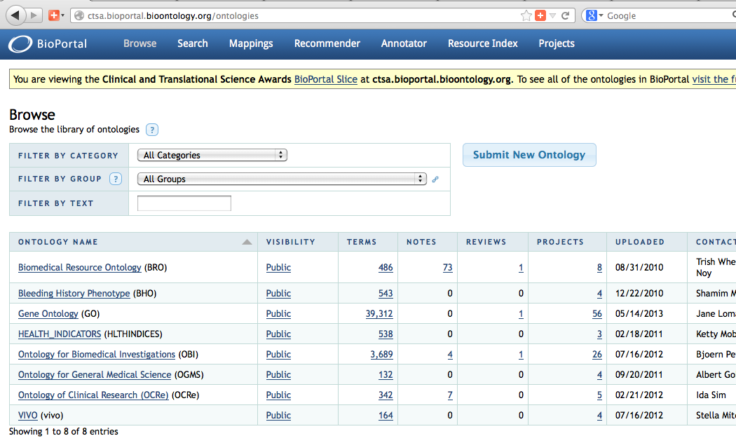
CTSA Slice of BioPortal
Custom URL
Slice filters all accessible content

Slide 5
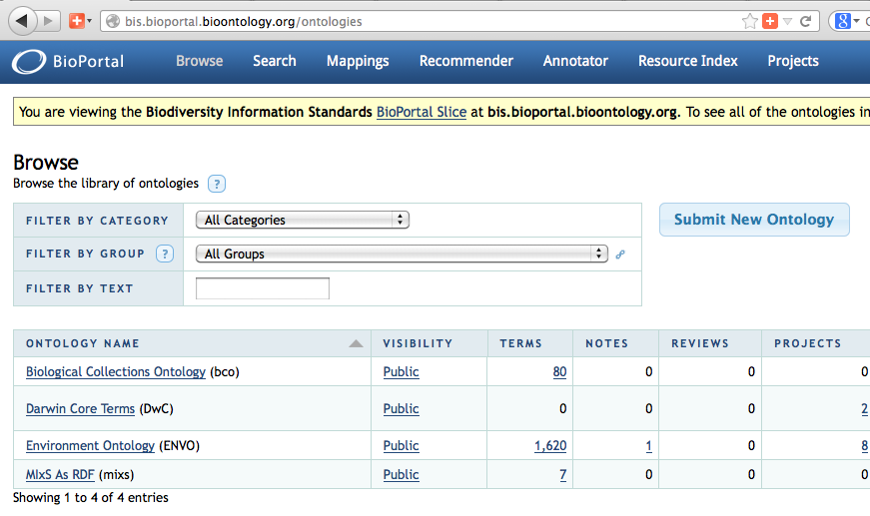
BIS Slice of BioPortal
Custom URL
Slice filters all accessible content

Slide 6
Advantages of BioPortal Slice
Customize ontology content for your consortium
Common ontology browser for your ontologies of interest
Provides all BioPortal functionality for ontologies in the Slice

