Slide 1
The Fifth Cycle of Philosophy
Barry Smith

Slide 2
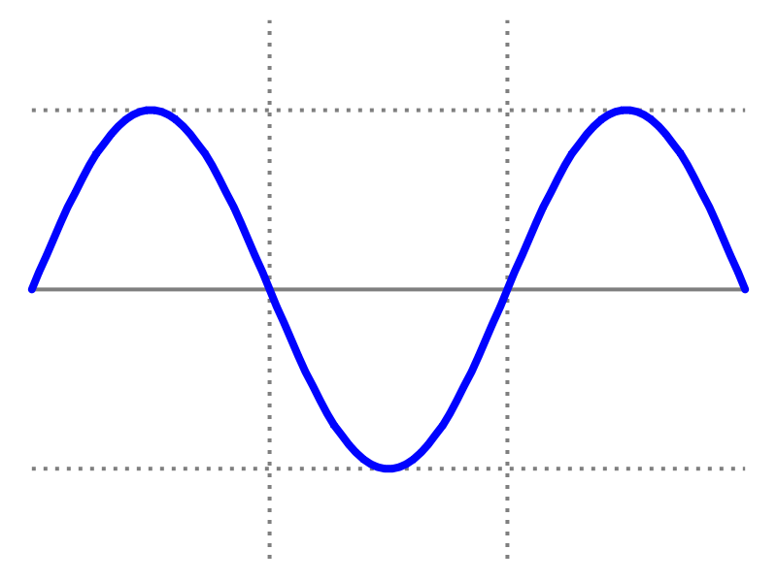
Franz Brentano’s Four Phases of Philosophy
rapid practical scepticism mysticism
progress interest

Slide 3
philosophy has passed, so far, through 4 cycles
rapid practical scepticism mysticism
progress interest

Slide 4
Ancient Medieval Modern 20th Century

Slide 5
Ancient Medieval Modern 20th Century
1 2 3 4

Slide 6
First Cycle: Ancient
Aristotle
empirical
wonderment
Thales to Stoicism and Pyrrho, Neo-Pythagoreans,
Aristotle Epicureanism Eclectics Neo-Platonists

Slide 7
Second Cycle: Medieval
Aquinas
learned
ignorance
Rediscovery of Scotism Ockham, Lull,
Aristotle by Augustine Nominalists Nicholas of
and Early Scholastics Cusa

Slide 8
Third Cycle: Enlightenment
Bacon Christian Wolff Hume Berkeley, Fichte
Descartes Reid Schelling, Hegel
Leibniz, Locke Kant

Slide 9
Third Cycle
Bacon
Descartes
Leibniz, Locke

Slide 10
Philosophical mother ship gives birth to empirical physics
Bacon Rising practical
Descartes relevance
Leibniz, Locke
Newton

Slide 11

Notes:
http://bobmschwartz.com/2013/11/01/saints-for-all/

Slide 12
Fourth Cycle: Continental
Brentano’s Husserl Heidegger Derrida and
Rediscovery Reinach the French
of Aristotle Ingarden

Slide 13
Philosophical mother ship gives birth to the new empirical science of psychology
Brentano, Stumpf
Meinong, Ehrenfels
Wundt

Slide 14
Birth of Psychology
1879: first psychological laboratory
1883: first psychology journal
1889: first International Congress of Psychology
1892: American Psychological Association

Slide 15
Fourth Cycle (Analytical)
Frege Vienna Circle Wittgenstein 2º Rorty
Wittgenstein 1º Gödel Quine Feyerabend
Russell Tarski Goodman

Slide 16
Philosophy gives birth to mathematical logic and computer science
Frege Gödel
Russell Tarski
Whitehead Turing

Slide 17
Each final phase of decline, with its ultimate collapse into nonsense and jokes, gives rise to the call for a new phase of renewal.
Derrida
Rorty
Judith Butler
Zizek

Slide 18
Nicola Guarino is here
Derrida
Rorty
Judith Butler
Zizek

Slide 19
Philosophical mother ship gives birth to the new discipline of ontological engineering
Husserl
Ingarden
Lowe
Armstrong
Fine
Simons

Slide 20
What is needed to found a new discipline?
Institute
Funding
Journal
Conference
Society
Industrial application
Military application

Slide 21
What is needed to found a new discipline
Institute
Funding
Journal
Conference
Society
Industrial application
Military application

Slide 22
Research Institutes (Examples)
Laboratory for Applied Ontology (Trento and Rome)
LabOnt (Turin and Rome)
Institute for Formal Ontology and Medical Information Science (Saarbrücken)
Centre for Knowledge Analytics and Ontological Engineering (Bangalore)
National Center for Biomedical Ontology (Stanford Medical School, Mayo Clinic, Buffalo Department of Philosophy)

Slide 23
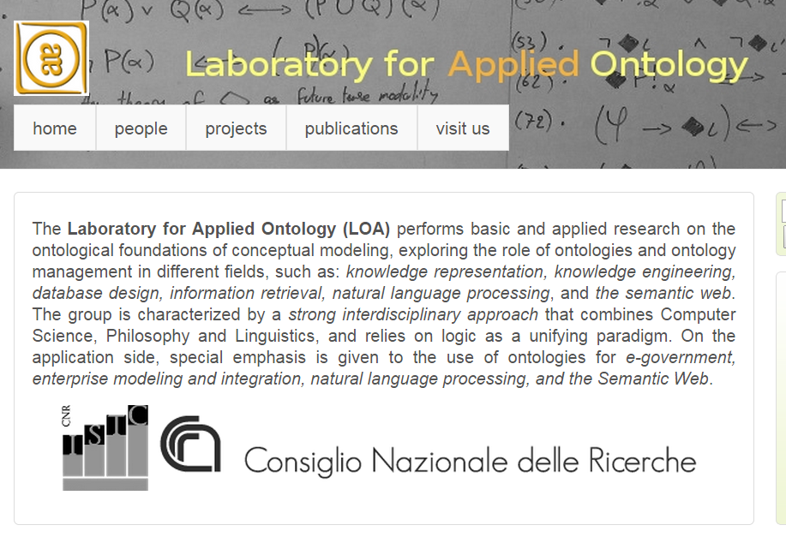

Slide 24
What is needed to found a new discipline
Institute
Funding
Journal
Conference
Society
Industrial application
Military application

Slide 25
Nicola Guarino Funded Projects
OZ | Osservare l'attenZione
STACCO | The Civil Status of Contradiction (lo STAto Civile della COntraddizione)
VisCoSO | Detection of Crisis in Socio-Material Systems via VISual-COgnitive-SOcial Processes
LASTS | Logical Analysis of Socio-Technical Systems
ODASP | Ontology Driven Analysis of Nominal Systematic Polysemy in WordNet
IZS VE 09/12 RC | Il monitoraggio del TAT (Turnaround time) come strumento per migliorare l’efficienza complessiva del laboratorio.
GECKO | Generic Evolutionary Control Knowledge-based mOdule

Slide 26
Nicola Guarino Funded Projects
SOGEI Ristrutturazione Ontologica del Dizionario Fiscale Integrato
IZS-VE 16/2009 Comunicazione del rischio correlato al consumo degli alimenti: analisi di dati e metadati in campioni destinati al controllo microbiologico.
TasLab Trentino as a Lab
EuJoint EUropean-Japanese Ontology INTeraction (Marie Curie IRSES Exchange Project n. 247503)
RC-16/09 Comunicazione del rischio correlato al consumo degli alimenti: analisi di dati e metadati in campioni destinati al controllo microbiologico
RC-19/08 Analisi e definizione di una metodologia operativa per migliorare la gestione dei dati relativi al conferimento di campioni all'Istituto Zooprofilattico delle Venezie, con particolare riferimento alla sicurezza alimentare.

Slide 27
Nicola Guarino Funded Projects
ILIKS Interdisciplinary Laboratory on Interacting Knowledge Systems.
TOCAI.IT Tecnologie Orientate alla Conoscenza per Aggregazioni di Imprese su InTernet - Knowledge-based technologies of enterprise integration (collaboration and exchange project).
EGOVONTO Interoperabilita' semantica nell'e-Government.
NeOn NEtworked ONtologies - Shaping the future infrastructure for semantic applications (collaboration and exchange project).
ICT4Law ICT Converging on Law - Next Generation Services for Citizens, Enterprises, Public Administration and Policymakers.
MOSTRO Modelling Security and Trust Relationships within Organizations
ALT INFO ALgebraic Tools IN Formal Ontology (collaboration and exchange project) [English (pdf)] [Italian (pdf)]
METOKIS Methodology and Tools Infrastructure for the Creation of Knowledge Units

Slide 28
Nicola Guarino Funded Projects
SemanticMining Network of Excellence – Semantic Interoperability and Data Mining in Biomedicine
OntoWeb Ontology-based information exchange for knowledge management and electronic commerce
WonderWeb Library of Foundation Ontologies
TICCA Tecnologie cognitive per l'interazione e la cooperazione con agenti artificiali
iKF Intelligent Knowledge Fusion (Eureka Project E!2235); Ontology of banking transactions (with ELSAG Banklab); Ontology of Service-Level Agreement and IS monitoring (with SELESTA)
FOS Fishery Ontology Service, a fishery ontology for semantic interoperability of legacy systems and terminologies (with FAO)
OUR Ontology of User Requirements, a contribution to the international LyeeProject

Slide 29
What is needed to found a new discipline
Institute
Funding
Journal
Conference
Society
Industrial application
Military application

Slide 30
Journals
Applied Ontology
Journal of Biomedical Semantics
International Journal of Metadata, Semantics and Ontologies
Ontology Development and Applications
Journal of Social Ontology
Metaphysica

Slide 31
What is needed to found a new discipline
Institute
Funding
Journal
Conference
Society
Industrial application
Military application

Slide 32
Conferences
Formal Ontology in Information Systems (FOIS)
Bio-Ontologies
Ontology for the Intelligence (OIC / STIDS)
International Conference on Biomedical Ontology (ICBO)
…

Slide 33
What is needed to found a new discipline
Institute
Funding
Journal
Conference
Society
Industrial application
Military application

Slide 34
Ontology Societies
International Association for Ontology and Its Applications (iaoa.org), founded 2012
International Society for Biocuration (biocurator.org)
UK Ontology Network (ukontology.org)
…
‎

Slide 35
What is needed to found a new discipline
Institute
Funding
Journal
Conference
Society
Industrial application
Military application

Slide 36
Guarino: Industrial Applications
LASTS Logical Analysis of Socio-Technical Systems
TOCAI.IT Tecnologie Orientate alla Conoscenza per Aggregazioni di Imprese su InTernet - Knowledge-based technologies of enterprise integration
ICT4Law ICT Converging on Law - Next Generation Services for Citizens, Enterprises, Public Administration and Policymakers.
iKF Intelligent Knowledge Fusion (Eureka Project E!2235); Ontology of banking transactions (with ELSAG Banklab); Ontology of Service-Level Agreement and IS monitoring (with SELESTA)
FOS Fishery Ontology Service, a fishery ontology for semantic interoperability of legacy systems and terminologies (with FAO)

Slide 37
What is needed to found a new discipline
Institute
Funding
Journal
Conference
Society
Industrial application
Military application

Slide 38
The Fifth Cycle of Philosophy
Ontology reaches the stage where it is pursued with military application and zeal
-- combat-grade levels of commitment, strategy, tactics, ground coverage …

Slide 39
World’s first ontological research institute founded by Nicola Guarino
World’s first ontology journal founded by Nicola Guarino
World’s first ontology conference series initiated by Nicola Guarino
World’s first international association conceived and realized by Nicola Guarino
Massive sustained funding for ontological research in multiple industries and disciplines for over 20 years

Slide 40
Already in the early 1990s, Nicola
… was a familiar face in the early Knowledge Acquisition Workshops where he was best known for pointing to himself and saying,
“Nicola Guarino”, Wikipedia entry

Slide 41
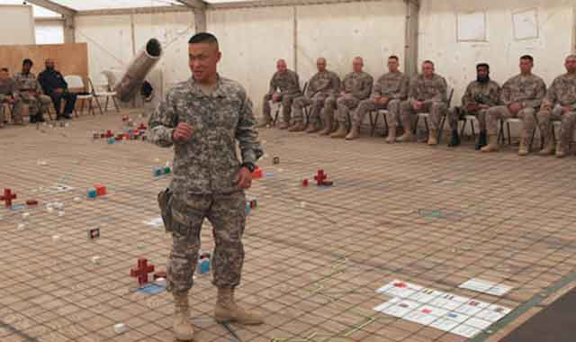
“I am not a class!”

