Slide 1
Leveraging Ontologies for Human Immunology Research
Barry Smith, Alexander Diehl, Anna-Maria Masci
Presented at Leveraging Standards and Ontologies to Improving HIPC Data Submission and Analysis, National Institiute of Allergy and Infectious Diseases (NIAID), Rockville, MD, November 19

Slide 2
ImmPort Antibody Registry and Ontology
1012 monoclonal antibodies used in immunology research (mAb) mapped to 510 PRO terms.
Adding new PRO terms to represent phosphorylated protein targets of mAbs.
Enables complex queries for antibodies based on their (multiple) names, protein targets, vendors, conjugation, and usefulness for different types of staining, or any combination thereof.
Initial release of ontology on ImmPort Labs will occur before the end of 2014.

Slide 3
Recommended HIPC IOF Project (1-2 years)
Project Title: Development of an Antibody Panel Ontology
Problem Statement: Antibody Panels used widely in immunology and oncology research and diagnosis to assay the types and percentages of immune cell types in blood and other tissues. We need a standardized way to represent these panels in regards to the antibodies used, markers targeted, and cell type targeted.
Project Goal: Build an Antibody Panel Ontology for both commercial and research products
specify antibodies via ImmPort Antibody Ontology and NIF Antibody Registry identifiers,
specify markers via Protein Ontology IDs,
specify cell types via Cell Ontology IDs. The panels will be based on both commercial products and panels specified in primary research.
Deliverables: 1) The Antibody Panel Ontology, 2) enhancements to supporting ontologies. 3) A simple web interface to the ontology to allow for querying

Slide 4
GO and Immunology
In 2006, 700+ new terms added to GO to represent immunological processes
But no focused immunology annotation project followed due to changing priorities of the GO Consortium.
List of prioritized genes for immunology:
http://wiki.geneontology.org/index.php/Immunologically_Important_Genes_Listed_by_Priority_Score (combined from several sources)
Many still have minimal annotation.

Slide 5
Recommended HIPC IOF Project (2 years)
Project Title: Focused Gene Ontology Annotation of Genes Involved in Immune System
Problem Statement: Results using GO term enrichment leads to incomplete or misleading results for immune processes, GO annotations do not reflect current experimental knowledge sufficiently.
Project Goals: Create priority list of immune system genes/proteins and protein complexes and immune system processes,
Annotate key papers with experimental data relevant to human immunology, so that GO annotations match experimental knowledge more completely. Add GO terms as added as necessary. Link GO annotations tied to cell types (CL) and anatomical sites (FMA/Uberon) where supported by experimental data.
Deliverables: 1) 4000 experimentally based granular GO annotations for human proteins related to the immune system. 2) Improvements to the GO representation of immunology. 3) Provide enhanced access via GO-based search tools to immunology data.

Slide 6
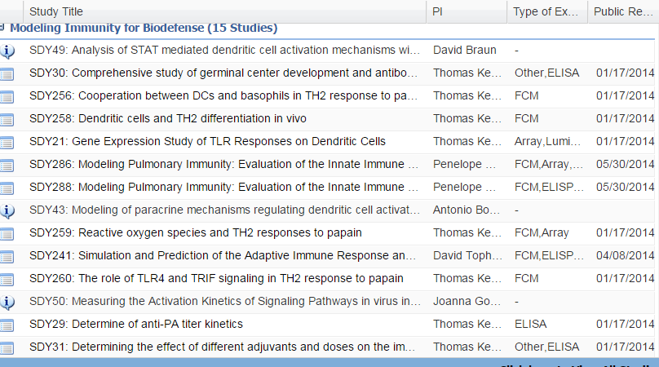
Modeling Immunity for Biodefense

Slide 7
Recommended HIPC IOF Project (2 years)
Project Title: Pipelines for Ingestion of In Silico Data into ImmPort
Problem Statement: Huge variety of in silico-generated data and mathematical tools have been developed for modeling immune functions, ranging from single receptor signaling to cell dynamics; each modeling initiative employs its own vocabularies and formats to represent the models, so data and tools are difficult to compare or aggregate
Project Goals: Create a controlled vocabulary, based on the Ontology for Biomedical Investigations, for representation of in silico research methods and outputs (models) In a form which will allow easy integration with conventional wet-lab data
Deliverables: secure ImmPort’s role as the source for immune system data by creating Immport Templates for uploading each type of in silico-generated data; enhanced value of modeling data since we will have an explicit and verifiable understanding of biological processes being modeled; enhanced opportunities for comparing computational and conventional data representing the same biological reality.

