Slide 1
Lecture 2 Ontology and Logic

Slide 2
Aristotelian realism vs. Kantian constructivism
Two grand metaphysical theories
20th-century analytic metaphysics dominated by a third grand metaphysical theory, a theory based on advances in predicate logic

Slide 3
propositional logic
p & q
p v q
p → q
∼p
∼p → (q v (r & ∼s))

Slide 4
Predicate logic
atomic sentences: F(a), R(a,b), …
molecular sentences:
F(a) & G(b)
F(a) → for some x, R(a, x)
for all x (P(x) → for some y, L(x, y))
this syntax inspired by the mathematical symbolism of function and argument

Slide 5
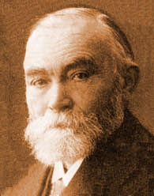
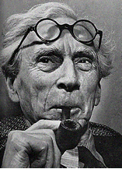
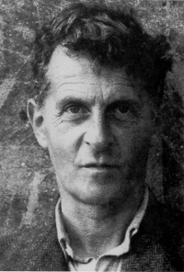
Frege Russell Wittgenstein
as a result of their work, the language of predicate logic came to be awarded a special role in the practice of philosophy
Notes:
http://faculty.washington.edu/smcohen/453/Photos.html

Slide 6
Fantology
The doctrine, usually tacit, according to which ‘Fa’ (and ‘Rab’) is the key to the ontological structure of reality
The syntax of first-order predicate logic is a mirror of reality (a Leibnizian universal characteristic)
http://ontology.buffalo.edu/bfo/Against_Fantology.pdf

Slide 7
For the fantologist
“F(a)”, “R(a, … , b)” is the language for ontology
This language reflects the structure of reality
The fantologist sees reality as being made up of individuals (a, b, c, …) plus abstract (1- and n-place) ‘properties’ or ‘attributes’

Slide 8
Fantology
Wittgenstein: Propositions show the logical form of reality. They display it. (4.121)
Russell: logic is concerned with the real world just as truly as zoology, though with its more abstract and general features. (1919)
Armstrong: the spreadsheet ontology*
* “Vérités et vérifacteurs” (2004)

Slide 9
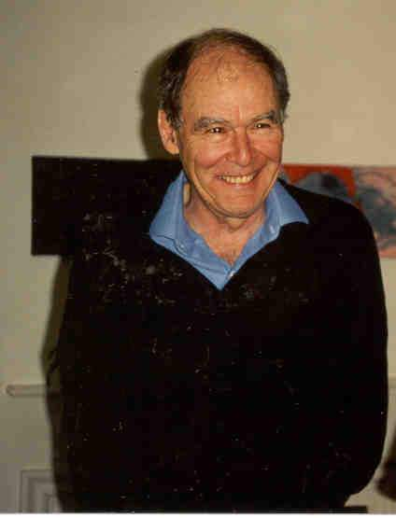
David Armstrong
spreadsheet ontology

Slide 10
 | F | G | H | I | J | K | L | M | N | O | P | Q | R | S | T | U | V
a
b
c
d
e
f
g
h
i
j
k

Slide 11
 | F | G | H | I | J | K | L | M | N | O | P | Q | R | S | T | U | V
a |  |  | x |  | x |  |  |  | x | x | x
b
c
d
e
f
g
h
i
j
k

Slide 12
 | F | G | H | I | J | K | L | M | N | O | P | Q | R | S | T | U | V
a |  |  | x |  | x |  |  |  | x | x | x
b |  | x | x |  |  |  |  |  |  |  | x | x |  |  |  | x
c
d
e
f
g
h
i
j
k

Slide 13
 | F | G | H | I | J | K | L | M | N | O | P | Q | R | S | T | U | V
a |  |  | x |  | x |  |  |  | x | x | x
b |  | x | x |  |  |  |  |  |  |  | x | x |  |  |  | x
c |  | x | x |  |  |  |  |  |  |  |  |  | x | x | x
d |  |  |  |  |  | x |  |  |  |  |  |  |  |  |  | x
e
f
g
h
i
j
k
and so on …

Slide 14
Fantology
wants you to believe in some future state of ‘total science’
when the values of ‘F’ and ‘a’, all of them,
will be revealed to the elect
All true ontology is the ontology of a future perfected physics of ultimate atoms
(Armstrong: all examples proving my ontology is wrong will be shown to belong merely to the ‘manifest image’)

Slide 15
Varieties of fantology
‘F’ stands for a property
‘a’ stands for an individual
Platonistic: the Fs belong to something like the Platonic realm of forms
Set-theoretic: the Fs are sets of individuals which F
Nominalistic: ‘F’ is just a predicate

Slide 16
The Spreadsheet Ontology
 | Substances | Attributes
Universals |  | Properties
Particulars | Particulars

Slide 17
A slightly more sophisticated Armstrongian view
 | Substances | Attributes
Universals |  | Properties and Relations
Particulars | Particulars

Slide 18
Generic Fantology
 | Individuals | Attributes
 |  | Attributes F( ), G( ), R( , ... , )
 | Individuals a, b, c this, that
Universal
Particular

Slide 19

Quine
 | Individuals | Attributes
 |  | Attributes F( ), G( ), R( , ... , ) (no ontological status)
 | Individuals a, b, c this, that
Universal
Particular

Slide 20
Nominalist Fantology (1CO)
To understand properties is to understand predication
If John is white, there is no extra entity, John‘s whiteness
If John is a man, there is no extra entity, John‘s humanity
-- modes and kinds and attributes are all ontologically in the same boat

Slide 21
Bicategorial Nominalism (Peter Simons)
 | Substantial | Accidental
 | First substance this man this cat this ox | Tropes this headache this sun-tan this dread
Universal
Particular

Slide 22
Aristotle’s Ontological Square (Husserl, Lowe, …)
 | Substantial | Accidental
 | Second substance man cat ox | Second accident headache sun-tan dread
 | First substance this man this cat this ox | First accident this headache this sun-tan this dread
Universal
Particular

Slide 23
Aristotle’s two kinds of predication
Predication in the category of substance:
John is a man, Henry is an ox
Predication in the category of accident:
John is hungry, Henry is asleep, John is wise

Slide 24
For Fantology
these two types of predication are often confused
For Armstrong: property universals are all we need
no need for kind universals
(Armstrong’s four-dimensionalism implies that there are no substances)

Slide 25
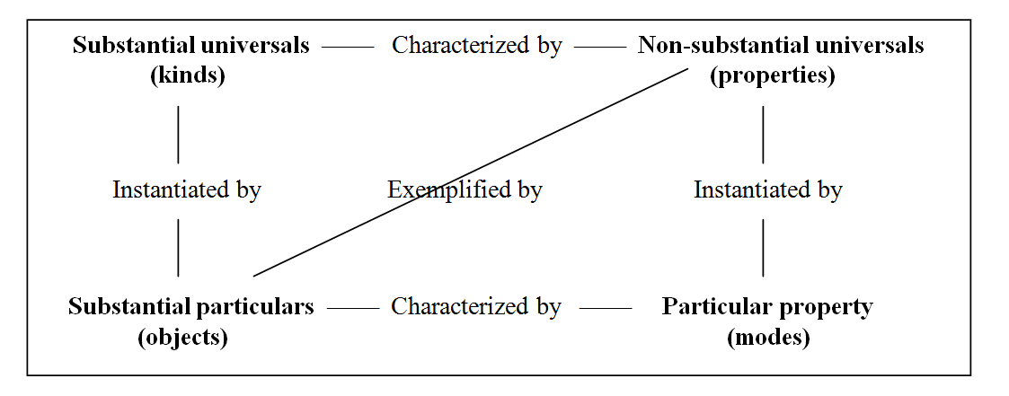
Husserl, Lowe, etc., tell us that there is a third kind of predication
John is a man
John is hungry
John has a headache (John has this headache)

Slide 26
Husserl, Lowe, etc., tell us that there is a third kind of predication
John is a man
John is hungry
John has a headache (John has this headache)

Slide 27
Husserl, Lowe, etc., tell us that there is a third kind of predication
John is a man
John is hungry
John has a headache (John has this headache)

Slide 28
Husserl, Lowe, etc., tell us that there is a third kind of predication
John is a man
John is hungry
John has a headache (John has this headache)

Slide 29
From 4CO to 6CO

Slide 30
A better view
6CO = there are objects, qualities and processes at the level of both universals and instances
Processes, like qualities, are dependent on substances
one-place processes:
getting warmer, getting hungrier
relational processes:
kissings, thumpings, conversations, dances

Slide 31
6CO (Ellis, BFO)
 | Substances | Quality entities | Processes
Universals | Substance-universals | Quality-universals | Process-universals
Particulars | Individual Substances | Quality-instances (Tropes…) | Process-instances
provides resources to understand important ontological alternatives

Slide 32
Process nominalism (Heraclitus, Whitehead, …)
 | Substances | Qualities | Processes
Universals
Particulars |  |  | Flux

Slide 33
Trope nominalism (Simons, again)
 | Substances | Qualities | Processes
Universals
Particulars |  | Tropes, bundles

Slide 34
Quine
 | Individuals | Attributes
 |  | Predicates F( ), G( ), R( , ... , )
 | Individuals a, b, c this, that
Universal
Particular

Slide 35
Davidson
 | Substances | Qualities | Processes
Universals |  | Predicates (including adverbial predicates): F( ), G( ), R( , ... , )
Particulars | Objects |  | Events

Slide 36
Quine
 | Individuals | Attributes
 |  | Predicates F( ), G( ), R( , ... , )
 | Individuals a, b, c this, that
Universal
Particular

Slide 37
Fantology
When we regiment language by using the forms ‘F(a)’ and ‘R(a, ... , b)’ then all generality belongs to the predicate ‘F’
‘a’ is a mere name (a mere identifier)
· a is a bare particular (Tractatus: an atom)
Contrast this with the way scientists use names:
the DNA-binding requirement of the yeast protein Rap1p as selected in silico from ribosomal protein gene promoter sequences

Slide 38
names used by scientists
DNA-binding
DNA-binding requirement
yeast protein Rap1p
ribosomal protein
gene promoter
gene promoter sequence

Slide 39
For extreme fantologists ‘a’ leaves no room for ontological complexity
From this it follows:
that fantology cannot do justice to the existence of different levels of granularity of reality
more generally, that fantology is conducive to and conduced by reductionism in philosophy

Slide 40
The 6 categories of entity are related together
via formal relations such as
instantiation
part-whole
exemplification
inherence
participation

Slide 41
A better syntax
variables x, y, z … range over
universals and particulars in all 6 categories
predicates stand only for one or other of these relations such as instantiates, part-of, connected-to, is-a-boundary-of, is-a-niche-for, etc.
the formal relations are not extra ingredients of being

Slide 42
This suggests a new syntax:
=(x,y)
Part(x,y)
Inst(x,y)
Dep(x,y)
Isa(x,y)
John is wise: Inst(John, wisdom)
John is a man: Isa(John, man)
FOLWUT (first order logic with universal terms)

Slide 43
Compare the syntax of first order logic with identity
The interpretation of identity is fixed
(does not vary with semantics)

Slide 44
Compare the syntax of set theory
∈(x,y)
=(x,y)
two (formal) primitive relational predicates
plus further defined predicates such as
⊂(x,y)
⊆(x,y)

Slide 45
New syntax:
=(x,y)
Part(x,y)
Inst(x,y)
Dep(x,y)
Compare Davidson’s treatment of events
Did(John,e)

Slide 46
Types of Formal Relation
Intracategorial
Part_of
Boundary_of
Dependent_on
Intercategorial
Inheres_in
Located_in
Participates_in
Transcendental
Identity
Barry Smith, et al., “Relations in Biomedical Ontologies”, Genome Biology (2005), 6 (5), R46.

Slide 47
FOLWUT
is still first order logic
but it allows quantification over universals exactly analogous to traditional quantification over individuals (and to Davidsonian quantification over events)
in this way it can simulate some of the expressive power of second order logic

Slide 48
For BFO
three kinds of attributes
qualities
dispositions
roles

Slide 49
For 4CO dispositions like occurrences are treated adverbially on ‘characterized by’

Slide 50
6CO Applied
Basic Formal Ontology

Slide 51
Applied Ontology 1. Biology
Plant Ontology
“Ontologies as Integrative Tools for Plant Science”, American Journal of Botany, 99(8): 2012.
Protein Ontology
“The Protein Ontology: A Structured Representation of Protein Forms and Complexes”, Nucleic Acids Research, 39: 2011.
Cell Ontology
“Logical development of the Cell Ontology”, BMC Bioinformatics 12(6): 2011.

Slide 52
Anatomical Space
Anatomical
Structure
Organ Cavity
Subdivision
Organ
Cavity
Organ
Organ Part
Serous Sac
Cavity
Subdivision
Serous Sac
Cavity
Serous Sac
Organ
Component
Organ
Subdivision
Tissue
is_a
Pleural Sac
Pleura(Wall
of Sac)
Pleural
Cavity
Parietal
Pleura
part_of
Visceral
Pleura
Interlobar
recess
Mediastinal
Pleura
Mesothelium
of Pleura
FMA
Foundational Model of Anatomy

Slide 53
Ontologies
are computer-tractable representations of types in specific areas of reality
are more and less general (upper and lower ontologies)
upper = organizing ontologies
lower = domain ontologies

Slide 54
Ontologies must be comparable
if we have multiple, redundant ontologies for a given domain, then this will recreate the very problem of siloes which ontology technology was designed to
to ensure non-redundancy, ontologies must be comparable
to enhance comparability ontologies should share a common upper level architecture

Slide 55
top level
mid-level
domain level
Basic Formal Ontology (BFO)
Information Artifact Ontology (IAO) | Ontology for Biomedical Investigations (OBI) | Spatial Ontology (BSPO)
Anatomy Ontology (FMA*, CARO) |  | Environment Ontology (EnvO) | Infectious Disease Ontology (IDO*) | Biological Process Ontology (GO*)
Cell Ontology (CL) | Cellular Component Ontology (FMA*, GO*)
 |  |  | Phenotypic Quality Ontology (PaTO)
Subcellular Anatomy Ontology (SAO)
Sequence Ontology (SO*) |  |  | Molecular Function (GO*)
Protein Ontology (PRO*)
Extension Strategy + Modular Organization
Notes:
* = dedicated NIH funding

Slide 56
Basic Formal Ontology
Continuant
Occurrent
biological process
Independent
Continuant
Dependent
Continuant
cell component
molecular function

Slide 57
top level
mid-level
domain level
Basic Formal Ontology (BFO)
Information Artifact Ontology (IAO) | Ontology for Biomedical Investigations (OBI) | Spatial Ontology (BSPO)
Anatomy Ontology (FMA*, CARO) |  | Environment Ontology (EnvO) | Infectious Disease Ontology (IDO*) | Biological Process Ontology (GO*)
Cell Ontology (CL) | Cellular Component Ontology (FMA*, GO*)
 |  |  | Phenotypic Quality Ontology (PaTO)
Subcellular Anatomy Ontology (SAO)
Sequence Ontology (SO*) |  |  | Molecular Function (GO*)
Protein Ontology (PRO*)
OBO Foundry: Downward Population from BFO
Notes:
* = dedicated NIH funding

