Slide 1
Representing the Reality Underlying Demographic Information
William R. Hogan, MD, MS
The Electronic Health Record of the Future
Buffalo, NY
September 22, 2010

Slide 2
My Plans
Build better systems for carrying out patient care and translational research
Link across levels of granularity
Focus on developing ontology for clinical medicine

Slide 3
Motivation
Demographics
  A key part of the Electronic Health Record (EHR)
  Necessary for secondary uses of EHR data
    Health care policy
    Research
  Required by “meaningful use” criteria in U.S.
Current approaches flawed – ad hoc approaches are failing even here, too
Need standard approach in Referent Tracking Systems

Slide 4
Demographics per “Meaningful Use”
 | Eligible Providers | Eligible Hospitals
Preferred language | X | X
Gender | X | X
Race | X | X
Ethnicity | X | X
Date of birth | X | X
Date of death |  | X
Preliminary cause of death |  | X

Slide 5
Existing Approaches
Simple tables
HL7
SNOMED CT

Slide 6
Typical Approach
Patient table
Id | Birth date | Gender | Marital status | Race* | Pref. Lang.
123456 | 01/01/1960 | M | Divorced | White | en
234567 | 02/02/1935 | F | Widowed | Black | en
345678 | 03/03/1990 | F | Married | Oriental | en
456789 | 04/04/2005 | M | Single, never married | Hispanic | es
567890 |  | U | Other | Unknown
*As taken directly from UAMS’ registration system, lest anyone have concerns of particular prejudices, insensitivities, etc.

Slide 7
HL7 RIM “Attributes”
LivingSubject: An organism, alive or not.
  administrativeGenderCode
  birthTime
Person*: A human being.
  raceCode
  ethnicGroupCode
  maritalStatusCode
  religiousAffiliationCode
Per the RIM, LivingSubject generalizes Person
*From RIM: This class can be used to represent either a single individual, a group of individuals or a kind of individual …

Slide 8
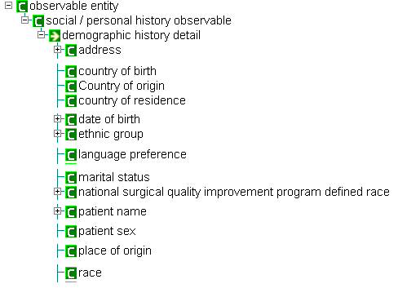
SNOMED CT Demographic “Concepts”

Slide 9
SNOMED CT Demographic “Concepts”
PROBLEM: implication is that none of these things exist outside of taking a history from the patient!
Gender?

Slide 10
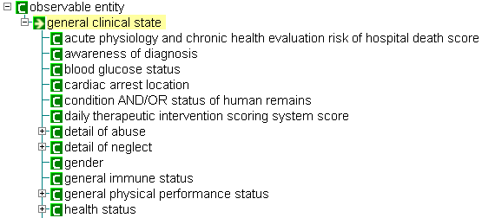
SNOMED CT and Gender

Slide 11
SNOMED CT and Gender
Do clinical states exist outside the clinic?

Slide 12
Outline
Birth date
Marital status
Gender/sex
Race/ethnicity
Preferred language
Bolded items are “meaningful use” demographics

Slide 13
BIRTH DATE

Slide 14
First Pass Attempt
J. Doe’s birth date is Jan 1, 1970
IUI_{jdoe} instance-of Human since 01/01/1970
Problems:
  It is equally true to say that he’s been an instance of human since 5 minutes, 5 days, 5 years ago
  John Doe was probably also a Human/Person prior to birth

Slide 15
In Reality
There was a birth event — we want its date
So, record the birth event:
  IUI_{birth} instance-of Birth and occurs at 01/01/1970
And say that J. Doe participated in it:
  IUI_{jdoe} participates-in IUI_{birth} at 01/01/1970
But is it not the case that J. Doe’s mother participated in his birth, too?

Slide 16
Passive Participation
Need patient-of relation
  IUI_{birth} instance-of Birth at 01/01/1970
  IUI_{jdoe} patient-of IUI_{birth} at 01/01/1970
A possible alternative: John’s role as offspring realized by his birth
  IUI_{role} instance_of Offspring role at 01/01/1970
  IUI_{jdoe} bearer_of IUI_{role} at 01/01/1970
  IUI_{role} realized_by IUI_{birth} at 01/01/1970

Slide 17
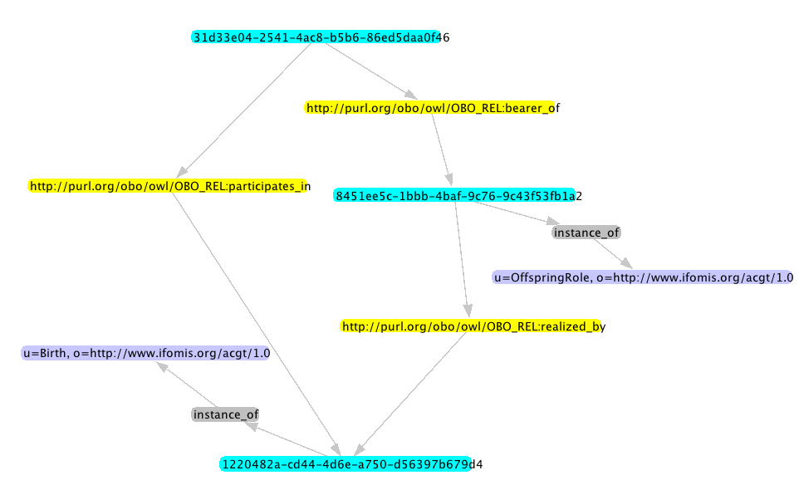
John Doe
participates-in
John Doe’s offspring role
John Doe’s birth

Slide 18
MARITAL STATUS

Slide 19
“Harmonized Value Set”*
SNOMED Code | SNOMED Fully Specified Name
125725006 | Single, never married (finding)
20295000 | Divorced (finding)
2326000 | Marriage annulment (finding)
3353000 | Wdowed [sic] (finding)
87915002 | Married (finding)
13184001 | Separated (finding)
430617007 | Legaly [sic] Separated with Interlocutory Decree (finding)
22187004 | Polygamous (finding)
430618002 | Domestic partnership (finding)
*…jointly under a memorandum of understanding between ASC X12 and Health Level Seven and … approved by both standards organizations
http://publicaa.ansi.org/sites/apdl/Documents/Forms/AllItems.aspx?RootFolder=%2fsites%2fapdl%2fDocuments%2fStandards%20Activities%2fHealthcare%20Informatics%20Technology%20Standards%20Panel%2fStandardization%20Committees%2fFoundations%2fUp%20for%20Panel%20Approval&View=%7b21C60355%2dAB17%2d4CD7%2dA090%2dBABEEC5D7C60%7d

Slide 20
Other Interesting, Current* Values from SNOMED CT
Spinster
Bachelor
Eloped
Newlywed
Cohabitee left home
*Current means that the “concept” is recommended for use in clinical records

Slide 21
In Reality…
“Value set” | “True” status | Married in past? | How most recent marriage ended?
Single, never married | Not married | No | n/a
Divorced | Not married | Yes | Legal severance
Marriage annulment | Not married | ? | Declared void
Widowed | Not married | Yes | Death of spouse
Married | Married | Yes | n/a
Separated | Married | Yes | n/a
Legaly [sic] Separated with Interlocutory Decree | Married | Yes | n/a
Polygamous | Married | Yes | n/a
Domestic partnership | Not married (most states) | n/a | n/a

Slide 22
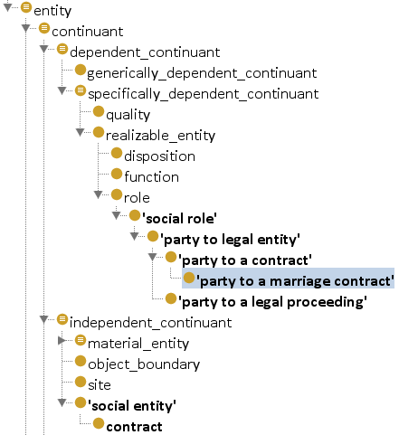
Going Out on a Limb…*
*Because BFO was not designed to account fully for social realm
Notes:
It’s a special type of role because it is brought into existence by the creation of the contract, exists only when contract exists. When contract goes out of existence, so does the role.

Slide 23
Presence vs. Absence of “Party” Role
Married = Present
  IUI_{r} instance_of Party to a marriage contract at t
  IUI_{jdoe} bearer_of IUI_{r} at t
Not married = Absent
  IUI_{jdoe} lacks Party to a marriage contract w.r.t. bearer_of at t
Domestic partnership
  IUI_{r} instance_of Party to a domestic partnership contract at t
  IUI_{jdoe} bearer_of IUI_{r} at t

Slide 24
Presence vs. Absence of “Party” Role
Married = Present
  IUI_{r} instance_of Party to a marriage contract at t
  IUI_{jdoe} bearer_of IUI_{r} at t
Not married = Absent
  IUI_{jdoe} lacks Party to a marriage contract w.r.t. bearer_of at t
Domestic partnership
  IUI_{r} instance_of Party to a domestic partnership contract at t
  IUI_{jdoe} bearer_of IUI_{r} at t
For “Never married”, we can instead say since t = [time of birth]. A treatment of how contracts end and annulment are beyond my scope here today.

Slide 25
GENDER/SEX

Slide 26
Gender vs. Sex
Gender | Refers to the socially constructed roles, behaviours, activities, and attributes that a given society considers appropriate for men and women. | Role
Sex | Refers to the biological and physiological characteristics that define men and women.
More in a minute…
Quoted from: http://www.who.int/gender/whatisgender/en/index.html

Slide 27
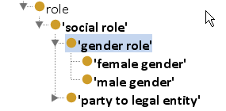
Gender In Referent Tracking
IUI_{gr} instance-of male gender at t
IUI_{jdoe} bearer-of IUI_{gr}

Slide 28
HL7 on Gender
the behavioral, cultural, or psychological traits typically associated with one sex
This attribute does not include terms related to clinical gender. Gender is a complex physiological, genetic, and sociological concept … The purpose of this attribute is to provide a high-level classification that can also be used for the appropriate allocation of inpatient bed assignment.

Slide 29
Phenotypic vs. Genotypic Sex
 | Canonical | Non-Canonical
Anatomical sex | Male sex Female sex | Hermaphroditic sex
Chromosomal sex | XY XX | XO XXY XYY XXX Mosaic

Slide 30
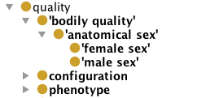
Sex as a Quality
IUI_{sx} instance-of male sex at t
IUI_{jdoe} bearer-of IUI_{sx}

Slide 31
Possible Alternative
John Doe’s body is an instance of Male body
  IUI_{jdoe_body} instance-of Male human body (FMAID:67811) at t
Somehow relate John Doe to his body
  IUI_{jdoe} constituted-of IUI_{jdoe_body} at t

Slide 32
RACE/ETHNICITY

Slide 33
Notions of Race*
Physical characteristics:
  a human population … whose members share a greater degree of physical and genetic similarity with one another than with other humans.
National and/or geographic origin of ancestry:
  a group of persons related by common descent or heredity.
Culture:
  any people united by common history, language, cultural traits, etc.
*www.dictionary.com

Slide 34
Definitions of Race
Stedman’s Medical Dictionary
  A class of animals or individuals having common inherited somatic characteristics
HL7
  …a named category of humans sharing common history, traits, geographical origin or nationality.
  This attribute is based on the belief of the person or the person reporting the attribute, not on any formal analysis of genetic or geneological relationships as these would need to be captured as observations.

Slide 35
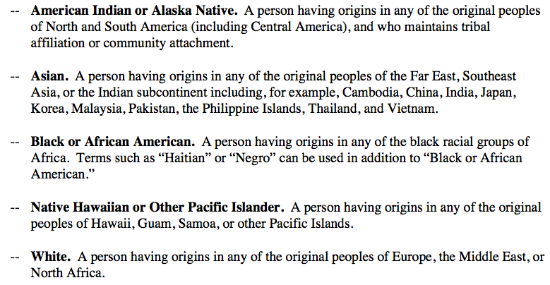
U.S. Government Standard for Race
General format is: a person having origins in … the original peoples of <continent or subcontinent or islands>
U.S. Guidelines are clear that data are about individuals’ self-identification. Individuals may report more than one.

Slide 36
U.S. Government Standard for Ethnicity
  Hispanic or Latino. A person of Cuban, Mexican, Puerto Rican, South or Central American, or other Spanish culture or origin, regardless of race. The term, "Spanish origin," can be used in addition to "Hispanic or Latino.”
  Not Hispanic or Latino.
Again, data should be about individuals’ self-identification. But, individuals may report only one ethnicity.

Slide 37
Representation
“Attributive collections” in application ontology
  Human with ancestral origins in Asia
  Human with ancestral origins in Europe
IUI_{jdoe} instance-of Human with ancestral origins in Europe at t

Slide 38
Preferred Language
Is English a type or instance of language?
An instance, as are Spanish, German, etc.
There are also dialects of languages
Relationship between a language and its dialects?
Relationship between person and her preferred language?

Slide 39
How to Represent Preferences?
John’s preference is a quality? For sure it’s a continuant. Most likely dependent since if John ceases to exist, so do his preferences.
Preferences are for or towards something.
They usually distinguish among subtypes or instances or sub-attributive collections
  Language preference is towards English over other instances of Language (German, Spanish, etc)
  John prefers red heads over blondes (i.e., women with red hair over women with blonde hair)

Slide 40
Language Competence as a Capability?
Speaker of as realizable entity. I am not at this moment speaking English
It’s a capability of some kind
So, Bill’s English speaking capability inheres-in Bill, Bill bearer-of Bill’s English capability
Bill’s English capability realized-by Bill’s conversation with John yesterday, realized-by giving this presentation, etc.

Slide 41
Language Relationships
Do we say Cantonese dialect-of Chinese?
Do we say Bob speaks English? (at instance level, of course. And then it’s inverse is true: English spoken-by Bob)
Or, in the interest of minimal, well-defined relations, do we try to leverage existing RO relations somehow?
Dialect part-of Language? en-US part-of en

