Slide 1
HL7 RIM
Barry Smith
Ontology Research Group
NYS Center for Bioinformatics, Buffalo
National Center for Biomedical Ontology

Slide 2
HL7 V3: It’s not all bad news
Clinical Document Architecture (CDA) is a good piece of work
... and is actually being used

Slide 3
But apart from CDA is there a single, successful RIM-implementation?
After 10 years?
And many attempts?
Is Oracle HTB actually being used?

Slide 4
There are clear examples of failure of billion-dollar implementations resting on the RIM
and of programmers involved in such failures who are tearing out their hair, and blaming HL7

Slide 5
Is it justified, in these circumstances, to promote HL7 V3 as an ISO Standard in the domain of patient care?

Slide 6
One indispensable foundation for a successful standard
a correct and uniform interpretation of its basic terms
    Act
    Participation
    Entity
    Role
    ActRelationship
    RoleLink

Slide 7
Demonstrably, the HL7 community does not understand its own basic terms

Slide 8
Sometimes ‘Act’ means information about an act
Sometimes ‘Act’ means real-world action
Sometimes ‘Act’ means a mixture of the above
Sometimes in the very same sentence

Slide 9
Act means: information object
Act = def. ‘A record of something that is being done, has been done, can be done, or is intended or requested to be done.’
(HL7 Ballot, RIM 3.1.1)

Slide 10
Act means: real-world action
‘The introduction of “information about” is a red herring. We're not modeling "information about". We're modeling the actual procedure.’
Notes:
Lloyd

Slide 11
Act means: a mixture of the two
"Act as statements or speech-acts are the only representation of real world facts or processes in the HL7 RIM. ... As such, there is no distinction between an activity and its documentation. Every Act includes both to varying degrees.”
(RIM Ballot 3.1.1, emphasis added)

Slide 12
Consequences of unclarity here
Different user groups have interpreted the same classes in different ways
It is very likely that different message specifications used different interpretations
and that this will create interoperability problems
Can we be sure that these problems will not lead to incidents relevant to patient safety?

Slide 13
Even with clarity – and clear documentation – the RIM would still be in bad shape

Slide 14
Where are diseases
    Acts ?
    Things, Persons, Organizations ?
    Participations ?
    Roles ?
    ActRelationships ?
    RoleLinks ?

Slide 15
The RIM has no coherent answer
For this reason, HL7 V3 dialects are formed – and the RIM does not do its job.
Basic categories cannot be agreed upon even for common phenomena like snakebites.

Slide 16
The $ 35 bn. NHS Program “Connecting for Health”
has applied the RIM rigorously, using all the normative elements, and it discovered that it needed to create dialects of its own to make the V3-based system work for its purposes (it still does not work)

Slide 17
Panic in HL7’s own e-mail forums
“I am ... frightened when I contemplate the number of potential V3ers who ... simply are turned away by the difficulty of accessing the product.”

Slide 18
The RIM’s normative specifications
are supposed to guarantee consistent messaging across all health-care institutions
yet the HL7 organization has not even succeeded in making its own V3 Glossary conform to the RIM’s normative specifications after 10+ years

Slide 19
A serious quandary
On the one hand the RIM is claiming to facilitate agreement on consistent meanings across the entire range of biological and clinical domains.
On the other hand the RIM’s own collaborating authors cannot reach agreement even amongst themselves.

Slide 20
Qui bono
from an overcomplex ‘standard’ which is difficult to teach and perhaps impossible to implement in any non-toy system ?

Slide 21
Consultant’s Motto
Why make it simple if it can be complicated?

Slide 22
More examples of the sorts of problems we face

Slide 23
HL7’s Data Types Specification states:
“Boolean” [BL] stands for the values of two-valued logic:
true, false

Slide 24
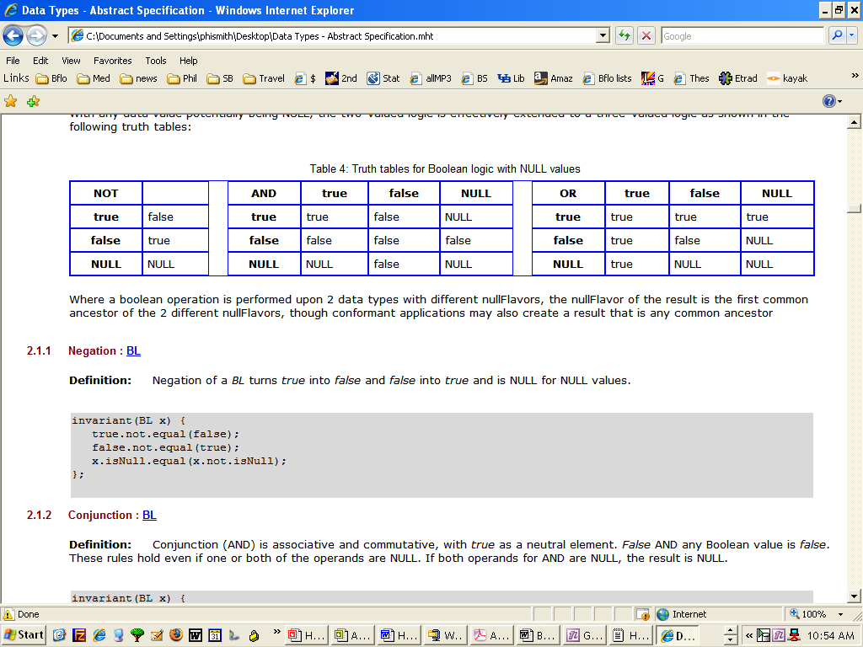
but the truthtables actually given for ‘BL’ are those of a 3-valued logic:

Slide 25
Boolean [BL] stands for the values of two-valued logic. A BL value can be either true or false, or, as any other value may be NULL.
BooleanNonNull [BN] constrains the boolean type so that the value may not be NULL.
(HL7 Data Types Specification)

Slide 26
COMPARE:
Fruit =def. Fruit that may be a Laptop
FruitNonLaptop =def. Fruit that is not a Laptop

Slide 27
AND EVEN
LivingSubject =def. A subtype of Entity representing an organism or complex animal, alive or not.
LivingSubjectNonDead =def. A Living Subject which is in fact living

Slide 28
makes HL7 datastores inaccessible to the DL-based reasoners underlying OWL, SNOMED CT, NCIT –unless NULL is re-construed prior to applying reasoning
But such reconstrual is impossible because of the many ‘flavors of null’.
Notes:
h

Slide 29
Domain: Flavors of Null
code | name | definition
NI | No information | No information whatsoever can be inferred from this exceptional value. This is the most general exceptional value. It is also the default exceptional value.
OTH | other | The actual value is not an element in the value domain of a variable. (e.g., concept not provided by required code system).
UNK | unknown | A proper value is applicable, but not known
ASKU | asked but unknown | Information was sought but not found (e.g., patient was asked but didn't know)
NAV | temporarily unavailable | Information is not available at this time but it is expected that it will be available later.
NASK | not asked | This information has not been sought (e.g., patient was not asked)
MSK | masked | There is information on this item available but it has not been provided by the sender due to security, privacy or other reasons. There may be an alternate mechanism for gaining access to this information.Note: using this null flavor does provide information that may be a breach of confidentiality, even though no detail data is provided. Its primary purpose is for those circumstances where it is necessary to inform the receiver that the information does exist without providing any detail.
NA | not applicable | No proper value is applicable in this context (e.g., last menstrual period for a male).
NP | not present | Value is not present in a message. This is only defined in messages, never in application data! All values not present in the message must be replaced by the applicable default, or no-information (NI) as the default of all defaults.
Section 1.11.4 of HL7 Data Type Specification

Slide 30
Domain: Flavors of Null
Unknown
Coding was not attempted
Coder could not be bothered to look
Coding was attempted but the information was not found
The value set was deficient
Information was not available but was expected to be available later.
Other

Slide 31
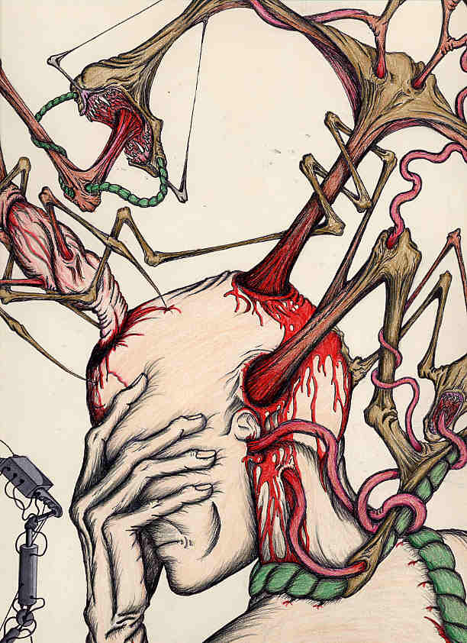

Slide 32
Each of these flavors actually demands different reasoning services.
The flavors are there because of RIM’s intolerance of optionality

Slide 33
Another example

Slide 34
The RIM does not understand the linguistics of modifiers
  A planned oophorectomy is not a special kind of oophorectomy
  A possible substance administration is not a special kind of substance administration
  A cancelled delivery is not a special kind of delivery
  An absent nipple is not a special kind of nipple

Slide 35
HL7’s treatment of these ‘moods’ cannot be reasoned with using any known reasoning system.

Slide 36
The above are difficult problems
whose resolution will have immense consequences for the bioinformatics and health IT systems of the future
They should not be resolved by ballot of non-experts

Slide 37
Conclusions
Steps to remediation

Slide 38
Conclusion 1/4
Don’t claim to be
“the data standard for biomedical informatics”
until you have a system that works
http://aurora.regenstrief.org/~schadow/ HL7TheDataStandardForBiomedicalInformatics.ppt

Slide 39
Conclusion 2/4
Do not promote standards in the domain of patient care until you have evidence that they will work
(especially if you have evidence that they do not work)

Slide 40
Conclusion 3/4
use objective testing
encourage critical secondary literature
avoid secrecy
build on what works
do not reinvent the wheel and make it square

Slide 41
But most of all:
First do no harm

Slide 42
With thanks to
for much patient assistance
Tom Beale Robert Dolin Gerard Freriks Graham Grieve Dipak Kalra John Madden | Charles Mead Alan Rector Dan Russler Gunther Schadow Mead Walker

